Slide 1
ALMA Observations of
S-bearing Molecules in Protoplanetary Disks: a Possible Tracer of Evaporation of
Icy Planetesimals
10th RESCEU/Planet2 Symposium : Planet Formation around Snowline, Nov. 28-30, 2017 @ Univ. of Tokyo
H.Nomura¹, A.Higuchi², N.Sakai², S.Yamamoto³,
M. Nagasawa⁴, K.K.Tanaka⁵, H.Miura⁶, T.Nakamoto¹, H.Tanaka⁷, T.Yamamoto⁵, C.Walsh⁸ , T.J.Millar⁹
1.TITECH, 2.RIKEN, 3.U. of Tokyo, 4.Kurume-U., 5.Hokkaido-U.,
6.Nagoya City-U., 7.Tohoku-U., 8. U. of Leeds, 9. Queen’s U. Belfast

Slide 2
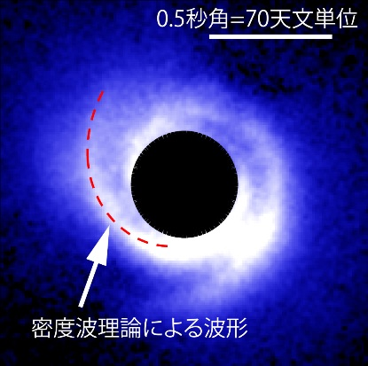
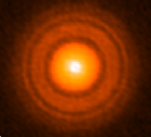
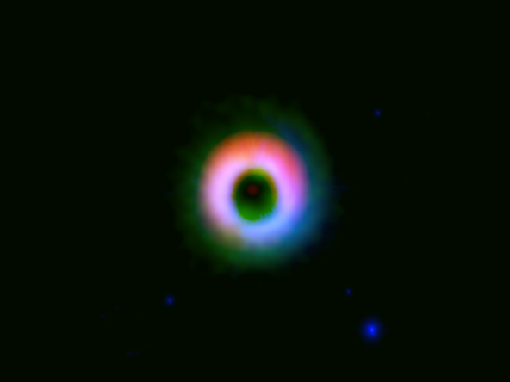
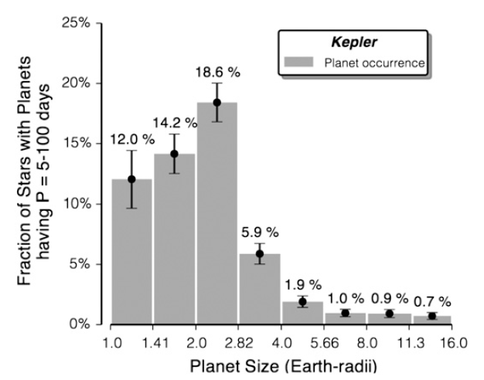
Planet Formation in Disks
TW Hya
ALMA
HD142527
SAO206462
dust
dust
dust+CO
(Muto+ 2012)
Can we observe a signature of planet formation in PPDs using molecular lines?
Subaru
(Tsukagoshi+ 2016)
(Fukagawa+ 2013)
J
S
Planet Mass [Jupiter]
U
N
V
E
M
M
Orbital Radius [AU]
(Petigure+13, Marcy+14)

Slide 3
Evaporation of Icy Planetesimals
Makiko Nagasawa’s talk!
Formation of protoplanet/planet
↓
Excite eccentricities of planetesimals
↓
Evaporation of icy planetesimals due to shock heating
(e.g., Kokubo & Ida 1998, Weidenschilling+ 1998, Tanaka+ 2013, Nagasawa+ 2014 )
Can we detect evaporation of
icy planetesimals with ALMA?

Slide 4
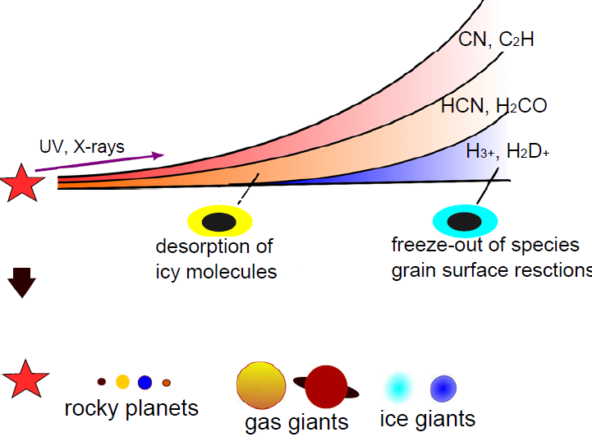
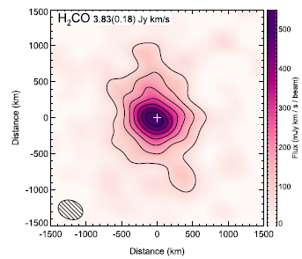
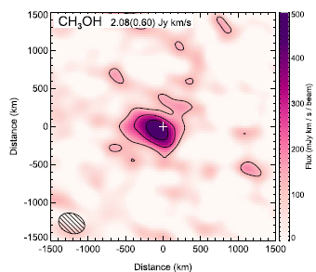
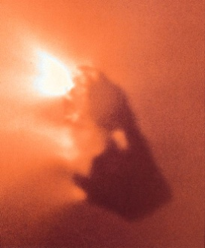
Chemical Structure of PPDs
(e.g., Markwick+2002, Aikawa+ 2002, Bergin+ 2007, Dutrey+ 2014)
H₂CO
ALMA
ISON
CH₃OH
(Kobayashi et al. 2010)
(Cordiner et al. 2014, 2017)
Molecules evaporated from
icy planetesimals will be similar to those in comets
→ ALMA observations?
ESA
H₂O, CO₂, CH₄, CH₃OH, H₂CO, NH₃, HCN, H₂S, SO, etc.
Halley

Slide 5
Chemical Model
Chemical network: 375 species, 4346 reactions
UMIST Database for Astrochemistry
(Woodall+ 2007, Walsh+ 2010)
Initial condition: evaporation of ice molecules
CH₄, C₂H₂, C₂H₄, C₂H₆, CO, CO₂, O₂, H₂O,
H₂CO, CH₃OH, C₂H₅OH, N₂, NH₃, H₂S, OCS
desorption
UV
cosmic rays
*
*
*
+
heating
+
electron

Slide 6

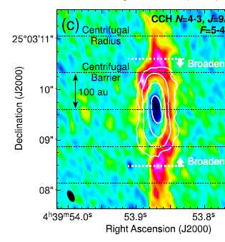
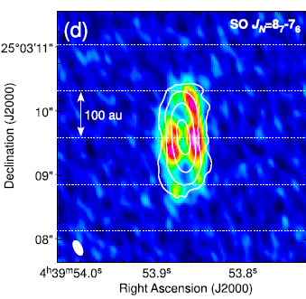
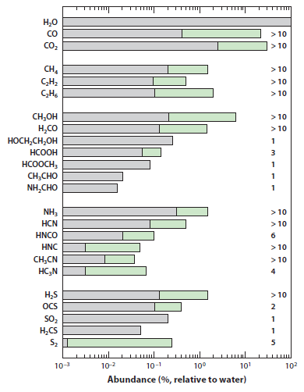
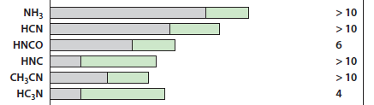
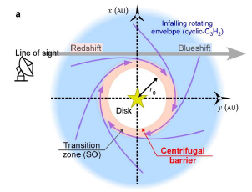
Obs. of S-bearing Mol. in Comets & YSOs
L1527 ALMA
CCH
SO
CCH
Gas Density
SO
Rosetta (67P/C.-G.)
centrifugal barrier
H₂S/H₂O ~ (0.67-1.75)x10⁻²
SO/H₂O ~ (1.4-4)x10⁻⁵
(Mumma & Charnley ‘11, Calmonte+ ‘16)
(e.g., Sakai+ ‘14, ‘17, Miura+ ‘17)

Slide 7
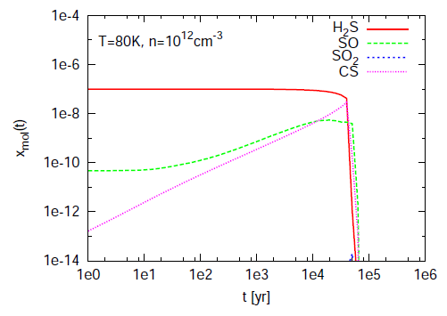
Evolution of Evaporated S-Species
Vp < 6 km/s, n=1e12cm⁻³
H₂S, SO: good tracers
T_{dust}=150K
T_{dust}=80K
T_{dust}=30K
H₂S
H₂S
H₂S
X_{mol}(t)
SO₂
SO
SO
CS
CS
SO
Can we detect S-species from evaporated icy planetesimals
in protoplanetary disks?
~1e-2 yr
~1e4 - 1e5 yr
~1e4 - 1e5 yr
t [yr]
t [yr]
t [yr]
for low T
grains
Destruction time of
evaporated mol. ~10⁴⁻⁵yr
Depletion time on grains
~10⁹ yr/n[cm⁻³]
H₂S, SO
snow lines
SO₂
snow line
★
~130K
~60K
(cf. Nomura & Millar 2004)

Slide 8
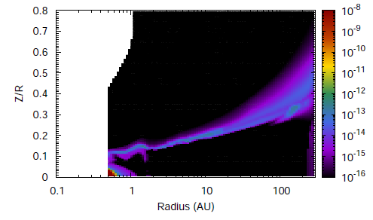
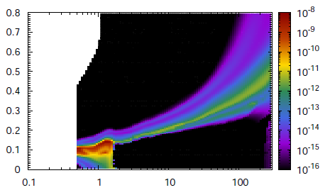
Distribution of H₂S & SO in PPD
Chemical reactions + Line radiative transfer
H₂S
SO
(no grain
surface reactions)
Height/Radius
R=5-15AU
X=1.0e-10
Radius [AU]
Radius [AU]
Peak flux density | Evaporation of ice |  | Previous observations (IRAM 30m, Dutrey+11)
 | No | Yes
H₂S @ 217GHz | 0.3mJy | 35mJy | < 10mJy @ 169GHz
SO @ 220GHz | 0.4mJy | 45mJy | < 10mJy @ 99GHz
Evaporated molecules are observable by ALMA
if icy planetesimals are excited at R~5-15AU

Slide 9
ALMA Observations of SO & H₂S
Date： 2016. 8. 1, 17, 27
ALMA cycle 3, band 6 (PI: H. Nomura)
Dust cont., SO 6(5)-5(4), H₂S 2_{2,0}-2_{1,1}
10 T Tauri disks in Taurus (angular resolution ~ 0.5”)
No SO & H₂S line is detected

Slide 10
ALMA Observations of SO & H₂S
Date： 2016. 8. 1, 17, 27
ALMA cycle 3, band 6 (PI: H. Nomura)
Dust cont., SO 6(5)-5(4), H₂S 2_{2,0}-2_{1,1}
10 T Tauri disks in Taurus (angular resolution ~ 0.5”)
SO & H₂S upper limits
By A. Higuchi
Make constraint on abundances of
S-bearing molecules in outer disks
cf. SO 6₇-5₆ @ jets 0.48-1.6Jy km s⁻¹ by IRAM 30m
(Guilloteau et al. 2016)

Slide 11
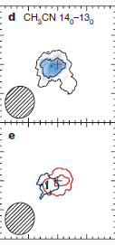
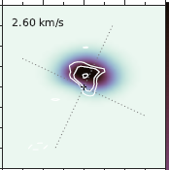
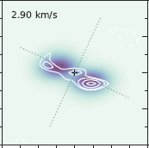
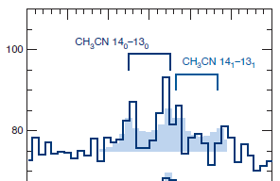
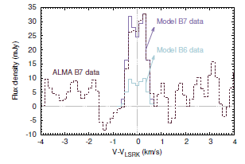
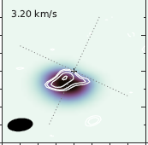

Complex Organic Molecules in Disks
HC₃N @ 91-146GHz, IRAM
c-C₃H₂ @ 218GHz, ALMA SV
(Chapillon et al. 2012)
(Qi et al. 2013b)
CH₃CN
14₀-13₀, 14₁-13₁, @ 257GHz, MWC480,
ALMA cycle 2
CH₃OH @
304, 305, 307GHz
(stacking)
TW Hya,
ALMA cycle 2
obs. (white)
Obs.＋Model→
Abundance of S-bearing species
non-thermally desorbed from icy grains
⇔ comparable to abundance in comets?
model
model (gray)
obs.
(Oberg et al. 2015)
(Walsh et al. 2016)
Disk radii of 30-100AU for CH₃CN, 30-60AU for CH₃OH
CH₃CN/HCN ~ 5-20%, CH₃OH/H₂O ~ 0.7-5%⇔ comets
* gas-phase abundances icy grain abundances

Slide 12
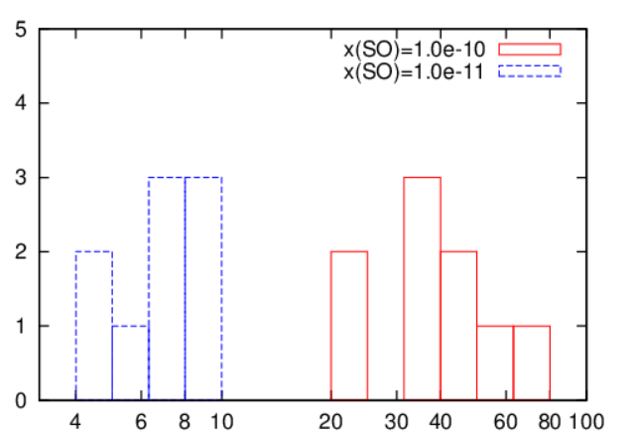
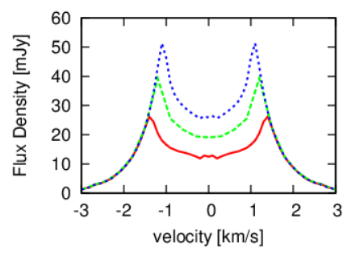
Upper Limit of SO Abundance
physical model + line radiative transfer
Abundance | 1e-11, 1e-10
Inclination | 30°, 55°, 70°
Outer Radius | 60 au, 80 au, 100 au
SO
Height/Radius
< 18mJy
< 25mJy
Obs.
Radius [AU]
10⁻¹¹
10⁻¹⁰
Rout=100au
Number of models
80au
60au
Peak flux density [mJy]

Slide 13
Upper Limit of SO Abundance
physical model + line radiative transfer
Abundance | 1e-11, 1e-10
Inclination | 30°, 55°, 70°
Outer Radius | 60 au, 80 au, 100 au
SO
Height/Radius
< 18mJy
< 25mJy
Obs.
Radius [AU]
10⁻¹¹
10⁻¹⁰
x(SO) < 10⁻¹⁰
Number of models
cf. TW Hya disk:
x(H₂O) ~ 10⁻⁹
x(CH₃OH) ~ 10⁻¹²-10⁻¹¹
comets: SO/H₂O ~ 10⁻³
CH₃OH/H₂O ~ 10⁻³ - 10⁻¹
Peak flux density [mJy]

Slide 14
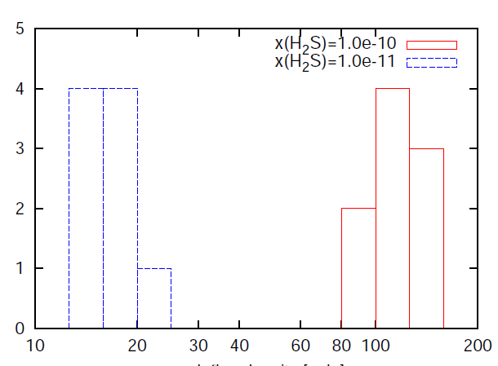
Upper Limit of H₂S Abundance
physical model + line radiative transfer
Abundance | 1e-12, 1e-11
Inclination | 30°, 55°, 70°
Outer Radius | 60 au, 80 au, 100 au
H₂S
Height/Radius
< 12mJy
< 19mJy
Obs.
Radius [AU]
10⁻¹⁰
x(H₂S) < 10⁻¹¹
10⁻¹¹
cf. TW Hya disk:
x(H₂O) ~ 10⁻⁹
x(CH₃OH) ~ 10⁻¹²-10⁻¹¹
comets: H₂S/H₂O ~ 10⁻³-10⁻²
CH₃OH/H₂O ~ 10⁻³ - 10⁻¹
Number of models
Peak flux density [mJy]

Slide 15
Summary
ALMA observation & modelling of S-bearing species
in protoplanetary disks
H₂S & SO can be a tracer of shock caused by (proto)planet formation & icy planetesimal evaporation
ALMA observations towards 10 T Tauri disks:
Observed upper limits & model calculations:
→ constraint on H₂S & SO abundances in outer disk
x(SO)< 10⁻¹⁰ & x(H₂S) < 10⁻¹¹
Consistent with H₂S, SO/H₂O ratios in comets
& CH₃OH/H₂O ratio in comets/disk
Higher sensitivity is required for further constraint on ice & icy planetesimal evaporation

Slide 17
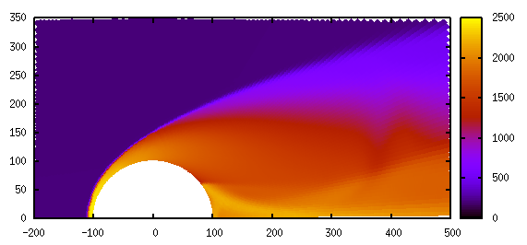
Dependence on Physical Parameters
Iida+ (2001), Miura & Nakamoto (2005)
Yamazaki, Nakamoto, Nakajima, in prep.
[K]
Vp < 6km/s
→ molecules can survive
Dust temperature
→ freeze-out on grains
θ =90°
Dust density
→ freeze-out time
θ =0
Icy planetesimal
[km]
freeze-out
Gas temperature [K]
Vp=10 km/s
＞2000K
→dissociation
of molecules
dust grains
8 km/s
Gas temperature
→ thermal dissociation
6 km/s
4 km/s
+
+
+
2 km/s
θ [radian]

Slide 18
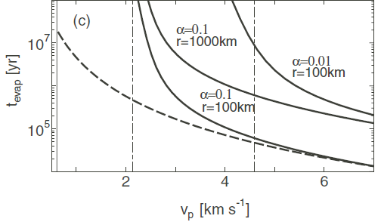
Comparison of Timescales
Destruction time of evaporated molecules ~ 10⁴⁻⁵ yrs
Evaporation time of an icy planetesimal ~ 10⁵⁻⁶ yrs
~1e6 yr
~1e5 yr
(Tanaka et al. 2013)
↓
~10% of evaporated molecules stay in gas-phase
Time duration of exciting planetesimals ~ 10⁶ yrs
(Nagasawa et al. 2014)

