Slide 1
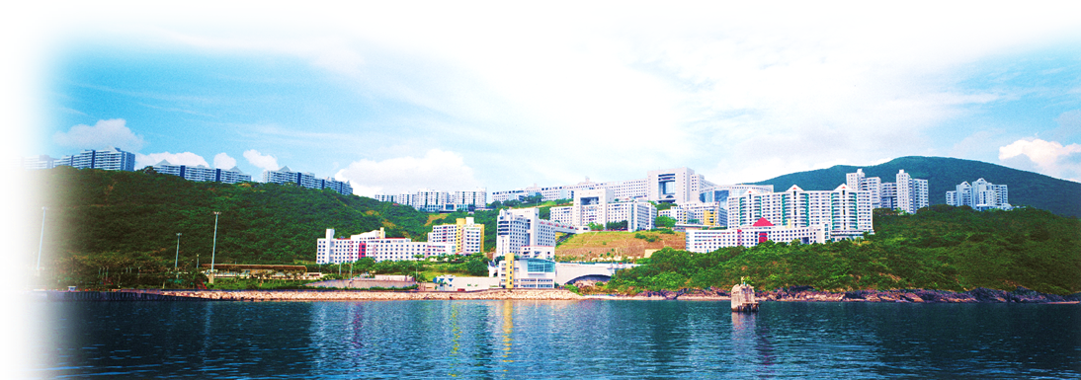
Inflation as a Cosmological Collider
Yi Wang 王一, 2017.12.13
The Hong Kong University of Science and Technology

Slide 2
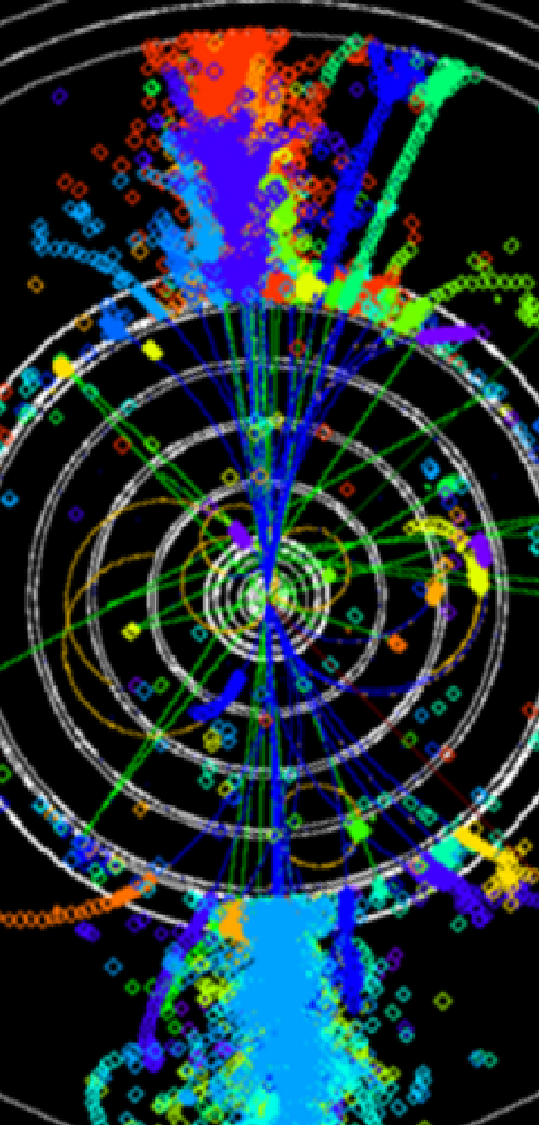
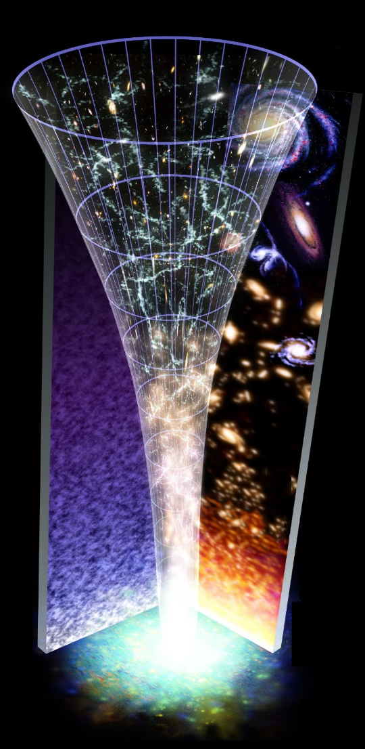
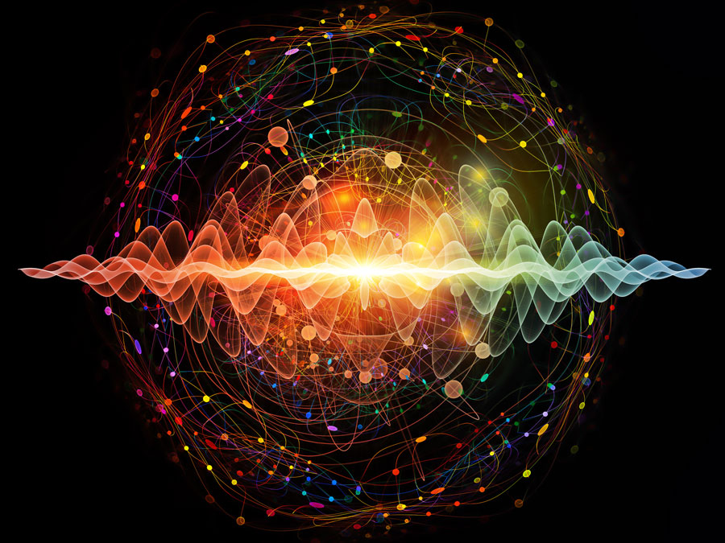
Collider
Inflate or Not
Quanta
Which Model

Slide 3
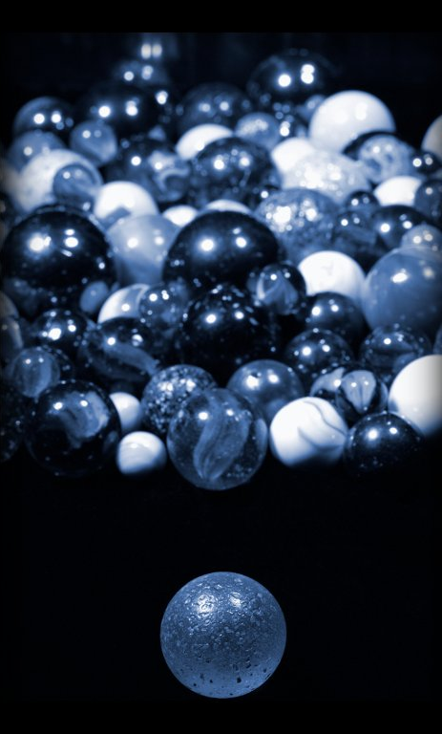
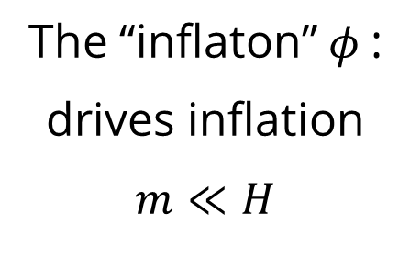
The “inflaton” $φ$:
drives inflation
$$m≪H$$

Slide 4
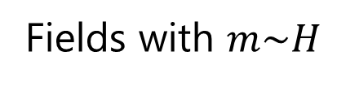
Fields with $m\sim H$
The “inflaton” $φ$:
drives inflation
$$m≪H$$

Slide 5
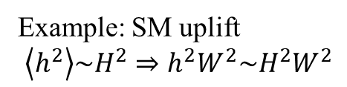
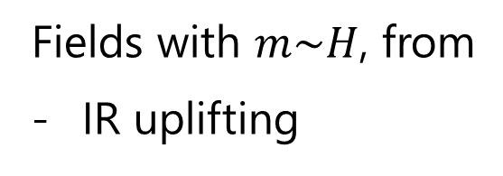
Fields with $m\sim H$, from
IR uplifting
Example: SM uplift
$\left\langle h^{2}\right\rangle \sim H^{2}⇒h^{2}W^{2}\sim H^{2}W^{2}$
The “inflaton” $φ$:
drives inflation
$$m≪H$$

Slide 6
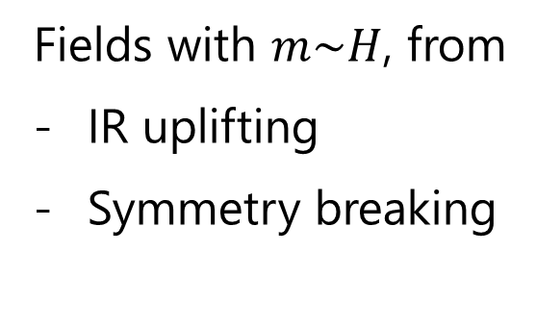
Fields with $m\sim H$, from
IR uplifting
Symmetry breaking
Example: SUSY
The “inflaton” $φ$:
drives inflation
$$m≪H$$

Slide 7

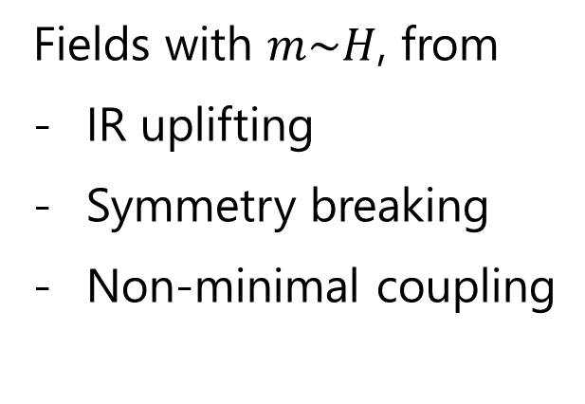
Fields with $m\sim H$, from
IR uplifting
Symmetry breaking
Non-minimal coupling
$$ξσ^{2}R⇒ξσ^{2}H^{2}$$
The “inflaton” $φ$:
drives inflation
$$m≪H$$

Slide 8
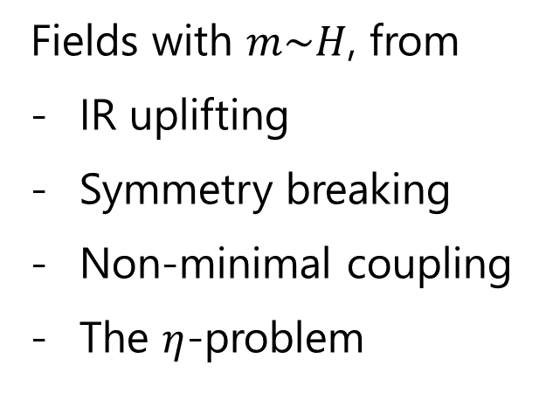
Fields with $m\sim H$, from
IR uplifting
Symmetry breaking
Non-minimal coupling
The $η$-problem
The “inflaton” $φ$:
drives inflation
$$m≪H$$

Slide 9
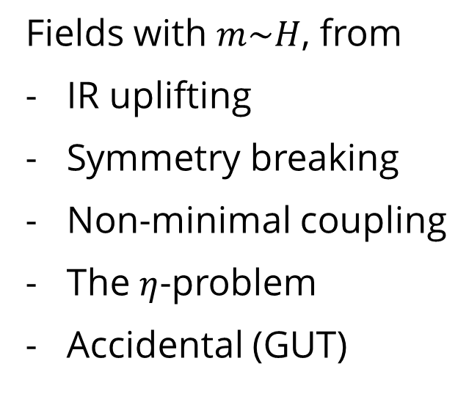
Fields with $m\sim H$, from
IR uplifting
Symmetry breaking
Non-minimal coupling
The $η$-problem
Accidental (GUT)
The “inflaton” $φ$:
drives inflation
$$m≪H$$

Slide 10
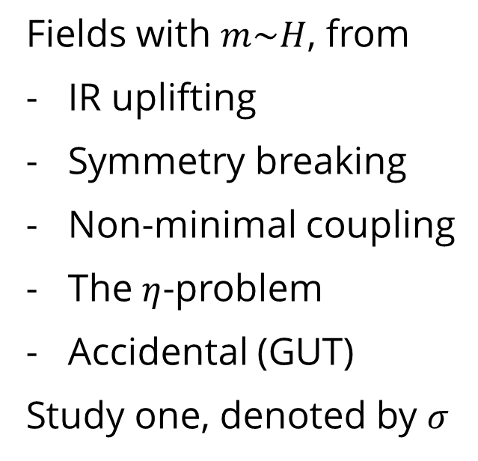
Fields with $m\sim H$, from
IR uplifting
Symmetry breaking
Non-minimal coupling
The $η$-problem
Accidental (GUT)
Study one, denoted by $σ$
The “inflaton” $φ$:
drives inflation
$$m≪H$$

Slide 11
Massive fields: Long history
e.g.
Hybrid Inflation, Linde, astro-ph/9307002
Induced effective potential,
Yamaguchi & Yokoyama, hep-ph/0512318
Particle productions
Giudice, Riotto, Zaffaroni, hep-ph/0408155
Romano, Sasaki, 0809.5142
Barnaby, Huang, 0909.0751
QSFI & Related References
(2009 - )
The characteristic features on cosmological
correlations by those massive fields

Slide 12
QSFI & Related References
X. Chen & YW 0909.0496, 0911.3380, 1205.0160
D. Baumann & D. Green 1109.0292
T. Noumi, M. Yamaguchi & D. Yokoyama 1211.1624
J. Gong, M. Sasaki, S. Pi 1205.0161, 1306.3691
X. Chen,YW & Xianyu 1604.07841, 1610.06597, 1612.08122, 1703.10166
N. Arkani-Hamed & J. Maldacena 1503.08043
J. Maldacena 1508.01082
R. Flauger, M. Mirbabayi, L. Senatore, E. Silverstein 1606.00513
X. Chen, M. H. Namjoo & YW 1509.03930, 1601.06228, 1608.01299
J. Liu, C. Sou & YW 1608.07909
H. Jiang & YW 1703.04477, X. Tong, YW & S. Zhou 1708.01709
H. An, M. McAneny, A. K. Ridgway, M. B. Wise
1706.09971, 1711.02667
S. Kumar, R. Sundrum, 1711.03988 … …

Slide 13
Fields with $m\sim H$, from
IR uplifting
Symmetry breaking
Non-minimal coupling
The $η$-problem
Accidental (GUT)
Study one, denoted by $σ$
The “inflaton” $φ$:
drives inflation
$$m≪H$$

Slide 14
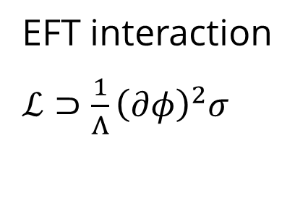
Fields with $m\sim H$, from
IR uplifting
Symmetry breaking
Non-minimal coupling
The $η$-problem
Accidental (GUT)
Study one, denoted by $σ$
EFT interaction
$ℒ⊃\frac{1}{Λ}{\left(∂φ\right)}^{2}σ$
The “inflaton” $φ$:
drives inflation
$$m≪H$$

Slide 15
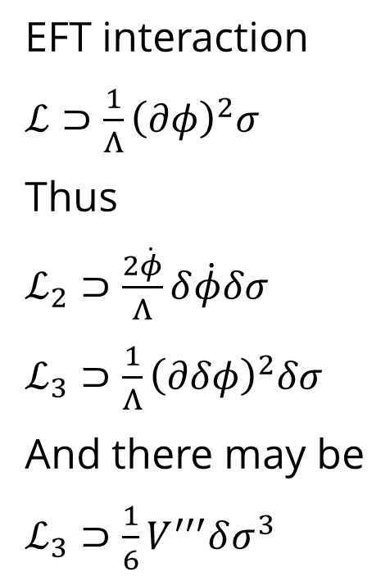
Fields with $m\sim H$, from
IR uplifting
Symmetry breaking
Non-minimal coupling
The $η$-problem
Accidental (GUT)
Study one, denoted by $σ$
EFT interaction
$ℒ⊃\frac{1}{Λ}{\left(∂φ\right)}^{2}σ$
Thus
$ℒ_{2}⊃\frac{2\dot{φ}}{Λ}δ\dot{φ}δσ$
$ℒ_{3}⊃\frac{1}{Λ}{\left(∂δφ\right)}^{2}δσ$
And there may be
${ℒ_{3}⊃\frac{1}{6}V}^{′′′}δσ^{3}$
The “inflaton” $φ$:
drives inflation
$$m≪H$$

Slide 16
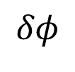
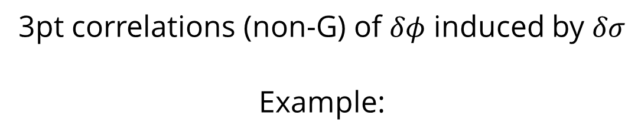
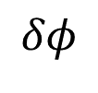

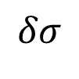
3pt correlations (non-G) of $δφ$ induced by $δσ$
Example:
$$δφ$$
$$δφ$$
$$δσ$$
$$δφ$$

Slide 17
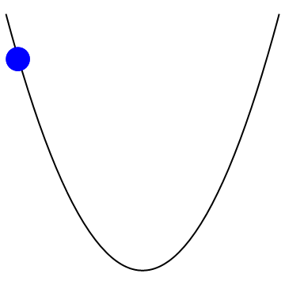
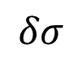
3pt correlations (non-G) of $δφ$ induced by $δσ$
Example:
$$δφ$$
$$δφ$$
$$δσ$$
$$δφ$$
$$δσ$$

Slide 18
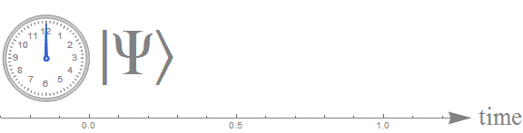
3pt correlations (non-G) of $δφ$ induced by $δσ$
Example:
$$δφ$$
$$δφ$$
$$δσ$$
$$δφ$$
Standard clock!
Tells physical time.

Slide 19
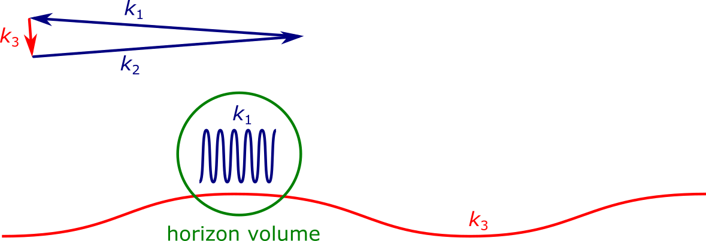


massive $→$ time dependent phase $e^{imt} \sim {(−τ)}^{im/H}$
curvature mode $\sim e^{ikτ}$, at resonance record the phase

Slide 20

Correlation between the density fluctuation and a clock

Slide 21
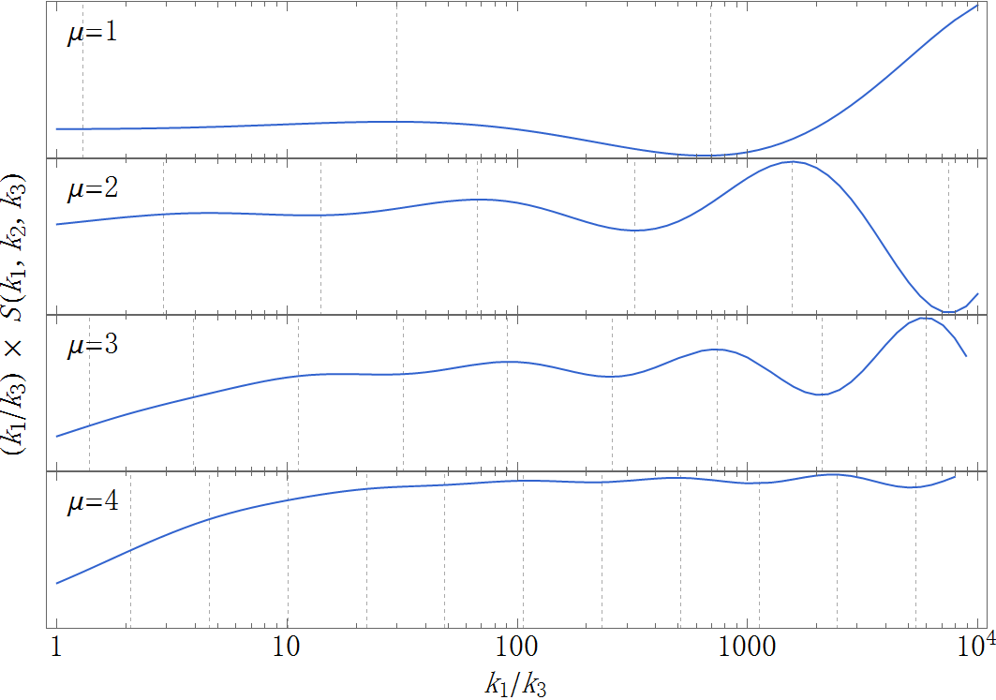
Shape of the signal

Slide 22
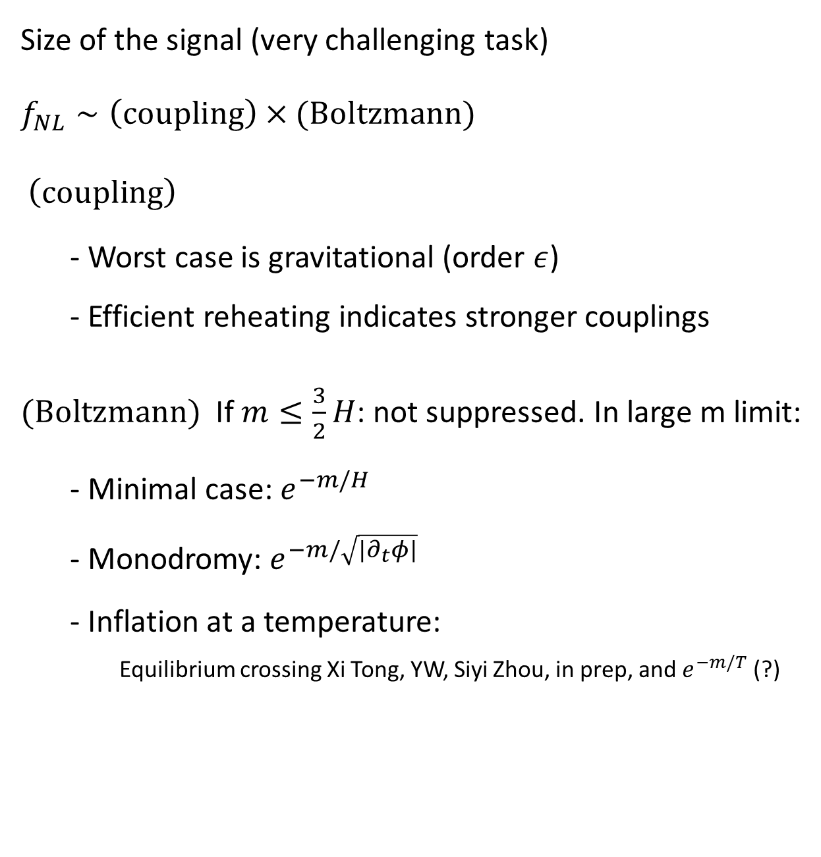
Size of the signal (very challenging task)
$f_{NL}∼\left(coupling\right)×(Boltzmann)$
$\left(coupling\right)$
- Worst case is gravitational (order $ε$)
- Efficient reheating indicates stronger couplings
$(Boltzmann)$ If $m≤\frac{3}{2}H$: not suppressed. In large m limit:
- Minimal case: $e^{−m/H}$
- Monodromy: $e^{−m/\sqrt{{|∂}_{t}φ|}}$
- Inflation at a temperature:
Equilibrium crossing Xi Tong, YW, Siyi Zhou, in prep, and $e^{−m/T}$ (?)
X. Chen & YW 09,
Arkani-Hamed & Maldacena 15
R. Flauger, M. Mirbabayi, L. Senatore, E. Silverstein 1606.00513

Slide 23
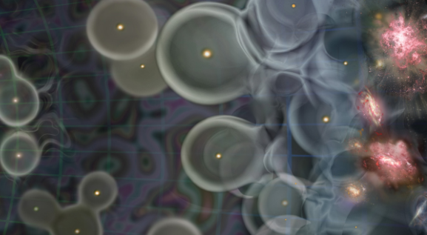
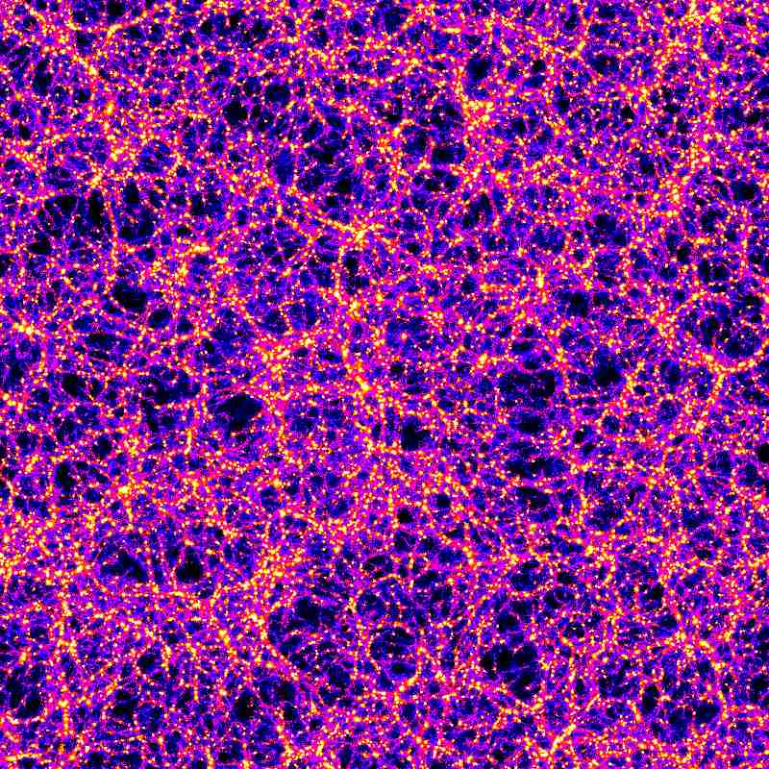
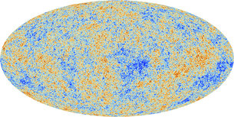
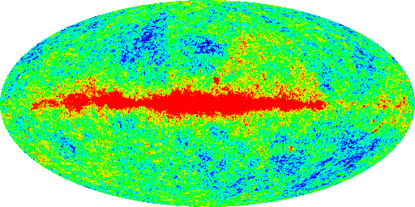
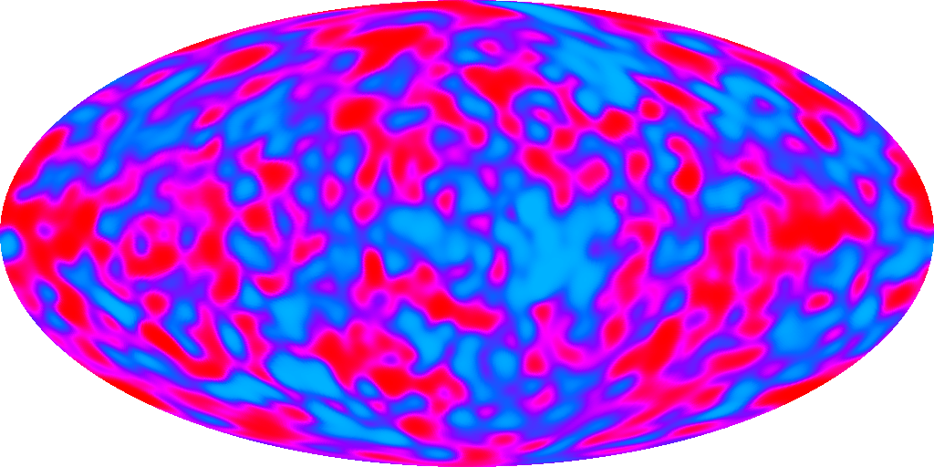
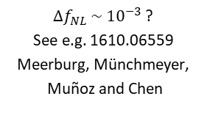
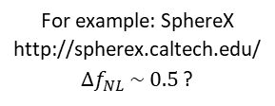

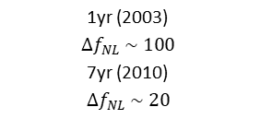

WMAP
PLANCK
1yr (2003)
$$Δf_{NL} \sim 100$$
7yr (2010)
$$Δf_{NL} \sim 20$$
(2013)
$$Δf_{NL} \sim 5$$
COBE
(1990s)
$$Δf_{NL} \sim 2000$$
21 cm Cosmology
$Δf_{NL} \sim {10}^{−3}$ ?
See e.g. 1610.06559
Meerburg, Münchmeyer,
Muñoz and Chen
Large Scale Structure
For example: SphereX
http://spherex.caltech.edu/
$Δf_{NL} \sim 0.5$ ?

Slide 24
Collider
Inflate or Not
Quanta
Which Model

Slide 25
Q1. Collider
The role of HEP:
New physics at high energies
How high in energy can we achieve?

Slide 26

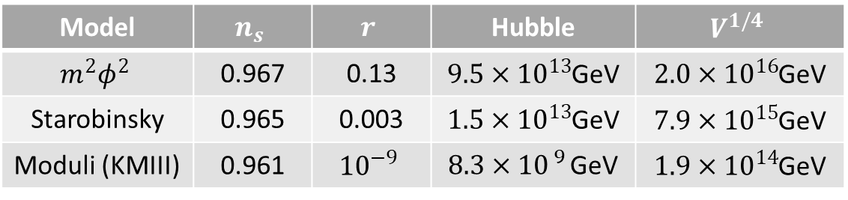
Model | $$n_{s}$$ | $$r$$ | Hubble | $$V^{1/4}$$
$$m^{2}φ^{2}$$ | 0.967 | 0.13 | $9.5×{10}^{13}$GeV | $2.0×{10}^{16}$GeV
Starobinsky | 0.965 | 0.003 | $1.5×{10}^{13}$GeV | $7.9×{10}^{15}$GeV
Moduli (KMIII) | 0.961 | $${10}^{−9}$$ | $8.3×{10}^{ 9 }$GeV | $1.9×{10}^{14}$GeV

Slide 27
A “cosmological collider”
Observational consequence:
scale-independent
shape-dependent
oscillations on shape of non-Gaussianities
“Prove” string theory?
X. Chen, YW 09; Arkani-Hamed, Maldacena 15 (with formula above)

Slide 28
Q1. Collider
What if a particle is detected?

Slide 29
Q1. Collider
What if a particle is detected?
Is it a Standard Model particle?
Or BSM physics is involved?

Slide 30
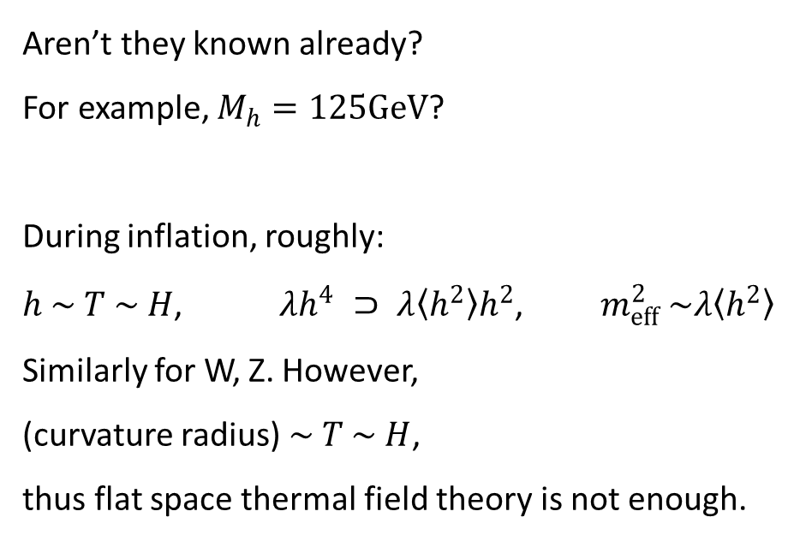
Q1. Collider
So one needs to first study the SM background
– mass spectrum of SM particles
Aren’t they known already?
For example, $M_{h}=125GeV$?
During inflation, roughly:
$h \sim T \sim H$, $λh^{4} ⊃ λ〈h^{2}〉h^{2}$, $m_{eff}^{2} \sim λ〈h^{2}〉$
Similarly for W, Z. However,
(curvature radius)$\sim T \sim H$,
thus flat space thermal field theory is not enough.

Slide 31
Q1. Collider
The Higgs mass: tree vs quantum-corrected
X. Chen, YW, Z. Z. Xianyu, 1610.06597, 1612.08122

Slide 32
Q1. Collider
The full SM spectrum
X. Chen, YW, Z. Z. Xianyu, 1610.06597, 1612.08122

Slide 33
Q1. Collider
If Higgs has negative mass squared during inflation,
EW broken during inflation
  X. Chen, YW, Z. Z. Xianyu, 1612.08122
Can have inflaton-Higgs mixing at tree-level
S. Kumar, R. Sundrum, 1711.03988

Slide 34
Q1. Collider
Predictions for BSM physics on the cosmological collider?

Slide 35
Q2. Inflate
or Not
Cosmic inflation is the leading theory
of the primordial universe

Slide 36
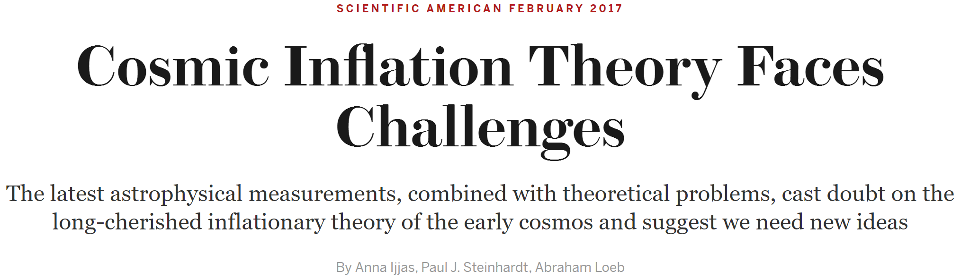
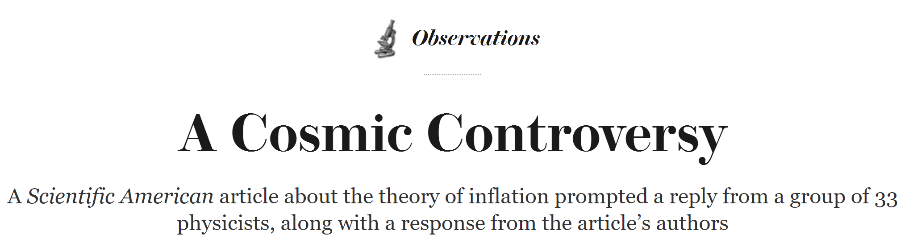
Q2. Inflate
or Not
vs

Slide 37
Q2. Inflate
or Not
You may have heard that
“we have understood our universe very well”

Slide 38
Q2. Inflate
or Not
You may have heard that
“we have understood our universe very well”
But you don’t even know
whether the primordial universe
was expanding or contracting !?

Slide 39
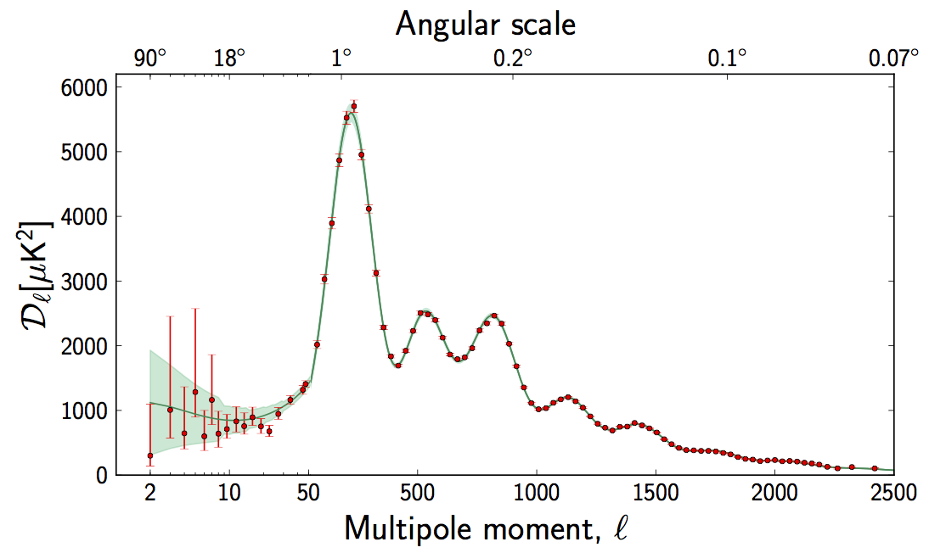
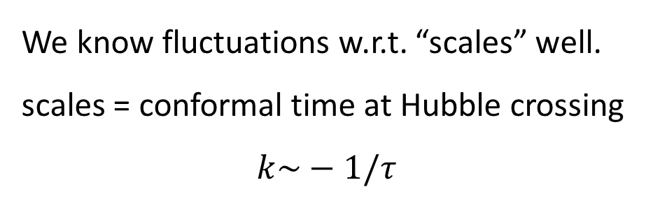
Q2. Inflate
or Not
We know fluctuations w.r.t. “scales” well.
scales = conformal time at Hubble crossing
$$k\sim −1/τ$$

Slide 40

Q2. Inflate
or Not
Lack of knowledge about physical time
Observations like stacked films

Slide 41

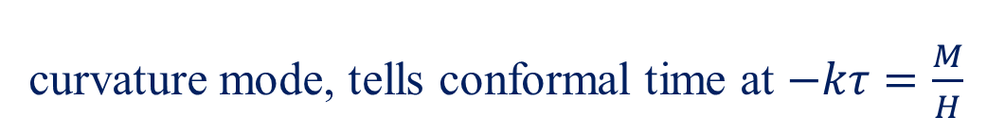

$$\left\langle ζ^{3}\right\rangle$$
massive $→$ curvature, tells physical time
curvature mode, tells conformal time at $−kτ=\frac{M}{H}$

Slide 42
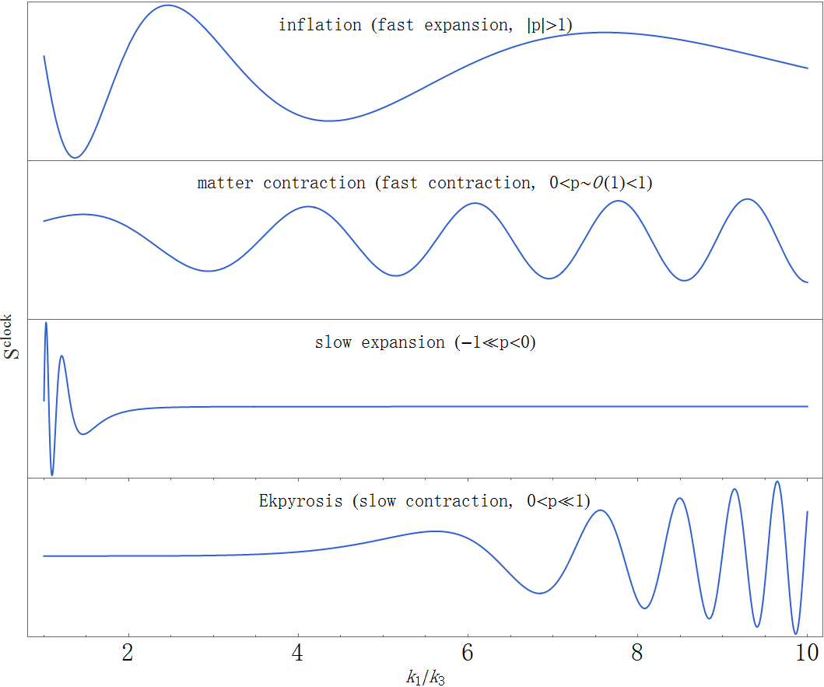
Q2. Inflate
or Not

Slide 44
Q3. Quanta
Do the primordial fluctuations
originate from their quantum vacuum?

Slide 45
Q3. Quanta
Do the primordial fluctuations
originate from their quantum vacuum?
Very likely. But how to test that?

Slide 46
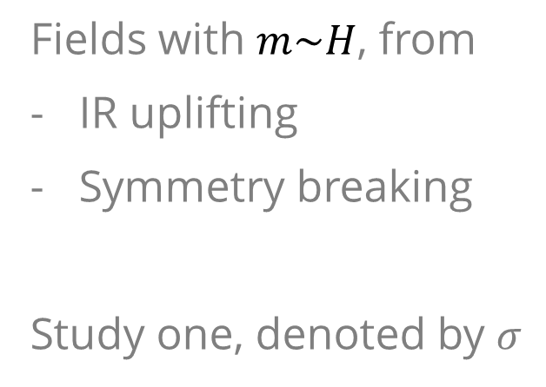
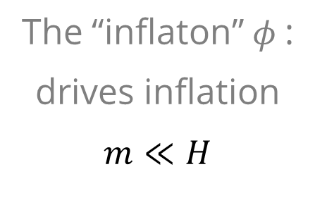
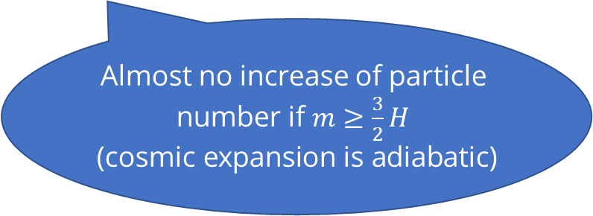
Q3. Quanta
Fields with $m\sim H$, from
IR uplifting
Symmetry breaking
Study one, denoted by $σ$
Almost no increase of particle number if $m≥\frac{3}{2}H$
(cosmic expansion is adiabatic)
Quantum-classical transition
at horizon crossing.
(cosmic expansion becomes non-adiabatic)
Decoherence.
The “inflaton” $φ$:
drives inflation
$$m≪H$$
J. Maldacena 1508.01082, J. Liu, C. Sou & YW 1608.07909

Slide 47
Q4. Which Model
Too many models
But still hope to distinguish simple models

Slide 48
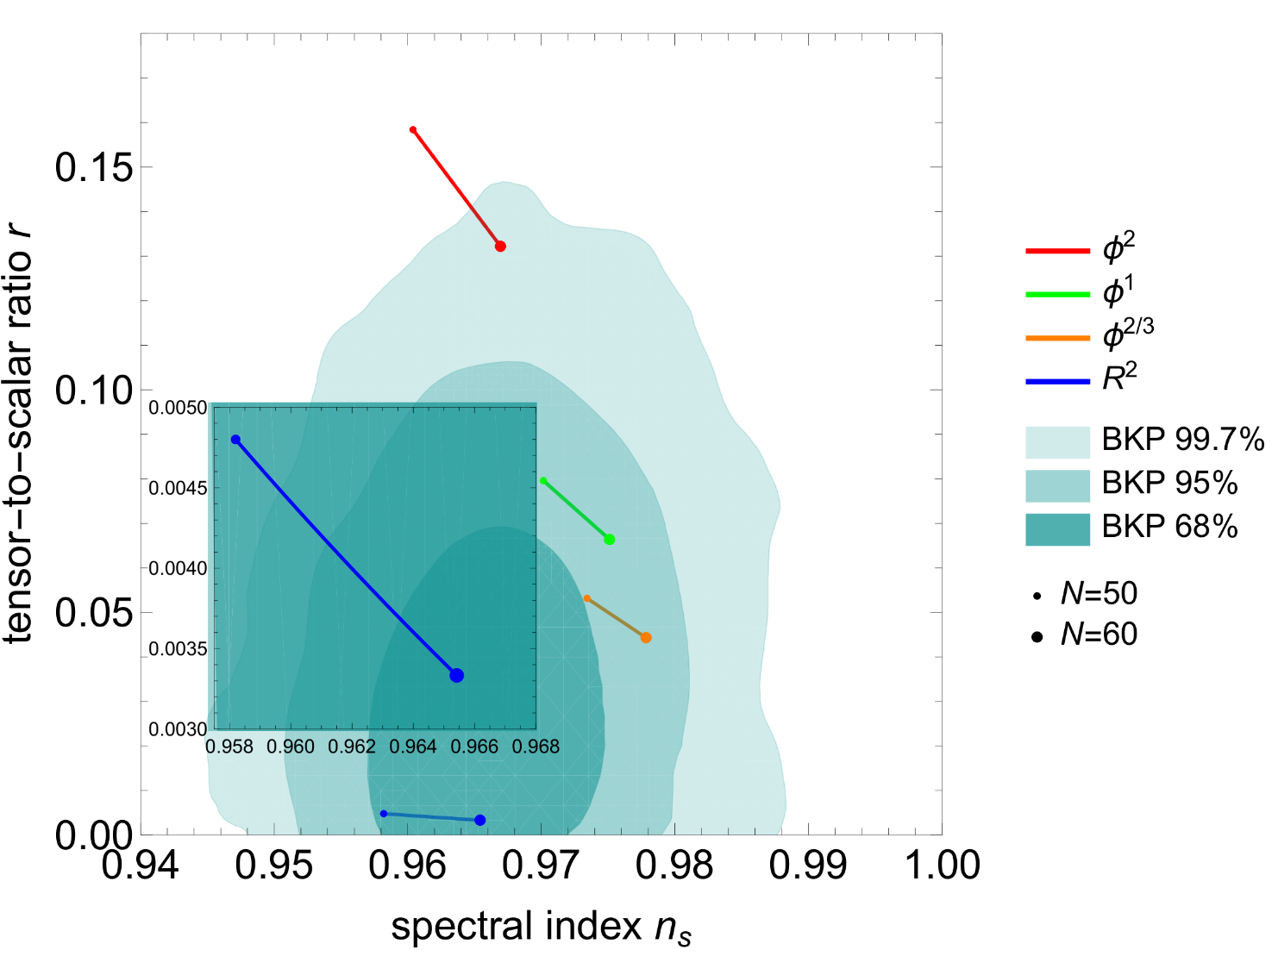
Q4. Which Model
ns-r diagram

Slide 49
Q4. Which Model
Is the ns-r diagram reliable
in telling “which model”?

Slide 50
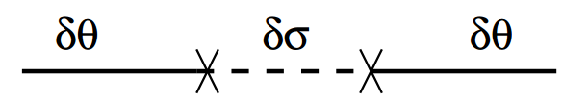

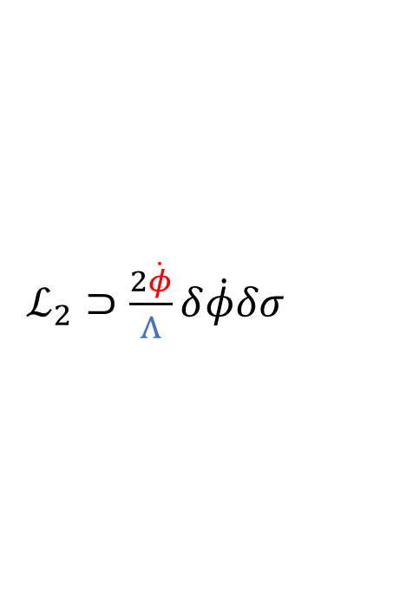


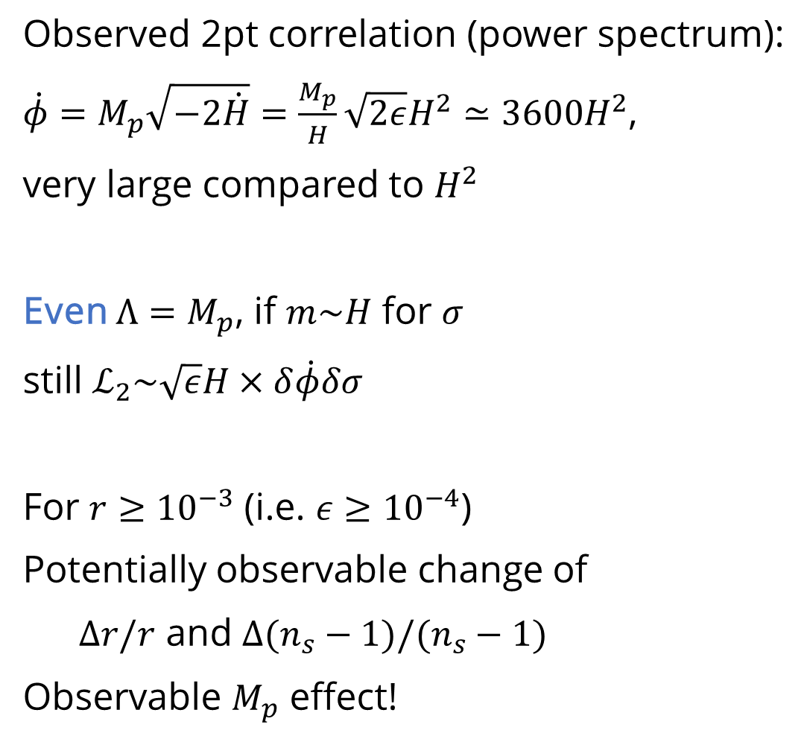
Observed 2pt correlation (power spectrum):
$\dot{φ}=M_{p}\sqrt{−2\dot{H}}=\frac{M_{p}}{H}\sqrt{2ε}H^{2}≃3600H^{2}$,
very large compared to $H^{2}$
Even $Λ=M_{p}$, if $m\sim H$ for $σ$
still $ℒ_{2}\sim \sqrt{ε}H×δ\dot{φ}δσ$
For $r≥{10}^{−3}$ (i.e. $ε≥{10}^{−4}$)
Potentially observable change of
$Δr/r$ and $Δ(n_{s}−1)/(n_{s}−1)$
Observable $M_{p}$ effect!
EFT interaction
$ℒ⊃\frac{1}{Λ}{\left(∂φ\right)}^{2}σ$
Thus
$ℒ_{2}⊃\frac{2\dot{φ}}{Λ}δ\dot{φ}δσ$
$ℒ_{3}⊃\frac{1}{Λ}{\left(∂δφ\right)}^{2}δσ$
And there may be
${ℒ_{3}⊃\frac{1}{6}V}^{′′′}δσ^{3}$
$$δφ$$
$$δσ$$
$$δφ$$
Notes:
Planck: $Δ$ns = 0.7%; CMB S4: $Δ$ns = 0.2%; LSS (SphereX) $Δ$ns = 0.2%; Combined with 21cm: may reach 0.01%

Slide 51
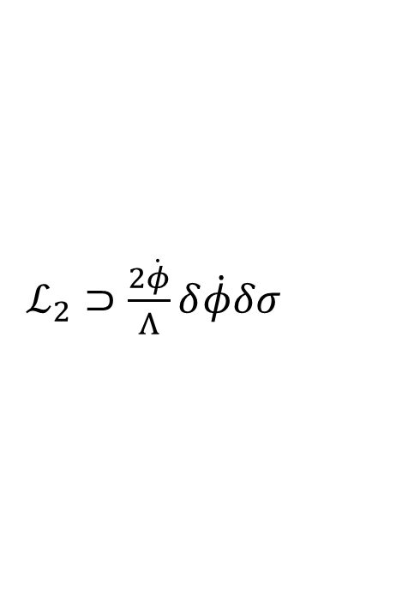

Observed 2pt correlation (power spectrum):
$\dot{φ}=M_{p}\sqrt{−2\dot{H}}=\frac{M_{p}}{H}\sqrt{2ε}H^{2}≃3600H^{2}$,
very large compared to $H^{2}$
Even $Λ=M_{p}$, if $m\sim H$ for $σ$
still $ℒ_{2}\sim \sqrt{ε}H×δ\dot{φ}δσ$
For $r≥{10}^{−3}$ (i.e. $ε≥{10}^{−4}$)
Potentially observable change of
$Δr/r$ and $Δ(n_{s}−1)/(n_{s}−1)$
Observable $M_{p}$ effect!
EFT interaction
$ℒ⊃\frac{1}{Λ}{\left(∂φ\right)}^{2}σ$
Thus
$ℒ_{2}⊃\frac{2\dot{φ}}{Λ}δ\dot{φ}δσ$
$ℒ_{3}⊃\frac{1}{Λ}{\left(∂δφ\right)}^{2}δσ$
And there may be
${ℒ_{3}⊃\frac{1}{6}V}^{′′′}δσ^{3}$
And many possible enhancement factors:
Larger $r$
Multi-field (all positive $ΔP_{ζ}$)
IR growth if $m≾H$
If $M_{string}<M_{p}$
If $M_{extra D}<M_{p}$
$$δφ$$
$$δσ$$
$$δφ$$
Notes:
Planck: $Δ$ns = 0.7%; CMB S4: $Δ$ns = 0.2%; LSS (SphereX) $Δ$ns = 0.2%; Combined with 21cm: may reach 0.01%

Slide 52

Observed 2pt correlation (power spectrum):
$\dot{φ}=M_{p}\sqrt{−2\dot{H}}=\frac{M_{p}}{H}\sqrt{2ε}H^{2}≃3600H^{2}$,
very large compared to $H^{2}$
Even $Λ=M_{p}$, if $m\sim H$ for $σ$
still $ℒ_{2}\sim \sqrt{ε}H×δ\dot{φ}δσ$
For $r≥{10}^{−3}$ (i.e. $ε≥{10}^{−4}$)
Potentially observable change of
$Δr/r$ and $Δ(n_{s}−1)/(n_{s}−1)$
Observable $M_{p}$ effect!
So quite likely to affect
“which model”
EFT interaction
$ℒ⊃\frac{1}{Λ}{\left(∂φ\right)}^{2}σ$
Thus
$ℒ_{2}⊃\frac{2\dot{φ}}{Λ}δ\dot{φ}δσ$
$ℒ_{3}⊃\frac{1}{Λ}{\left(∂δφ\right)}^{2}δσ$
And there may be
${ℒ_{3}⊃\frac{1}{6}V}^{′′′}δσ^{3}$
And many possible enhancement factors:
Larger $r$
Multi-field (all positive $ΔP_{ζ}$)
IR growth if $m≾H$
If $M_{string}<M_{p}$
If $M_{extra D}<M_{p}$
$$δφ$$
$$δσ$$
$$δφ$$
Notes:
Planck: $Δ$ns = 0.7%; CMB S4: $Δ$ns = 0.2%; LSS (SphereX) $Δ$ns = 0.2%; Combined with 21cm: may reach 0.01%

Slide 53



Q4. Which Model
(Original: $n_{s}−1= −2ε −η$)
H. Jiang & YW 1703.04477, X. Tong, YW, S. Zhou, 1708.01709
See also H. An, M. McAneny, A. K. Ridgway, M. B. Wise 1706.09971

Slide 54
Collider
Inflate or Not
Quanta
Which Model

Slide 55


Slide 56

PGW
Probing New Physics
Confirming
Known
Physics
Probing
Expansion
History
QSF
Non-
degeneracy
Free of
Foreground
$$n_{s}−1$$
Strength of Signal

Slide 57
Thank you!
Probing New Physics
The work is supported in part by grants HKUST4/CRF/13G, ECS 26300316
and GRF 16301917
issued by the Research Grants Council (RGC) of Hong Kong.
Confirming
Known
Physics
Probing
Expansion
History
QSF
Non-
degeneracy
Free of
Foreground
Strength of Signal

