Slide 1
Why concave rather than convex?
Possible explanations for the inflaton potential from quantum cosmology
Dong-han Yeom 염동한
Asia Pacific Center for Theoretical Physics 아시아태평양이론물리센터
2017. 12. 15.

Slide 2
Motivation

Slide 3
Planck data prefers a concave inflaton potential.

Slide 4
Planck data prefers a concave inflaton potential.
But, why?

Slide 5

$$φ$$

Slide 6

Why our universe
started from here?
$$φ$$

Slide 7
Why concave rather than convex?

Slide 8
Why concave rather than convex?
Why did the universe start from a concave part?

Slide 9
What I will show …
The Euclidean path integral is dominated by Euclidean wormholes
(rather than the original Hartle-Hawking instantons).
Euclidean wormholes require the concave inflaton potential.

Slide 10
A short review on the
Hartle-Hawking wave function

Slide 11
How to assign probability?

Slide 12

Wheeler-DeWitt equation
$$\hat{H}Ψ=0$$
The Wheeler-DeWitt equation is the Schrodinger equation for gravity and all fields.

Slide 13

Wheeler-DeWitt equation
$$\hat{H}Ψ=0$$
The wave function of the Universe gives a probability distribution for a certain stage of our universe, e.g., a probability before inflation.

Slide 14

Boundary condition problem
$$\hat{H}Ψ=0$$
The problem is, how to give a boundary condition for this partial differential equation.

Slide 15
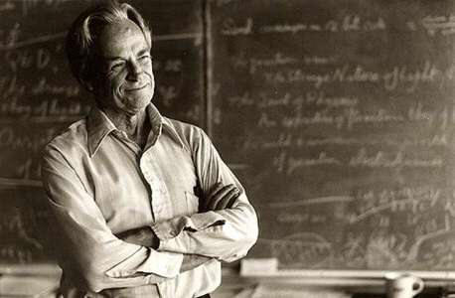
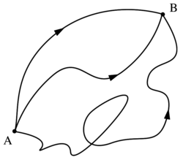
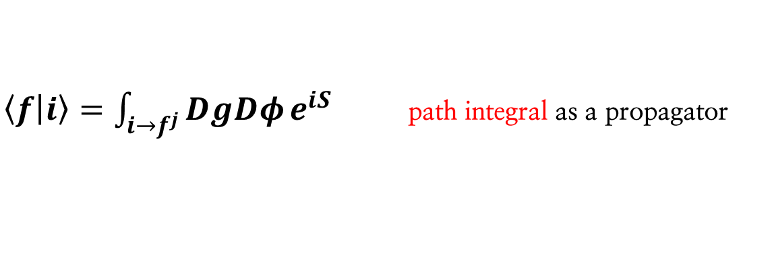

Euclidean path integral approach
(Hartle and Hawking, 1983)
$$|f⟩=\sum_{j}{a_{j}|f^{j}⟩}$$
$\left\langle f | i\right\rangle =\int_{i→f^{j}}^{ }{DgDφ}e^{iS}$ path integral as a propagator

Slide 16
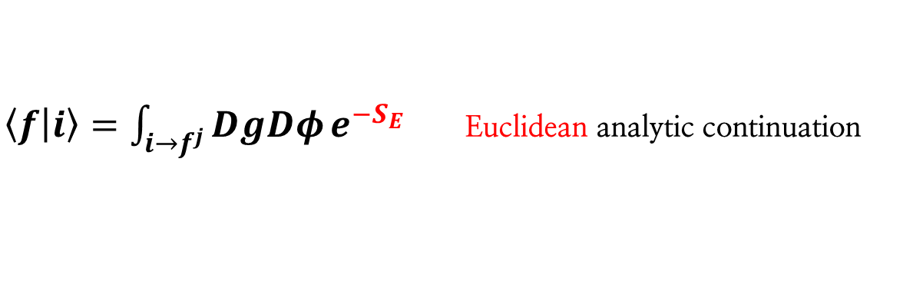
Euclidean path integral approach
(Hartle and Hawking, 1983)
$$|f⟩=\sum_{j}{a_{j}|f^{j}⟩}$$
$\left\langle f | i\right\rangle =\int_{i→f^{j}}^{ }{DgDφ}e^{−S_{E}}$ Euclidean analytic continuation

Slide 17

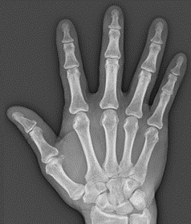
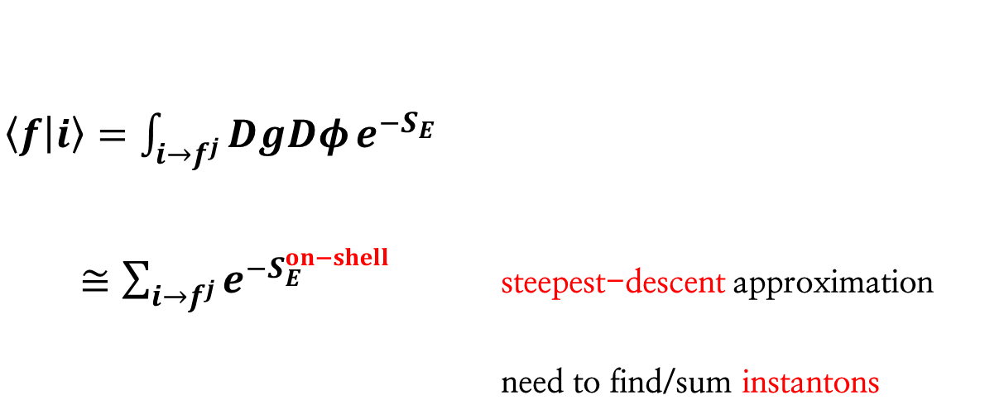
Euclidean path integral approach
(Hartle and Hawking, 1983)
$$|f⟩=\sum_{j}{a_{j}|f^{j}⟩}$$
$\left\langle f | i\right\rangle =\int_{i→f^{j}}^{ }{DgDφ}e^{−S_{E}}$
$≅\sum_{i→f^{j}}^{ }{e^{−S_{E}^{on−shell}}}$ steepest-descent approximation
need to find/sum instantons

Slide 18

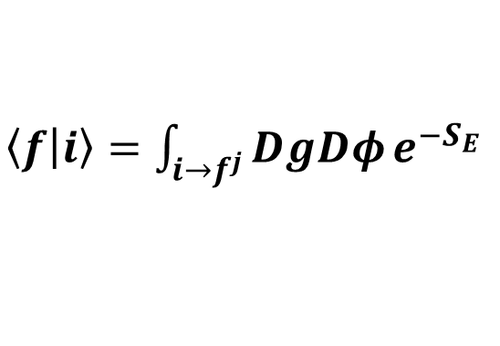
$\left\langle f | i\right\rangle =\int_{i→f^{j}}^{ }{DgDφ}e^{−S_{E}}$
$$|i⟩$$

Slide 19
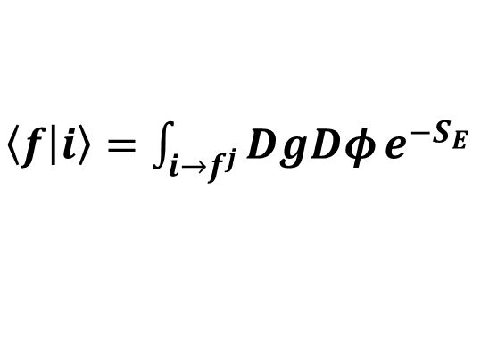

$\left\langle f | i\right\rangle =\int_{i→f^{j}}^{ }{DgDφ}e^{−S_{E}}$
$$|f^{1}⟩$$
$$|i⟩$$

Slide 20


$\left\langle f | i\right\rangle =\int_{i→f^{j}}^{ }{DgDφ}e^{−S_{E}}$
…
$$|f^{1}⟩$$
$$|f^{j}⟩$$
$$|f⟩=\sum_{j}{a_{j}|f^{j}⟩}$$
$$|i⟩$$

Slide 21
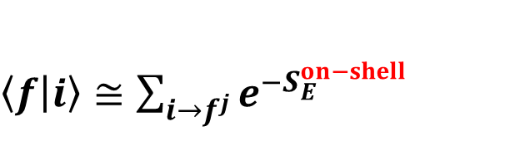
$\left\langle f | i\right\rangle ≅\sum_{i→f^{j}}^{ }{e^{−S_{E}^{on−shell}}}$
…
$$|f^{1}⟩$$
$$|f^{j}⟩$$
$$|f⟩=\sum_{j}{a_{j}|f^{j}⟩}$$
Lorentzian
Euclidean
instantons
Lorentzian
$$|i⟩$$

Slide 22
Wave function of Universe
Field direction ~ different initial condition
Scale-factor direction
~ time

Slide 23
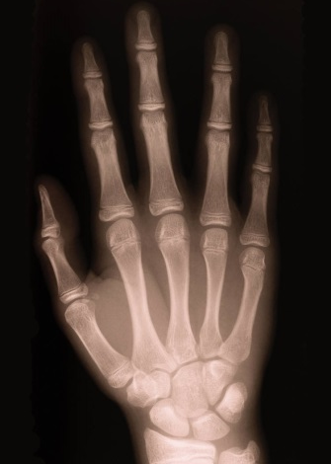
Steepest-descent approximation

Slide 24
Steepest-descent approximation
~ sum-over instantons
Alternative histories:
many-world interpretation

Slide 25

Present universe:
we want to know
the probability of here.
initial singularity → wave function

Slide 26


$$t→t−iτ$$

Slide 27

big-bang singularity

Slide 28
regular Euclidean boundary

Slide 29



Lorentzian dS
$$a\left(t\right)=\frac{1}{H_{0}}\cosh{H_{0}t}$$
Wick-rotation
$$τ=\frac{π}{{2H}_{0}}+it$$
Euclidean on-shell solution
$$a\left(τ\right)=\frac{1}{H_{0}}\sin{H_{0}τ}$$

Slide 30
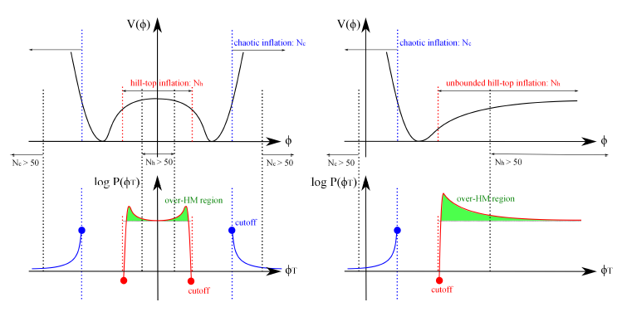
There is no specific preference for concave part
Hwang and DY, 1311.6872

Slide 31
Euclidean wormholes
Chen, Hu and DY, 1611.08468
Chen and DY, 1706.07784

Slide 32
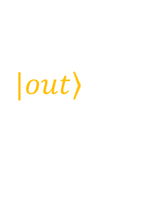

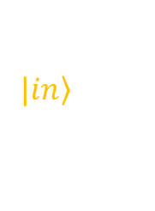
$$|\left.out\right\rangle$$
disconnected
$$\left\langle out | in\right\rangle$$
$$|\left.in\right\rangle$$

Slide 33

$$|\left.out\right\rangle$$
$$\left\langle out | 0\right\rangle$$
no-boundary proposal

Slide 34
$$|\left.out\right\rangle$$
disconnected
$$\left\langle out | in\right\rangle$$
$$|\left.in\right\rangle$$

Slide 35
What if connected?

Slide 36

$${\dot{a}}^{2}=1−\frac{Λ}{3}a^{2}−\frac{C}{a^{n}}$$
If there exists this correction term,
then we can obtain a wormhole.

Slide 37
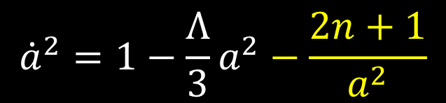
Several candidates
1. Quantum gravity: quantum excitation of WDW equation
$${\dot{a}}^{2}=1−\frac{Λ}{3}a^{2}−\frac{2n+1}{a^{2}}$$

Slide 38

Several candidates
1. Quantum gravity: quantum excitation of WDW equation
$${\dot{a}}^{2}=1−\frac{Λ}{3}a^{2}−\frac{2n+1}{a^{2}}$$
2. String theory: axion induced model
$${\dot{a}}^{2}=1−\frac{C}{a^{4}}$$

Slide 39

Several candidates
1. Quantum gravity: quantum excitation of WDW equation
$${\dot{a}}^{2}=1−\frac{Λ}{3}a^{2}−\frac{2n+1}{a^{2}}$$
2. String theory: axion induced model
$${\dot{a}}^{2}=1−\frac{C}{a^{4}}$$
3. Modified gravity: SO(3) massive gravity model
$${\dot{a}}^{2}=\left(1−\frac{Λ_{eff}}{3}a^{2}−\frac{C}{a^{4}}\right){\left(1+\frac{m_{1}^{2}}{a^{2}}\right)}^{−1}$$

Slide 40
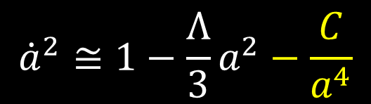
Several candidates
4. Fuzzy Euclidean wormholes: complexification of a scalar field
$${\dot{a}}^{2}≅1−\frac{Λ}{3}a^{2}−\frac{C}{a^{4}}$$

Slide 41
Details of fuzzy Euclidean wormholes

Slide 42
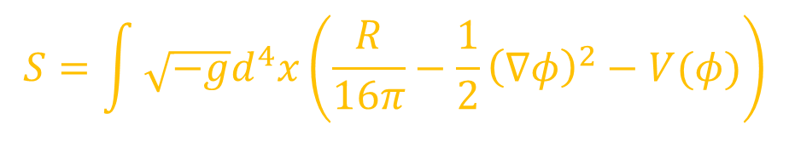


Model
$$S=\int{\sqrt{−g}d^{4}x\left(\frac{R}{16π}−\frac{1}{2}{\left(∇φ\right)}^{2}−V(φ)\right)}$$
Euclidean mini-superspace
$$ds_{E}^{2}={dτ}^{2}+a^{2}(τ){dΩ}_{3}^{2}$$
Equations of motion
$${\dot{a}}^{2}−1−\frac{8πa^{2}}{3}\left(\frac{{\dot{φ}}^{2}}{2}−V\right)=0$$
$$\ddot{φ}+3\frac{\dot{a}}{a}\dot{φ}−V^{′}=0$$
$$\frac{\ddot{a}}{a}+\frac{8π}{3}\left({\dot{φ}}^{2}+V\right)=0$$

Slide 43
Classicality
Due to the analyticity, all functions can be complexified. However, after a sufficient Lorentzian time, every functions should be realized: classicality.
In this limit, we obtain a well-defined probability.

Slide 44









Initial conditions
(assuming $V=V_{0}$)
$$a_{r}\left(0\right)=a_{min}$$
$$a_{i}\left(0\right)=0$$
$${\dot{a}}_{r}\left(0\right)=\sqrt{\frac{4π}{3}}\frac{ℬ}{a_{min}^{2}}\sqrt{\sinh{ζ}\cosh{ζ}}$$
$${\dot{a}}_{i}\left(0\right)=\sqrt{\frac{4π}{3}}\frac{ℬ}{a_{min}^{2}}\sqrt{\sinh{ζ}\cosh{ζ}}$$
$$φ_{r}\left(0\right)=0$$
$$φ_{i}\left(0\right)=0$$
$${\dot{φ}}_{r}\left(0\right)=\frac{ℬ}{a_{min}^{3}}\sinh{ζ}$$
$${\dot{φ}}_{i}\left(0\right)=\frac{ℬ}{a_{min}^{3}}\cosh{ζ}$$

Slide 45


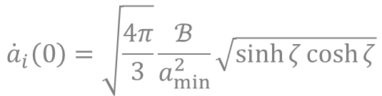

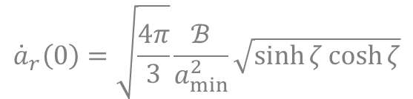

Initial conditions
(assuming $V=V_{0}$)
$$a_{r}\left(0\right)=a_{min}$$
wormhole throat
$$a_{i}\left(0\right)=0$$
$${\dot{a}}_{r}\left(0\right)=\sqrt{\frac{4π}{3}}\frac{ℬ}{a_{min}^{2}}\sqrt{\sinh{ζ}\cosh{ζ}}$$
$${\dot{a}}_{i}\left(0\right)=\sqrt{\frac{4π}{3}}\frac{ℬ}{a_{min}^{2}}\sqrt{\sinh{ζ}\cosh{ζ}}$$
$$φ_{r}\left(0\right)=0$$
$$φ_{i}\left(0\right)=0$$
$${\dot{φ}}_{r}\left(0\right)=\frac{ℬ}{a_{min}^{3}}\sinh{ζ}$$
$${\dot{φ}}_{i}\left(0\right)=\frac{ℬ}{a_{min}^{3}}\cosh{ζ}$$

Slide 46


Initial conditions
(assuming $V=V_{0}$)
$$a_{r}\left(0\right)=a_{min}$$
$$a_{i}\left(0\right)=0$$
$${\dot{a}}_{r}\left(0\right)=\sqrt{\frac{4π}{3}}\frac{ℬ}{a_{min}^{2}}\sqrt{\sinh{ζ}\cosh{ζ}}$$
$${\dot{a}}_{i}\left(0\right)=\sqrt{\frac{4π}{3}}\frac{ℬ}{a_{min}^{2}}\sqrt{\sinh{ζ}\cosh{ζ}}$$
$$φ_{r}\left(0\right)=0$$
arbitrary since flat potential
$$φ_{i}\left(0\right)=0$$
$${\dot{φ}}_{r}\left(0\right)=\frac{ℬ}{a_{min}^{3}}\sinh{ζ}$$
$${\dot{φ}}_{i}\left(0\right)=\frac{ℬ}{a_{min}^{3}}\cosh{ζ}$$

Slide 47

Initial conditions
(assuming $V=V_{0}$)
$$a_{r}\left(0\right)=a_{min}$$
$$a_{i}\left(0\right)=0$$
$${\dot{a}}_{r}\left(0\right)=\sqrt{\frac{4π}{3}}\frac{ℬ}{a_{min}^{2}}\sqrt{\sinh{ζ}\cosh{ζ}}$$
$${\dot{a}}_{i}\left(0\right)=\sqrt{\frac{4π}{3}}\frac{ℬ}{a_{min}^{2}}\sqrt{\sinh{ζ}\cosh{ζ}}$$
$$φ_{r}\left(0\right)=0$$
$$φ_{i}\left(0\right)=0$$
$${\dot{φ}}_{r}\left(0\right)=\frac{ℬ}{a_{min}^{3}}\sinh{ζ}$$
$${\dot{φ}}_{i}\left(0\right)=\frac{ℬ}{a_{min}^{3}}\cosh{ζ}$$
for small $ζ$, imaginary part dominated

Slide 48
Initial conditions
(assuming $V=V_{0}$)
$$a_{r}\left(0\right)=a_{min}$$
$$a_{i}\left(0\right)=0$$
$${\dot{a}}_{r}\left(0\right)=\sqrt{\frac{4π}{3}}\frac{ℬ}{a_{min}^{2}}\sqrt{\sinh{ζ}\cosh{ζ}}$$
$${\dot{a}}_{i}\left(0\right)=\sqrt{\frac{4π}{3}}\frac{ℬ}{a_{min}^{2}}\sqrt{\sinh{ζ}\cosh{ζ}}$$
constrained by equations
$$φ_{r}\left(0\right)=0$$
$$φ_{i}\left(0\right)=0$$
$${\dot{φ}}_{r}\left(0\right)=\frac{ℬ}{a_{min}^{3}}\sinh{ζ}$$
$${\dot{φ}}_{i}\left(0\right)=\frac{ℬ}{a_{min}^{3}}\cosh{ζ}$$

Slide 49
An example
classicalized
directions
poles

Slide 51
Euclidean section
(part B)

Slide 52


Lorentzian section
(part C)
$$a_{i}→0$$
$φ_{i}→$const corresponds
classicality, since
flat potential

Slide 53
Probability
Sometimes, more probable than the
original Hawking-Hawking wave function

Slide 54
Interpretations
Duality between ‘two time arrows’ and ‘one time arrow’

Slide 55
Coupling inflaton potential and
classicality

Slide 56





Initial conditions
(generic $V$)
$$a_{r}\left(0\right)=a_{min}\cosh{η}$$
$$a_{i}\left(0\right)=a_{min}\sinh{η}$$
$${\dot{a}}_{r}\left(0\right)=\sqrt{\frac{4π}{3}}\frac{ℬ}{a_{min}^{2}}\sqrt{\sinh{ζ}\cosh{ζ}}$$
$${\dot{a}}_{i}\left(0\right)=\sqrt{\frac{4π}{3}}\frac{ℬ}{a_{min}^{2}}\sqrt{\sinh{ζ}\cosh{ζ}}$$
$$φ_{r}\left(0\right)=φ_{0}\cos{θ}$$
$$φ_{i}\left(0\right)=φ_{0}\sin{θ}$$
$${\dot{φ}}_{r}\left(0\right)=\frac{ℬ}{a_{min}^{3}}\sinh{ζ}$$
$${\dot{φ}}_{i}\left(0\right)=\frac{ℬ}{a_{min}^{3}}\cosh{ζ}$$

Slide 57

Initial conditions
(generic $V$)
$$a_{r}\left(0\right)=a_{min}\cosh{η}$$
$$a_{i}\left(0\right)=a_{min}\sinh{η}$$
$${\dot{a}}_{r}\left(0\right)=\sqrt{\frac{4π}{3}}\frac{ℬ}{a_{min}^{2}}\sqrt{\sinh{ζ}\cosh{ζ}}$$
$${\dot{a}}_{i}\left(0\right)=\sqrt{\frac{4π}{3}}\frac{ℬ}{a_{min}^{2}}\sqrt{\sinh{ζ}\cosh{ζ}}$$
$$φ_{r}\left(0\right)=φ_{0}\cos{θ}$$
Among 6 free parameters,
($a_{min}$, $η$, $ℬ$, $ζ$, $φ_{0}$, $θ$),
$a_{min}$ and $η$ should be constrained by the constraint equation.
$$φ_{i}\left(0\right)=φ_{0}\sin{θ}$$
$${\dot{φ}}_{r}\left(0\right)=\frac{ℬ}{a_{min}^{3}}\sinh{ζ}$$
$${\dot{φ}}_{i}\left(0\right)=\frac{ℬ}{a_{min}^{3}}\cosh{ζ}$$

Slide 58

Initial conditions
(generic $V$)
$$a_{r}\left(0\right)=a_{min}\cosh{η}$$
$$a_{i}\left(0\right)=a_{min}\sinh{η}$$
$${\dot{a}}_{r}\left(0\right)=\sqrt{\frac{4π}{3}}\frac{ℬ}{a_{min}^{2}}\sqrt{\sinh{ζ}\cosh{ζ}}$$
$${\dot{a}}_{i}\left(0\right)=\sqrt{\frac{4π}{3}}\frac{ℬ}{a_{min}^{2}}\sqrt{\sinh{ζ}\cosh{ζ}}$$
$$φ_{r}\left(0\right)=φ_{0}\cos{θ}$$
$$φ_{i}\left(0\right)=φ_{0}\sin{θ}$$
$ℬ$ and $ζ$ determines the shape of the wormhole. $φ_{0}$ is the initial condition of the field.
$${\dot{φ}}_{r}\left(0\right)=\frac{ℬ}{a_{min}^{3}}\sinh{ζ}$$
$${\dot{φ}}_{i}\left(0\right)=\frac{ℬ}{a_{min}^{3}}\cosh{ζ}$$

Slide 59

Initial conditions
(generic $V$)
$$a_{r}\left(0\right)=a_{min}\cosh{η}$$
$$a_{i}\left(0\right)=a_{min}\sinh{η}$$
$${\dot{a}}_{r}\left(0\right)=\sqrt{\frac{4π}{3}}\frac{ℬ}{a_{min}^{2}}\sqrt{\sinh{ζ}\cosh{ζ}}$$
$${\dot{a}}_{i}\left(0\right)=\sqrt{\frac{4π}{3}}\frac{ℬ}{a_{min}^{2}}\sqrt{\sinh{ζ}\cosh{ζ}}$$
$$φ_{r}\left(0\right)=φ_{0}\cos{θ}$$
Hence, $θ$ is the only parameter to tune the classicality condition.
However, we have two boundaries.
$$φ_{i}\left(0\right)=φ_{0}\sin{θ}$$
$${\dot{φ}}_{r}\left(0\right)=\frac{ℬ}{a_{min}^{3}}\sinh{ζ}$$
$${\dot{φ}}_{i}\left(0\right)=\frac{ℬ}{a_{min}^{3}}\cosh{ζ}$$

Slide 60
Chaotic inflation model
(part C)
One end can be classicalized by choosing a proper $θ$.

Slide 61
Chaotic inflation model
(part A)
Not possible for the other end.

Slide 62

If we cannot make $φ_{i}→0$, for both ends,
then the next way is to make it zero for only one end,
and make it a constant for the other end.

Slide 63
In order to satisfy the classicality for both ends,
what we can do further is to choose
the shape of the potential.
Then there should be a flat direction
in order to make the field asymptotically constant.

Slide 64
Something like this
needed!
$$φ$$

Slide 65


Starobinsky-type model
(part A)
$$a_{i}→0$$
$φ_{i}→$const corresponds
classicality, since
flat direction!
The second end can be also classicalized!

Slide 66
Therefore, if …
The landscape does not prefer a specific potential,
The boundary condition of the wave function is the Euclidean path integral,
$$φ$$

Slide 67
Therefore, if …
The landscape does not prefer a specific potential,
The boundary condition of the wave function is the Euclidean path integral,
$$φ$$
Then …
The concave potential is preferred, since
the no-boundary wave function is dominated by Euclidean wormholes and
the classicalized wormhole is only allowed by the potential that has a flat direction.

Slide 68
Future topics
Fuzzy Euclidean wormholes in AdS: 1703.07746
Can there be observational consequences for the Euclidean wormholes, e.g., bias from the BD vacuum?
One or two arrows of time?
Entanglements between two universes?

Slide 69
Thank you very much

