Slide 1
Dark Matter, Dark Energy Interaction:
Cosmological Implications, Observational Signatures and Theoretical Challenges
Bin Wang
Center for Gravitation and Cosmology
YZU/SJTU
B. Wang, E. Abdalla, F. Atrio-Barandela, D. Pavon
Reports on Progress in Physics, 79, 096901 (2016)

Slide 2
Outline
Cosmological Implications:
Why do we need the interaction between DE&DM?
Observational Signatures:
Is the interaction between DE&DM allowed by observations?
  CMB
    ISW effect
    Kinetic SZ
  Galaxy Cluster scale tests
    Growth factor and Structure formation
    Number of Galaxy Cluster counting
    Weak Lensing
    HI intensity mapping observations
Theoretical Challenges:

Slide 3
95% Unknown: 25% DM+70% DE
DE-- ?
  QFT value 123 orders larger than the observed
  Coincidence problem:
  Why the universe is accelerating just now?
  In Einstein GR: Why are the densities of DM and DE of precisely the same order today?
is not the end story to account for the cosmic acceleration

Slide 4
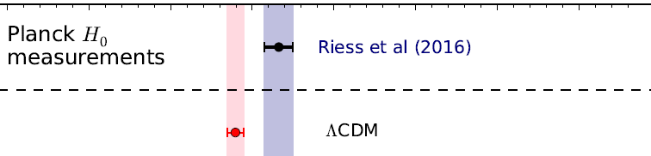
Evidence Against ΛDCM?
Hubble constant constraints at 68% CL
Ade et al. (2016, h = 0.673 ± 0.010)
Riess et al. (2016, h = 0.732 ± 0.017)
Discordance 2.7σ

Slide 5
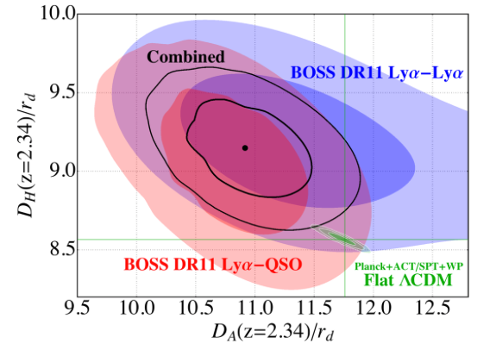
Evidence Against ΛDCM?
Baryon acoustic oscillations in the Lyα forest of BOSS DR11 quasars
A&A 574, A59 (2015)
The study uses 137,562 quasars in the redshift range 2.1≤z≤3.5 from the Data Release 11 (DR11) of the Baryon Oscillation Spectroscopic Survey (BOSS) of SDSS-III
DA/rd are 7% lower and DH/rd are 7% higher than the predictions of a flat ΛDCM cosmological model
Discrepancy 2.5σ

Slide 6
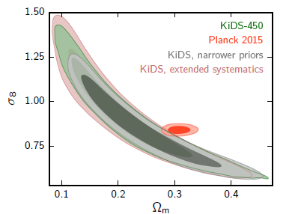
Evidence Against ΛDCM?
Weak Lensing from Kilo Degree Survey (KiDS)
MNRAS471,1259(2017)
ΛDCM
The discordance between the two datasets is largely unaffected by a more conservative treatment of the lensing systematics.

Slide 7


Modification to ΛDCM is needed?
Interaction
70% Dark Energy
25% Dark Matter

Slide 8





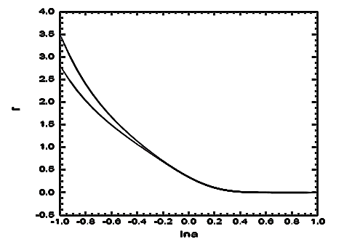

Why do we need the interaction between DE&DM?
A phenomenological generalization of the LCDM model is
LCDM model,
Stationary ratio of energy densities
Coincidence problem less severe than LCDM
The period when energy densities of DE and DM are comparable is longer
The coincidence problem
is less acute
can be achieved by a suitable interaction between DE & DM

Slide 9
Is Einstein’s GR successful on large scale?
Modified gravity: f(R) model ------ Extended GR by introducing
Non-minimal coupling between DE and DM
Motivations to introduce the interaction between DE and DM:
Alleviate the coincidence problem
Accommodate the DE with w<-1
Relate to the study of the modified gravity

Slide 10
The Interaction Between DE & DM
Phenomenological interaction forms:
For Q > 0 the energy proceeds from DE to DM
Phenomenological forms of Q

Slide 11
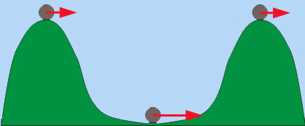
Signature of the interaction in the CMB
Sachs-Wolfe effects:
non-integrated
photons’ initial conditions
Early ISW
integrated
has the unique ability to probe the
“size” of DE: EOS, the speed of sound
Late ISW
Signature of the interaction between DE and DM?

Slide 12

ISW imprint of the interaction
The analytical descriptions for such effect
ISW effect is not simply due to the change of the CDM perturbation. The interaction enters each part of gravitational potential.
J.H. He, B.Wang, P.J.Zhang, PRD(09)
J.H.He, B.Wang, E.Abdalla, PRD(11)

Slide 13
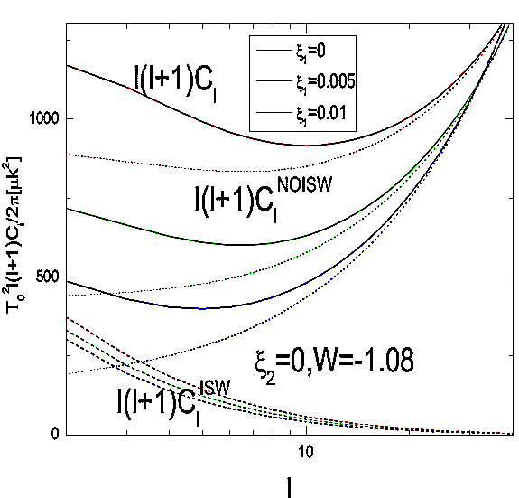
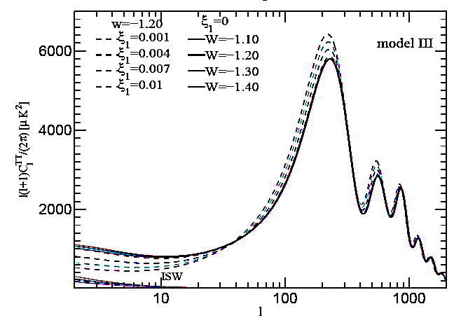
Imprint of the interaction in CMB
Interaction proportional to the energy density of DM & DE+DM
EISW+SW
He, Wang, Zhang, PRD(09)
He, Wang, Abdalla, PRD(11)

Slide 14

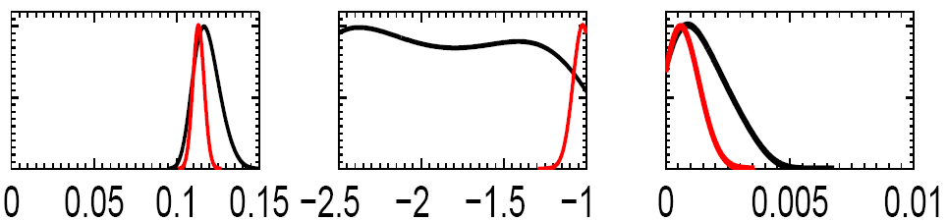
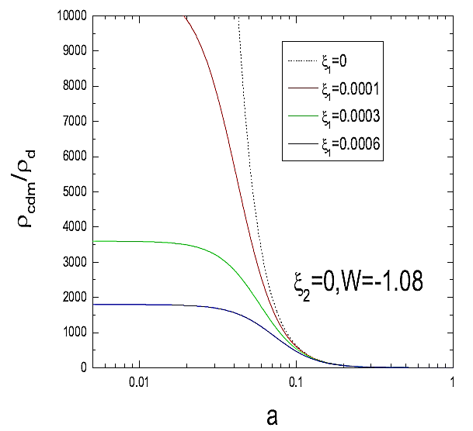
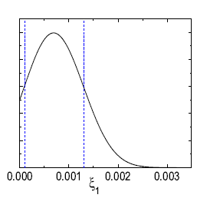
Likelihoods of ,w and ξ
ξ ~DM
Alleviate the coincidence problem
WMAP data: He, Wang, Abdalla, PRD(11)
PLANCK 2013data: Costa, Xu, Wang, Ferreira, Abdalla, PRD(14)
PLANCK 2015data: Costa, Xu, Wang, Abdalla, JCAP (17)

Slide 15
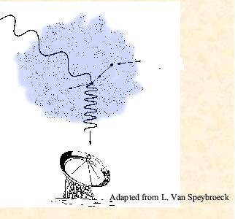
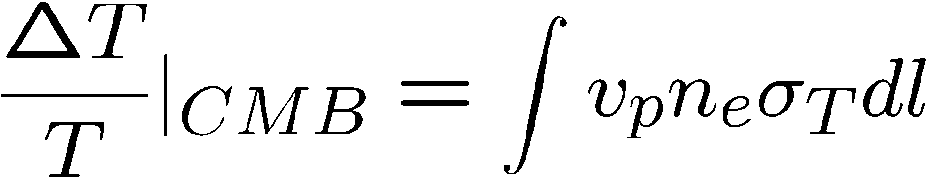
Sunyaev Zel'dovich effect
The Kinetic SZ effect
CMB photon
T_{CMB}=2.73K
1% probability
free energetic
electron in
Inverse Compton scattering
v_{p}: peculiar velocity
scattered CMB photon
boost CMB photon
T_{CMB}=2.73+ΔT
scattering probability
Interesting to study KSZ effect
Interesting to study KSZ effect
PLANCK result: the upper limit of the peculiar velocity can be three times of the LCDM prediction. 1303.5090

Slide 16


In the small scale approximation k>>aH, neglect the time variation of the potential
Evolution of DE, DM perturbation;
background density
Density perturbation of electrons
Velocity field of electrons
Interaction
KSZ effect
X.D.Xu, B.Wang, P.J.Zhang, F.Atrio-Barandela, JCAP(13)

Slide 17
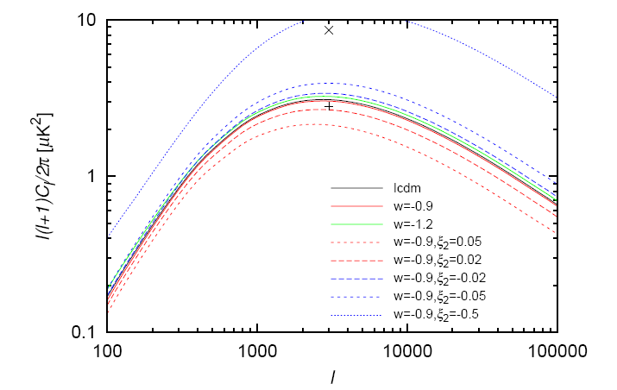
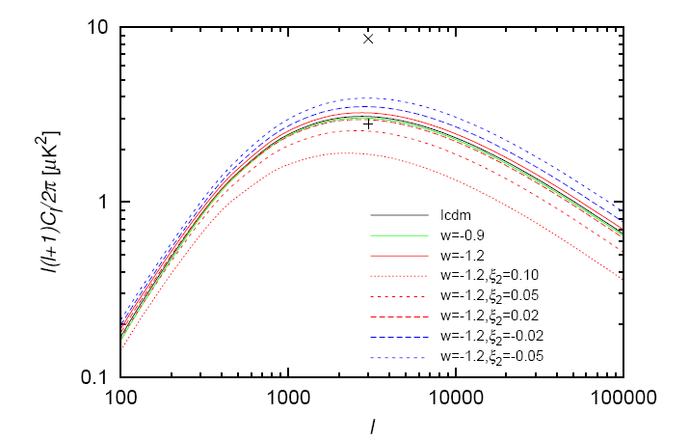
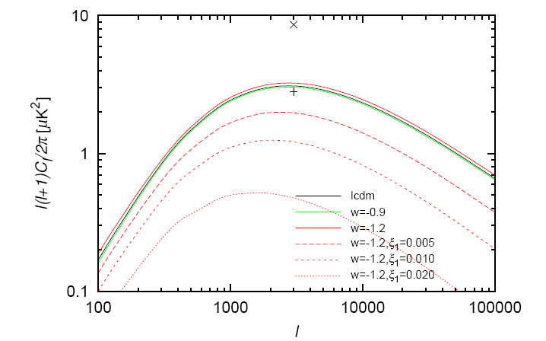
ξ ~DE, w>-1
The amplitude increases with
decreasing of coupling
ξ >0, smaller than the LCDM
model
ξ <0, larger than the LCDM
model
X: upper limit from ACT 8.6uk^2 at l=3000
+: upper limit from SPT
2.8uk^2 at l=3000
Upper limits depend on:
reionization history
the modeling of CIB
TSZ contribution
We just consider: homogeneous, linear
patchy reionization, nonlinear
ξ ~DE, w<-1
ξ~DM, w<-1
Tension with negative coupling.
KSZ observations favor a positive coupling between DM-DE interaction !

Slide 18
Summary:
KSZ effect:
potential,
peculiar velocity,
Large at big l,
from the moment of reionization z ~10.
ISW effect:
time evolution of the potential,
at large angular scales,
during the period of acceleration
complementary
X.D.Xu, B.Wang, P.J.Zhang, F.Atrio-Barandela, JCAP(13)

Slide 19
How does the interaction influence the structure formation?
The dynamics in the process of the structure formation.
Layzer-Irvine equation
Virial condition of the galaxy cluster
E. Abdalla, L.Abramo, L.Sodre, B.Wang, PLB(09)
E. Abdalla, L.Abramo, J.Souza, PRD(09)
2. Spherical collapse model.
Critical density to collapse
Number of galaxy clusters at different redshift
J.H.He, B.Wang, E.Abdalla, D.Pavon, JCAP(10)

Slide 20
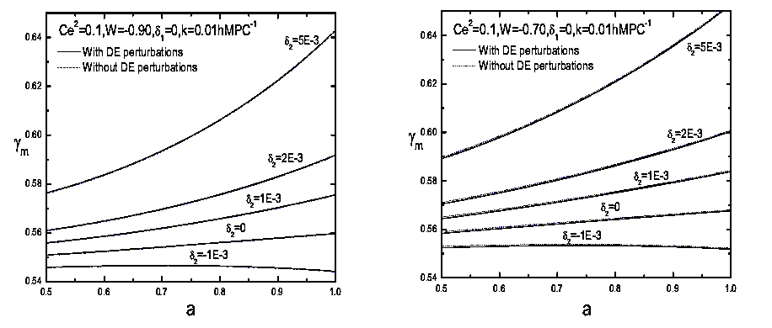
Growth Index:
The influence of the interaction between dark sectors
The interaction influence on the growth index overwhelms the DE perturbation effect.
This opens the possibility to reveal the interaction between DE&DM through measurement of growth factor in the future.
He, Wang, Jing, JCAP09

Slide 21

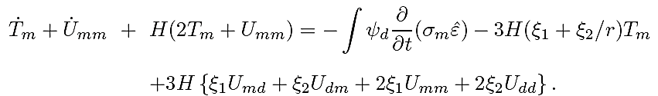
Layzer-Irvine equation for DM
Layzer-Irvine equation describes how a collapsing system reaches dynamical equilibrium in an expanding universe
For DM: the rate of change of the peculiar velocity is
describes how DM reaches dynamical equilibrium in the collapsing system in the expanding universe.
E. Abdalla, L.Abramo, L.Sodre, B.Wang, PLB(09)
J.H.He, B.Wang, E.Abdalla, D.Pavon, JCAP(10)

Slide 22


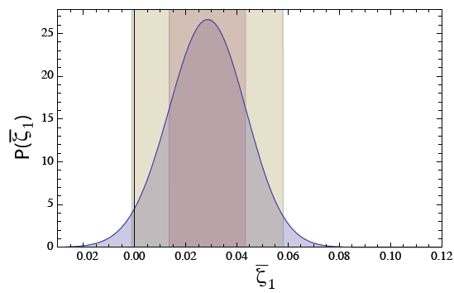
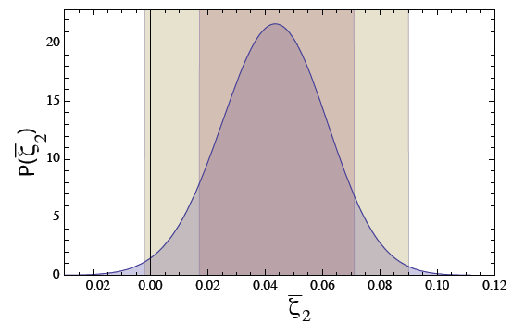
Virial condition
If the DE is distributed homogeneously,
For DM:
For a system in equilibrium
Virial Condition:
presence of the coupling between DE and DM changes the
equilibrium configuration of the system
Galaxy clusters are the largest virialized structures in the universe
Comparing the mass estimated through naïve virial hypothesis with that from WL and X-ray
E. Abdalla, L.Abramo, L.Sodre, B.Wang, PLB(09)
E. Abdalla, L.Abramo, J.Souza, PRD(09)
galaxy clusters optical, X-ray and weak lensing data

Slide 23

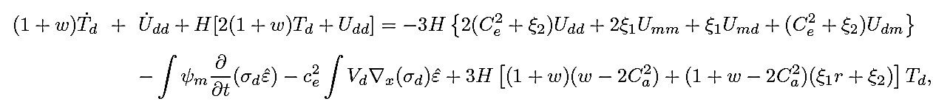
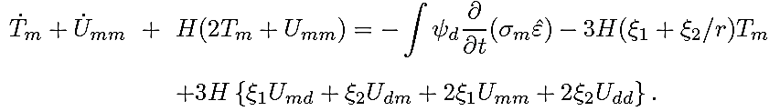
Layzer-Irvine equation for DE
For DE: starting from
Multiplying both sides of this equation by
integrating over the volume
and using continuity equation, we have:
For DE:
For DM:
The time and dynamics required by DE and DM to reach equilibrium are different in the collapsing system.
DE does not fully cluster along with DM.
J.H.He, B.Wang, E.Abdalla, D.Pavon, JCAP(10)

Slide 24

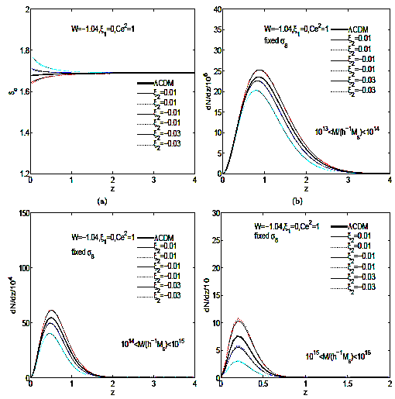
Press-Schechter Formalism
J.H.He, B.Wang, E.Abdalla, D.Pavon, JCAP(10)

Slide 25
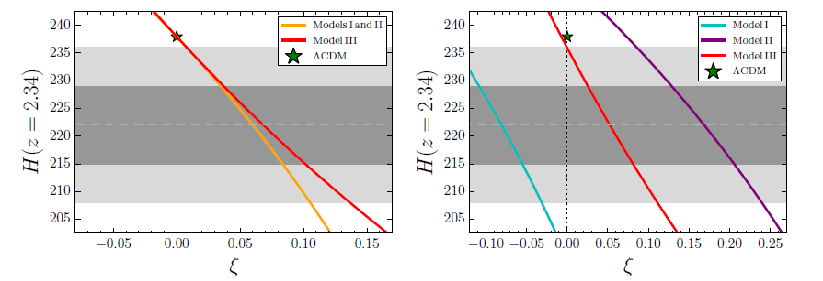
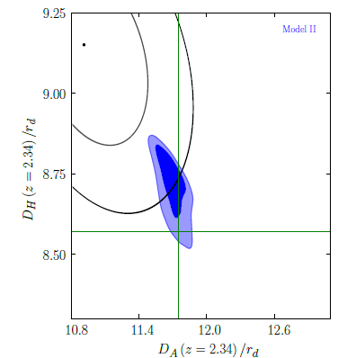
Evidence for interacting model from BOSS
Hubble parameter obtained by BOSS
A&A 574, A59 (2015)
ΛDCM differs from the BOSS combined contours by at least 2σ.
This difference is reduced due to interaction between dark sectors.

Slide 26
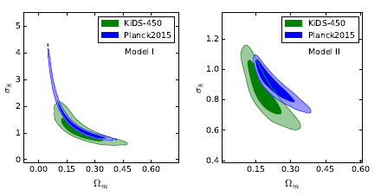
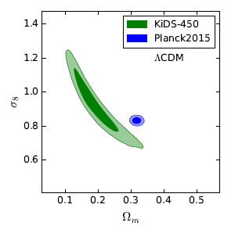
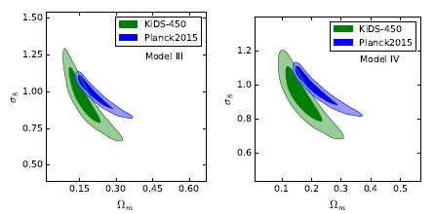
Evidence for interacting model from Weak Lensing
This difference is reduced due to interaction between dark sectors.

Slide 27
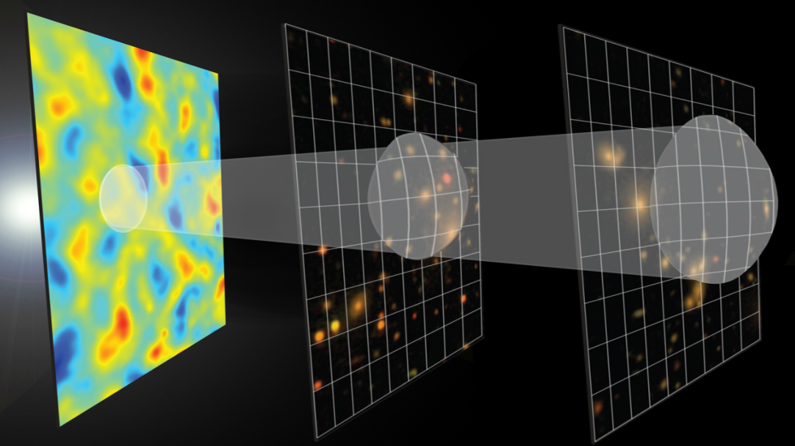
More evidence for interacting DE model
The BAOs are a signature in the matter distribution from the recombination epoch.
BAO the most powerful probes
of DE
To date, BAOs have only been detected by performing
large galaxy redshift surveys in the optical waveband.
The radio band provides a unique and complementary observational window.
via the redshifted 21cm neutral hydrogen emission line from distant galaxies.

Slide 28
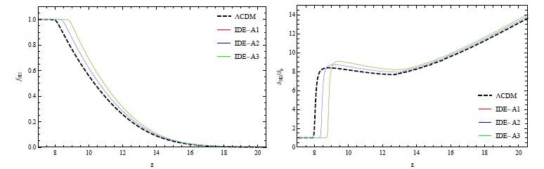
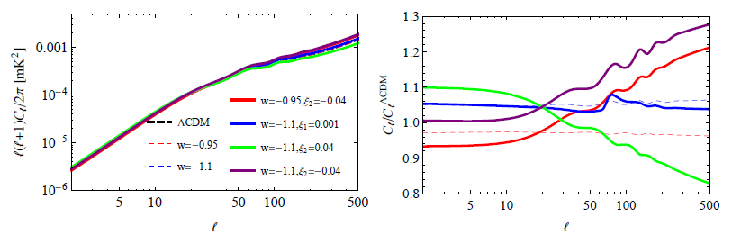
Evidence for interacting model from 21cm windows
Reionization Epoch:
Xu, Zhang, Wang 1702.06358
The coupling can speed up the reionization.
Acceleration Epoch:
Xu, Ma, Weltman 1710.03643
The auto-power spectra of 21-cm, IDE models with respect to the ΛCDM model
window at z = 0.3

Slide 29
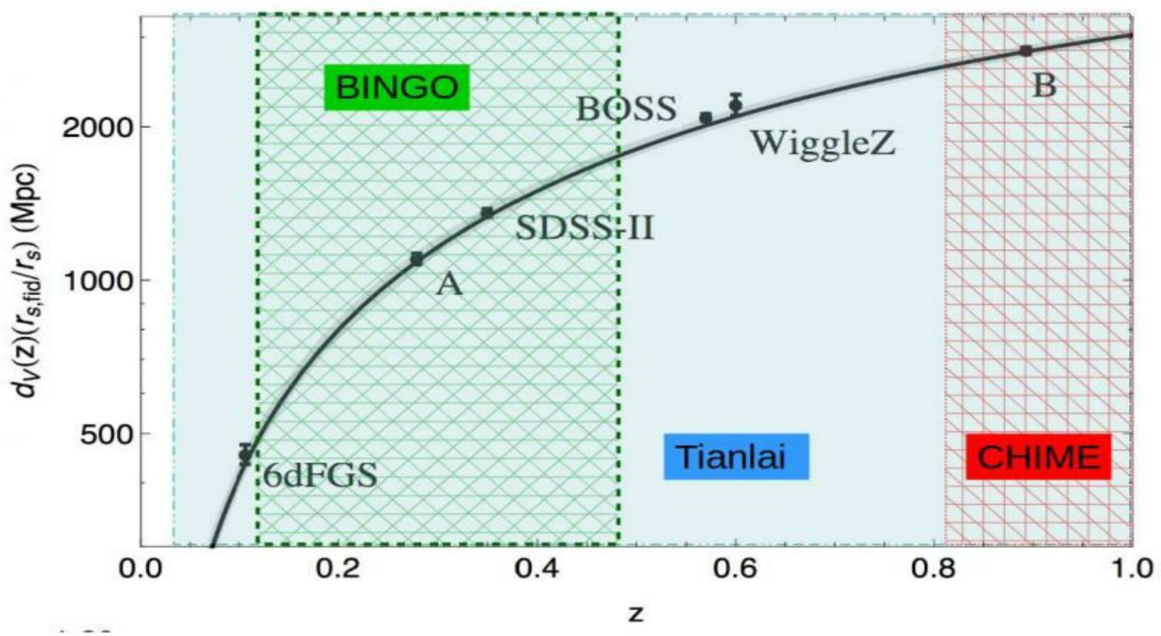
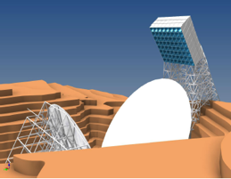
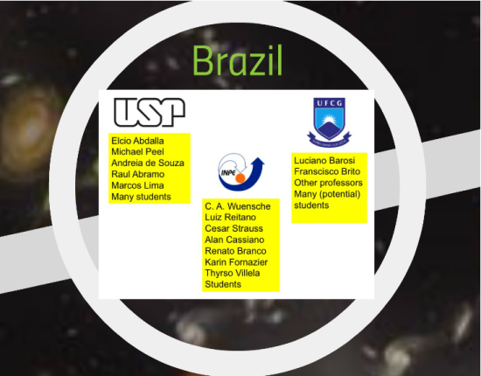

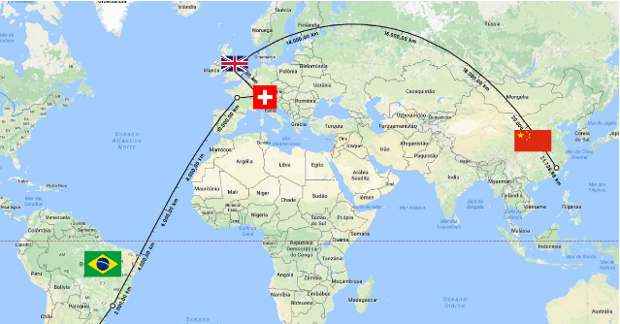


21cm windows:
BINGO

Slide 30
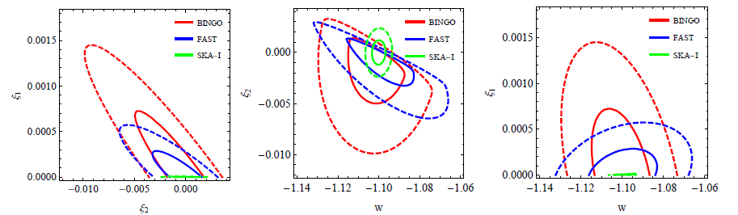
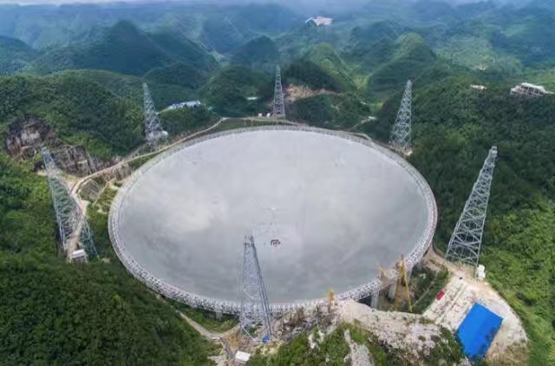
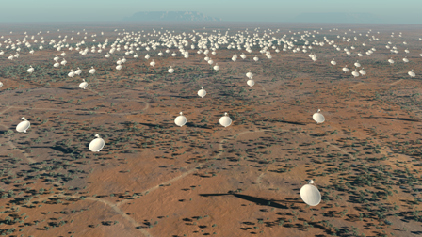
Forcasted constraints on the interaction from 21cm windows:
Xu, Ma, Weltman 1710.03643
BINGO
FAST
SKA

Slide 31
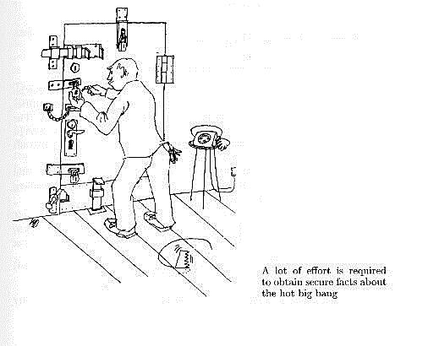
A lot of efforts are required to disclose the signature on the interaction between DE and DM
CMB
Cluster M
Cluster N
kSZ
Redshift Distortion
Weak Lensing
21cm HI
More tests are needed

Slide 32
Summary
Cosmological Implications:
Motivation to introduce the interaction between DE & DM
Observational Signatures:
CMB+SNIa+BAO+kSZ
Galaxy cluster scale tests
Weak Lensing
    HI intensity mapping observations
Alleviate the coincidence problem
Theoretical Challenges:
Understanding the interaction from field theory

Slide 33


CosPA 2018
Welcome to Yangzhou

Slide 34
Thanks!!!

