Slide 1


CMB weak lensing with a primordial magnetic field
CosPA 2017
D. G. Yamazaki,
University Education Center, Ibaraki University,
Division of Theoretical Astronomy, National Astronomical Observatory of Japan

Slide 2
Abstract
Primordial magnetic fields (PMF) affect the matter power spectrum (MPS) and the cosmic microwave background (CMB).
The effects of the PMF on the MPS and the CMB are two kinds.
The first is the perturbative PMF effects.
The second is the background PMF effects.
We investigate the overall PMF effects on the MPS, the lensing potential(LP) and the CMB B mode from the weak lensing(WL) effect.
Yamazaki, et al. Physics Reports 517, pp. 141-167, (2012).
Yamazaki, PRD 89, 083528(2014) [arXiv:1311.2584].
Yamazaki, PRD 93 043004 (2016) [arXiv:1602.02750].
Yamazaki, WL and PMF, preparation (2017).

Slide 3

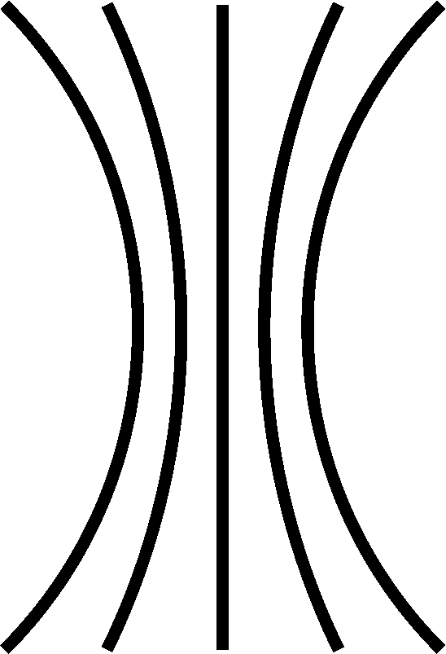
Background
Clusters of galaxies have magnetic field of 0.1-1μ G
Kronberg et al. ApJ. 387, 528 (1992); Wolfe et al.ApJ. 388, 17 (1992); Clarke et al. ApJL. 547, L111 (2001);
Xu, et al. ApJ. 637, 19 (2006); Govoni et al A&A 460, 425-438 (2006) .
The magnetic fields in cosmological scales are frozen-in the baryon field.
The relation between the comoving strength of the magnetic field and the baryon density is
[magnetic strength] ∝[density of baryon (ρ_{b} )]^{2/3}
baryon density in clusters of galaxies
～10² ～ 10³
Average of the baryon density in Universe
Magnetic field in cluster of galaxies
=
Average of magnetic field in Universe
Density: low
Density: high
2/3
(
)
B : weak
B : strong
baryon density in clusters of galaxies
～10²
Average of the baryon density in Universe
[PMF]= B₀(a=1) =1 nG – 10 nG
Notes:
The ratio the baryon density in clusters of galaxies to Average of the baryon density in Universe is like this,
Therefore we can estimate the comoving strength of the PMF from this relation, and its strength is the order of nG.

Slide 4
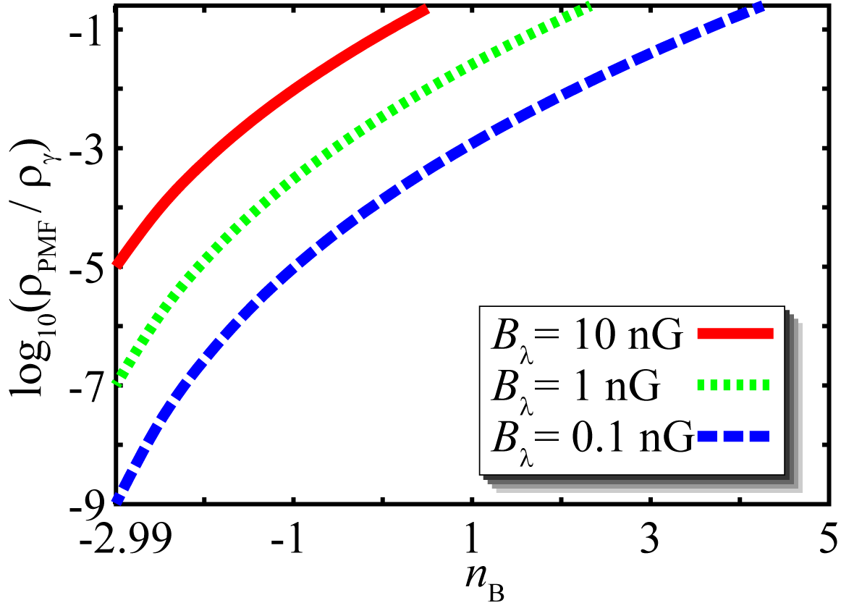

○the energy density of the PMF exceeds the perturbative region around $n_{B}$=-2.0
Constraint on the PMF from BBN
Yamazaki, et al. Phys. Rev. D 90, 023001(2014)
The enegy density of the PMF is too large to be negligible in this range.

Slide 5
Background
Since a energy density of a PMF of nG in n_{B}> -2.0 exceeds the energy density of temperature perturbations of CMB, PMF effects are very important on the CMB and MPS, and we should consider PMF effects on the early universe. (Jedamzik et al. 2000: Durrer et al. 2000, Mack et al. 2002 Subramanian and Barrow, 1998, 2002, Lewis 2004, Giovannini 2006)

Slide 6
PMF effects on the MPS
There are two kinds of the PMF effects
on the MPS
Perturbative PMF effects
They are due to the first perturbation source from
the PMF in the linear perturbative equations.

Slide 7
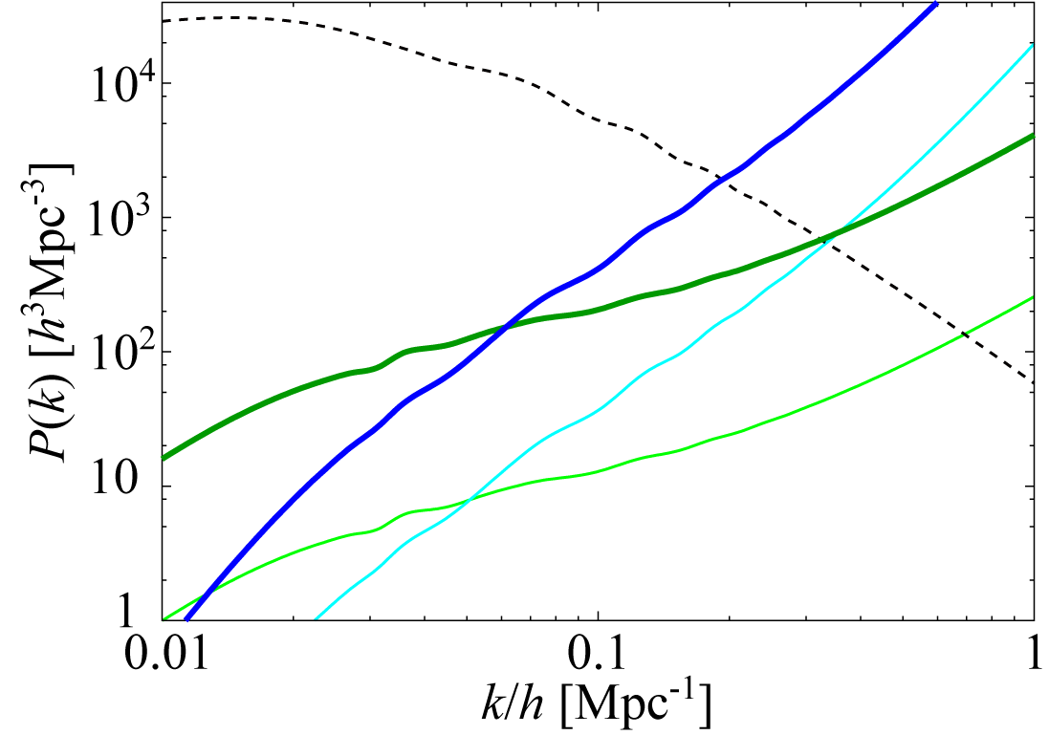
The perturbative PMF effects on the MPS
B_{λ} = 5nG, n_{B} = -1.0
B_{λ} = 2.5nG, n_{B} = -1.0
without PMF
B_{λ} = 5nG, n_{B} = -2.5
B_{λ} = 2.5nG, n_{B} = -2.5
the perturbative PMF effects generate the other fluctuations of the MPS in higher k

Slide 8
PMF effects on the MPS
There are two kinds of the PMF effects
on the MPS
Perturbative PMF effects
They are due to the first perturbation source from
the PMF in the linear perturbative equations.
They are generate the other fluctuations of the MPS
in smaller scales.

Slide 9
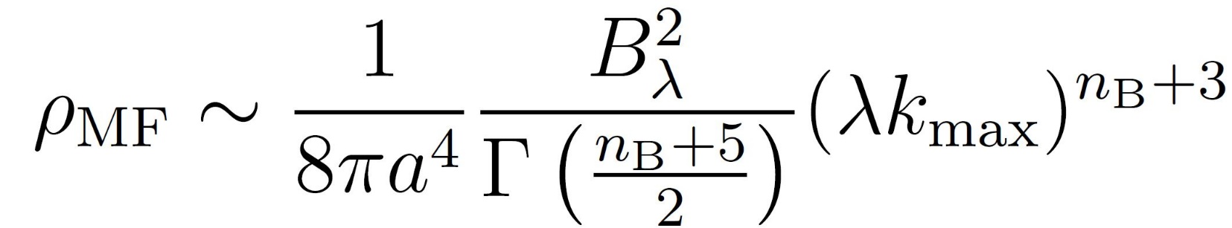
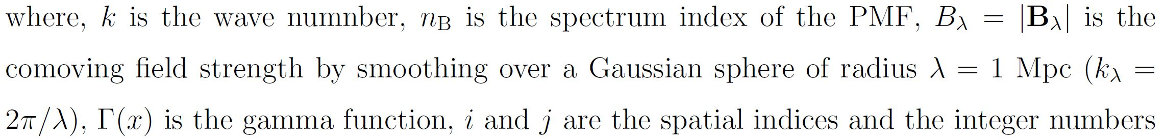


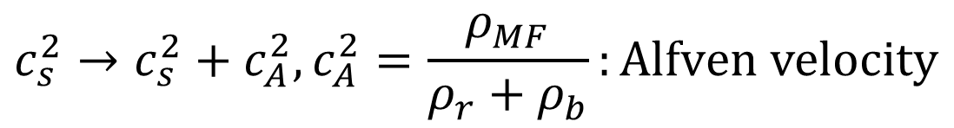
the nonperturbative source of the PMF
ρ_{MF} :The ensemble average of the PMF energy density
The sound speed is affected by the PMF
$$c_{s}^{2}→c_{s}^{2}+c_{A}^{2}, c_{A}^{2}=\frac{ρ_{MF}}{ρ_{r}+ρ_{b}}:Alfven velocity$$
Increase of sound speed ∝ $\sqrt{ρ_{MF}}$
The energy density of PMF is very important for the evolution of the cosmological fluid !
Notes:
Before the second effects of the PMF on the MPS, I am talking about review the Linear perturbation theory.
In cosmological scale, to compute the physical quantity, we use the linier perturbation theory and equations.
Rough image is like this,
This first-order perturbation term includes perturbative PMF sources as mentioned above.
Since the average field strength of the primordial magnetic field in the Universe is 0,
its zero order sources is also 0
But, since the ensemble average energy density of their PMF is proportional to the root-mean-square of the PMF strength,
its zero order source is not 0
The PMF increase the effective sound speed like this.

Slide 10
PMF effects on the MPS
There are two kinds of the PMF effects
on the MPS
Perturbative PMF effects
They are due to the first perturbation source from
the PMF in the linear perturbative equations.
They are generate the other fluctuations of the MPS
in smaller scales
2. Background PMF effects
ρ_{MF} and c_{S} are considered as the nonperturbative source.

Slide 11
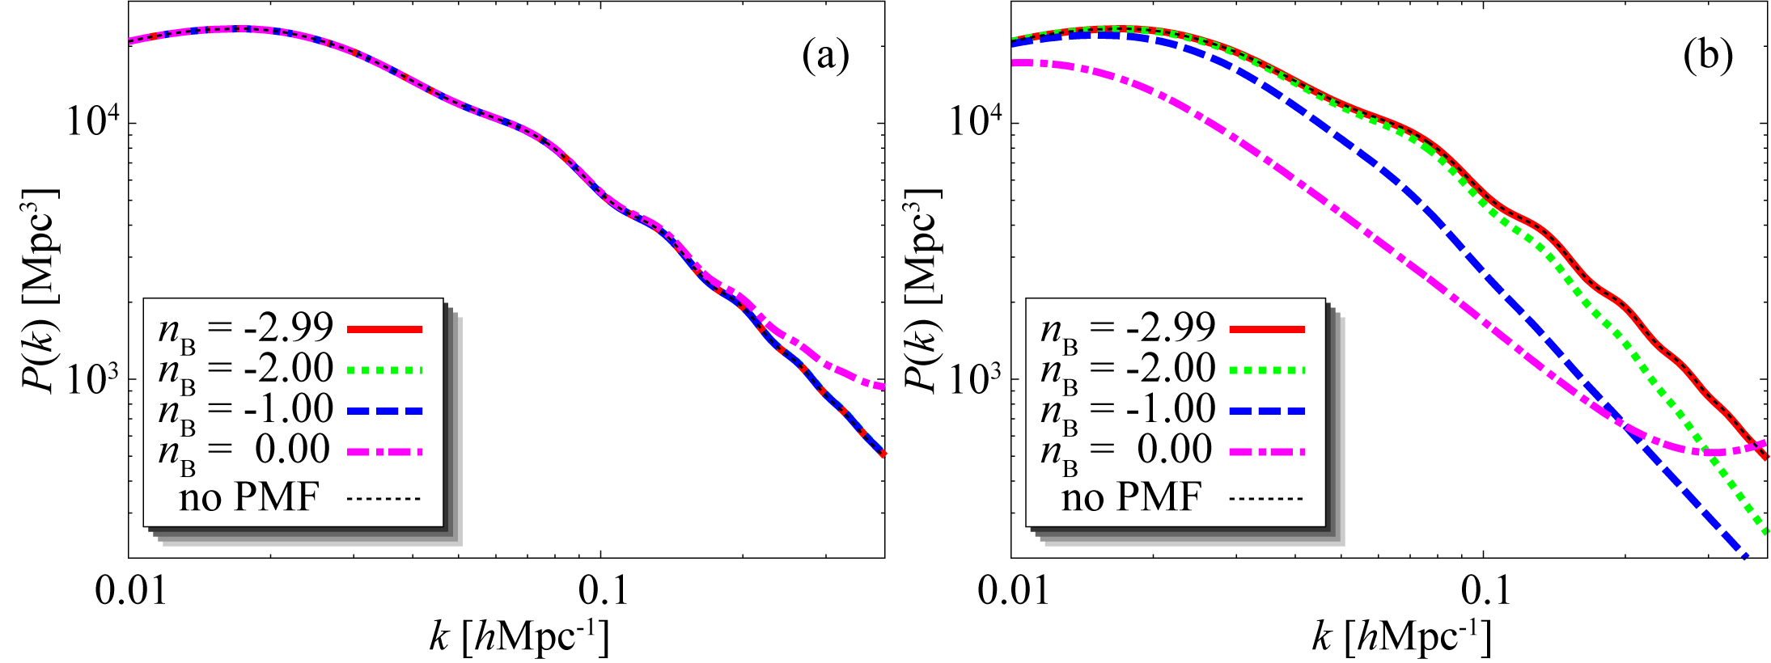
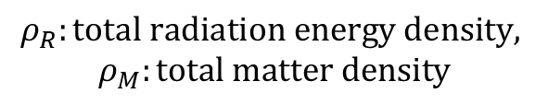
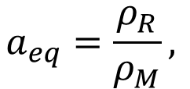






Meszaros effect on MPS with $ρ_{MF}$
The horizon scale at the matter radiation equality time become the peak of the MPS
Without $ρ_{MF}$
With$ρ_{MF}$
peak
After the fluctuations of the MPS enter the horizon on the radiation dominated era, the fluctuations cannot grow.
Meszaros effect
P. Meszaros, Astron. & Astrophys. 37, 225 (1974).
B_{λ} = 10 nG
The peak position is determined by the matter-radiation equality time
$$a_{eq}=\frac{ρ_{R}}{ρ_{M}},$$
$$ρ_{R}:total radiation energy density,$$
$$ρ_{M}:total matter density$$
Larger$ρ_{R}$shifts peaks to larger scales
The amplitude in smaller scale is suppressed
$ρ_{MF}$shifts peaks to larger scales
The amplitude in smaller scale is suppressed by $ρ_{MF}$
$$PMF energy density:ρ_{MF}∝\frac{1}{a^{4}}$$
Notes:
n_{B} = -2.99, ${ρ_{MF}/ρ}_{γ}$ = 1.0 10⁻⁵
n_{B} = -2.00, ${ρ_{MF}/ρ}_{γ}$ = 5.84 10⁻⁴
n_{B} = -1.00, ${ρ_{MF}/ρ}_{γ}$ = 9.65 10⁻³
n_{B} = -0.00, ${ρ_{MF}/ρ}_{γ}$ = 8.63 10⁻²
This figure show us the MPS with and without the background PMF effects.
the peak position of the MPS is determined by the matter-radiation equality time as follows,
therefore, Larger 𝜌_𝑅 shifts peaks to larger scales The amplitude in smaller scale is suppressed. It is called the Meszaros effect and the references like this.
Since the PMF energy density is inversely proportional to the fourth power of the scale factor, rho_MF enforce the the Meszaros effect.
As the result, the PMF energy density shift the peak of MPS to larger scale, and the amplitude of the MPS in the smaller scale is suppressed as right hand figure.

Slide 12
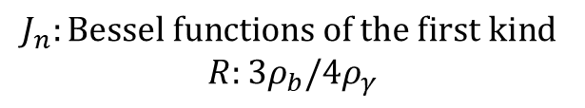
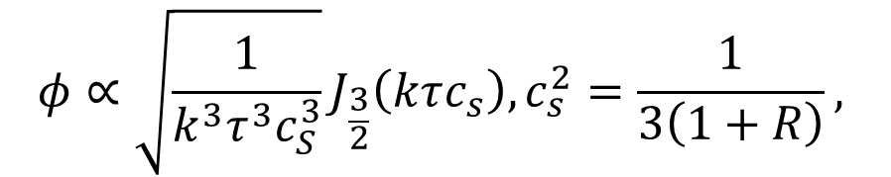


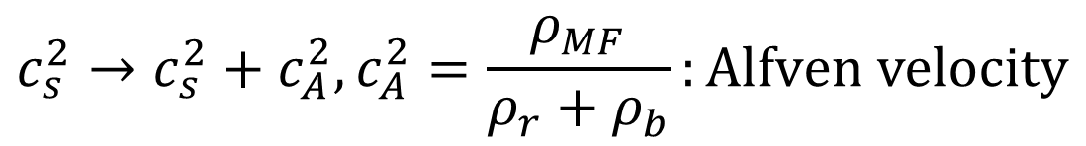
Potential damping from sound wave with PMF
Without $ρ_{MF}$
With$ρ_{MF}$
B_{λ} = 10 nG
the potentials on the horizon in the radiation-dominated era
$$φ∝\sqrt{\frac{1}{k^{3}τ^{3}c_{S}^{3}}}J_{\frac{3}{2}}\left(kτc_{s}\right), c_{s}^{2}=\frac{1}{3\left(1+R\right)},$$
$$J_{n}:Bessel functions of the first kind$$
$$R:{3ρ}_{b}/4ρ_{γ}$$
C.-P. Ma and E. Bertschinger, Astrophys. J. 455, 7 (1995).
The amplitude in smaller scale is suppressed by $c_{s}$
$$c_{s}^{2}→c_{s}^{2}+c_{A}^{2}, c_{A}^{2}=\frac{ρ_{MF}}{ρ_{r}+ρ_{b}}:Alfven velocity$$
Notes:
the potentials on the horizon in the radiation-dominated era as follows, also damps the MPS in the smaller scale.
As this equation, the larger C_s induces the potential decay.
The PMF energy density increase the sound speed as mentioned above,
So the PMF damps the potential and
as the results
The amplitude of the MPS in smaller scale is suppressed

Slide 13
PMF effects on the MPS
There are two kinds of the PMF effects
on the MPS
Perturbative PMF effects
They are due to the first perturbation source from
the PMF in the linear perturbative equations.
They are generate the other fluctuations of the MPS
in smaller scales
2. Background PMF effects
ρ_{MF} and c_{S} are considered as the nonperturbative source.
The background PMF effects shift the peak position of the MPS to larger scale and suppress the amplitude of the MPS in smaller than the peak position.

Slide 14
Matter power spectrum with PMF
Without $ρ_{MF}$
With$ρ_{MF}$
B_{λ} = 10 nG
If we consider the PMF effects on the MPS correctly, the PMF decrease the amplitude of the MPS.
The LP spectrum and the WL effect is from the MPS.
The PMF suppress the LP and the WL effect
Notes:
n_{B} = -2.99, ${ρ_{MF}/ρ}_{γ}$ = 1.0 10⁻⁵
n_{B} = -2.00, ${ρ_{MF}/ρ}_{γ}$ = 5.84 10⁻⁴
n_{B} = -1.00, ${ρ_{MF}/ρ}_{γ}$ = 9.65 10⁻³
n_{B} = -0.00, ${ρ_{MF}/ρ}_{γ}$ = 8.63 10⁻²

Slide 15
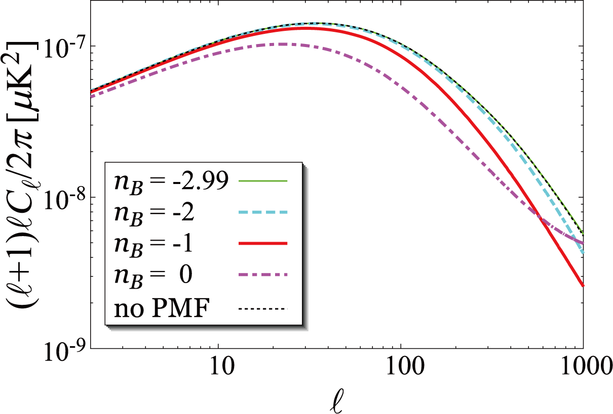
$ρ_{MF}$ + lensing potential
B_{λ} = 10 nG
shift
DOWN
The peak positions of the LP are shifted to larger scale by the background PMF
The amplitude of the LP is also suppressed in smaller than the peak position

Slide 16
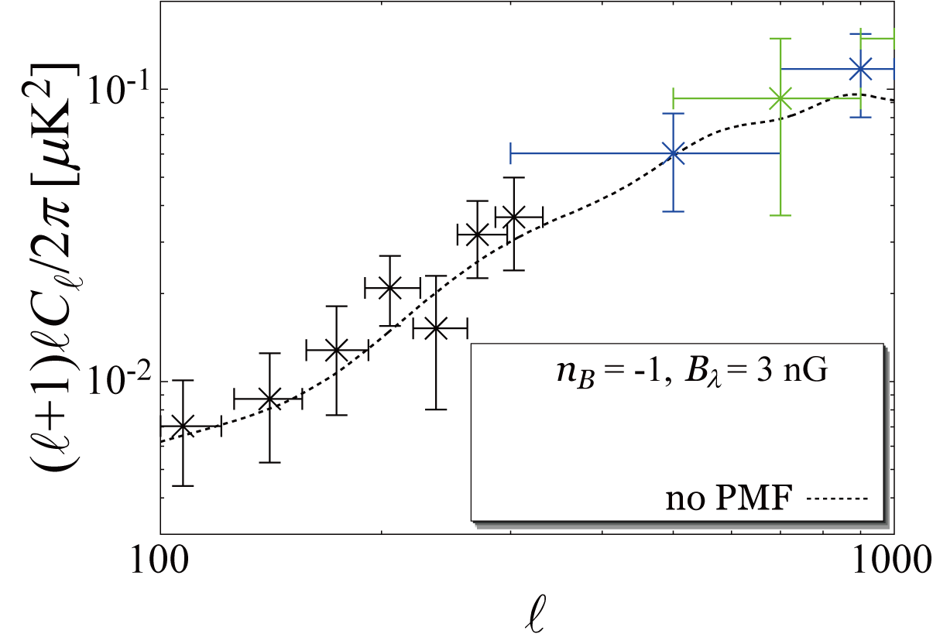
$ρ_{MF}$ + lensing + the perturbative PMF
BKP: Phys. Rev. Lett. 116, 031302, 2016
SPTpol: ApJ, 807, 151, (2015),
POLARBEAR: ApJ, 794, 171, (2014).
POLARBEAR
Parameters from Astron. & Astrophys. 594,
A13 (2016) (TT + lowP + lensing in the table 4)
SPTpol
BKP
1. The PMF が k<0.01~0.02 hMps⁻¹のMPS減らす。
2. lensing potential も比較的小スケールで減少。
3. Weak lensing effect 由来のB mode 減少

Slide 17
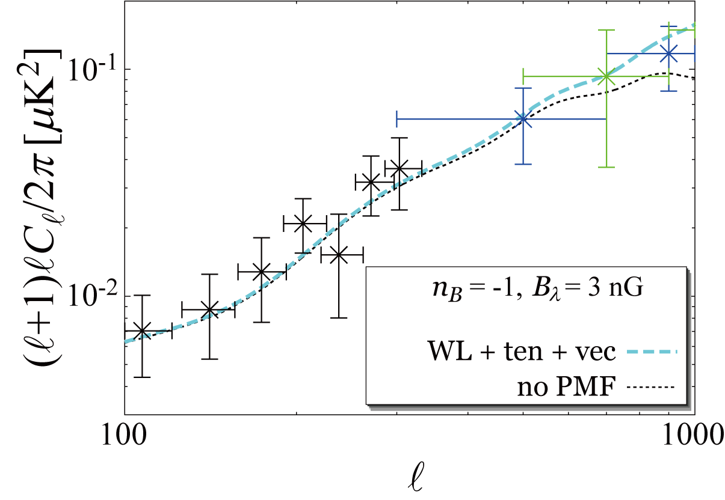
$ρ_{MF}$ + lensing + the perturbative PMF
BKP: Phys. Rev. Lett. 116, 031302, 2016
SPTpol: ApJ, 807, 151, (2015),
POLARBEAR: ApJ, 794, 171, (2014).
POLARBEAR
SPTpol
BKP
The perturbative PMF adds the other source to
the CMB B mode in smaller scales

Slide 18
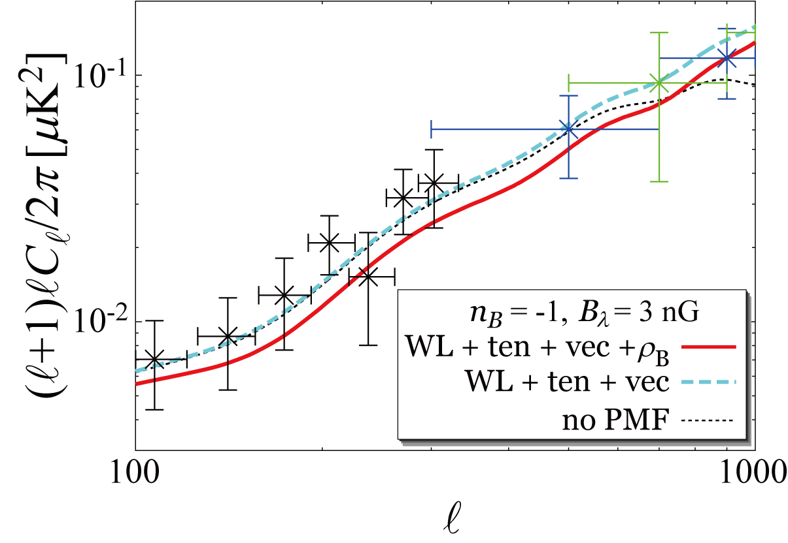

$ρ_{MF}$ + lensing + the perturbative PMF
BKP: Phys. Rev. Lett. 116, 031302, 2016
SPTpol: ApJ, 807, 151, (2015),
POLARBEAR: ApJ, 794, 171, (2014).
POLARBEAR
SPTpol
BKP
The background PMF changes the feature of the CMB B mode spectrum in wider range.

Slide 19
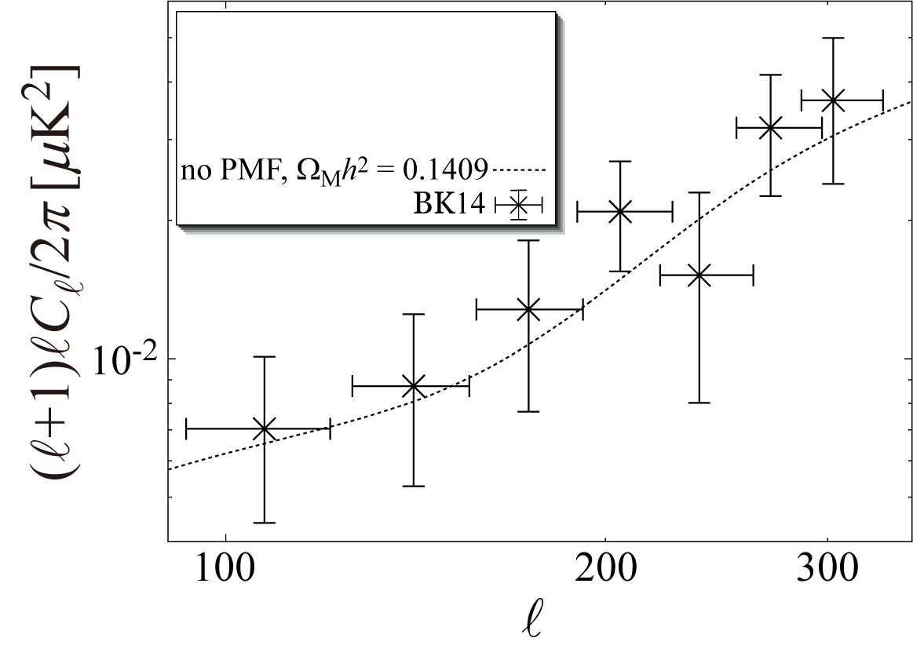
Degeneracy between PMF and matter density
BK14: Phys. Rev. Lett. 116, 031302, 2016
Parameters from Astron. & Astrophys. 594,
A13 (2016) (TT + lowP + lensing in the table 4)

Slide 20
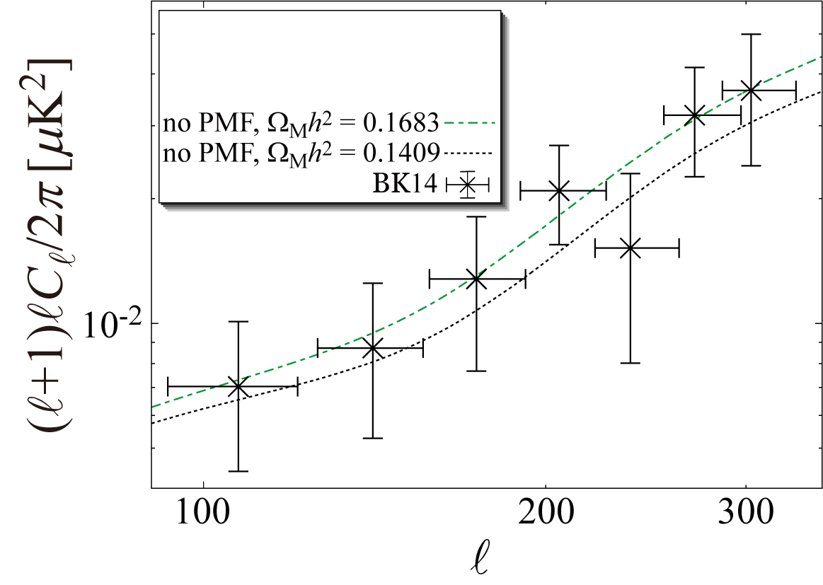
Degeneracy between PMF and matter density
BK14: Phys. Rev. Lett. 116, 031302, 2016
Parameters from Astron. & Astrophys. 594,
A13 (2016) (TT + lowP + lensing in the table 4)
The larger matter density induces increasing the CMB B mode from the WL effects

Slide 21
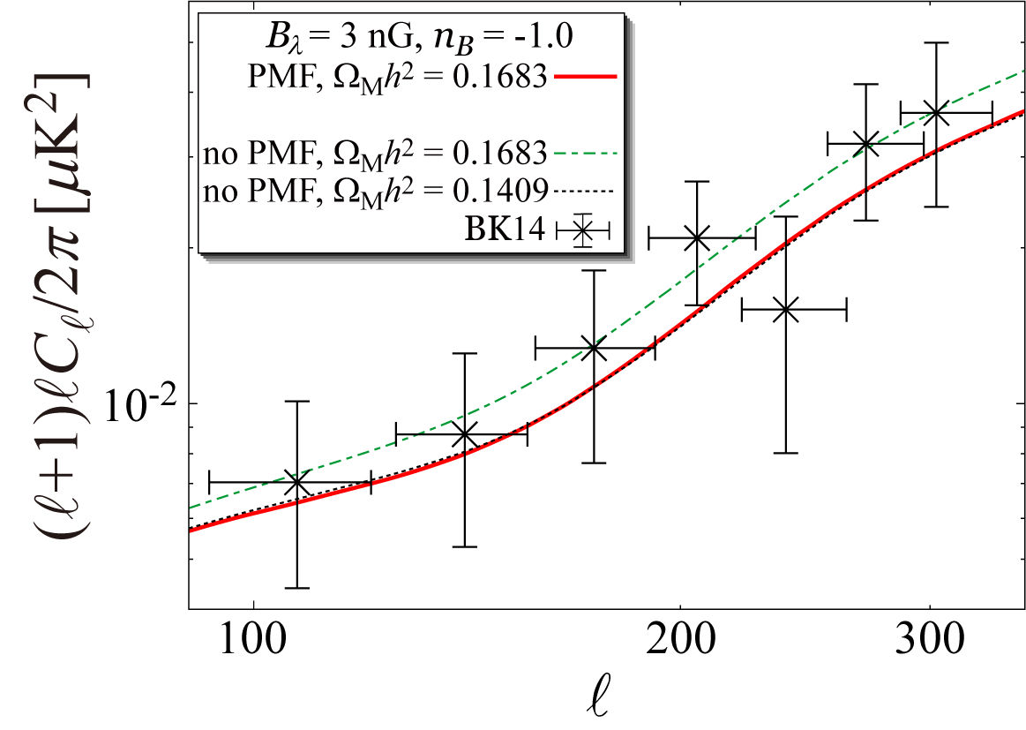
Degeneracy between PMF and matter density
BK14: Phys. Rev. Lett. 116, 031302, 2016
The affected CMB B mode by the PMF can be adjusted by changing the matter density parameter. We expect that there are a degeneracy the PMF and the matter density parameter.
Parameters from Astron. & Astrophys. 594,
A13 (2016) (TT + lowP + lensing in the table 4)

Slide 22
Summary
○The PMF energy density and the sound speed with the PMF affect the MPS
1. The background PMF effects suppress the MPS.
2. The effect of the weak lensing is suppressed by the background PMF.
3. The CMB B mode from the weak lensing is suppressed by the background PMF.
4. There is a degeneracy the PMF and the matter density parameter.

Slide 23
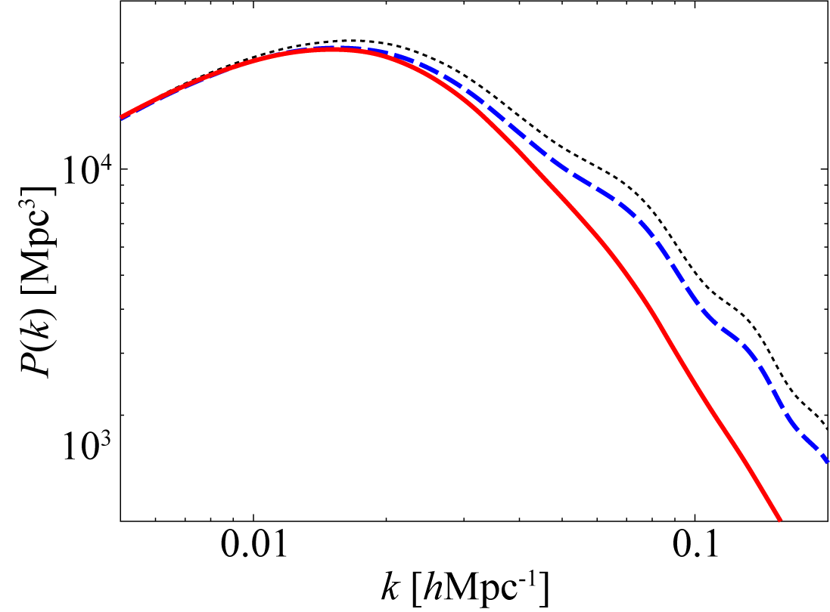
Peak is shifted by Meszaros effect
Damping from neutrinos
Damping from
Meszaros effect + Potential damping

Slide 24
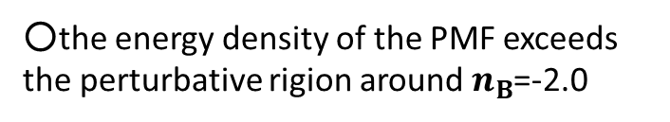
○the energy density of the PMF exceeds the perturbative rigion around $n_{B}$=-2.0
Constraint on the PMF from BBN
Yamazaki, et al. Phys. Rev. D 90, 023001(2014)
The enegy density of the PMF is too large to be negligible in this range.
Notes:
では、実際power law で分布を仮定した原初磁場のエネルギー密度はどうなるのでしょうか。それを示すとこのようになります。
Bl は1Mpcでの磁場の強度、nbは磁場のパワースペクトル、kmaxとkminはそれぞれ、磁場が生成したときの最大,最小wavenumberです。
この式からエネルギー密度を、0.1nG,1nG, 10nGごとに図示したのがこの図です。
縦軸は磁場のエネルギー密度を光子のエネルギー密度で割ったもので、横軸がnBです。
BBNからの制限はこの図の最上部になり、約0.2となります。
nB=-2.0 付近でnGオーダーの磁場のエネルギが摂動というには大きくなりすぎることがわかります。nB>0となるとBBNによる磁場のエネルギー密度の制限を超え始めます。
磁場による音速は磁場強度の自乗、つまり磁場のエネルギー密度に比例するため、結果的に音速と宇宙膨張に影響を与えます。
また、インフレーション起源の揺らぎとPMFが無相関の場合、宇宙背景放射揺らぎは、線形摂動では、次のように与えられます。
右辺第一項はインフレーション起源の揺らぎをソースとするもので、第二項は原初磁場をソースとしたものです。
過去の研究では、この第一項に磁場の影響を一切考慮していませんでした。
しかし、音速や宇宙膨張は0次の成分なので、原初磁場のエネルギー密度を正しく考慮した場合、C_{ℓ}(primary)と C_{ℓ}(PMF)の両方に効果が出る。

Slide 25
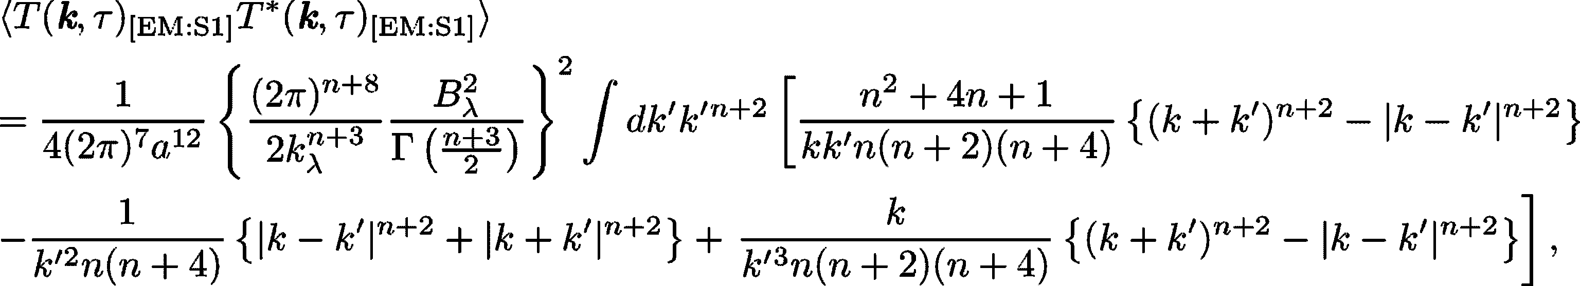
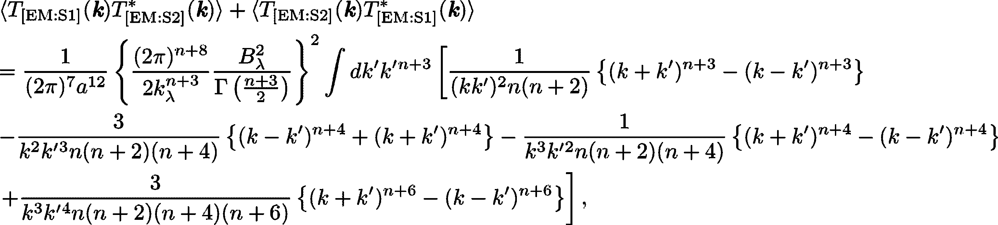
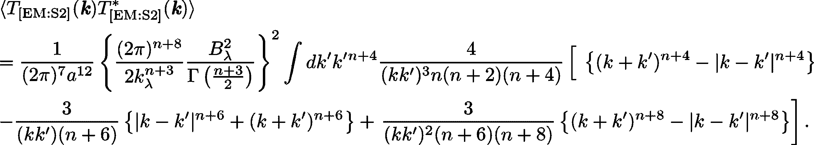
Power spectrum of the Lorentz force of the PMF
Pressure of the PMF
Correlation between Tension and Pressure of the PMF
-
-
-
Tension of the PMF

