Slide 1
New constraints on small-scale primordial magnetic fields from Magnetic Reheating
Shohei Saga (YITP, Kyoto University)
Based on: 1708.08225 (published in MNRAS Letters)
with Hiroyuki Tashiro (Nagoya U.) and Shuichiro Yokoyama (Rikkyo U.)
CosPA2017, Dec. 11 - Dec. 15, @Kyoto

Slide 2
Outline
  Introduction to PMFs
  Reheating of the CMB photon
  Magnetic Reheating
  Summary

Slide 3
Outline
  Introduction to PMFs
  Reheating of the CMB photon
  Magnetic Reheating
  Summary

Slide 4
1. Introduction to PMFs
Primordial Magnetic Fields(PMFs)
  generated by cosmological phenomena in the early universe (before recombination)
Why we consider PMFs?
  Observed (large-scale) magnetic fields
    Galaxy(~ kpc) ~ 10⁻⁵ - 10⁻⁶ Gauss
    Cluster(~ Mpc) ~ 10⁻⁶ Gauss
    Intergalactic(void) > 10⁻¹⁶ - 10⁻²¹ Gauss
  Setting seed fields in the early universe and amplifying
Cosmological constraint on PMFs
  CMB anisotropy
  CMB distortion
  Big Bang Nucleosynthesis (BBN)
Vachaspati’s talk
Notes:
First of all, I introduce the primordial magnetic fields of the definition, motivation, and constraints.
In the following sections, as a example, I present the constraints from CMB anisotropy and CMB distortion.

Slide 5
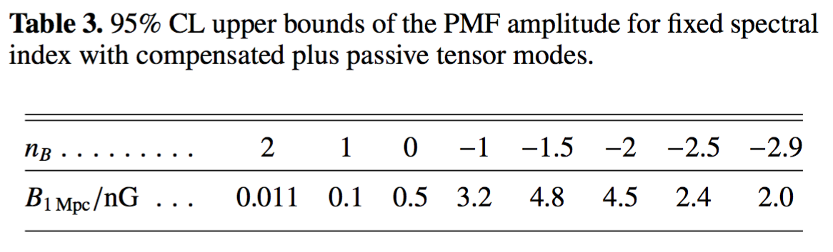
1.1 Example(1) CMB anisotropy
PMFs generate CMB temperature and polarization anisotropies.
A. Lewis [astro-ph/0406096]
n_{B} = -2.9
B_{1Mpc} = 4.5 nGauss
n_{B} = -2.9
B_{1Mpc} = 4.5 nGauss
Planck 2015 [1502.01549]
Notes:
Here, I show the effect of the primordial magnetic fields on the CMB anisotropies.
By using the current CMB observation from Planck, we can obtain the upper limit on the amplitude of PMFs.

Slide 6
1.2 Example(2) CMB distortion
J. Ganc and M. S. Sloth [1404.5957]
K. K. Kunze and E. Komatsu [1309.7994]
Double Compton era
Double Compton scattering
~ 2.0 × 10⁶
μ era
Chemical potential
Compton scattering
# of CMB photon fix
Bose-Einstein distribution
~ 4.0 × 10⁴
y-parameter
y era
Non-equilibrium state
z
Decaying of PMFs generates μ and y distortion
➔ From the observation of COBE, B < O(nG).
Notes:
Next, I briefly explain the CMB distortion.
I show the thermal history of the Universe.

Slide 7
1.3 Constraint on PMFs
In the cosmological observations,
n Gauss PMFs on Large Scale ( > Mpc)
PMFs on much smaller scales ?
Notes:
Summarizing the current upper limit of PMFs, by using the cosmological observation,
we put the constraint on the amplitude of PMFs about nano-Gauss on large scales, that is, larger than Mpc scales.
On the other hand, how about small-scale primordial magnetic fields?
This is our motivation.
And following section, I will show the new mechanism named “magnetic reheating”, which can constrain small-scale primordial magnetic fields.

Slide 8
Outline
  Introduction to PMFs
  Reheating of the CMB photon
  Magnetic Reheating
  Summary

Slide 9
2. Reheating of the CMB photon
Double Compton era
During the Double Compton era,
i.e., 2.0 × 10⁶ < 1 + z,
Compton scattering
Double Compton scattering
Planck distribution
Double Compton scattering is efficient.
  Thermal equilibrium
  Planck distribution
~ 2.0 × 10⁶
μ era
Compton scattering
# of CMB photon fix
Bose-Einstein distribution
An energy injection
increases # of CMB photons
while # of baryons does not change.
~ 4.0 × 10⁴
y era
Non-equilibrium state
z
The baryon-photon number ratio η decreases.
Notes:
I again show the thermal history of the Universe.
Magnetic reheating occurs before the mu era, that is, the double Compton era.
The baryon-photon ratio is constrained from two ways..

Slide 10
2.1 Baryon-photon ratio η
Baryon-photon ratio is determined independently by BBN and CMB.
R.H.Cyburt, B.D.Fields, and K.A.Olive [astro-ph/0503065]
η determines
  ➔ photon dissociation rate, reaction rate, and so on.
  ➔ abundance of light element generated in BBN era
BBN constrained value
K.M.Nollet and G.Steigman [1312.5725]
Notes:
Baryon-photon ration is determined independently by BBN and CMB observations.
In the BBN era, baryon-photon ratio determines…
Finally, we obtain the baryon-photon ratio at BBN era like this value.

Slide 11
2.2 Baryon-photon ratio η
Baryon-photon ratio is determined independently by BBN and CMB.
By CMB observations,
  Temperature of CMB photons: T_{CMB}
  Density of baryons: Ω_{b0}
We can directly determine η
CMB (after the onset of the μ-era) constrained value
Planck 2013 [1303.5076]
Notes:
Next, by using the CMB observation,
we obtain the temperature of CMB photons, …
Finally, we obtain the baryon-photon ratio after the onset of the mu-era,

Slide 12
2.3 Baryon-photon ratio η
Energy injection ⬄ increasing n_{γ} (“reheating”)
⬄ decreasing η
Δn_{γ}
Injected energy case
η
Standard
@BBN
@CMB
z
Notes:
By using two values of the baryon-photon ratio, we can give a constraint on the energy injection during the double Compton era.
The story is quite simple.
If there exist the energy injection during the double Compton era, it increases the number of photons, but the number of baryons does not change.
Therefore net effect is decreasing the baryon-photon ratio.

Slide 13
2.4 Baryon-photon ratio η
We assume increasing photon number density Δn_{γ},
Allowed energy injection in terms of photon’s energy density:
Arbitrary energy injection into the CMB photon:
Q_{in} = Diffusion of PMFs ➔ Magnetic Reheating
c.f., Q_{in} = Diffusion of density perturbations ➔ Acoustic Reheating
D.jeong, J.Pradler, J.Chluba, and M.Kamionkowski [1403.3697]
T.Nakama, T.Suyama, and J.Yokoyama [1403.5407]
Notes:
Here, we assume the additional energy injection, in other words, the change of number of CMB photons,
We focus on the ratio between the baryon-photon ratio at BBN and at CMB,

Slide 14
Outline
  Introduction to PMFs
  Reheating of the CMB photon
  Results: Magnetic Reheating
  Summary

Slide 15

3 Results: Magnetic Reheating
MHD mode analysis: Fast-magnetosonic mode
Slow-magnetosonic and Alfven modes
Spectrum of PMFs:
Reheating photon
k
Large scale ←
k_{D}
k^{A}_{D}
→ Small scale
Slow-magnetosonic and Alfven modes are sensitive to small-scale PMFs than the fast mode
Notes:
In the MHD mode analysis, there appear three modes, that is, fast mode, slow mode, and alfven mode.
In our case, the diffusion scale of fast mode is given like this.

Slide 16
3.1 Delta-function type

Slide 17
3.2 Power-law type
Scale-invariant

Slide 18
Outline
  Introduction to PMFs
  Reheating of the CMB photon
  Magnetic Reheating
  Summary

Slide 19
4. Summary
Magnetic Reheating is the novel mechanism to study small-scale PMFs.
In the case of power-law type spectrum,
bluer tilt is strongly constrained:
For example,
  B ≲ 10⁻¹⁷ nG for n_{B} = 1.0
  10⁻²³ nG for n_{B} = 2.0
  10⁻²⁹ nG for n_{B} = 3.0
⬄ Planck ~ O(1.0 nG) !!!

Slide 21
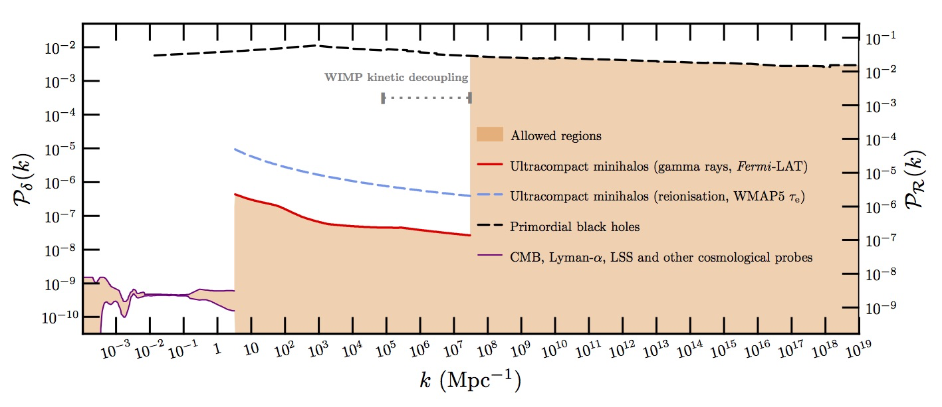
2.5 Acoustic Reheating
This limit can be rewritten in the amplitude of the primordial power spectrum:
Scale-invariant power spectrum gives negligible reheating.
T.Bringmann et al.[1110.2484]

Slide 22
2.6 Acoustic Reheating
Silk damping case:
➔ Large amplitude on small scales
T.Nakama, T.Suyama, and J.Yokoyama [1403.5407]
D.jeong, J.Pradler, J.Chluba, and M.Kamionkowski [1403.3697]
Q_{in} = Diffusion of PMFs ➔ Magnetic Reheating

Slide 23
3.2 Diffusion of PMFs
In the damping PMF case,
Injection energy due to PMFs is given as
Power spectrum:
c.f.) Silk damping
D.jeong, J.Pradler, J.Chluba, and M.Kamionkowski [1403.3697]
T.Nakama, T.Suyama, and J.Yokoyama [1403.5407]
Notes:
Next, as we know the diffusion scale of PMFs, we assign the Q_in as PMFs decaying.

Slide 24
3. Magnetic Reheating
PMFs lose their amplitude on small scales through the dissipation process due to the photon viscosity.
Solution of the MHD mode:
Oscillation
Diffusion
Diffusion of PMFs:
Diffusion scale is very small (~Silk scale) ➔ Small-scale PMFs
Notes:
Before moving the our main results, I briefly explain the decaying of primordial magnetic fields.

Slide 25
Blazer observation
Without MFs
EBL
CMB inverse Compton
TeV γ
e⁻e⁺
GeV γ
TeV γ
TeV Blazer
With MFs
EBL
CMB inverse Compton
MFs
TeV γ
GeV γ
TeV γ
TeV Blazer

