Slide 1
Multi T-Model Inflation
†
^{Ryota Tozuka}
with Kei-ichi Maeda, Shuntaro Mizuno
†
† †
†：Waseda U.
† †：Kyoto U., Yukawa Inst.

Slide 2
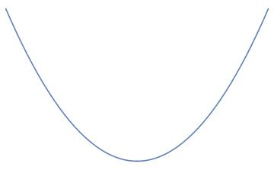
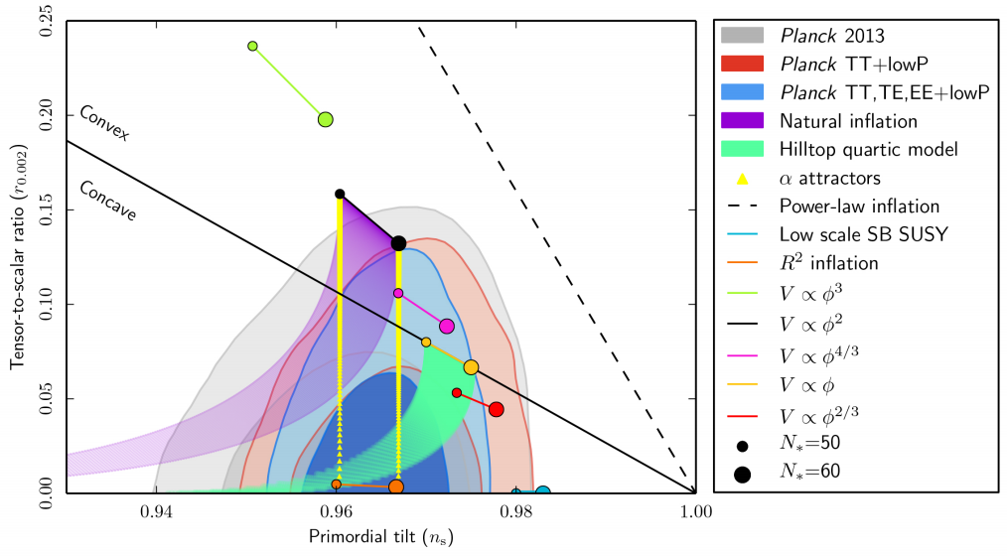
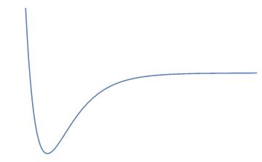
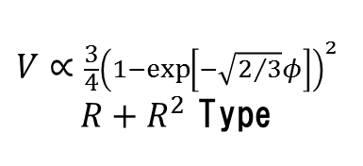

Introduction
Inflation（exponential expansion at the early universe）
Observation(CMB)⇒$n_{s},r,…$ ⇒Constrain to the Inflation model
$$V∝φ^{2}$$
r
$$V∝\frac{3}{4}{\left(1−\exp\left[−\sqrt{2/3}φ\right]\right)}^{2}$$
$R+R^{2}$ Type
ns

Slide 3


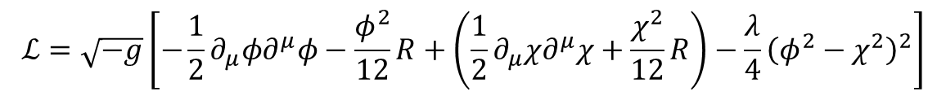
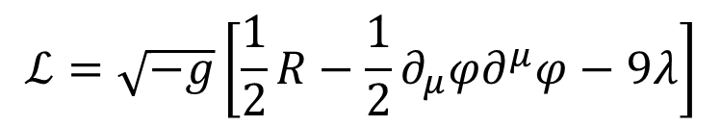


Inflation from spontaneously broken conformal symmetry （ Kallosh, Linde 2013)
Action（Conformal Symm.＋$SO\left(1,1\right)$Symm.）
$$\left(M_{pl}=1\right)$$
$$ℒ=\sqrt{−g}\left[−\frac{1}{2}∂_{μ}φ∂^{μ}φ−\frac{φ^{2}}{12}R+\left(\frac{1}{2}∂_{μ}χ∂^{μ}χ+\frac{χ^{2}}{12}R\right)−\frac{λ}{4}{\left(φ^{2}−χ^{2}\right)}^{2}\right]$$
$$φ=\sqrt{6}cosh\frac{φ}{\sqrt{6}}$$
$$χ=\sqrt{6}sinh\frac{φ}{\sqrt{6}}$$
＋Constraint（ghost free）
$$χ^{2}−φ^{2}=6$$
$$ℒ=\sqrt{−g}\left[\frac{1}{2}R−\frac{1}{2}∂_{μ}φ∂^{μ}φ−9λ\right]$$
Const. ⇒ de Sitter

Slide 4
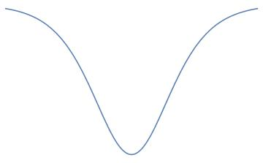
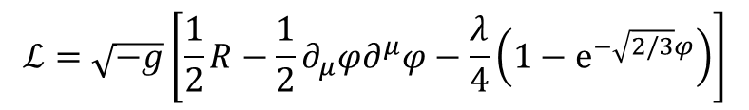

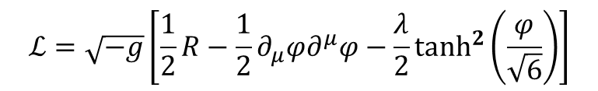


Inflation from spontaneously broken conformal symmetry （ Kallosh, Linde 2013)
Action（Conformal Symm.）
$$ℒ=\sqrt{−g}\left[−\frac{1}{2}∂_{μ}φ∂^{μ}φ−\frac{φ^{2}}{12}R+\left(\frac{1}{2}∂_{μ}χ∂^{μ}χ+\frac{χ^{2}}{12}R\right)−\frac{1}{36}F\left(\frac{φ}{χ}\right){\left(φ^{2}−χ^{2}\right)}^{2}\right]$$
$$φ=\sqrt{6}cosh\frac{φ}{\sqrt{6}}$$
$$χ=\sqrt{6}sinh\frac{φ}{\sqrt{6}}$$
＋Constraint（ghost free）
$$χ^{2}−φ^{2}=6$$
$$F=λ\frac{φ^{2}}{{\left(φ+χ\right)}^{2}}$$
$$ℒ=\sqrt{−g}\left[\frac{1}{2}R−\frac{1}{2}∂_{μ}φ∂^{μ}φ−\frac{λ}{4}\left(1−e^{−\sqrt{2/3}φ}\right)\right]$$
ex）
Starobinsky Type
$$F=\frac{λ}{2}{\left(\frac{φ}{χ}\right)}^{2}$$
$$ℒ=\sqrt{−g}\left[\frac{1}{2}R−\frac{1}{2}∂_{μ}φ∂^{μ}φ−\frac{λ}{2}\tanh^{2}\left(\frac{φ}{\sqrt{6}}\right)\right]$$
T Type
$$1−n_{s}=2/N, r=N^{2}/12$$

Slide 5





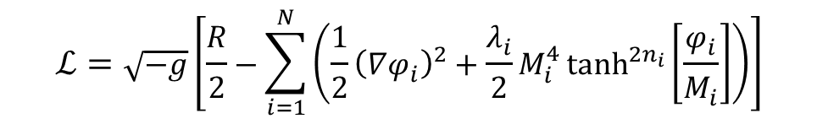

Multi T-Model Inflation
Action (Conformal Symm.)
$$ℒ=\sqrt{−g}\left[−\frac{1}{2}∂_{μ}φ_{i}∂^{μ}φ_{i}−\frac{φ_{i}^{2}}{12}R+\left(\frac{1}{2}∂_{μ}χ_{i}∂^{μ}χ_{i}+\frac{χ_{i}^{2}}{12}R\right)−\frac{1}{36}\frac{λ_{i}}{2}{\left(\frac{φ_{i}}{χ_{i}}\right)}^{2}{\left(φ_{i}^{2}−χ_{i}^{2}\right)}^{2}\right]$$
＋
Constraint（ghost free）
$φ_{i}^{2}−χ_{i}^{2}=M_{i}^{2}$
$$φ_{i}=\sqrt{M_{i}}cosh\frac{φ_{i}}{\sqrt{M_{i}}},χ_{i}=\sqrt{M_{i}}sinh\frac{φ_{i}}{\sqrt{M_{i}}}$$
Action
$$ℒ=\sqrt{−g}\left[\frac{R}{2}−\sum_{i=1}^{N}{\left(\frac{1}{2}{\left(∇φ_{i}\right)}^{2}+\frac{λ_{i}}{2}M_{i}^{4}\tanh^{2n_{i}}\left[\frac{φ_{i}}{M_{i}}\right]\right)}\right]$$
$$\sum_{i=1}^{N}{M_{i}^{2}}=6M_{pl}^{2}$$
co
Coefficient of R
$i→$large
$M_{i}→$small
$𝒪\left(M_{pl}\right)→𝒪\left(M_{GUT}\right)$??

Slide 6



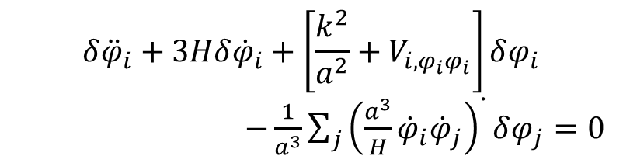
Metric （specially flat gauge）
$$ds^{2}=−\left(1−2A\right)dt^{2}+2aB_{,i}dx^{i}dt+a^{2}δ_{ij}dx^{i}dx^{j}$$
Inflaton：$φ_{i}→φ_{i}+δφ_{i}$
$A,B,δφ_{i}$ : perturbation (scalar)
＋
E.o.M.
Back Ground (BG)
Perturbation
$${\ddot{φ}}_{i}+3H{\dot{φ}}_{i}+V_{i,φ_{i}}=0$$
$$δ{\ddot{φ}}_{i}+3Hδ{\dot{φ}}_{i}+\left[\frac{k^{2}}{a^{2}}+V_{i,φ_{i}φ_{i}}\right]δφ_{i}$$
$−\frac{1}{a^{3}}\sum_{j}{{\left(\frac{a^{3}}{H}{\dot{φ}}_{i}{\dot{φ}}_{j}\right)}^{∙}}δφ_{j}=0$
（＋Freidman）
（＋linear Einstein Eq.）

Slide 7




The initial condition (Bunch-Davies Vacuum)
$$δφ_{i;0}\left(τ\right)=\frac{H_{∗}}{\sqrt{2k^{3}}}e^{−iθ_{i;0}}$$
For 2-field case
$$δφ_{1}=\frac{H_{∗}}{\sqrt{2k^{3}}}$$
$θ∈[0,2π)$ : Phase difference
$$δφ_{2}=\frac{H_{∗}}{\sqrt{2k^{3}}}e^{−iθ}$$
In some case, the dynamics is depend on the phase difference

Slide 8





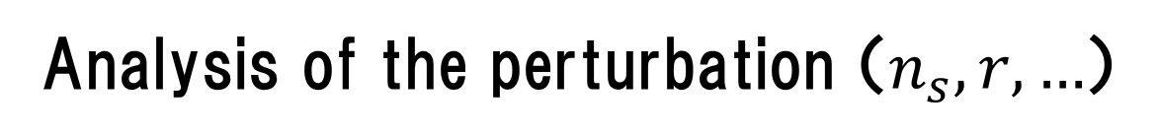


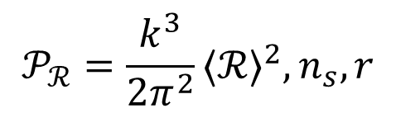



Analysis of the perturbation （$n_{s},r,…$）
Single-field⇒Adiabatic perturbation
Multi-field⇒ Adiabatic perturbation , Entropy perturbation
・redefinition of the perturbative fields :
(C Gordon, D Wands, BA Bassett, R Maartens,2000)
$$φ_{2}$$
$$δφ_{2}$$
$$ℛ≡\frac{H}{v_{σ}}δσ$$
perturbation
adiabatic ：
$$δs$$
entropy：
$$𝒮≡\frac{H}{v_{σ}}δs$$
$$δσ$$
BG trajectory
$$Θ$$
$$δφ_{1}$$
$$𝒫_{ℛ}=\frac{k^{3}}{2π^{2}}{⟨ℛ⟩}^{2},n_{s},r$$
$$φ_{1}$$
（$v_{σ}≡\sqrt{{\dot{φ}}_{1}^{2}+{\dot{φ}}_{2}^{2}}$）

Slide 9
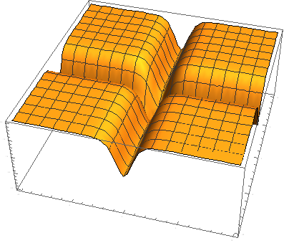
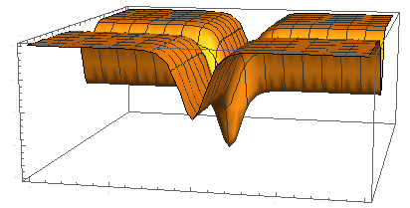

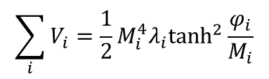
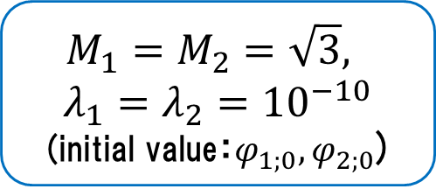
Example
“turn”
$$M_{1}=M_{2}=\sqrt{3},$$
$$λ_{1}=λ_{2}={10}^{−10}$$
(initial value：$φ_{1;0}, φ_{2;0}$)
$$\sum_{i}{V_{i}}=\frac{1}{2}M_{i}^{4}λ_{i}\tanh^{2}\frac{φ_{i}}{M_{i}}$$
We can classify the dynamics when the “turn” occurs:
1. $N≫60$ 2. $N∼60$ 3. $N<60$

Slide 10
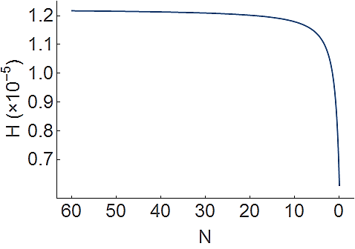


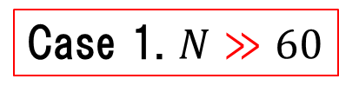

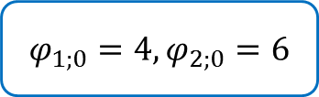
Case 1. $N≫60$
$$φ_{1;0}=4,φ_{2;0}=6$$
$$\left(φ_{1},φ_{2}\right)=\left(4,6\right)$$
$$N=60$$
$$N=0$$
Single-field like

Slide 11
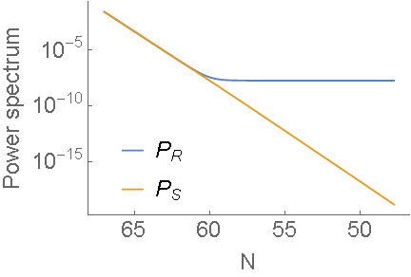
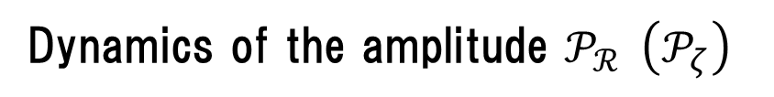

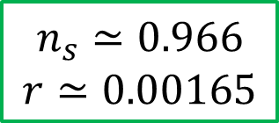
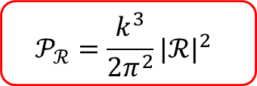
Case 1. $N≫60$
Dynamics of the amplitude $𝒫_{ℛ} \left(𝒫_{ζ}\right)$
（$k=aH|_{N=60}$）
$$𝒫_{ℛ}=\frac{k^{3}}{2π^{2}}{|ℛ|}^{2}$$
$$n_{s}≃0.966$$
$$r≃0.00165$$
○

Slide 12
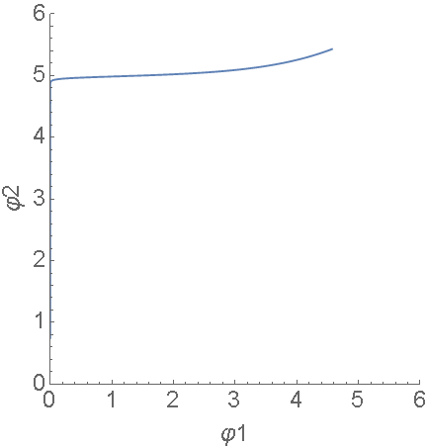
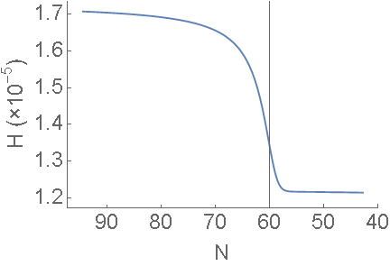
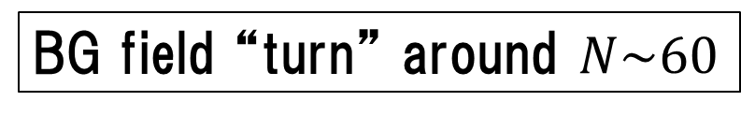



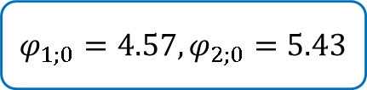
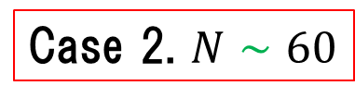
Case 2. $N∼60$
$$φ_{1;0}=4.57,φ_{2;0}=5.43$$
$$\left(φ_{1},φ_{2}\right)=\left(4.57,5.43\right)$$
$$N=60$$
$$N=0$$
BG field “turn” around $N\sim 60$

Slide 13
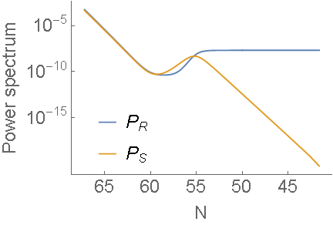
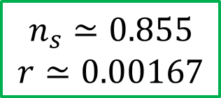

Case 2. $N∼60$
$$θ=0$$
$$n_{s}≃0.855$$
$$r≃0.00167$$
×

Slide 14
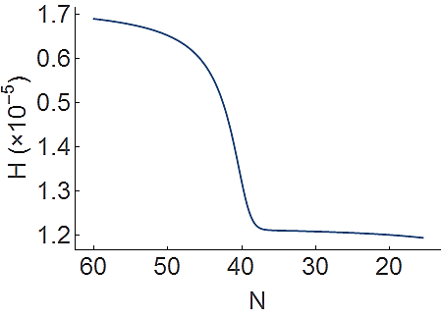


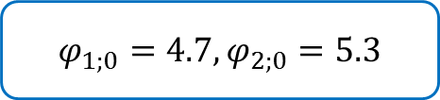
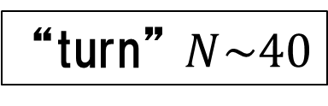
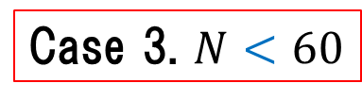

Case 3. $N<60$
$$φ_{1;0}=4.7,φ_{2;0}=5.3$$
$$\left(φ_{1},φ_{2}\right)=\left(4.7,5.3\right)$$
$$N=60$$
$$N=0$$
“turn” $N\sim 40$

Slide 15
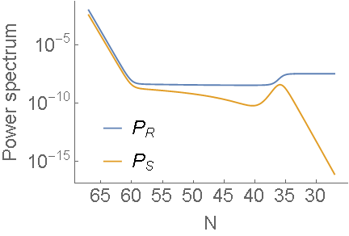
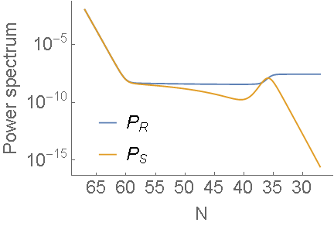
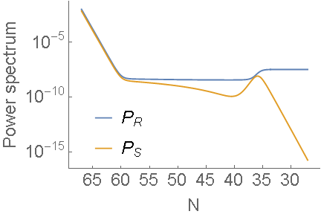
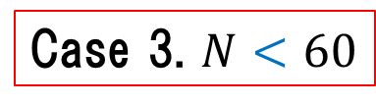
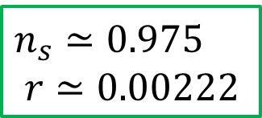



Case 3. $N<60$
$$θ=0$$
$$θ=\frac{π}{2}$$
$n_{s}≃0.$975
$$r≃0.00222$$
○
$$θ=\frac{π}{4}$$

Slide 16
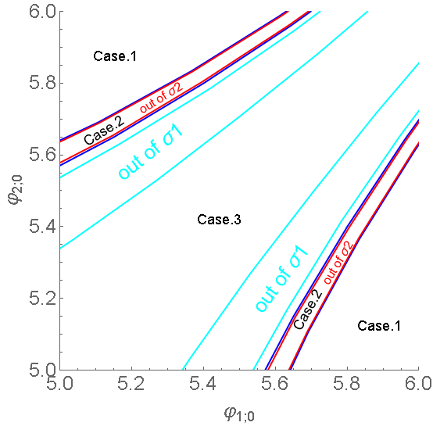




Result
Constraint of initial condition$φ_{1;0},φ_{2;0}$
Case 1.
“turn” at sub horizon
（single-field like）
Case 2.
“turn” around horizon crossing
Case 3.
“turn” at Super horizon
$n_{s}$ contour plot
Notes:
初期値6-6,10-10あたりを計算して入れる、ケースの図と重ねる

Slide 17


Conclusion
The dynamics is different when the “turn” occurs
Almost of all the case,
the entropy perturbation is generated at sub horizon
(single-field like)
$$\sum_{i}{V_{i}}=\frac{1}{2}M_{i}^{4}λ_{i}\tanh^{2}\frac{φ_{i}}{M_{i}}$$
Try the different parameter （$M_{i},λ_{i}$）⇒constraint the model
Calculate more than 3-field
$$\sum_{i=1}^{N}{M_{i}^{2}}=6M_{pl}^{2}$$
In progress…
Notes:
Ｎ無限大の今後の展望入れる

