Slide 1
Planck constraints on the non-flat ΛCDM inflation model
Junpei Ooba¹
, Bharat Ratra², Naoshi Sugiyama¹
¹Nagoya University, ²Kansas State University
arXiv:1707.03452

Slide 2
Contents
Introduction
Non-flat inflation model
Result
Summary

Slide 3
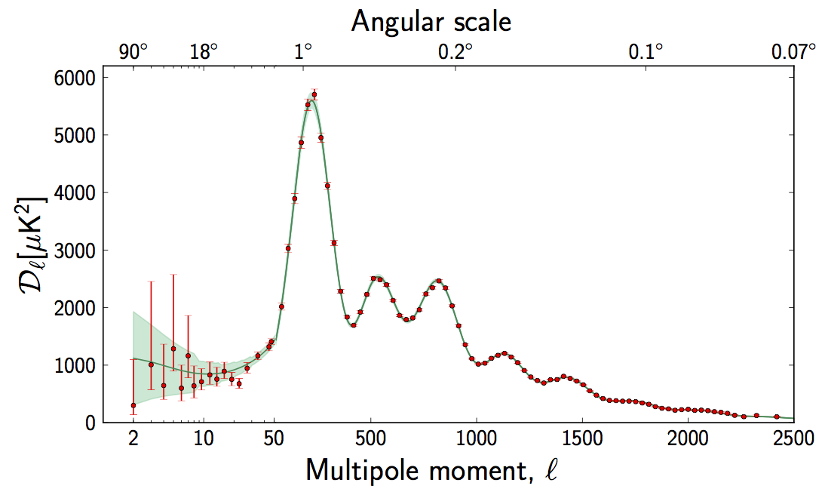
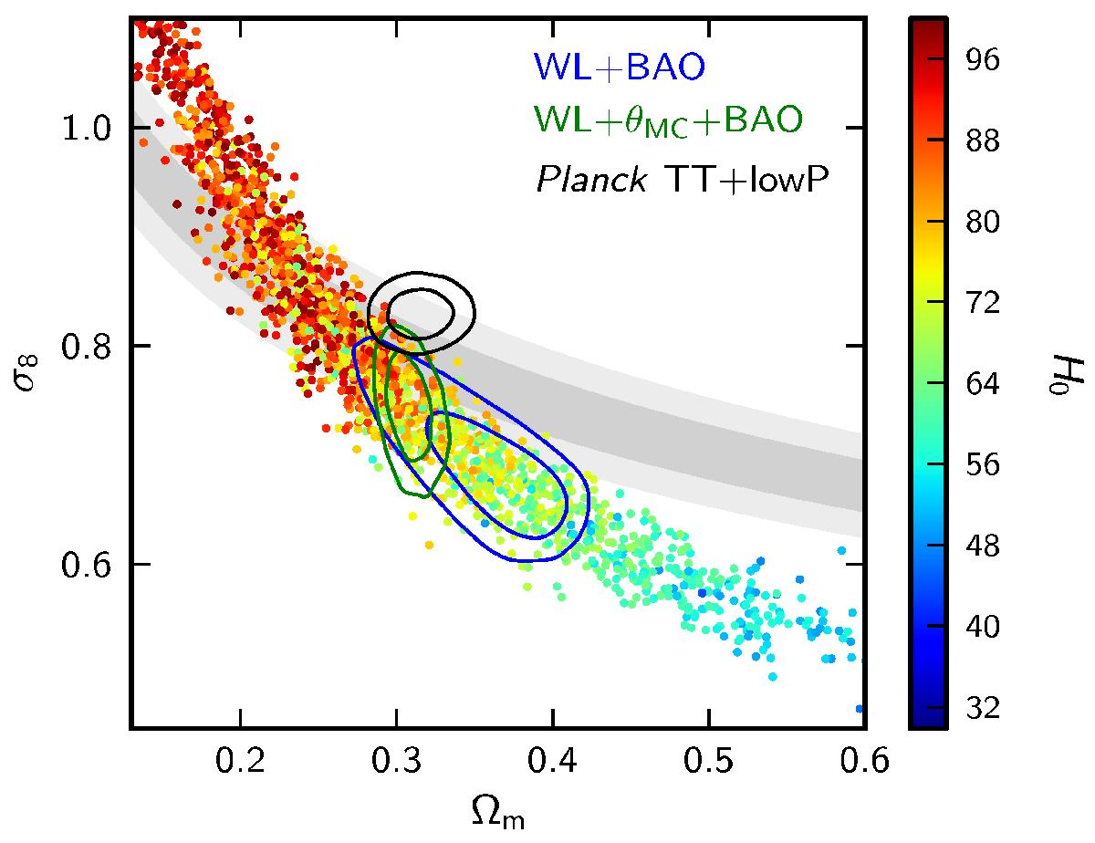
Introduction
Planck mission put strong constraint on the cosmological parameters.
Flat ΛCDM model is very consistent.
However there are some deviations.
  low-l power of C_{l}
  higher σ₈ value than weak lensing observation
These deviations might be a possibility of extended theory.
ESA
Planck 2015 results. XIII.

Slide 4
Non-flat inflation model
Angular power spectra are written as
  Here, and .
Using following equations,
The density power spectrum in the slow-roll limit
Hu & White (1997)
Hu+ (1998)
Lyth & Stewart (1990)
Ratra & Peebles (1995)
Ratra (2017)

Slide 5
Non-flat inflation model
This is a generalization of the flat-space scale invariant spectrum.
On large scales, the fractional energy density inhomogeneity power spectrum for the best-fit closed ΛCDM model is suppressed relative to that of flat ΛCDM model.
Open case, q runs from 0 to ∞.
Closed case, q/sqrt(K) runs 3, 4, 5, … .
  It takes discrete values because the universe is spatially closed.
Lyth & Woszczyna (1995)
Zaldarriaga+ (1998)

Slide 6
Result
CLASS (class-code.net)
  To compute the fluctuations in the CMB.
Monte python (montepython.net)
  To analyze data by using the Markov chain Monte Carlo (MCMC) method.
Data
  Planck 2015: TT, lowP, lensing
  BAO: 6dF, BOSS (LOWZ and CMASS), SDSS

Slide 7
Result
We found that non-flat models fit the low-l C_{l} measurements better than the flat case.
When CMB lensing is included, we found that our non-flat model weakens the tension in the σ₈–Ω_{m} constraint.
  lower σ₈ values are preferred.
The spatial curvature density parameter is constrained as,

Slide 8
Result
Including the BAO data does somewhat degrade the fit in the low-l region.
Including the BAO data also worsen the tension in the σ₈–Ω_{m} constraint.
The spatial curvature density parameter is constrained as,
This case is about 4 σ away from flat.

Slide 9
Result

Slide 10
Summary
arXiv:1707.03452
We study the non-flat inflation model which realize a reduced power in the large scale region of the density power spectrum.
This model is interesting and might be useful for the tensions in the current CMB observation.
  low-l C_{l} deficit, weak lensing σ₈
Ongoing works
  non-flat XCDM, φCDM models

