Slide 1

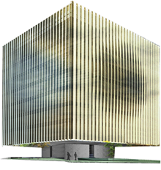
Generic features of Kinetically Driven INflation
Rio Saitou (HUST, China → LeCosPA, NTU)
CosPA 2017 @ YITP, Kyoto University
2017/12/12
Based on arXiv:1710.04941

Slide 2
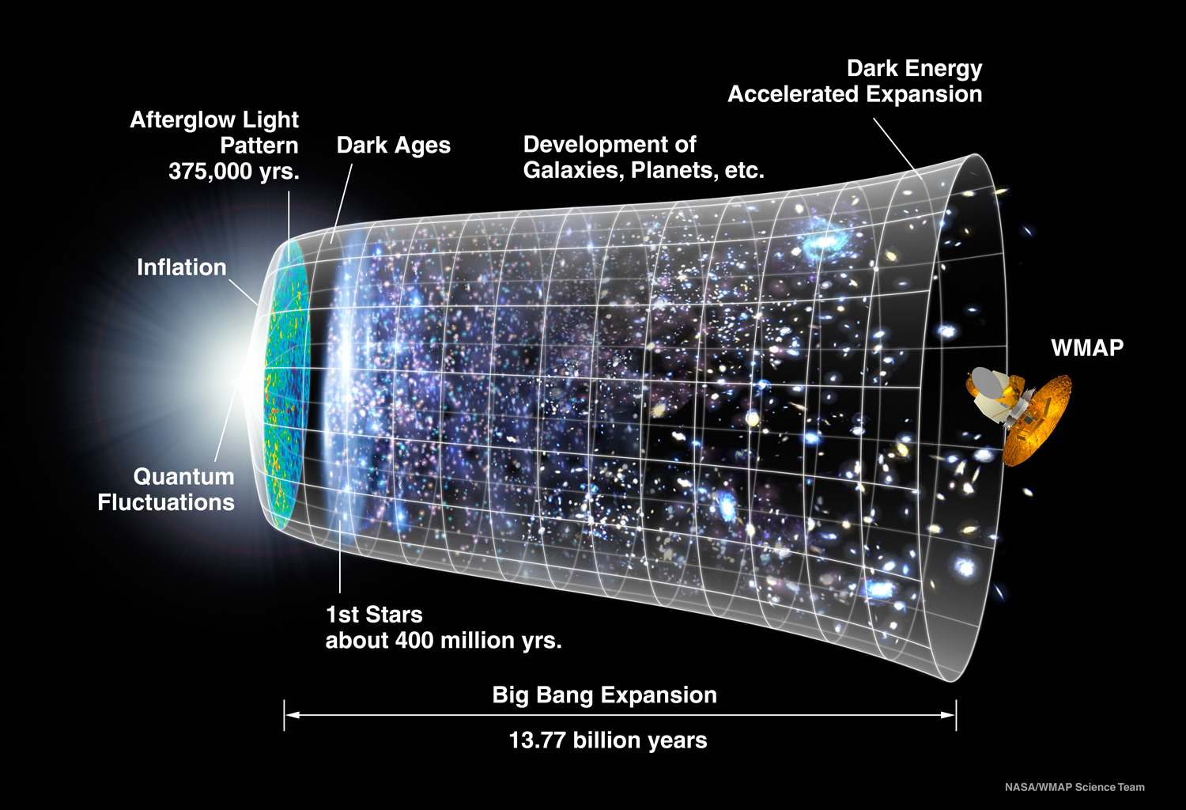
Inflation
A solution for the 3 problems of Big Bang by accelerating the early universe
The quantum fluctuation created in the inflationary era provides the seed of the large scale structure
Graceful exit + reheating

Slide 3
Classes of inflation
V(Φ)
Kinetic terms
Slow-roll inflation
k-inflation
Ultra slow-roll inflation
Higgs G-inflation
Hybrid
G-inflation
…
…
Ghost inflation
Galileon inflation
…

Slide 4
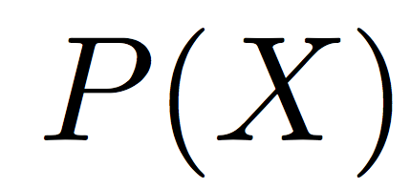

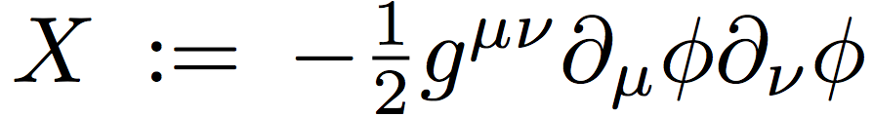
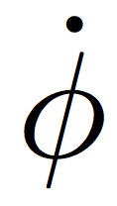
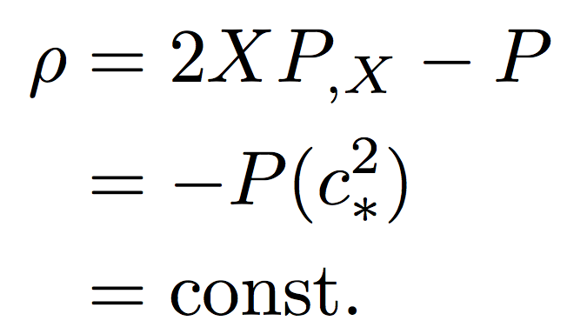
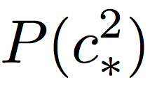
Schematic of the typical Kinetically driven inflation
Non unitary region
Inflationary attractor
(critical point)
Vacuum energy × (-1)
Notes:
the form of action like this
non canonical kinetic terms make a attractor of the time evolution.
this kinetic energy plays a role of vacuum energy.

Slide 5
KDI
No unified formulation for KDI ever (as long as I know).
Research object
To develop a model-independent formulation for evaluating the whole behavior of KDI systematically.
k-inflation
Armendariz-Picon et al. PLB458 (1999) 209-218
G-inflation
Kobayashi et al. PRL105 (2010) 231302
…
Ghost inflation
Galileon inflation
…
Arkani-Hamed et al. JCAP0404 (2004) 001
Burrage et al. JCAP1101 (2011) 014
Notes:
In this talk, I’d like to consider the whole kinetically driven class of inflation.
But, so far, as long as I know, there’s no unified…
Thus, I will construct a unified formulation…

Slide 6
Introduction
Model-independent formulation of KDI
Case I: Shift symmetric KDI
Case II: Φ-dependent KDI
Summary

Slide 7
2. Model-independent formulation of KDI

Slide 8
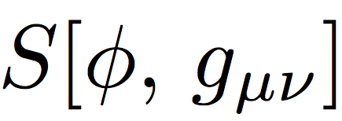

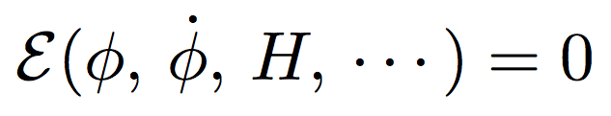

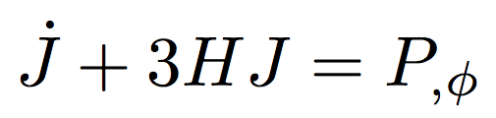
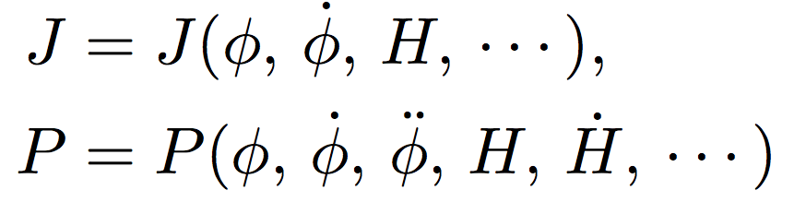
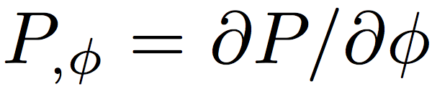
A model-independent form of equations of motion
2+1 scalar-tensor theory:
flat FRW metric :
Equations of motion
~ Friedmann equation
~ Klein-Gordon equation
Notes:
These generic EoMs include those of previous models, for example, Horndeski theory and Ghost inflation.

Slide 9

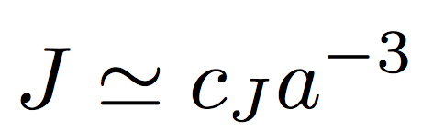
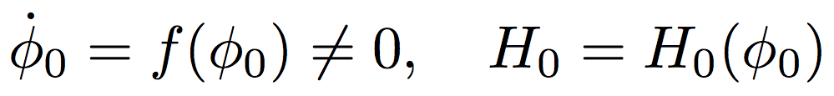
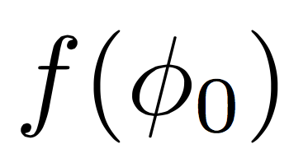
Inflationary attractor of KDI
If H0 varies sufficiently slowly with respect to Φ0, the root solution becomes a quasi-de Sitter attractor.
If ,
A root solution for
,
Inflationary attractor of KDI

Slide 10


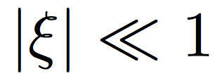
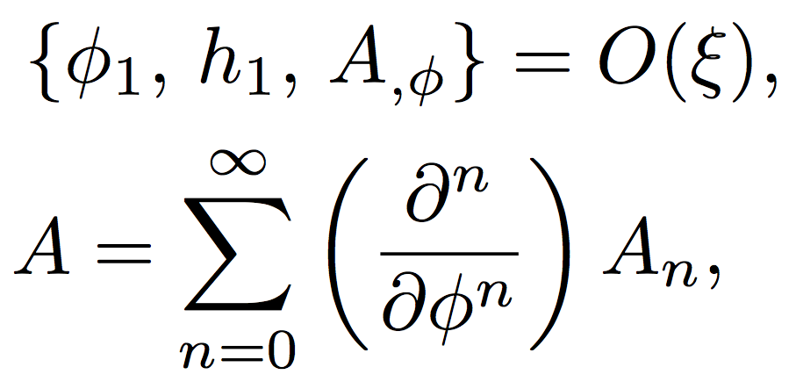

Next-to-leading solution and an Ansatz
Consider perturbations of background
Split motions to the KDI attractor and the perturbations
Ansatz for all of the derivative w.r.t. Φ (not only for P,Φ)
{An} : Arbitrary functions of backgrounds w/o
Notes:
ANSATZと摂動展開をしっかり説明

Slide 11
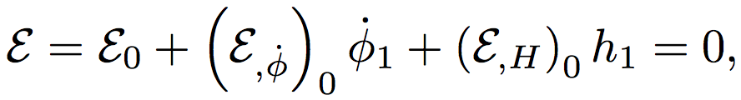
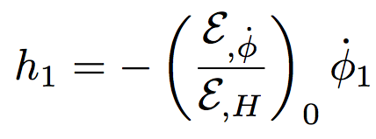
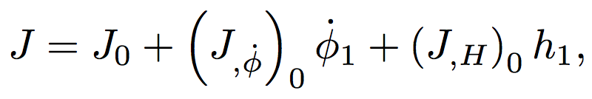
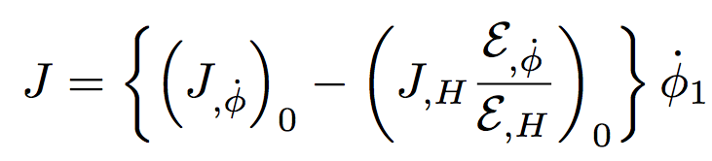
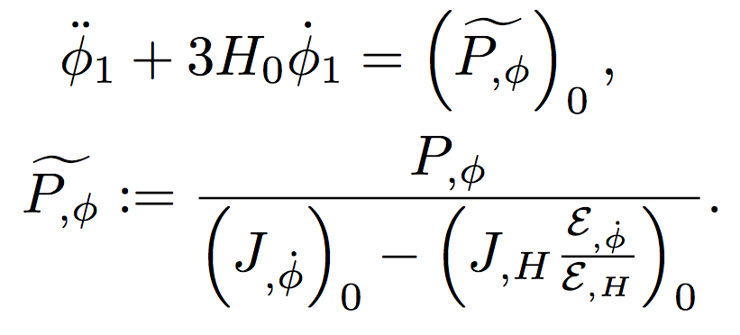
Equations of motion up to O(ξ)
The constraint equation
The field equation for Φ1

Slide 12
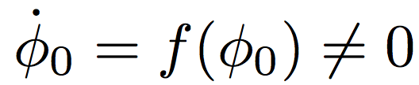
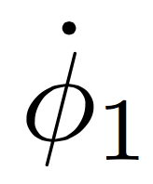
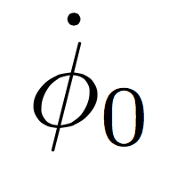
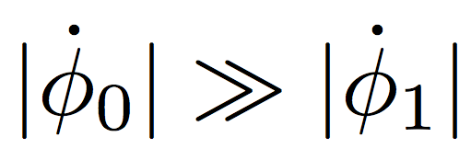
Validity of the perturbative solution
The evolution of KDI attractor is characterized by not the field value but the field velocity (or the functional form of f): .
Perturbative expansion
Notes:
field velocity が leadingから大きくずれると、摂動解が使えんクなる
field valueはinitial conditionをleadingとsubで適当に定義しとけば、いつでもΦ１を小さくできる

Slide 13
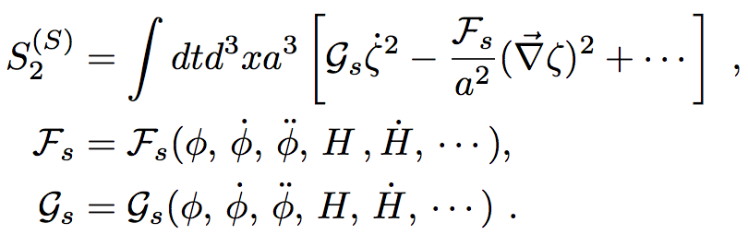
2nd order action of the scalar fluctuation
We assume the form of the 2nd order action of scalar mode of quantum fluctuation as
ζ may be regarded as the curvature perturbation, for example.
Ghost inflation
Scalar fluctuation with a usual scaling. ex.) Horndeski theory

Slide 14
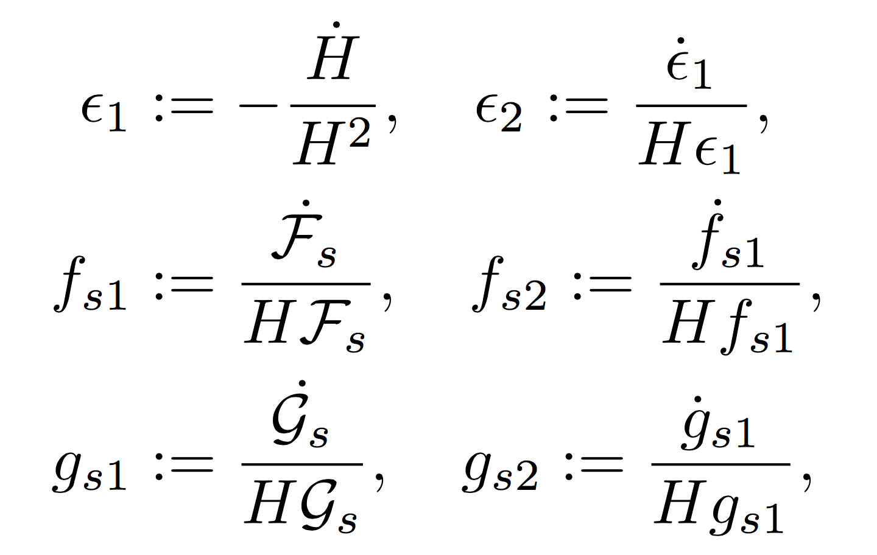
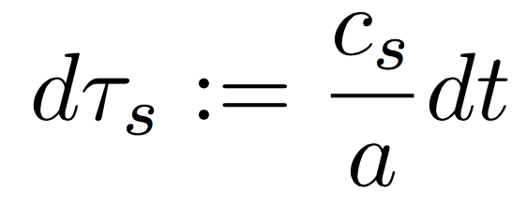
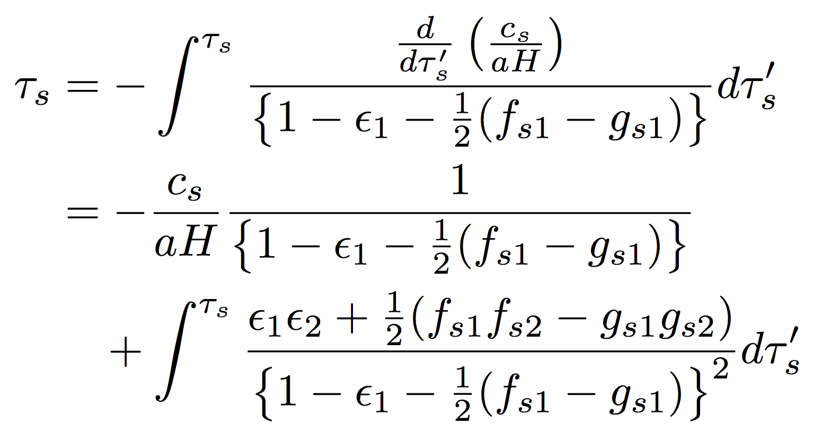
Approximation to the conformal time
Def.) slow-roll parameters and the conformal time
Integration of dτs and the approximation we employ:
Notes:
τの近似をちゃんと明言しておく。

Slide 15
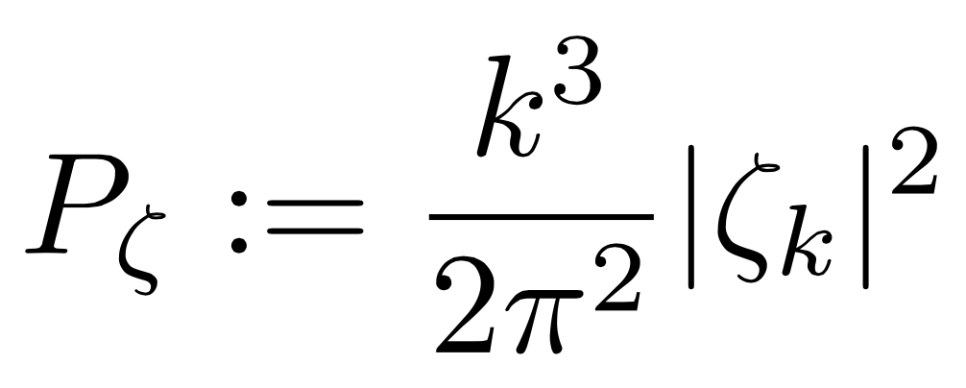
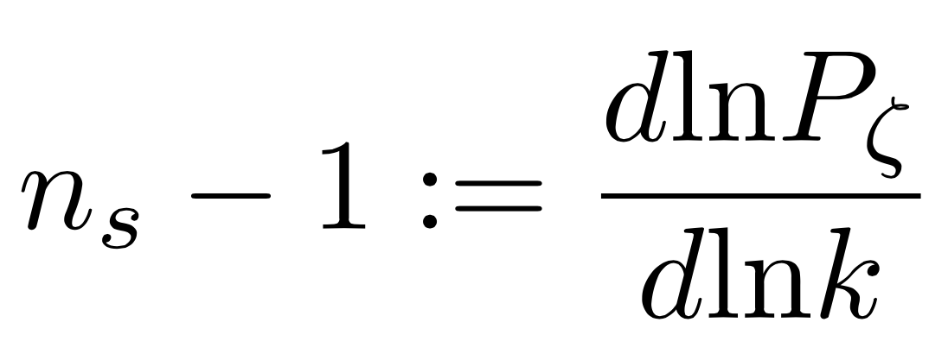
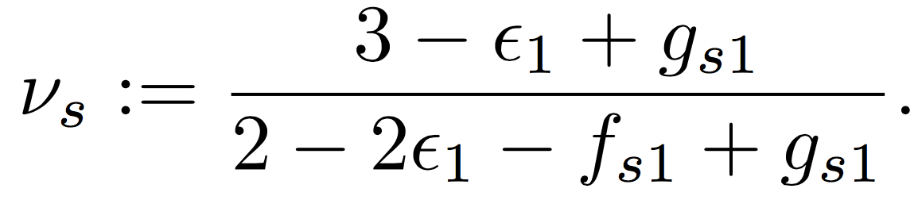
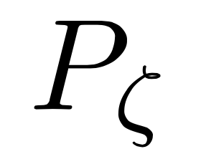
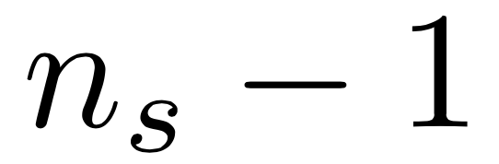

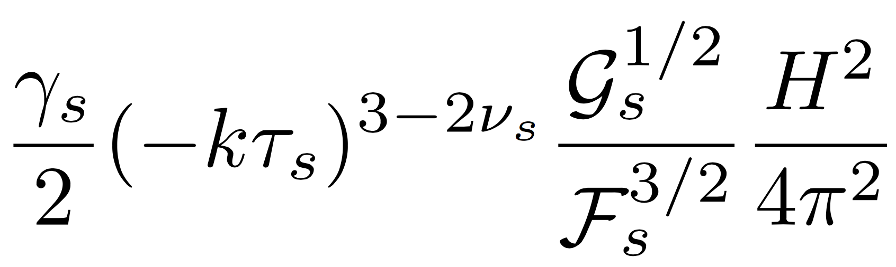
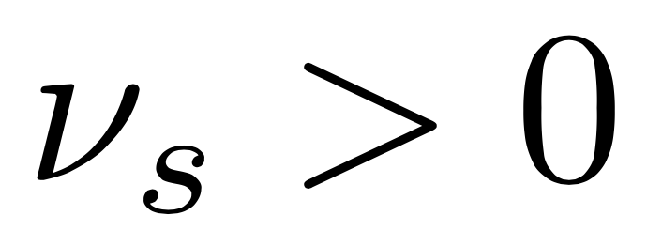
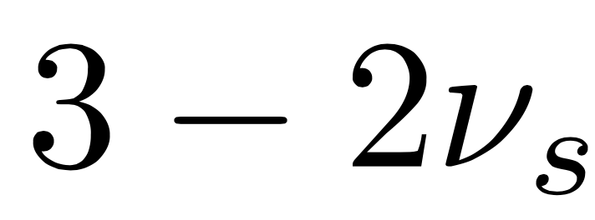
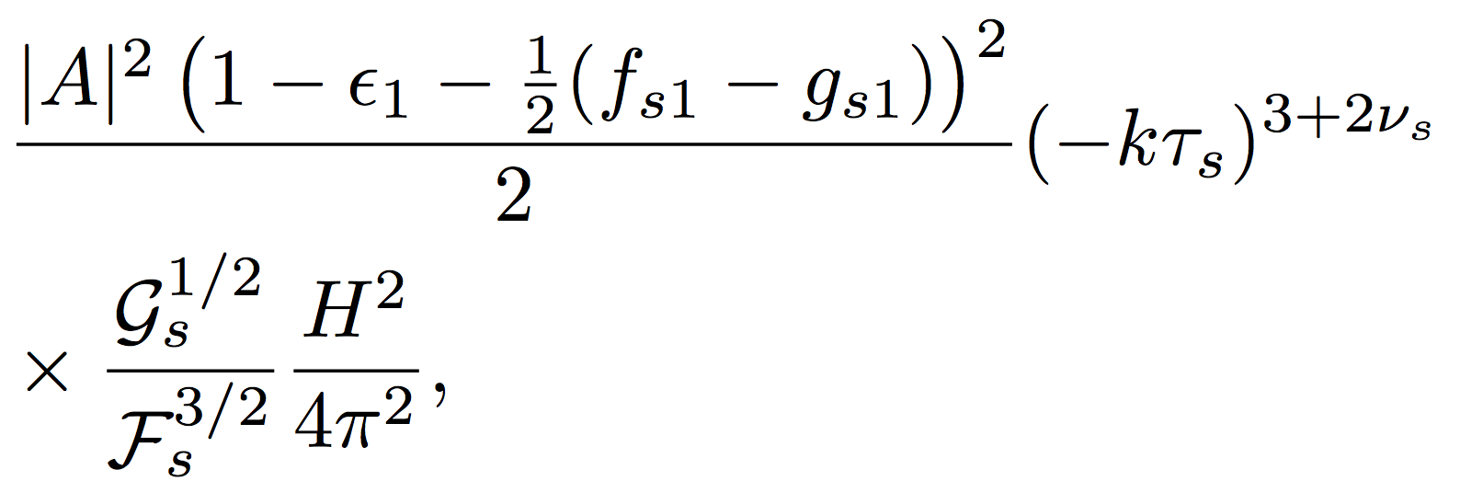
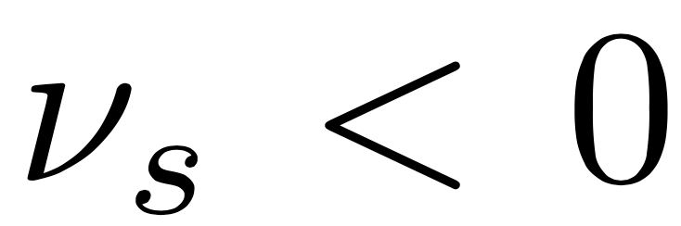
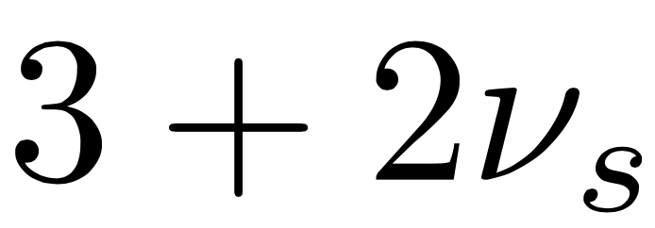
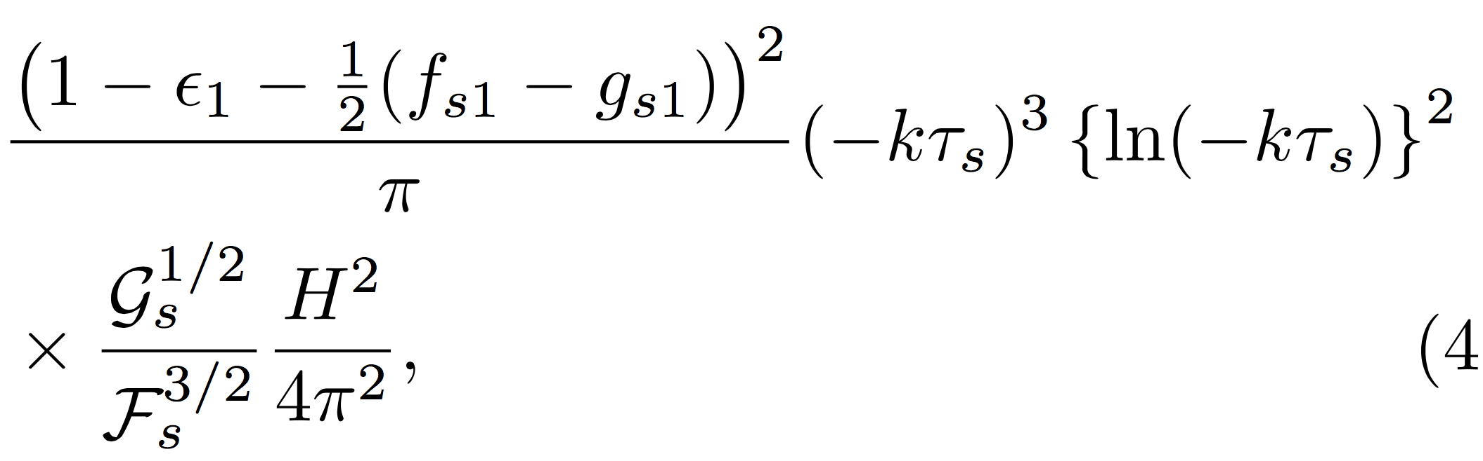
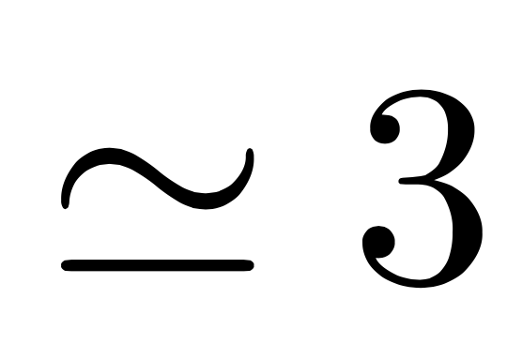
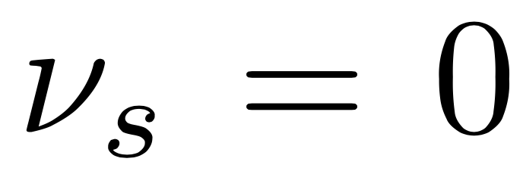
Spectrum and spectral index for the superhorizon modes
const.
growing
growing

Slide 16
3. Case I: Shift symmetric KDI

Slide 17
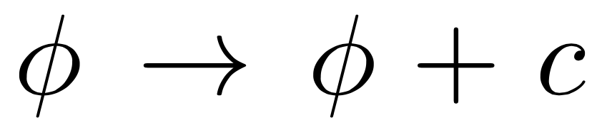

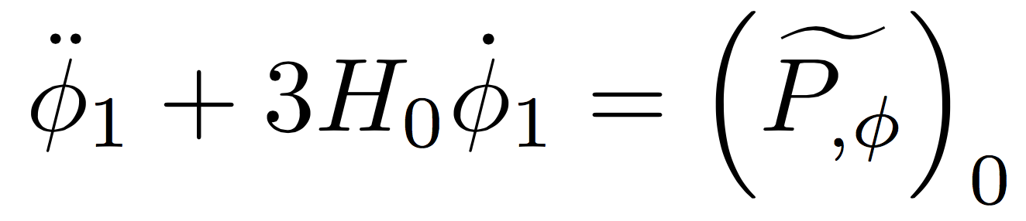
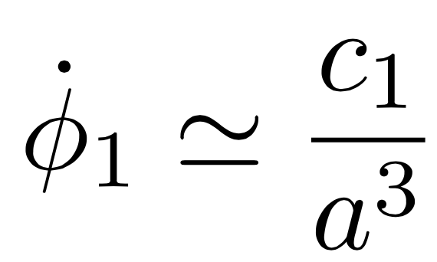


Background evolution of shift symmetric system
Shift symmetry of the scalar field
KDI attractor of shift symmetric system
Perturbation of background
= 0 exactly.
~ Ultra slow-roll motion around KDI attractor

Slide 18
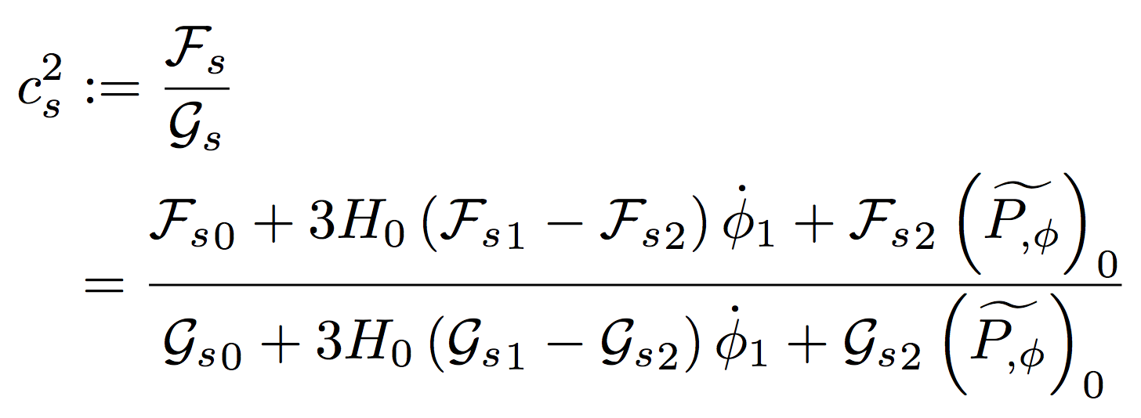
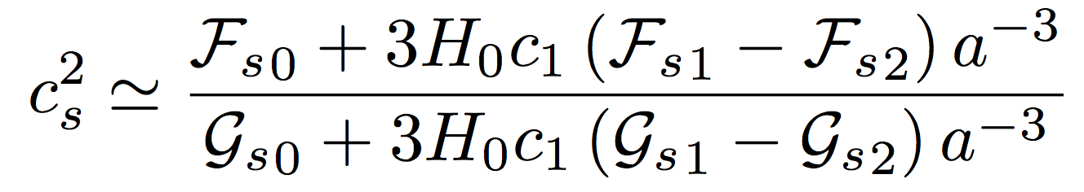
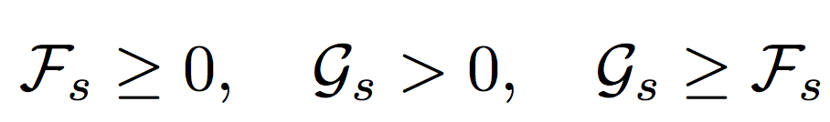




Classification by speed of sound
Speed of sound for the shift symmetric system
3 types satisfied with the stability condition

Slide 19


Second order products of slow-roll parameters
For the type (i) theories,
The conformal time
Notes:
τの近似から得られる帰結をきちんと述べる

Slide 20


Sum of the shift symmetric KDI
The shift symmetric system within our generic framework cannot create the red spectrum.
→ We need to introduce other sources for the scalar
fluctuation, or, break the shift symmetry to create the
spectral tilt consistent to the observational value
^{ns-1~ -0.04.}
Type (i)
3/2
0
scale-invariant
const.
Type (ii)
3/5
9/5
Blue
const.
Type (iii)
0
Blue
growing
Others
Unstable

Slide 21
4. Case II: Φ-dependent KDI

Slide 22



Background evolution of Φ-dependent system
KDI attractor and EoM
If ,
~Slow-roll motion around KDI attractor

Slide 23





3 conditions for slow-roll like motion
“Slow-roll” condition for Φ1:
Leading >> sub-leading:
Quasi-de Sitter attractor

Slide 24



A condition for the graceful exit
THE END OF INFLATION:
To end up with the graceful exit, we have to tune H0 as
inflating the universe enough
changing its value rapidly and stopping the acceleration
escaping from the KDI attractor
&
Continuation of the condition
Inflation
Graceful exit

Slide 25

Other constraints
Stability condition
Conditions for ignoring the second order products of slow-roll parameters
Observational constraints to ns, r, fNL etc.
Highly model-dependent
We could satisfy all of the constraints by tuning the Φ-dependent functions
in the action

Slide 26




Sum of Φ-dependent KDI
Requirements Equations Conditions up to O(ξ)
1.Slow-roll condition
for Φ1
Eventually, all of the conditions become the constraints to the Φ-dependent functions in the models ☺
2. KDI attractor
>> perturbation
3. Quasi-de Sitter expansion
4. Graceful exit
& its continuation
at late time
Others
Highly model-dependent

Slide 27
5. Summary
We have performed a model-independent analysis of KDI within a generic framework, which includes many of previous models.
The shift symmetric KDI is described as the perturbation behaves as ultra slow-roll inflation around the exact de Sitter attractor, but the shift symmetric models cannot create the observed quantum fluctuation.
The Φ-dependent KDI is described as the perturbation “slow-rolls” around the quasi-de Sitter attractor. They take 4 essential conditions to inflate the universe and end in the graceful exit. We could construct viable models by tuning the Φ-dependent functions in the models.

