Slide 1
Some new results on NG in single-field Inflation
and
on anisotropic features
Nicola Bartolo
Dipartimento di Fisica Galileo Galilei, Padova, Italy
COSMO/COSPA 2010, Tokyo 27 September-1 October 2010

Slide 2
Plan of the talk
Report on recent results on two issues
NG in generic single-field inflation models from new interaction terms
using the Effective Field Theory approach to inflationary perturbations
N.B., M. Fasiello, S. Matarrese and A. Riotto, JCAP08, 008 (2010)
N.B., M. Fasiello, S. Matarrese and A. Riotto, to appear in JCAP
Statistical Anisotropy and NG
N.B., E. Dimastrogiovanni , S. Matarrese and A. Riotto JCAP 0910, 015 (2009)
JCAP 0911, 028 (2009)
E. Dimastrogiovanni, N.B., S. Matarrese and A. Riotto arXiv:1001.4049, review for Advances in Astronomy
N.B., E. Dimastrogiovanni , M. Liguori, S. Matarrese and Riotto, in preparation.
Notes:
- O e` meglio stressare, anche altrove, come nelle conclusioni, che e ` in qualche modo l’analisi piou` generica che e` stata fatta?

Slide 3
Effective Field Theory Approach (EFT) to inflationary
perturbations (a very short summary)
See: Creminelli et al 2006; Cheung et al. 2008; Weinberg 2008.
The standard approach: start from a Lagrangian for the inflaton φ(t,x) and study the
perturbations around the homegeneous inflationary background φ₀(t)
EFT Approach: build the most general Lagrangian of inflationary perturbations
around a given inflationary background
The procedure:
φ(t,x) is a natural ``clock’’ that provides a priviliged spatial slicing (time diff. broken)
Choose a comoving (unitary) gauge: φ(t,x)=φ₀(t)
the scalar fluctuation δφ has been absorbed by the metric perturbations
(similar to what happens in a spontaneously broken gauge theory)
2. Build the Lagrangian allowing any term that respects spatial diff. :
g⁰⁰; extrinsic curvature of surfaces at constant time K^{μ}_{ν}

Slide 4
EFT Approach to inflationary perturbations II (a very short
summary)
Fixed by the the background H(t)
The action
The other operators are free and parametrize all the theories of perturbations with
the same background
Make explicit the scalar degree of freedom: restore diff. invariance by t t+ξ₀(t,x)
promote ξ₀(t,x) to a field π(t,x) which describes scalar fluctuations around FRW
4. Simplification: decoupling regime. At enough high energies the mixing with gravity
can be neglected: E~H>> E_{mix}: just focus on π
Notes:
- Su decouling: importante dire

Slide 5
The Action up to third-order from the EFT expansion
N.B., Fasiello, Matarrese, Riotto 09
✓ Known cases: 1. all the M,M=0 ➔ standard slow-roll inflation (c_{s}=1)
2. M₂, M₃ ≠ 0 ➔ c_{s}< 1 Inflation (DBI);
3. de Sitter limit (H=const) & M₂, M₃≠ 0 ➔ Ghost Inflation
The Ms characterize curvature-generated interactions (from extrinsic curvature of
constant time surfaces K^{μ}_{ν}, as M²₆(g⁰⁰+1) δK^{μ}_{ν} δK^{ν}_{μ})
Most of them not discussed so far.
Notes:
Tenere il termine con M_PL; rimettere il background?
forse dire che quelli nuovi sono tutti quelli M_{i}, con i>3?

Slide 6
Solutions for the linear fluctuations
We have found a completely general solution that interpolates between known cases
like DBI and Ghost inflation
✓
(N.B, Fasiello, Matarrese & Riotto 10;
see also Senatore 05;)
The α₀ and β₀ parameters generalize the sound speed c²_{s}:
N.B.: DBI-like inflation corresponds to β₀=M₁=0 ➔ α₀=c²_{s} < 1
Ghost inflation corresponds to α₀=0 (H=const. & M₁=0)
Notes:
Mettere Ref. di Senatore?
per la prima frase ricordarsi di dire che cosa significa in termini dei termini cinetici, nella slide precedente e/o eventualmente accennare a relazione di dispersione.

Slide 7
Solutions for the linear fluctuations
Integration constants fixed to recover standard and ghost inflation
In the asymptotic limit τ 0

Slide 8
Analysis of the Bispectra (I)
Amplitude
Shape
Strategy employed:
thorough study of the NG generated by each interaction operator
in-in formalism (here we use the linear solutions)
Cases considered
pure ``DBI’’ pure Ghost intermediate cases

Slide 9
Analysis of the Bispectra (II)
Novelties:
We are able to interpolate between known solutions (DBI & Ghost) for
the linear perturbations
We account for novel interactions terms related to the curvature terms in the
EFT approach. These interaction give rise to bispectra with a flat shape
which is rather uncommon in single-field models of inflation.
Notes:
- Togliere rather uncommon?

Slide 10
The origin of large non-Gaussianities
All the interactions are of derivative type; one expects that
the main contribution to the bispectrum arises when all the
perturbation modes are crossing the horizon (otherwise the
correlation between k₁,k₂,k₃ will rapidly decay away)
At horizon crossing:
so that a high level of NG comes from space derivative interactions
rather time-like derivatives whenever α₀, β₀ <<1
(at least for interactions proportional to the same M; we allow the Ms coefficient to be different)
One gets
in the same way as, e.g., in DBI, f_{NL}~1/c²_{s}
Notes:
- Accennare a effective horizon crossing o effective

Slide 11
Amplitudes of the Bispectra: f_{NL}
✓ An example:
DBI with c²_{s}= 10⁻²
For case 1 (DBI wavefunction):
is comparable to for
N.B.: we allow for the different Ms coefficient to be different

Slide 12
Shapes of the Bispectra: example 1
Interaction term: , one of the leading terms for DBI and Ghost models
x₂
DBI
GHOST
x₃
INTERPOLATING SOLUTIONS

Slide 13
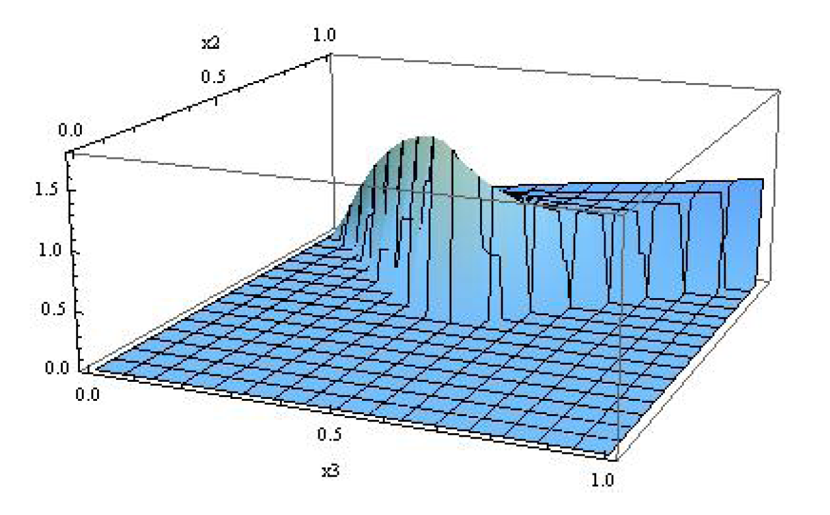
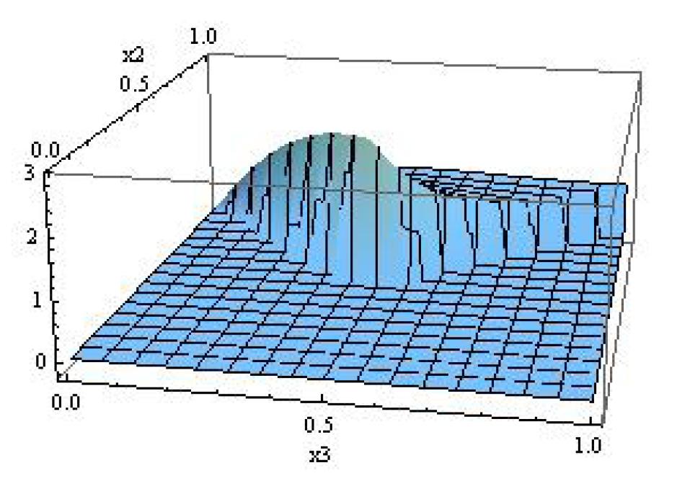
Shapes of the Bispectra: example 2
NEW curvature-generated interaction term: ,
DBI
Intermediate case
x₂
x₂
k₂
x₃
k₃
x₃
k₁
The bispectra peak for flat triangles, specifically for k₁=k₂/2=k₃/2;
similar conclusions for two other operators (proportional to M₈ and M₉);
✓ The remaining novel operators Ms give rise to equilateral shapes
Notes:
- Mettere anche slide su shape per M₉?

Slide 14
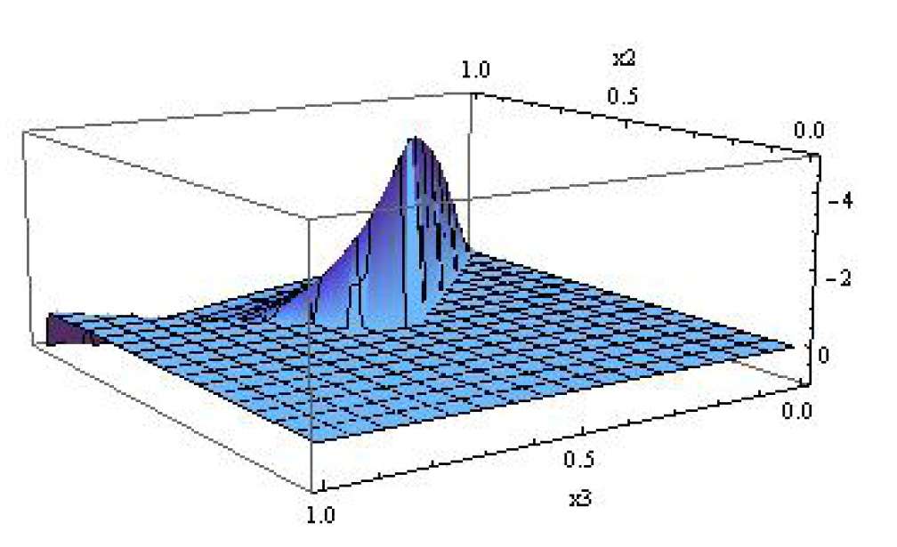
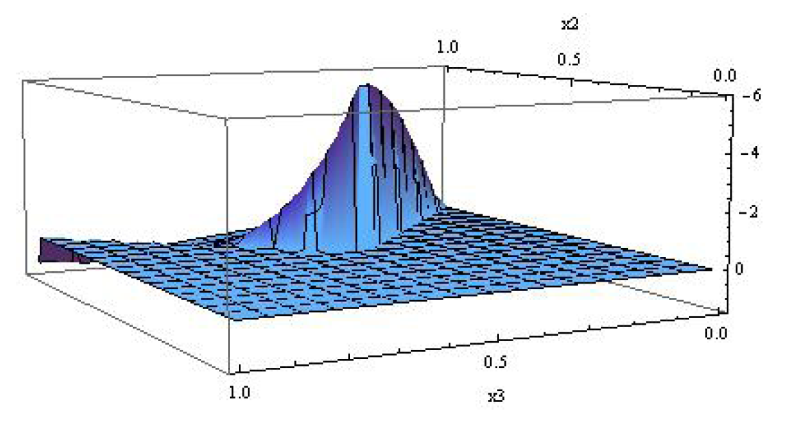
Shapes of the Bispectra: example 3
NEW curvature-generated interaction term: ,
DBI
Intermediate case
x₂
x₂
x₃
x₃
The bispectra peak for flat triangles, specifically for k₁=k₂/2=k₃/2

Slide 15
Main Messages:
We have found solutions to the e.o.m for the linear
perturbations that interpolate between known cases (DBI &
Ghost)
Besides the equilateral shape, the flat shape can be generated in
single-field models of inflation, even without resorting to non
Bunch-Davies vacuum
(see Senatore et al. 10 and discussion on orthogonal shape )
Importance of the curvature-induced operators:
Large bispectra peaking in the flat configuration can emerge
from new single independent (curvature-induced) operators,
rather than from a combination of equilateral-like bispectra.
N.B.: Similar study for the trispectra from single-field models of inflation (N.B., M.
Fasiello, S. Matarrese and A. Riotto JCAP)

Slide 16
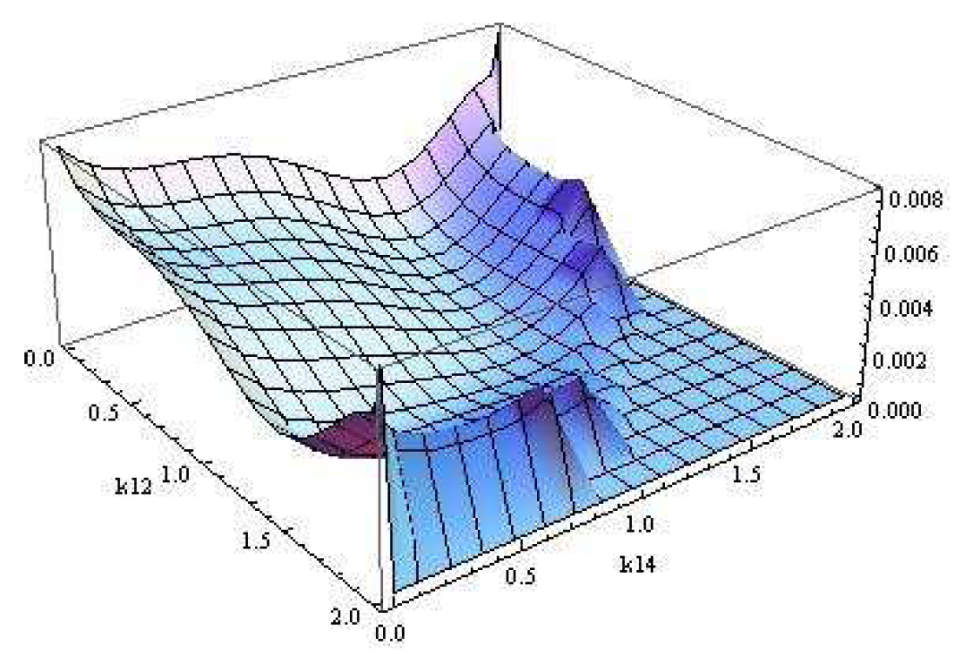
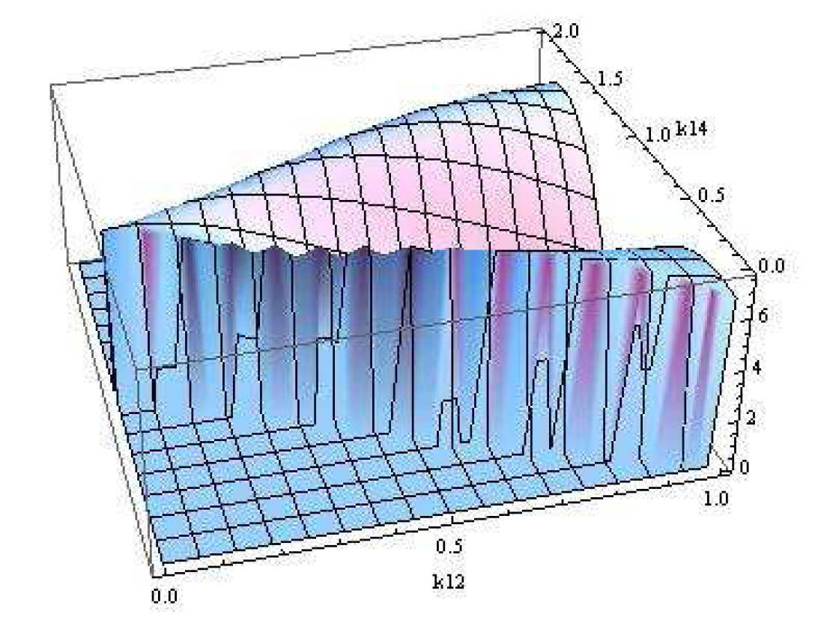
Trispectra
(N.B, Fasiello, S. Matarrese and A. Riotto JCAP)
(scalar exchange)
In equilateral configuration the shape is
different w.r.t. any shape of DBI models
k₁₂
k₁₄
(contact interaction)
In the limit k₁₂ ➔0 does not vanish
(unlike DBI)
k₁₄
k₁₂
(to compare with: Chen et al. 2009 for DBI-like; Izumi/Mukohyama ‘10 for Ghost inflation;
Senatore/Zaldarriaga ’10; Huang ‘10 for Ghost inflation)

Slide 17
Statistical Anisotropy
Growing interest spurred also by some CMB anomalies
(e.g. the hemispherical power asymmetry, Eriksen et al. 2004).
Among various models:
inflationary models populated by vector fields
(e.g. Ford 89; Dimopolous 06; Ackerman, Carroll, Wise 07; Golovnev, Mukhanov, Vanchurin 08;
Himmentoglou, Contaldi, Peloso 09; Gumrukcuoglu, Himmentoglou, Peloso 09; Farese, Pitrou, Uzan 10)
An example: primordial power spectrum
(Ackerman, Carroll, Wise 07, Pullen & Kamionkowski 07)
signature of vector fields during inflation:
In terms of CMB power spectra:
Planck can reach g~0.02
Notes:
sostituire ad n, N_A??? Per notazioni dopo
Mettere espressione di g in funzione dei campi vettoriali?
Mettere cosa si ottiene per CMB?
Mettere Planck sensitivity to g?

Slide 18
Satistical Anisotropy and NG
Anisotropic non-Gaussianity also predicted in models where vector
fields play a role during inflation
(see, e.g., Yokoyama & Soda 08; Karciauskas, Dimopolous, Lyth 09)
Why to care about anisotropic NG?
NG as a new diagnostic for statistical anisotropy
violation of rotational invariance
Notes:
- Vedere cosa dicono articoli di eriksen

Slide 19
The model
We generalize Abelian models (e.g Dimopoulos et al. 08) to a non-Abelian SU(2) gauge
multiplet
(Bartolo, Dimastrogiovanni, Matarrese, Riotto 09)
Motivations:
- more realistic embedding
- self-interactions of gauge fields give rise to extra new contributions to the
correlation functions
Possible realizations: vector inflation; vector curvaton;
scalar field models of inflation+subdominant vector fields

Slide 20
Anisotropic bispectra: main results
(for a trispectrum analysis see N.B, Dimastrogiovanni, Matarrese, Riotto 09)
NG peaks in the local configuration with an amplitude that is modulated by the preferred directions that break statistical isotropy
The anisotropic part can be of the same magnitude as the isotropic part
The non-Abelian contributions can dominate over the pure Abelian ones
(N.B., Dimastrogiovanni, Matarrese, Riotto 09)
The anisotropic features can be subdominant in the power-spectrum but
non-negligible in the bispectrum (trispectrum)

Slide 21
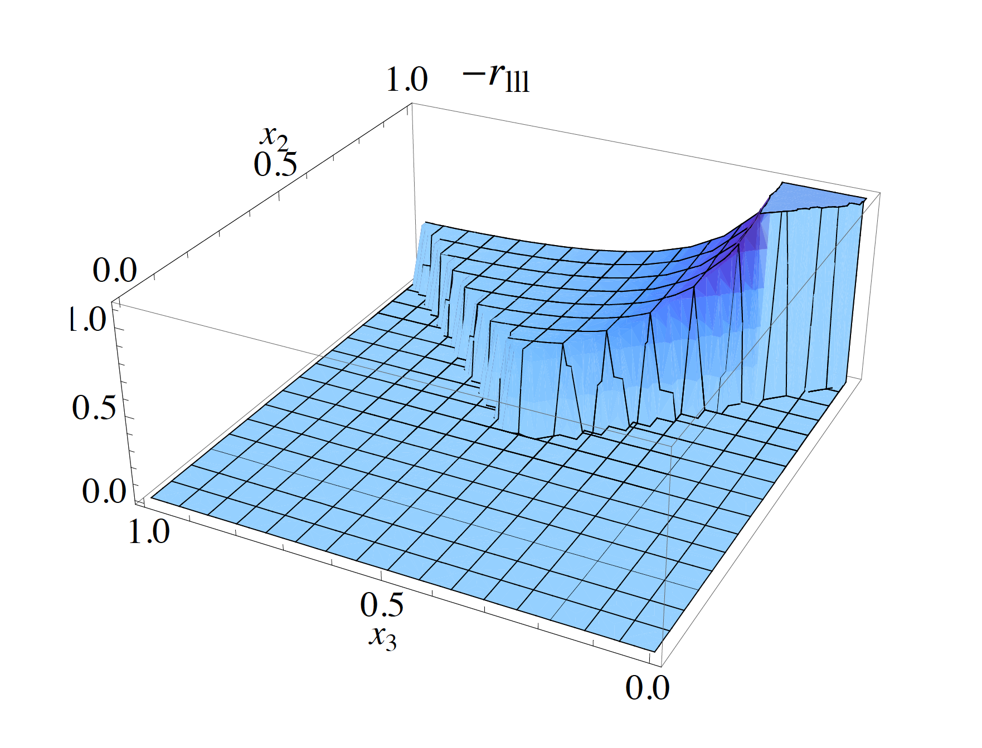
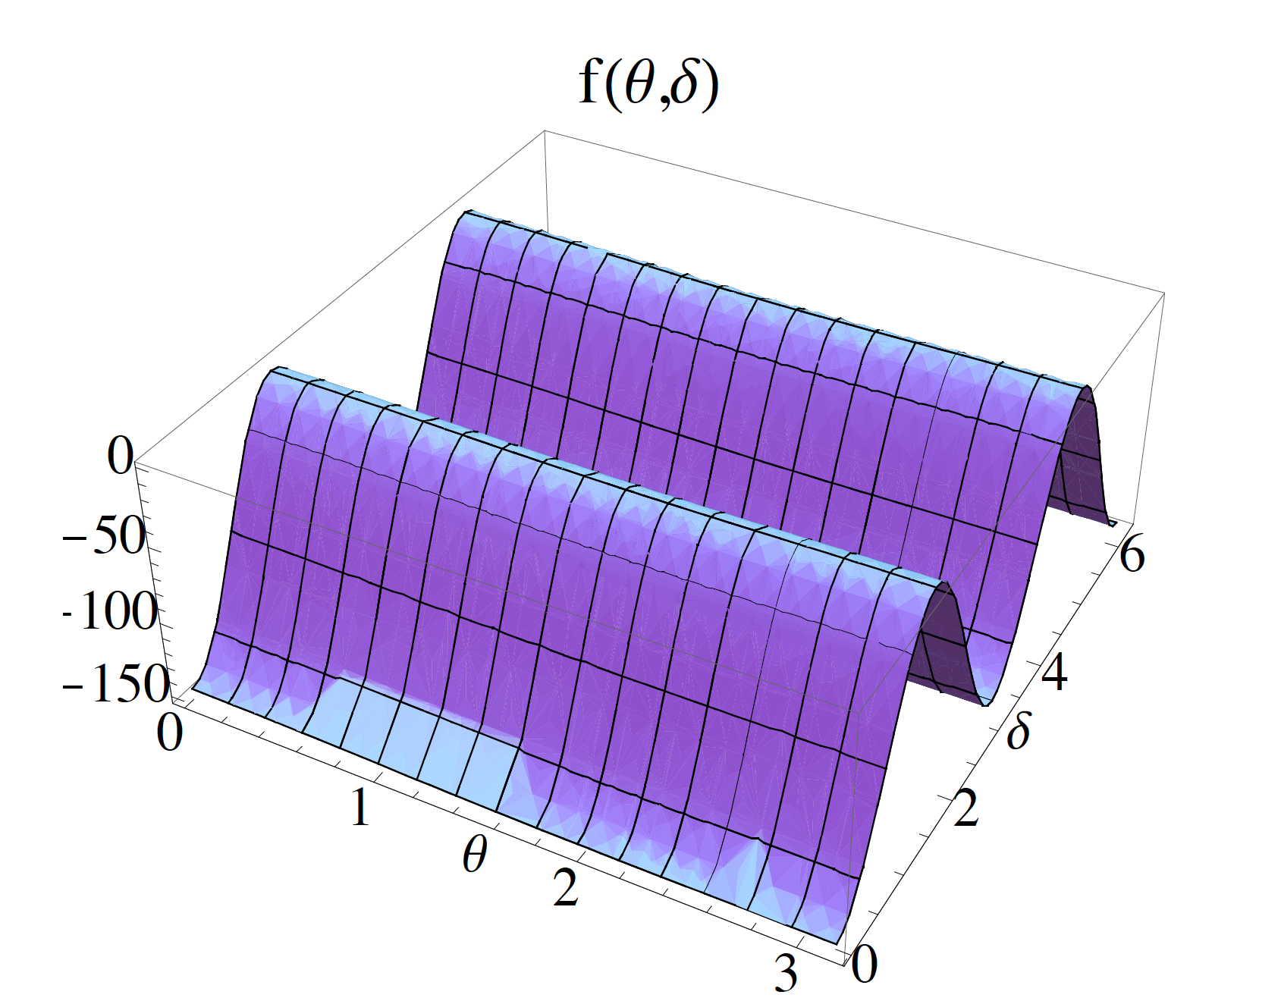
Anisotropic bispectra: the structure
(for a trispectrum analysis see N.B, Dimastrogiovanni, Matarrese, Riotto 09)
``Amplitude ‘’ of the anisotropic bispectrum
(for a non-Abelian contribution)
Such an amplitude is modulated by the preferred directions
(anisotropic features)

Slide 22
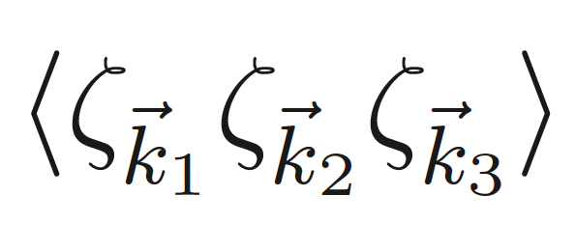
Anisotropic bispectra: the structure
(for a trispectrum analysis see N.B, Dimastrogiovanni, Matarrese, Riotto 09)
Contribution from 3rd-order interaction vanishes; from 4-th order interactions:
for vector inflation
Here
A, B and C are functions of |k_{i}| and of x*=-kη*~1.
For the curvaton case
Notes:
Qiuesta forse da nascondere o da tralasciare

Slide 23
Anisotropic bispectra: statistical estimator
(N.B., Dimastrogiovanni, Liguori, Matarrese, Riotto in preparation)
1. First step: write down the expression in multipole moments for the CMB bispectrum
A simplified model:
Amplitudes
Anisotropic features
Notes:
- Togliere le permutazioni?
Cambiare titolo: Estimators for statistival anisotorpy form the CMB bispectrum

Slide 24
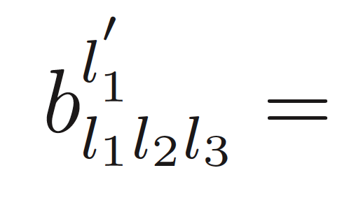
Anisotropic bispectra: statistical estimator
(N.B., Dimastrogiovanni, Liguori, Matarrese, Riotto in preparation)
An example:
N.B.: only for l=0=m one gets the usual expression
Second step: PDF for a general non-Gaussian (Babich 2005) and anisotropic case.
3. Third step: derive it w.r.t. to the anisotropic parameters g_{lm} to obtain an optimal
and unbaised estimator for g_{lm}
For a local B^{iso}(k₁,k₂.k₃) we are computing the signal-to-noise ratio for the
anisotropic signals g_{lm} for an experiment like Planck
Notes:
- Accennare a Fisher matrix? (almeno a parole)
- Riscrivere la formula in modo piu` chiaro.

Slide 25
Conclusions
Shown that in single-field models of inflation large NG peaking in the flat
shape can emerge as associated to different individual (curvature-induced)
operators not studied before
The predictions for NG in single-field models is richer than previously thought
Degeneracy between NG predictions in different models increases:
in single-field models high NG is not just equilateral; flat shape not only from
models with non Bunch-Davies vacuum, but also from a linear combination of
equilateral operators, or from these curvature-operators
Statistical anisotropy and NG could be the same face of two different interesting
cosmological signals
We are computing an optimal estimator for non-Gaussian anisotropic models, and
the expected sensitivity to statistical anisotropy using the CMB bispectrum
Notes:
Rifare il pounto di interpolazione?
mettere articoli in preparazione?

Slide 27
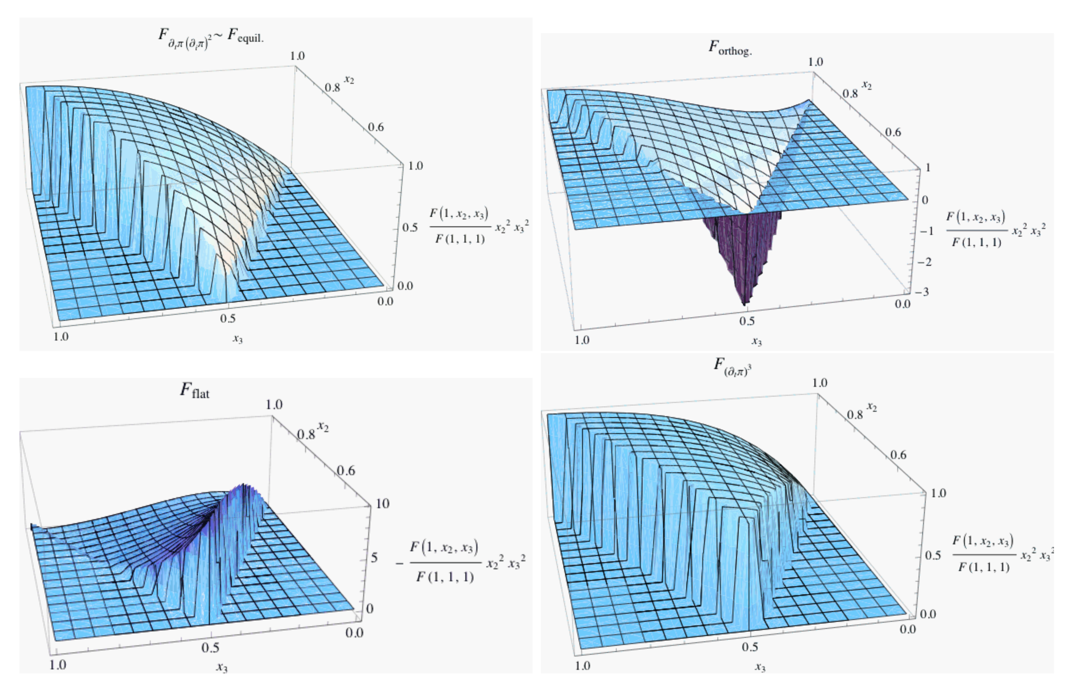
Some remarks on the flat shape
Of course it is not new; it appears for single-field models with non Bunch-Davies vacuum
(Chen et al. 07; Holman & Tolley 08; Meerburg et al. 09)
But……. in single-fleld models of inflation (with Bunch-Davies vacuum) it was standard to
associate high levels of NG to the equilateral shape
The orthogonal (and flat) shape (Senatore et al. 2010) is an interesting counter-example:
a flat shape is generated when combining two equilateral-type operators
We have shown that a flat shape emerges simply from individual operators

