Slide 1
Primordial non-Gaussianity from multi-field inflation re-examined
Yuki Watanabe
Arnold Sommerfeld Center
for Theoretical Physics,
Ludwig-Maximillians-University Munich

Slide 2
Why study non-Gaussianity from multi-field inflation?
f_{NL} is ~ O(1-n_{s}) in single-field inflation. (Maldacena 2003; Creminelli & Zaldarriaga 2004; Seery & Lidsey 2005)
Curvarure perturbation, ζ, is conserved outside the horizon.
f_{NL} can be generated outside the horizon in multi-field inflation since ζ is NOT conserved.
Entropy perturbations convert into ζ when a classical trajectory of fields turns. (Gordon et al 2000)

Slide 3
Two approaches to non-linear ζ outside the horizon
Covariant formalism (Ellis, Hwang, & Bruni 1989; Langlois & Vernizzi 2005)
δN formalism (Starobinsky 1985; Salopek & Bond 1990; Stewart & Sasaki 1996; Lyth, Malik, & Sasaki 2004)
Are they equivalent?
If so, which approach has more advantages?

Slide 4
f_{NL}: 2nd order ζ during multi-field inflation
Covariant formalism (Rigopoulos et al 2004; Langlois & Vernizzi 2007)
δN formalism (Sasaki & Tanaka 1998; Lyth & Rodriguez 2005)

Slide 5
f_{NL}: a measure of 2nd order ζ
Local non-Gaussianity (Komatsu & Spergel 2001; Maldacena 2003)
Covariant formalism (Lehners & Steinhardt 2008)
δN formalism (Lyth & Rodriguez 2005)

Slide 6
f_{NL}: 2nd order ζ during multi-field inflation
Covariant formalism
δN formalism (Lyth & Rodriguez 2005)

Slide 7
Numerical examples: Two-field Inflation
Case 1: m₁/m₂ = 1/9; Case 2: m₁/m₂ = 1/20
Rigopoulos et al. (2005) solved 2nd order perturbed equations and estimated f_{NL} analytically with case 1. They found a large f_{NL} ~ O(1-10).
Vernizzi & Wands (2006) calculated f_{NL} numerically (and analytically) with δN formalism. They found a peak and a small net effect on f_{NL} ~ O(0.01).
Rigopoulos et al. (2006) re-calculated f_{NL} numerically and found the similar peak. The result agrees with Vernizzi & Wands qualitatively but not quantitatively.
S. Yokoyama et al. (2007) has considered case 2 and found large peaks on f_{NL}.
(Byrnes et al 2008; Mulryne et al 2009)

Slide 8
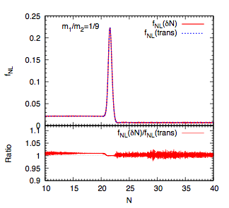
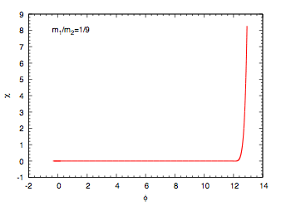
χ is the 1st inflaton.
φ is the 2nd inflaton.
A peak in NG shows up at the turn. It is sourced by entropy modes.
The plateau contribution of NG is from the horizon exit ~O(ε) ~0.01.
δN and covariant formalisms match within ~ 1%.
Slow-roll approx. has been used only for the initial condition (at horizon exit).

Slide 9
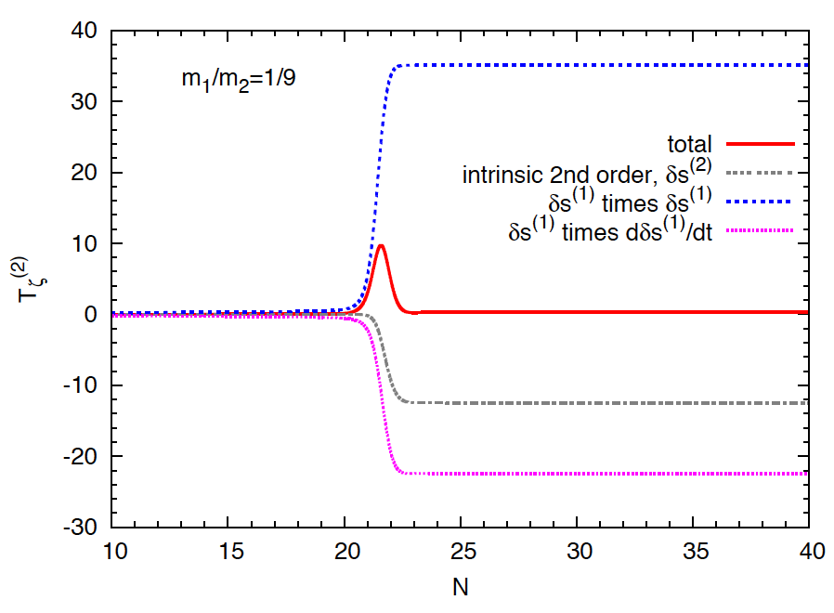
Why did the peak in NG show up?
Each term in 2nd order perturbations becomes large but almost cancels out!
The difference in growths of terms makes the peak shape. Only small net effect remains because of symmetry of the potential.

Slide 10
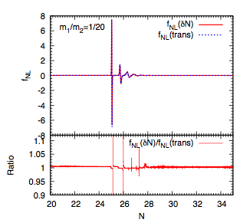
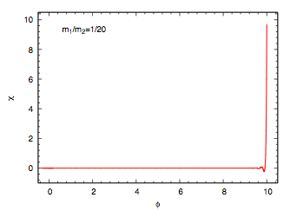
χ is the 1st inflaton.
φ is the 2nd inflaton.
A few large peaks in NG show up at the turn.
The plateau contribution of NG is from the horizon exit ~O(ε) ~0.01.
δN and covariant formalisms match within ~ 1% except at peaks.
Discrepancy is from inaccuracies of data-sampling at peaks and the initial condition.

Slide 11
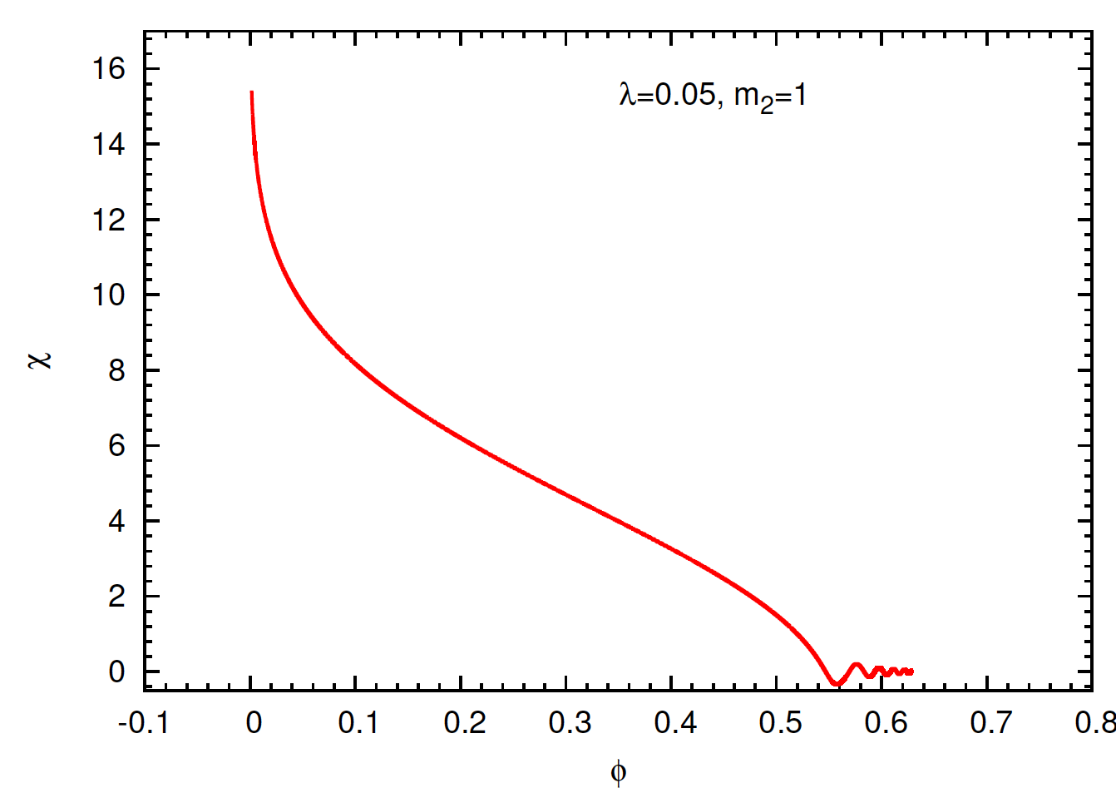
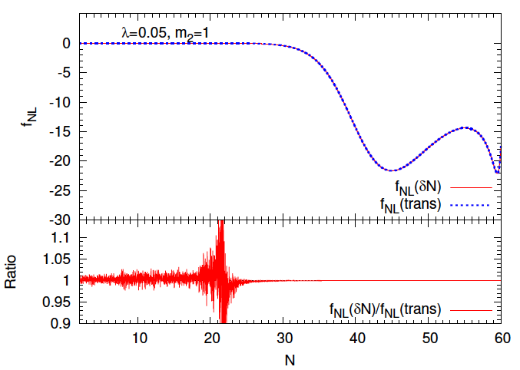
(Byrnes et al 2008; Mulryne et al 2009)
χ is inflaton.
φ is inflaton.
Large negative NG shows up during the turn.
The plateau of NG is closed to zero.
δN and covariant formalisms match within ~ 1% except at the plateau
(N~ 20).
Discrepancy is from dividing zero by zero.

Slide 12
Summary
NG in two-field inflation models have been re-examined;
δN and covariant formalisms match numerically very well in the models, therefore they can be used for cross-checking each other.
Delicate cancellations happen in the 2nd order transfer functions for ζ; A careful analysis is needed.
2nd order entropy modes source NG during turns in the field space.

