Slide 1
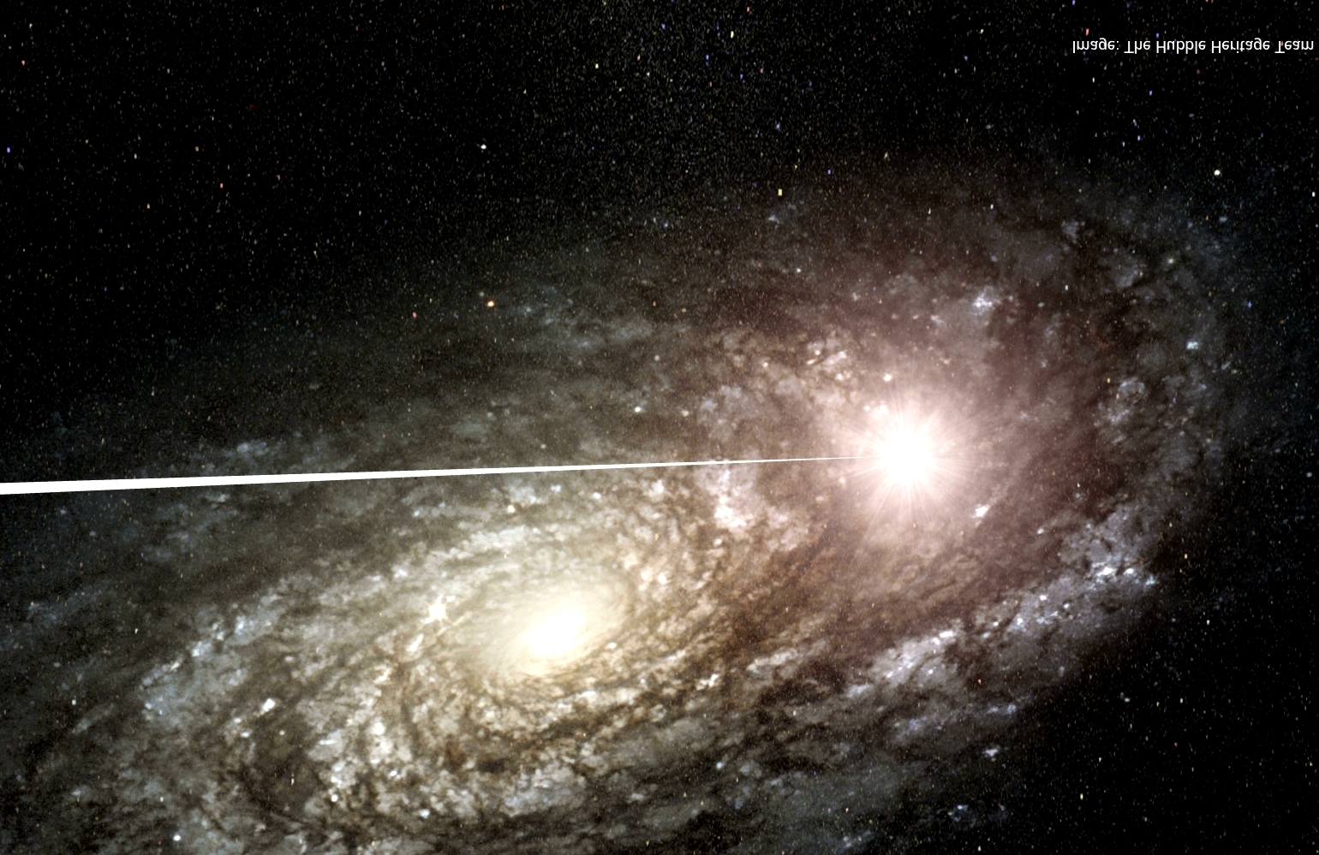
A new result on cosmological variation of the fine-structure constant
Michael Murphy, Swinburne
Julian King, UNSW
John Webb, UNSW
Collaborators on new VLT analysis: Matthew Bainbridge, Steve Curran, Chanakya Jaiswal, Elliott Koch, Michael Wilczynska, Victor Flambaum UNSW (Sydney) Bob Carswell IoA (Cambridge)
Collaborators on Keck analysis: Chris Churchill, Jason Prochaska, Wal Sargent, Art Wolfe

Slide 2
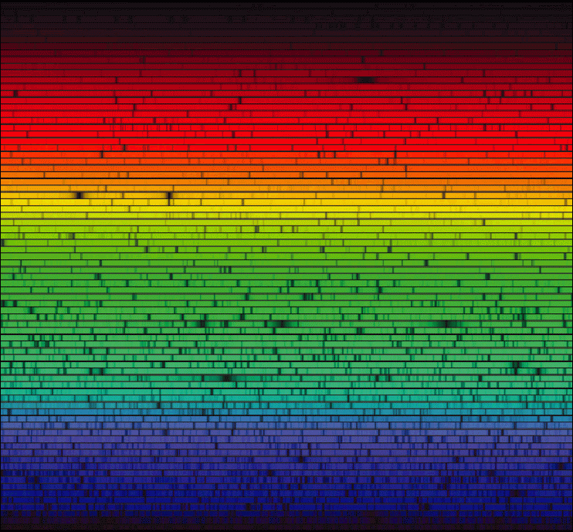
Outline:
Motivations for varying “constants”
Measuring α=e²/ħc from quasar spectra
Previous Keck/HIRES constraints: Δα/α<0
New VLT/UVES constraints: Δα/α>0
A spatial variation in α?
Really? Or just systematics?
Future work
Notes:
Hello

Slide 3
Fundamental? Constants?:
[Note: Only low-energy limits of constants discussed here]
Why “fundamental”?
Cannot be calculated within Standard Model
Why “constant”?
Because we don’t see them changing
No theoretical reason – see above
Best of physics: Relative stability of α ~10⁻¹⁷ yr⁻¹ (Rosenband et al. 2008)
Worst of physics: Sign of incomplete theory?
Constancy based on Earth-bound, human time-scale experiments
Extension to Universe seems a big assumption

Slide 4
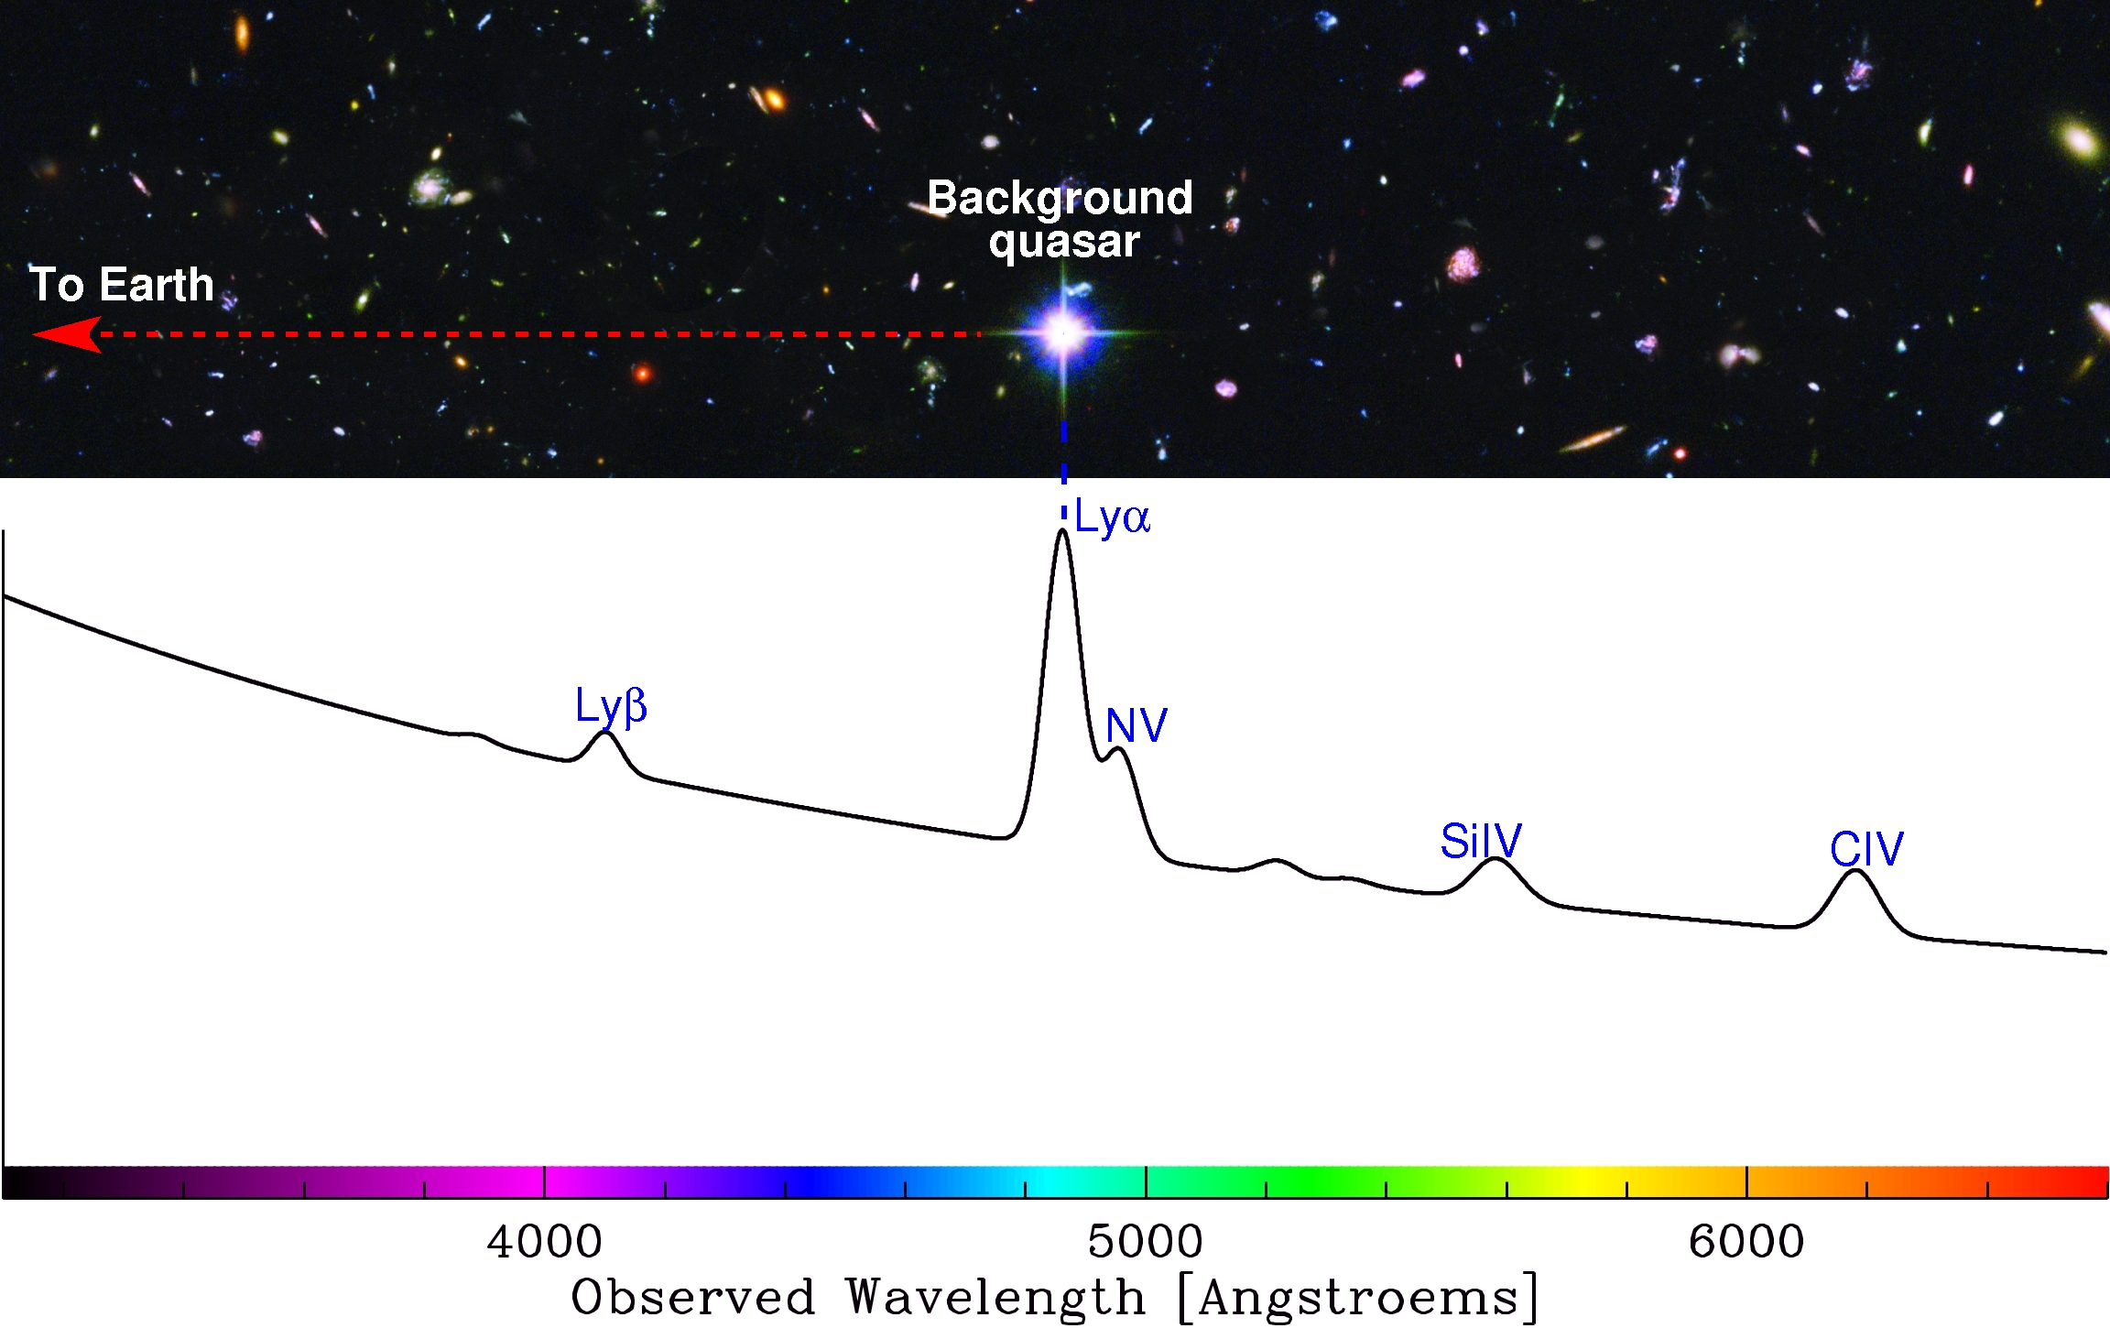
Anatomy of a quasar spectrum:

Slide 5
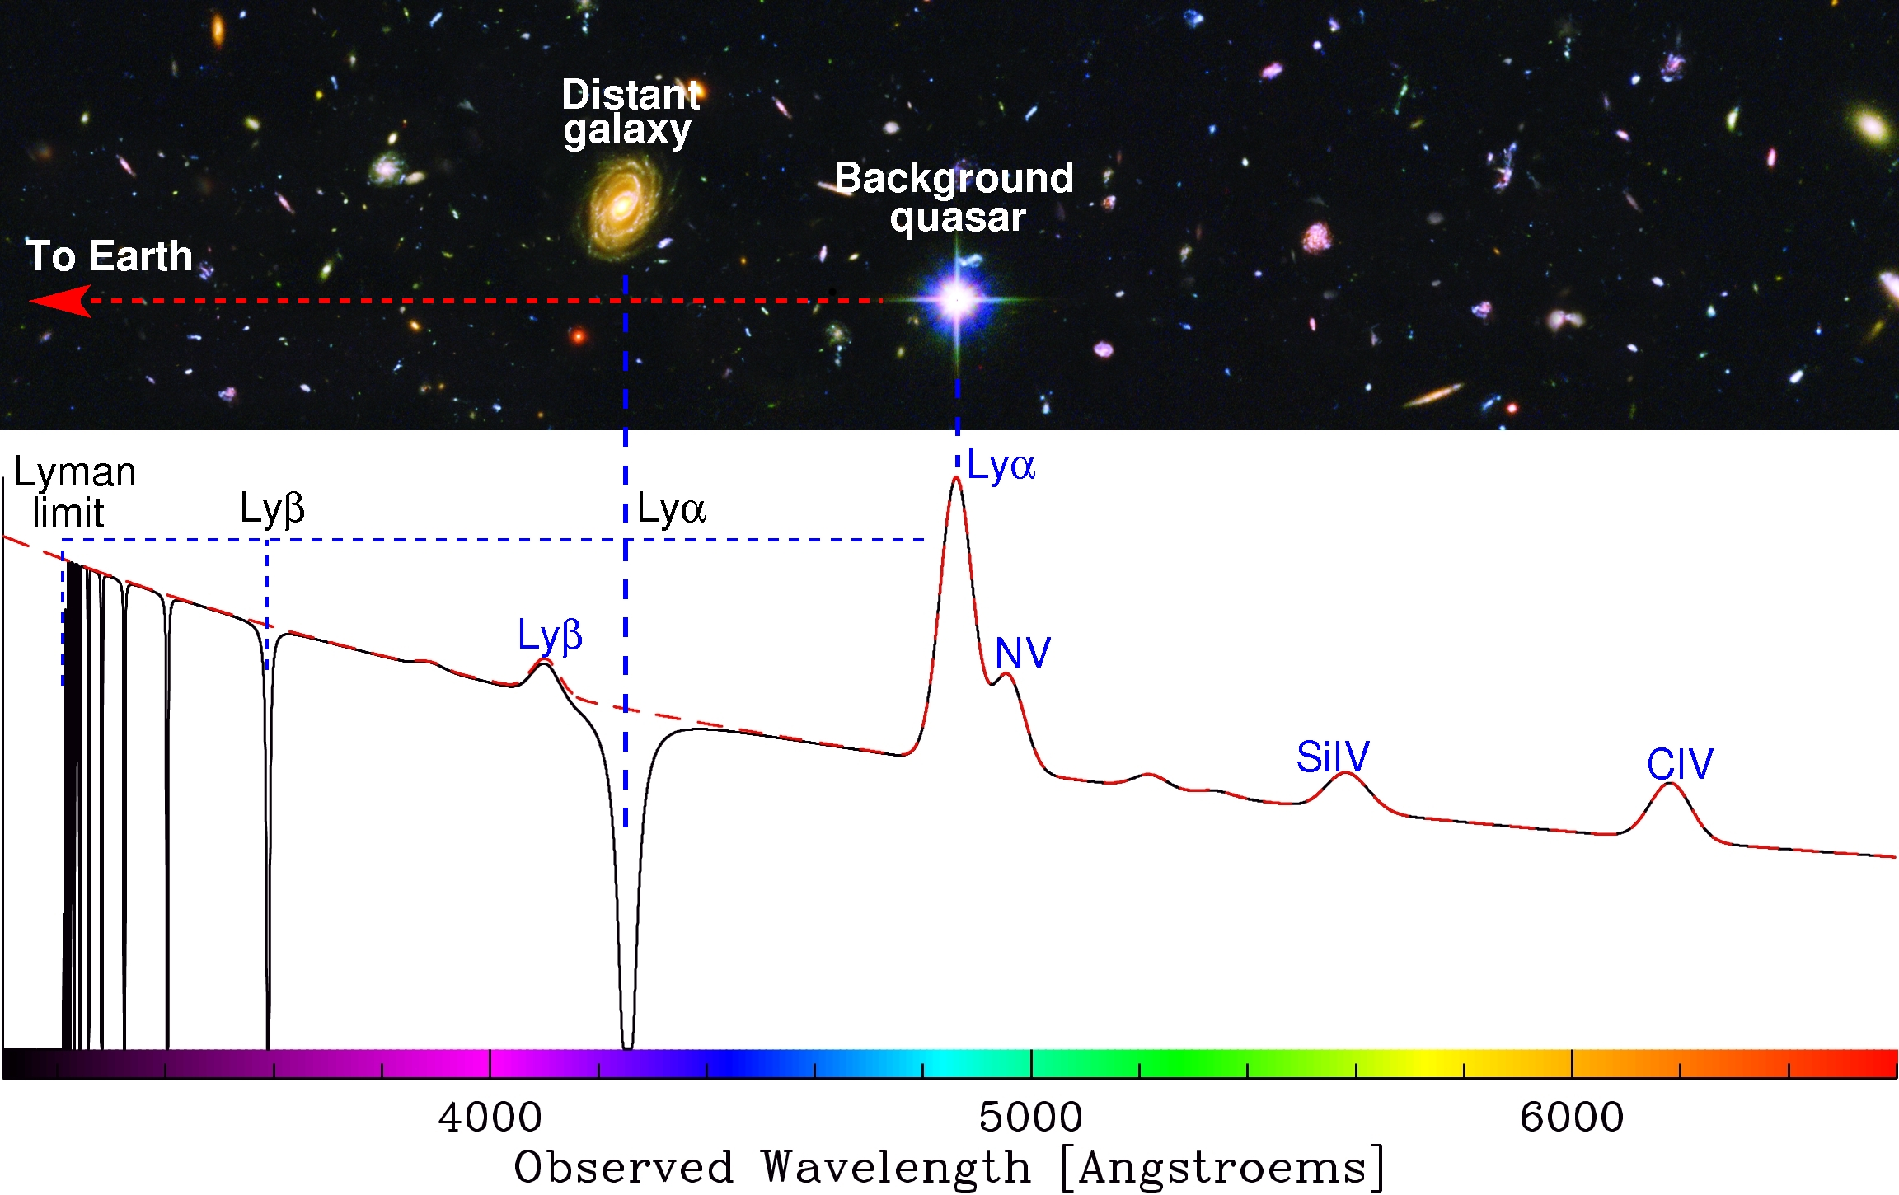
Anatomy of a quasar spectrum:

Slide 6
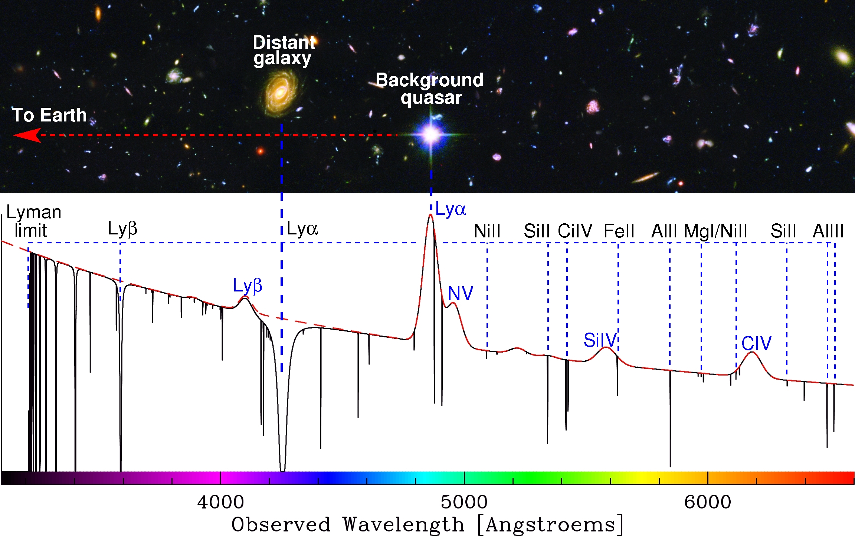
Anatomy of a quasar spectrum:

Slide 7
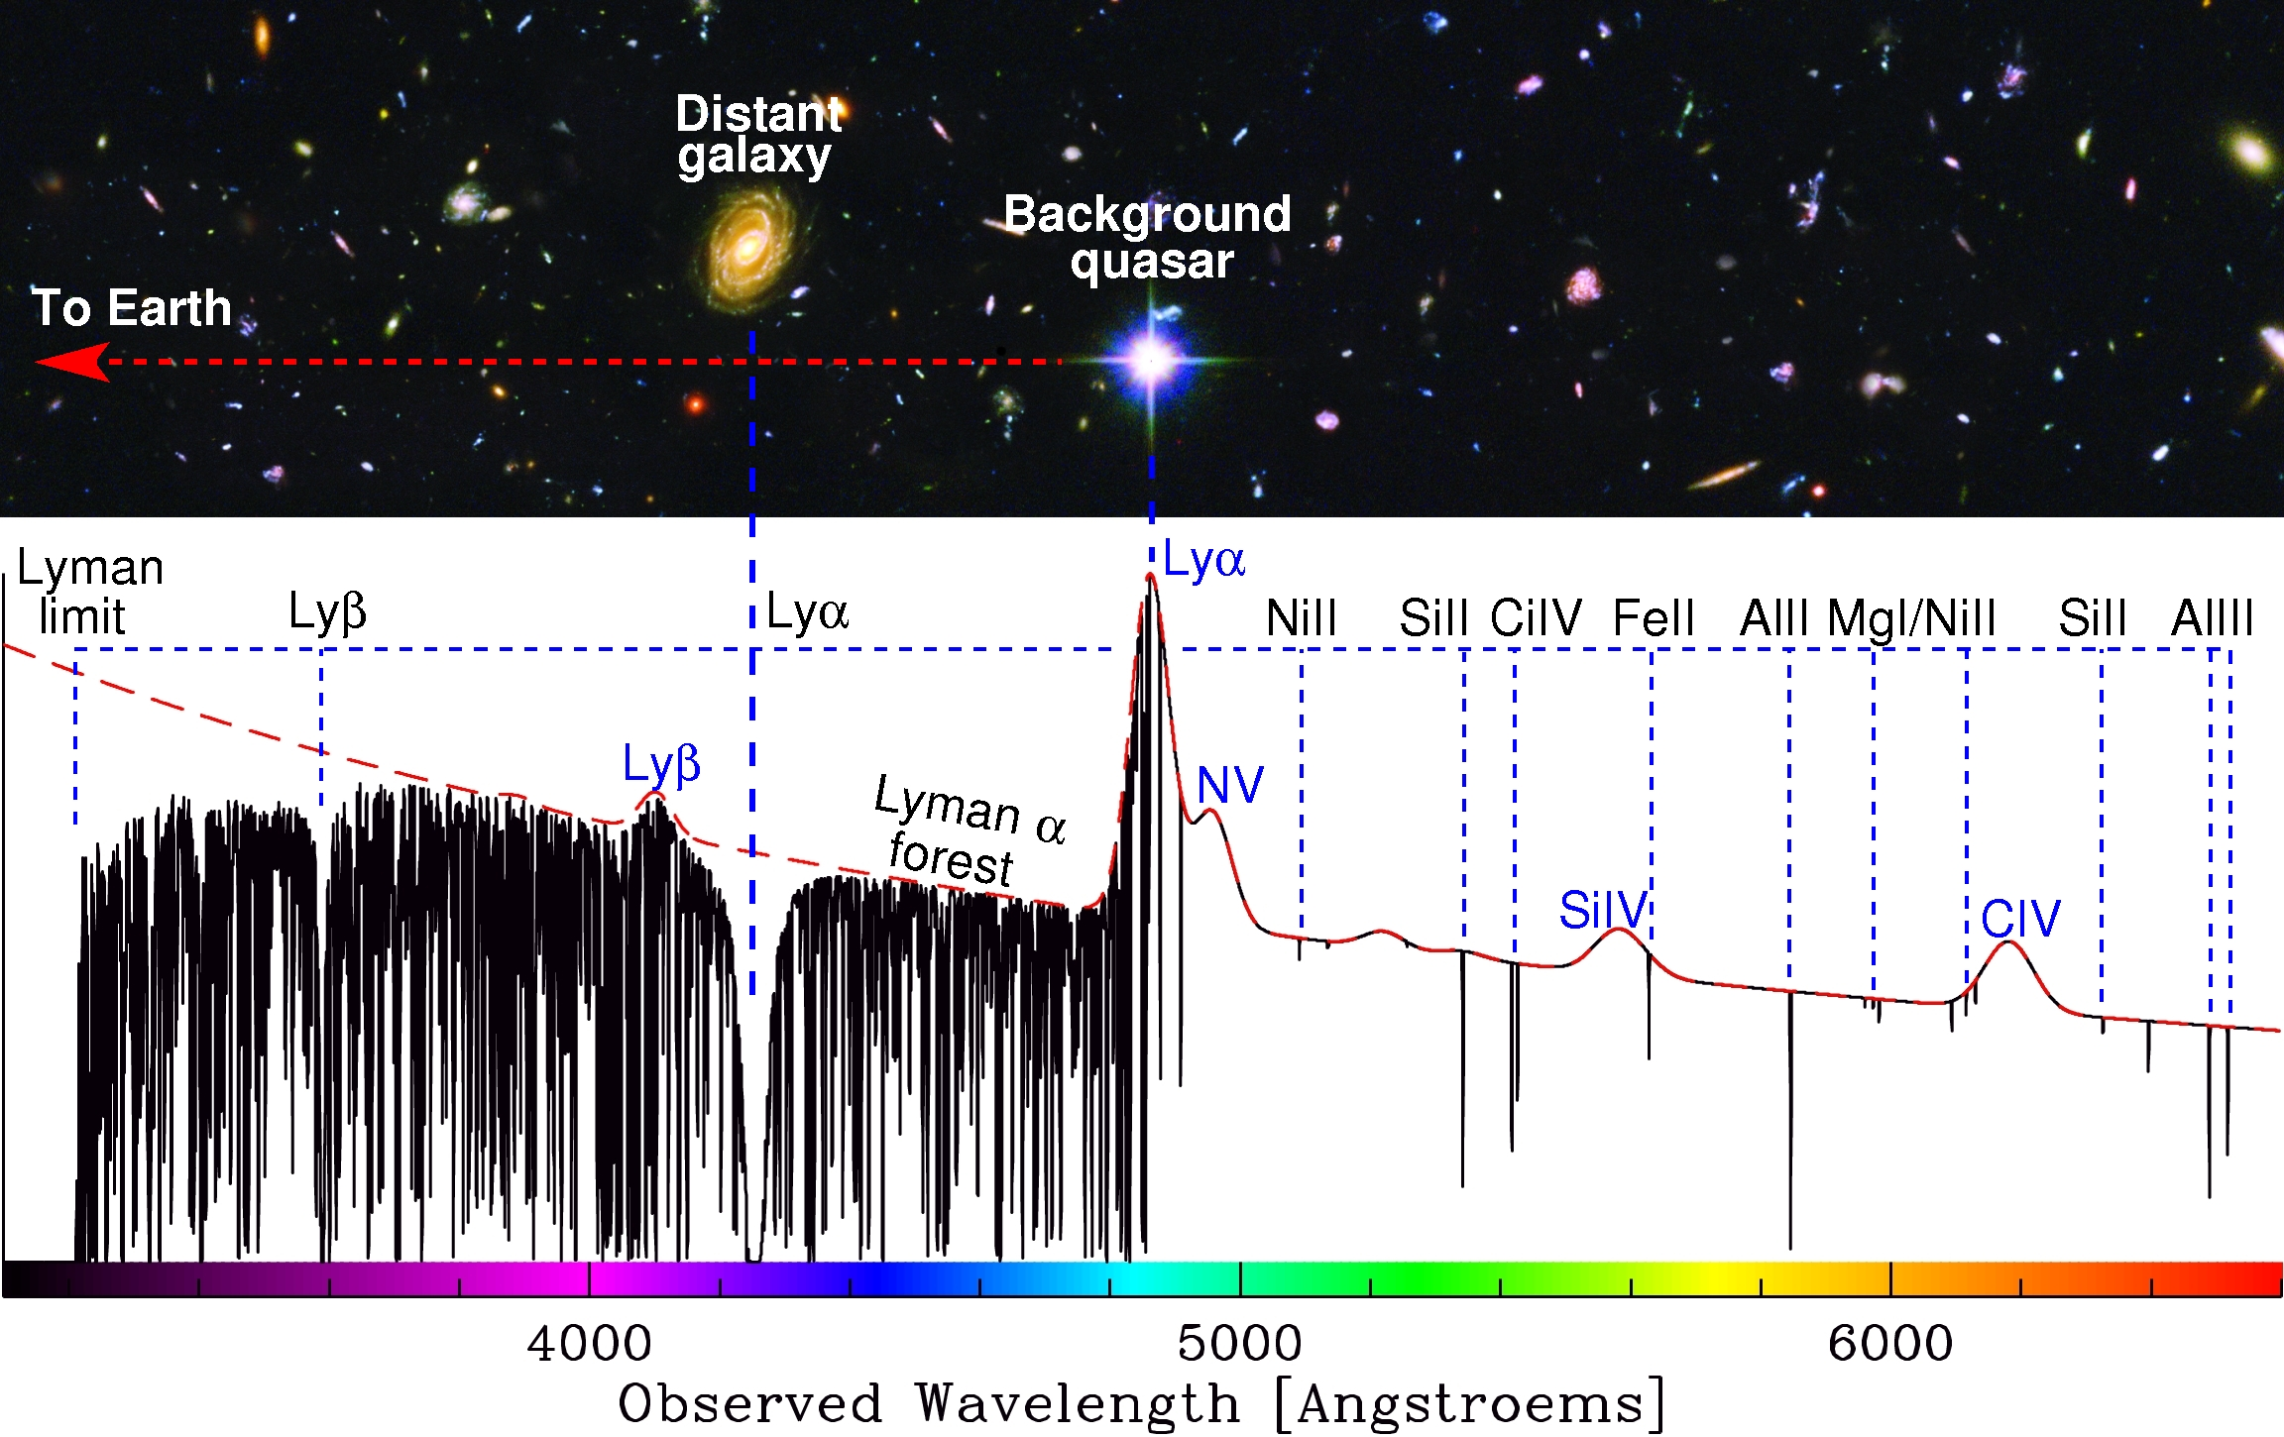
Anatomy of a quasar spectrum:

Slide 8
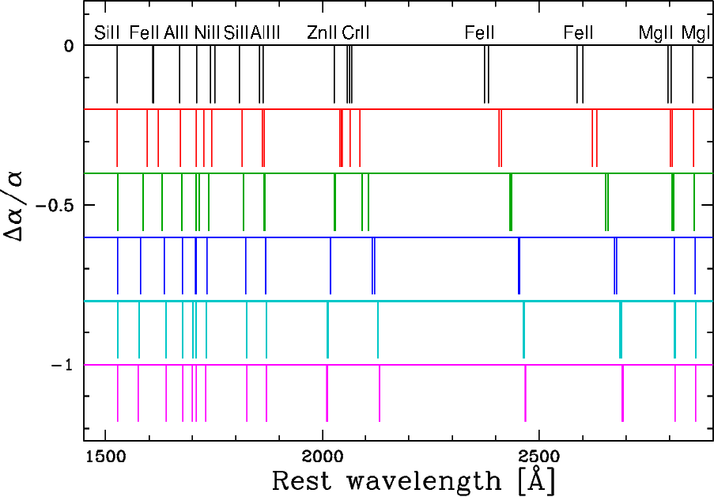
The Many Multiplet (MM) method:

Slide 9
The Many Multiplet (MM) method:
Δα/α=1×10⁻⁵ Δv=200ms⁻¹

Slide 10
Line shifts and Δα/α:
3 params per line
b-params related
z's MUST be tied
b_{MgII}
N_{MgII}
MgII2796
b_{FeII}
N_{FeII}
FeII2600
z_{MgII}=z_{FeII}
Velocity

Slide 11
Line shifts and Δα/α:
1 more param, Δα/α
z's still tied
MgII2796
Δω≈2qΔα/α or
Δλ/λ ≈ Δv/c ~ qΔα/α
FeII2600
Δα/α
Velocity

Slide 12
Line shifts and Δα/α:
1 more param, Δα/α
z's still tied
MgII2796
Δω≈2qΔα/α or
Δλ/λ ≈ Δv/c ~ qΔα/α
FeII2600
Δα/α
Velocity
Fit components simultaneously; 1 Δα/α value
Minimize χ² to find parameters, including Δα/α
Error in Δα/α from final covariance matrix

Slide 13
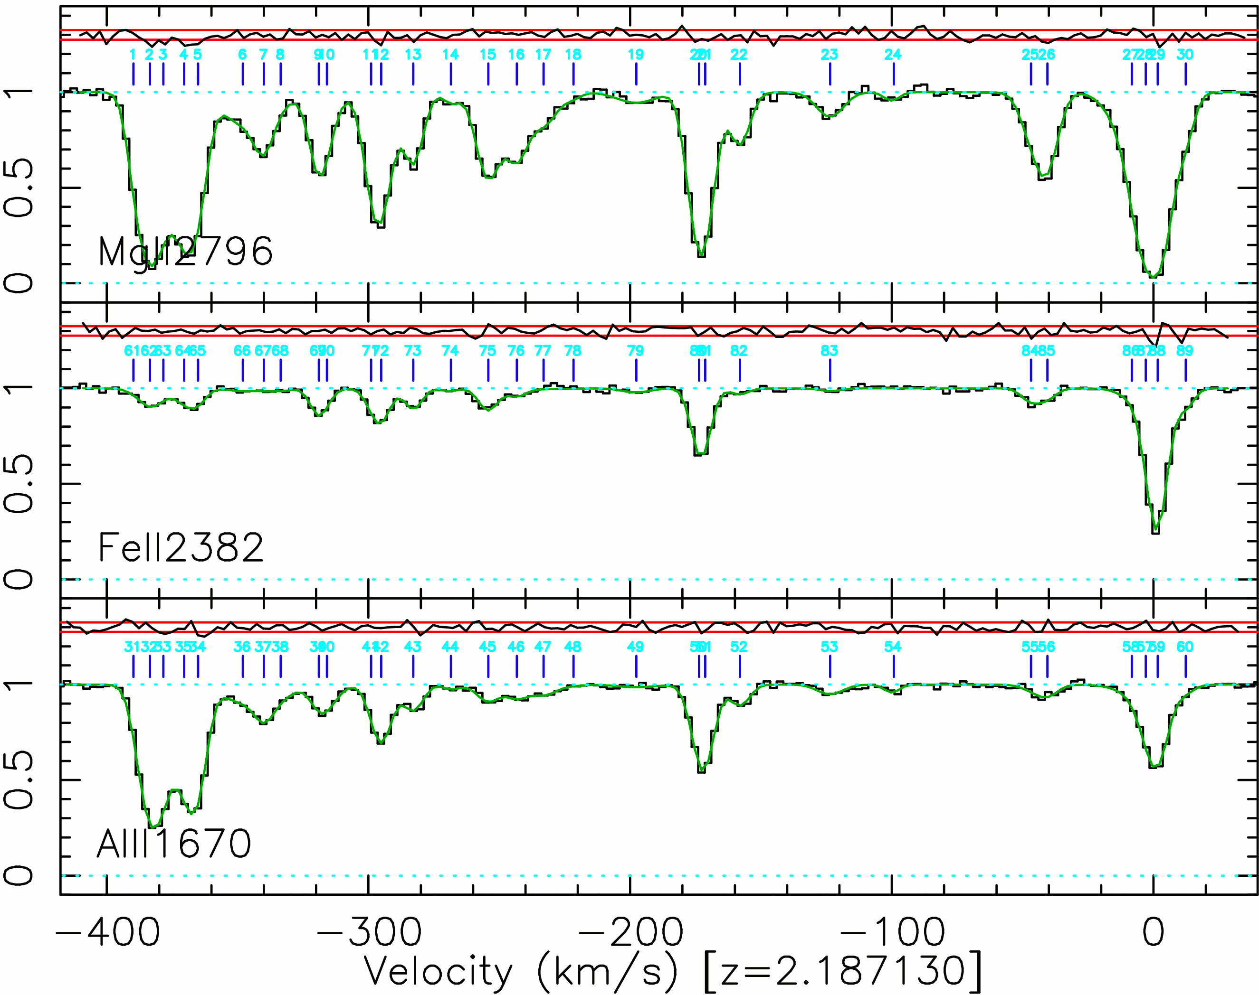
Real, complex profile:

Slide 14
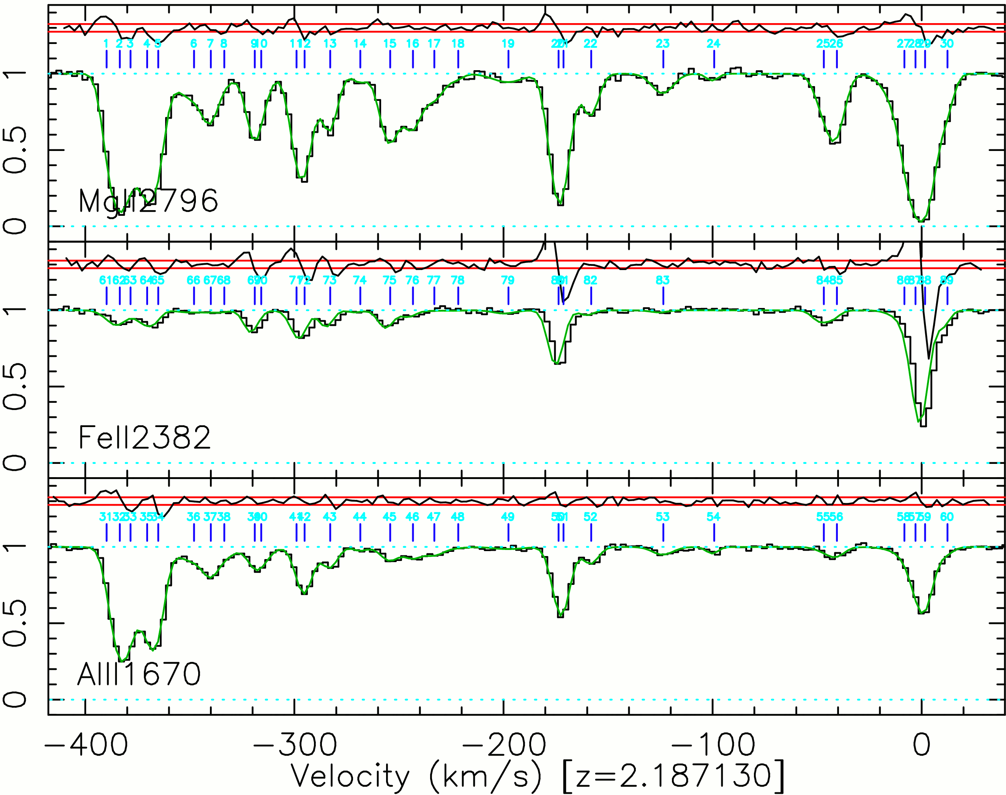
Real, complex profile: Δα/α=10⁻⁴

Slide 15
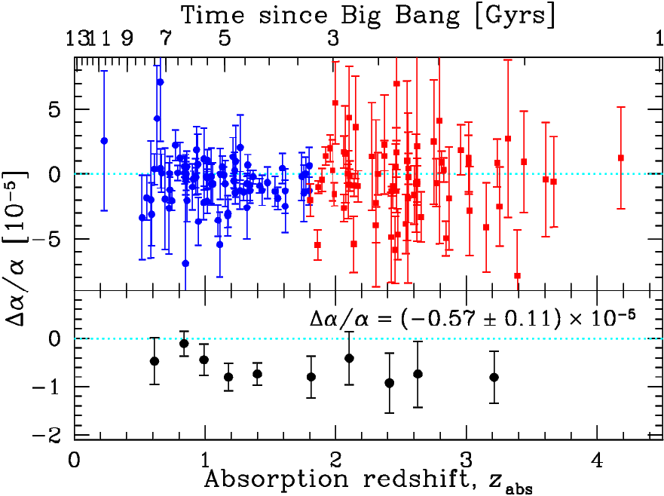
143 Keck/HIRES absorbers:
MTM et al. (LNP, 2004)

Slide 16
New VLT/UVES measurements:
Must check Keck/HIRES results on different telescope/spectrograph
Very Large Telescope (VLT) UVES spectrograph
Repeatable reduction of ~500 UVES QSO spectra
Reduced data to be publicly available
~200 absorbers studied, ~100 high-SNR QSOs.
Δα/α from 153 absorbers (61 QSOs) at 0.2<z_{abs}<3.6 (2.6 – 12 Gyr look-back time).
Predicted statistical precision δ(Δα/α) ≈ 0.5 × 10⁻⁶
~780 hrs exposure (~90 nights inc. o'heads).
ARCHIVAL SPECTRA – wavelength calibration!

Slide 17
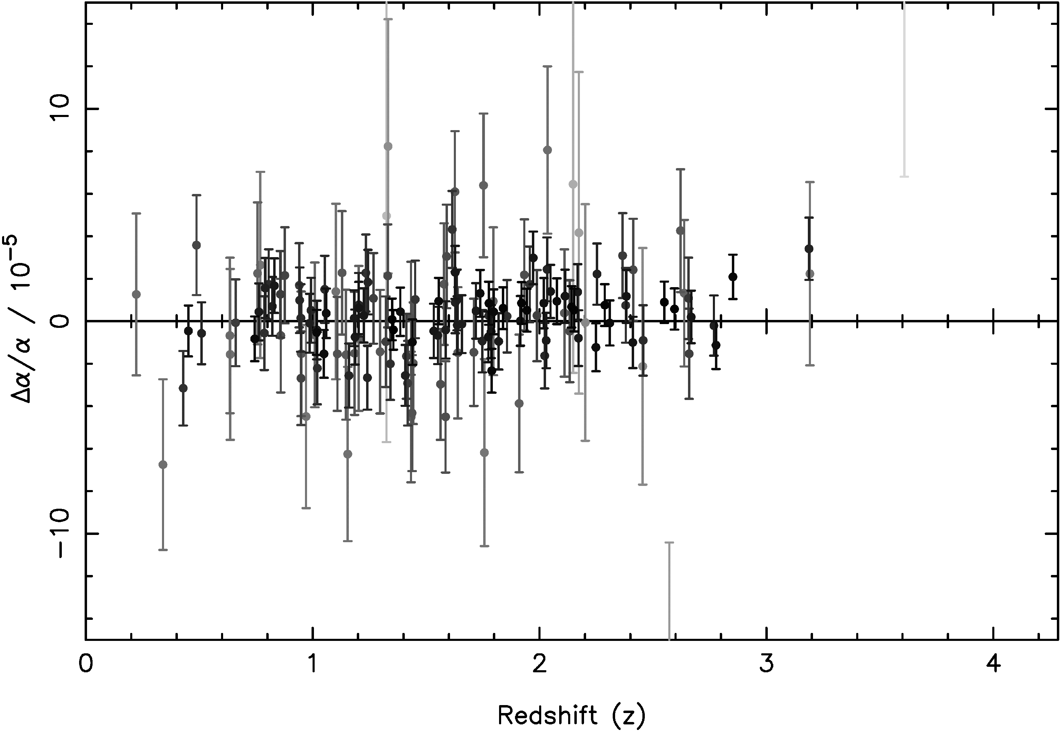
153 VLT/UVES absorbers:

Slide 18
153 VLT/UVES absorbers:
Systematic error 0.9×10⁻⁵ added to errors
Weighted mean: Δα/α=(0.23±0.12) ×10⁻⁵
c.f. Keck sample’s Δα/α=(-0.57±0.11) ×10⁻⁵

Slide 19
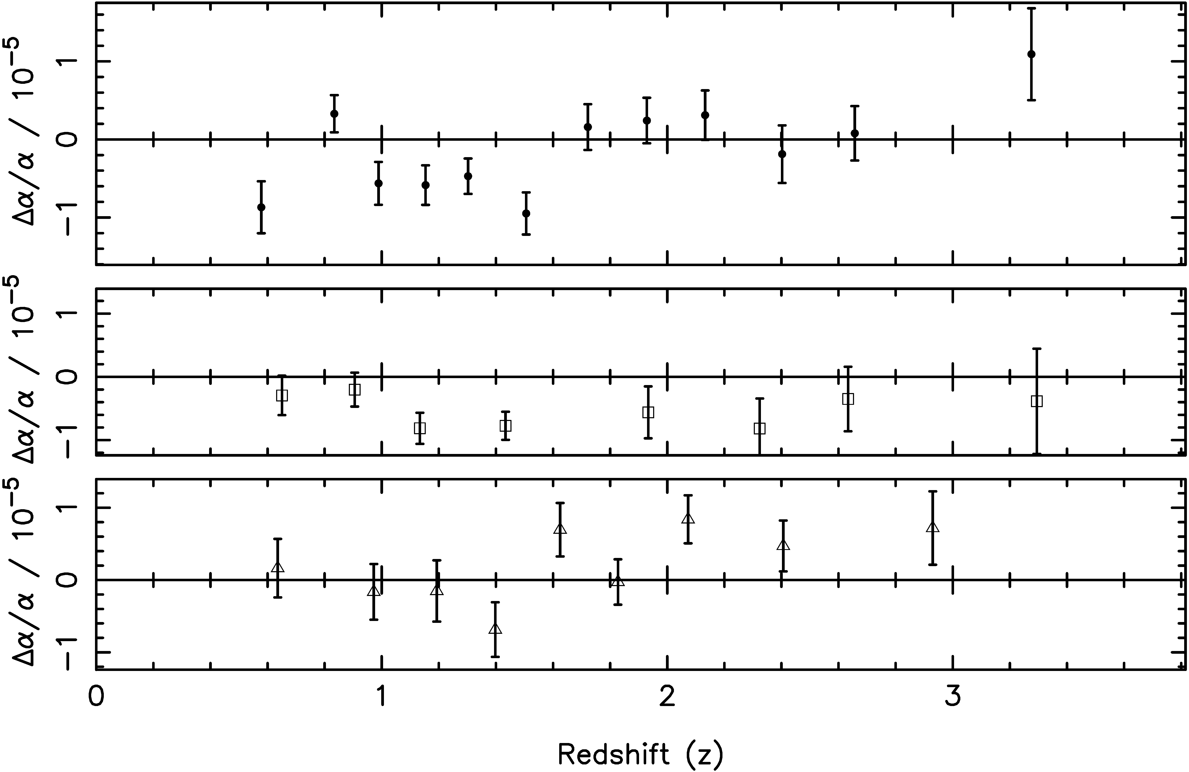
VLT/UVES vs. Keck/HIRES:
Keck
+
VLT
Keck
VLT

Slide 20
VLT/UVES vs. Keck/HIRES:
Keck
+
VLT
Keck
VLT
Keck @ z>1.8: Δα/α=(−0.74±0.17)×10⁻⁵
VLT @ z>1.8: Δα/α=(+0.61±0.20)×10⁻⁵

Slide 21
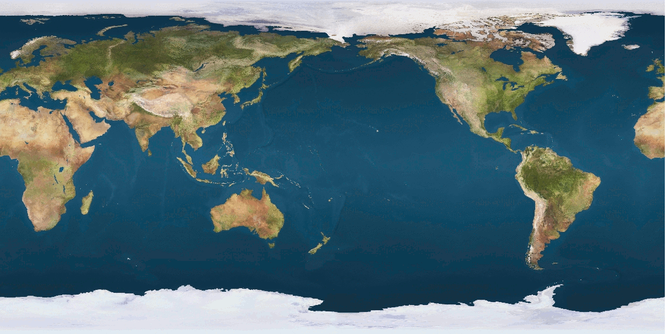
VLT/UVES vs. Keck/HIRES:
Keck:10-m diameter; Hawaii; latitude=19°49.7'
VLT: 8-m diameter; Chile; latitude=-24°37.5'
Keck
VLT
Notes:
Hello

Slide 22
VLT/UVES vs. Keck/HIRES:
Keck:10-m diameter; Hawaii; latitude=19°49.7'
VLT: 8-m diameter; Chile; latitude=-24°37.5'
+77°
Keck
-38°
Notes:
Hello

Slide 23
VLT/UVES vs. Keck/HIRES:
Keck:10-m diameter; Hawaii; latitude=19°49.7'
VLT: 8-m diameter; Chile; latitude=-24°37.5'
+77°
Keck
+17°
-38°
VLT
-51°
Notes:
Hello

Slide 24
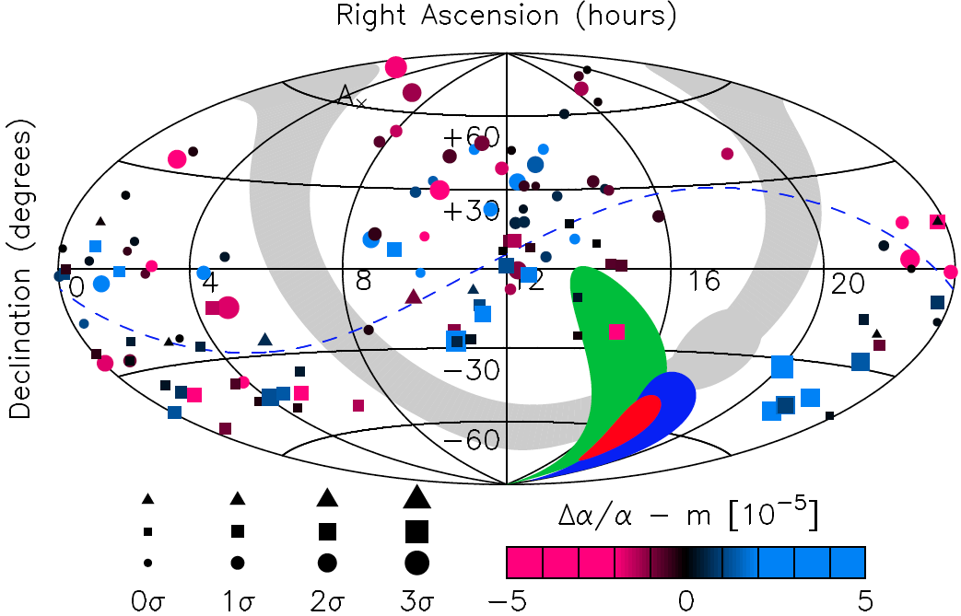
Δα/α for individual sight-lines:

Slide 25
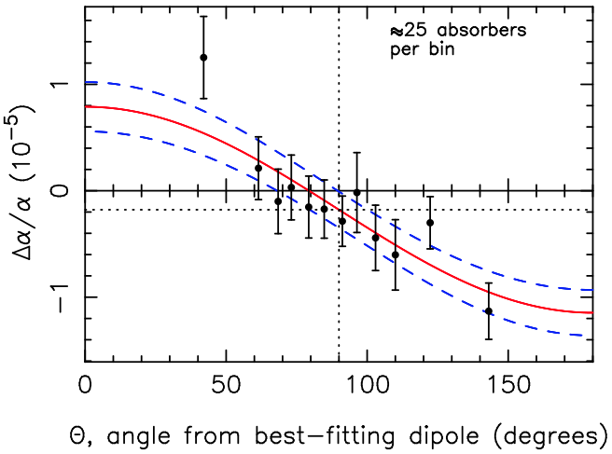
Evidence for an α dipole:
Keck+VLT data combined
Δα/α = A cosθ + m
Dipole required at 4.1-σ significance over monopole

Slide 26
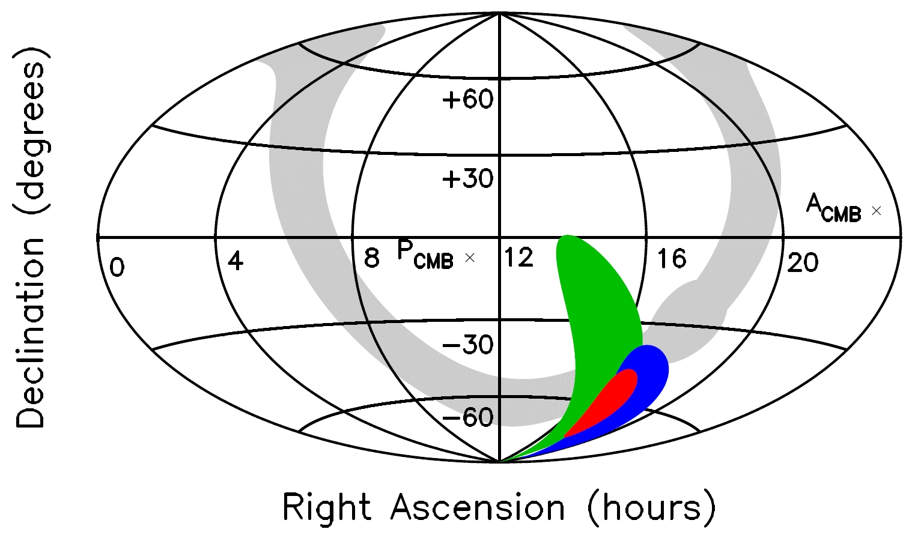
Dipoles from VLT & Keck agree:
20° separation,
prob.=5%
Keck
VLT
Combined

Slide 27
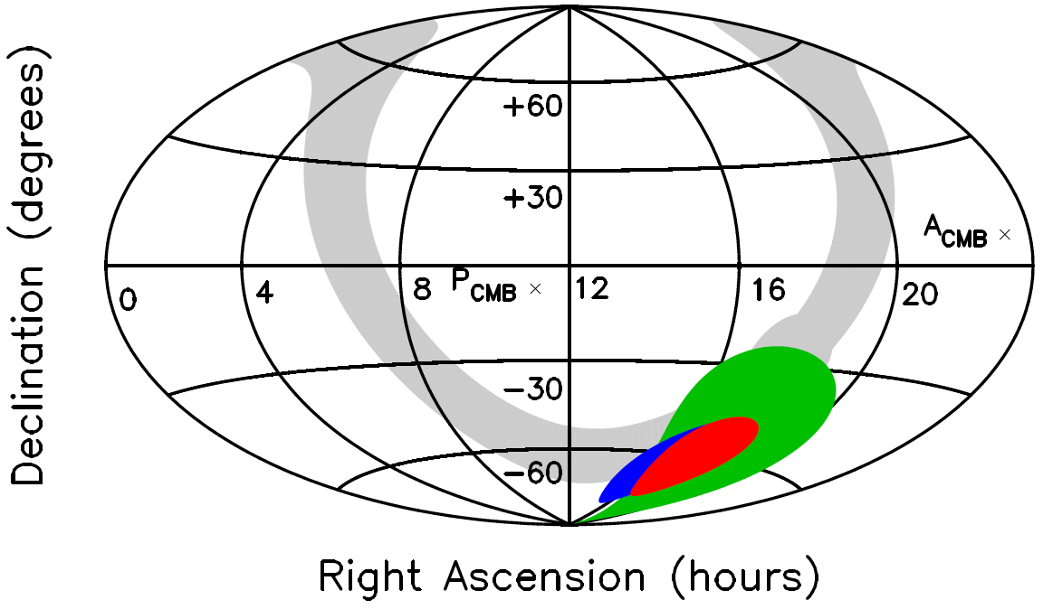
Dipoles at different z agree:
13° separation,
prob.=2%
z<1.6
z>1.6
Combined

Slide 28
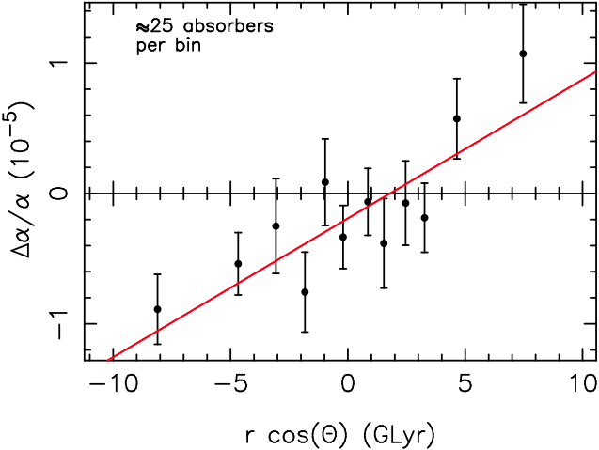
Dipole large at higher z:
Keck+VLT combined
Δα/α = B r cosθ + m
Distance dependence required at 4.1-σ significance

Slide 29
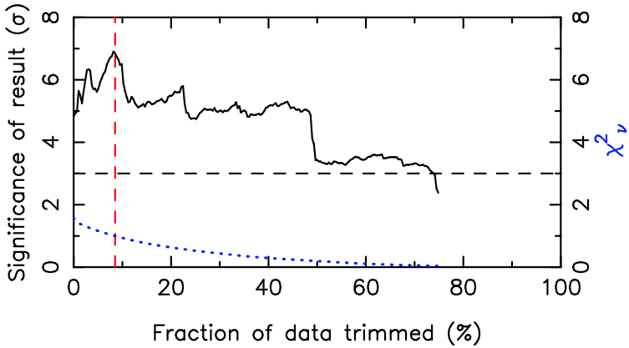
Dipole not from outliers:
Trim data instead of adding systematic to errors
Adopt statistical errors only
Iteratively trim most deviant points
χ²_{ν}=1 when ~10% data clipped.
Dipole at ~7σ at χ²_{ν}=1
Dipole still ~4σ after 50% data clipped.

Slide 30
Varying α…or just systematics?:
Despite internal consistencies & robustness, most important question is the effect and magnitude of systematic errors.
Two approaches:
Identify all systematics we can think of and quantify them all
Done for both Keck & VLT
No systematics found which explain results
But can never be 100% convincing

Slide 31
Varying α…or just systematics?:
Despite internal consistencies & robustness, most important question is the affect and magnitude of systematic errors.
Two approaches:
Identify all systematics we can think of and quantify them all, and
Find a purely empirical approach which directly measures all important systematics, both known and unknown, simultaneously.
Done for both Keck & VLT
No systematics found which explain results
But can never be 100% convincing
Compare Keck & VLT spectra of the same QSOs

Slide 32
Direct Keck–VLT comparison:
2 spectra of same QSO, 1 from Keck, 1 from VLT
For all absorption lines, measure Δv between Keck & VLT spectra
Using additional information breaks degeneracy between Δα/α and systematics

Slide 33
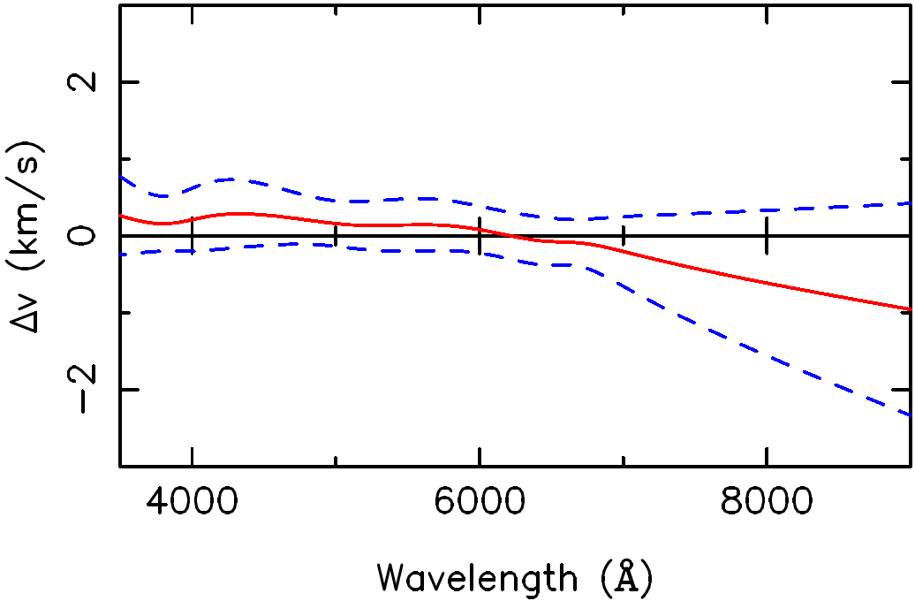
Direct Keck–VLT comparison:
Joint Δv prediction from ~800 lines in 6 paired spectra

Slide 34
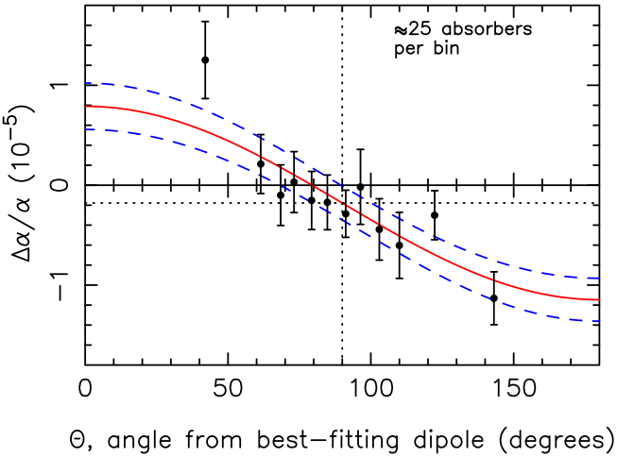
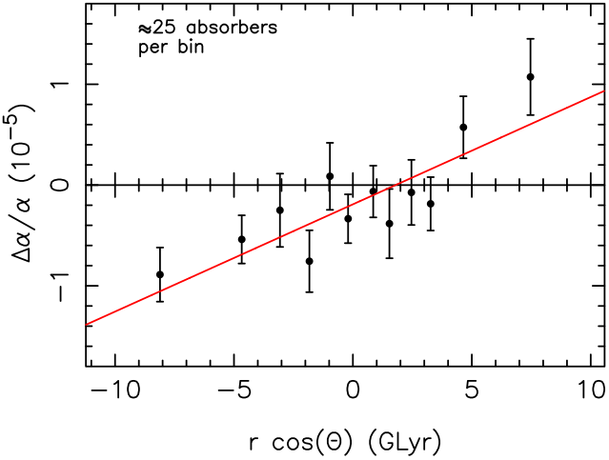
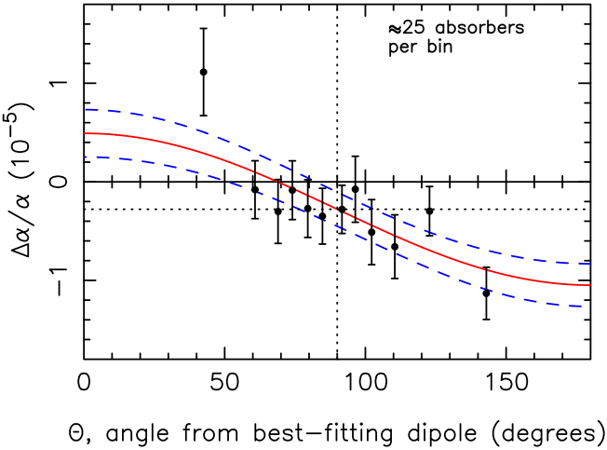
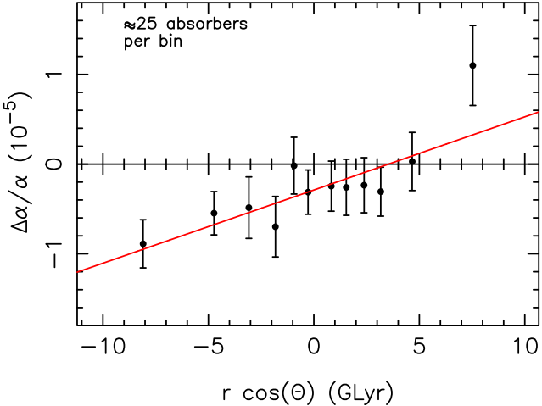
Before & after applying Δv fit:
Before
After

Slide 35
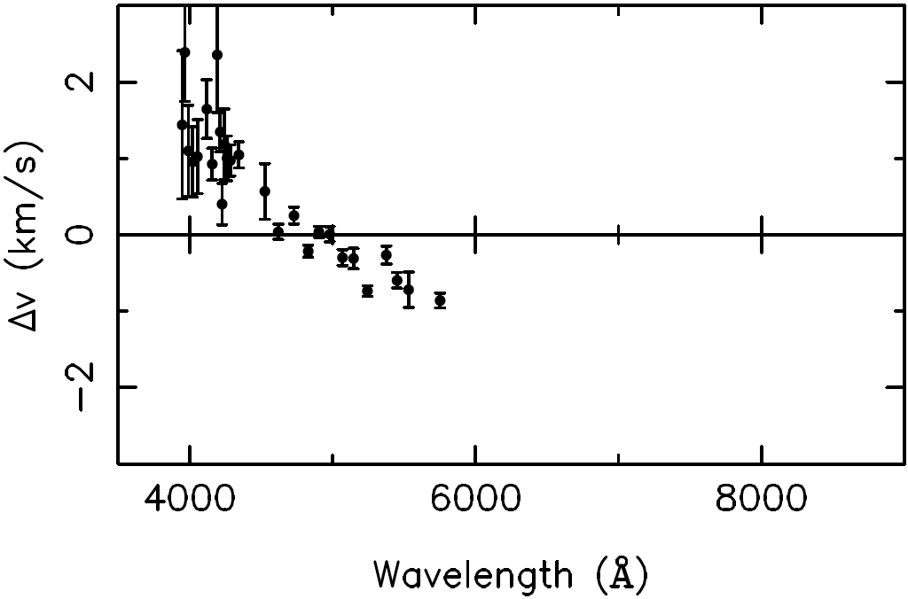
The odd one out – the 7th pair:
Likely problems with the Keck spectrum
Unrepresentative effect; if ubiquitous, would dramatically increase observed scatter in Δα/α

Slide 36
Conclusions:
Previous Keck + new VLT results show evidence for spatial variation in α
Two internal consistencies:
Keck and VLT dipoles agree
High- and low-z dipoles agree
Robustness: dipole not generated by outliers
No known systematics explain the results
Quasar pairing:
Empirical, direct test for unknown systematics
7 current pairs don’t indicate Keck or VLT problems
Need more pairs!

Slide 37
Future work:
More archival VLT + Keck absorbers in pipeline
New dedicated VLT “Large Programme” underway (PI Molaro)
Target α pole/anti-pole
Comparing spectra of same QSOs with diff. telescopes most con- vincing test
What about Japan’s Subaru/HDS in Hawaii?
Need a completely independent method: OH “conjugate” systems? H I 21-cm vs. optical or millimetre? Constraints on varying proton-to-electron mass ratio (H₂ and NH₃)…
?
?

Slide 39
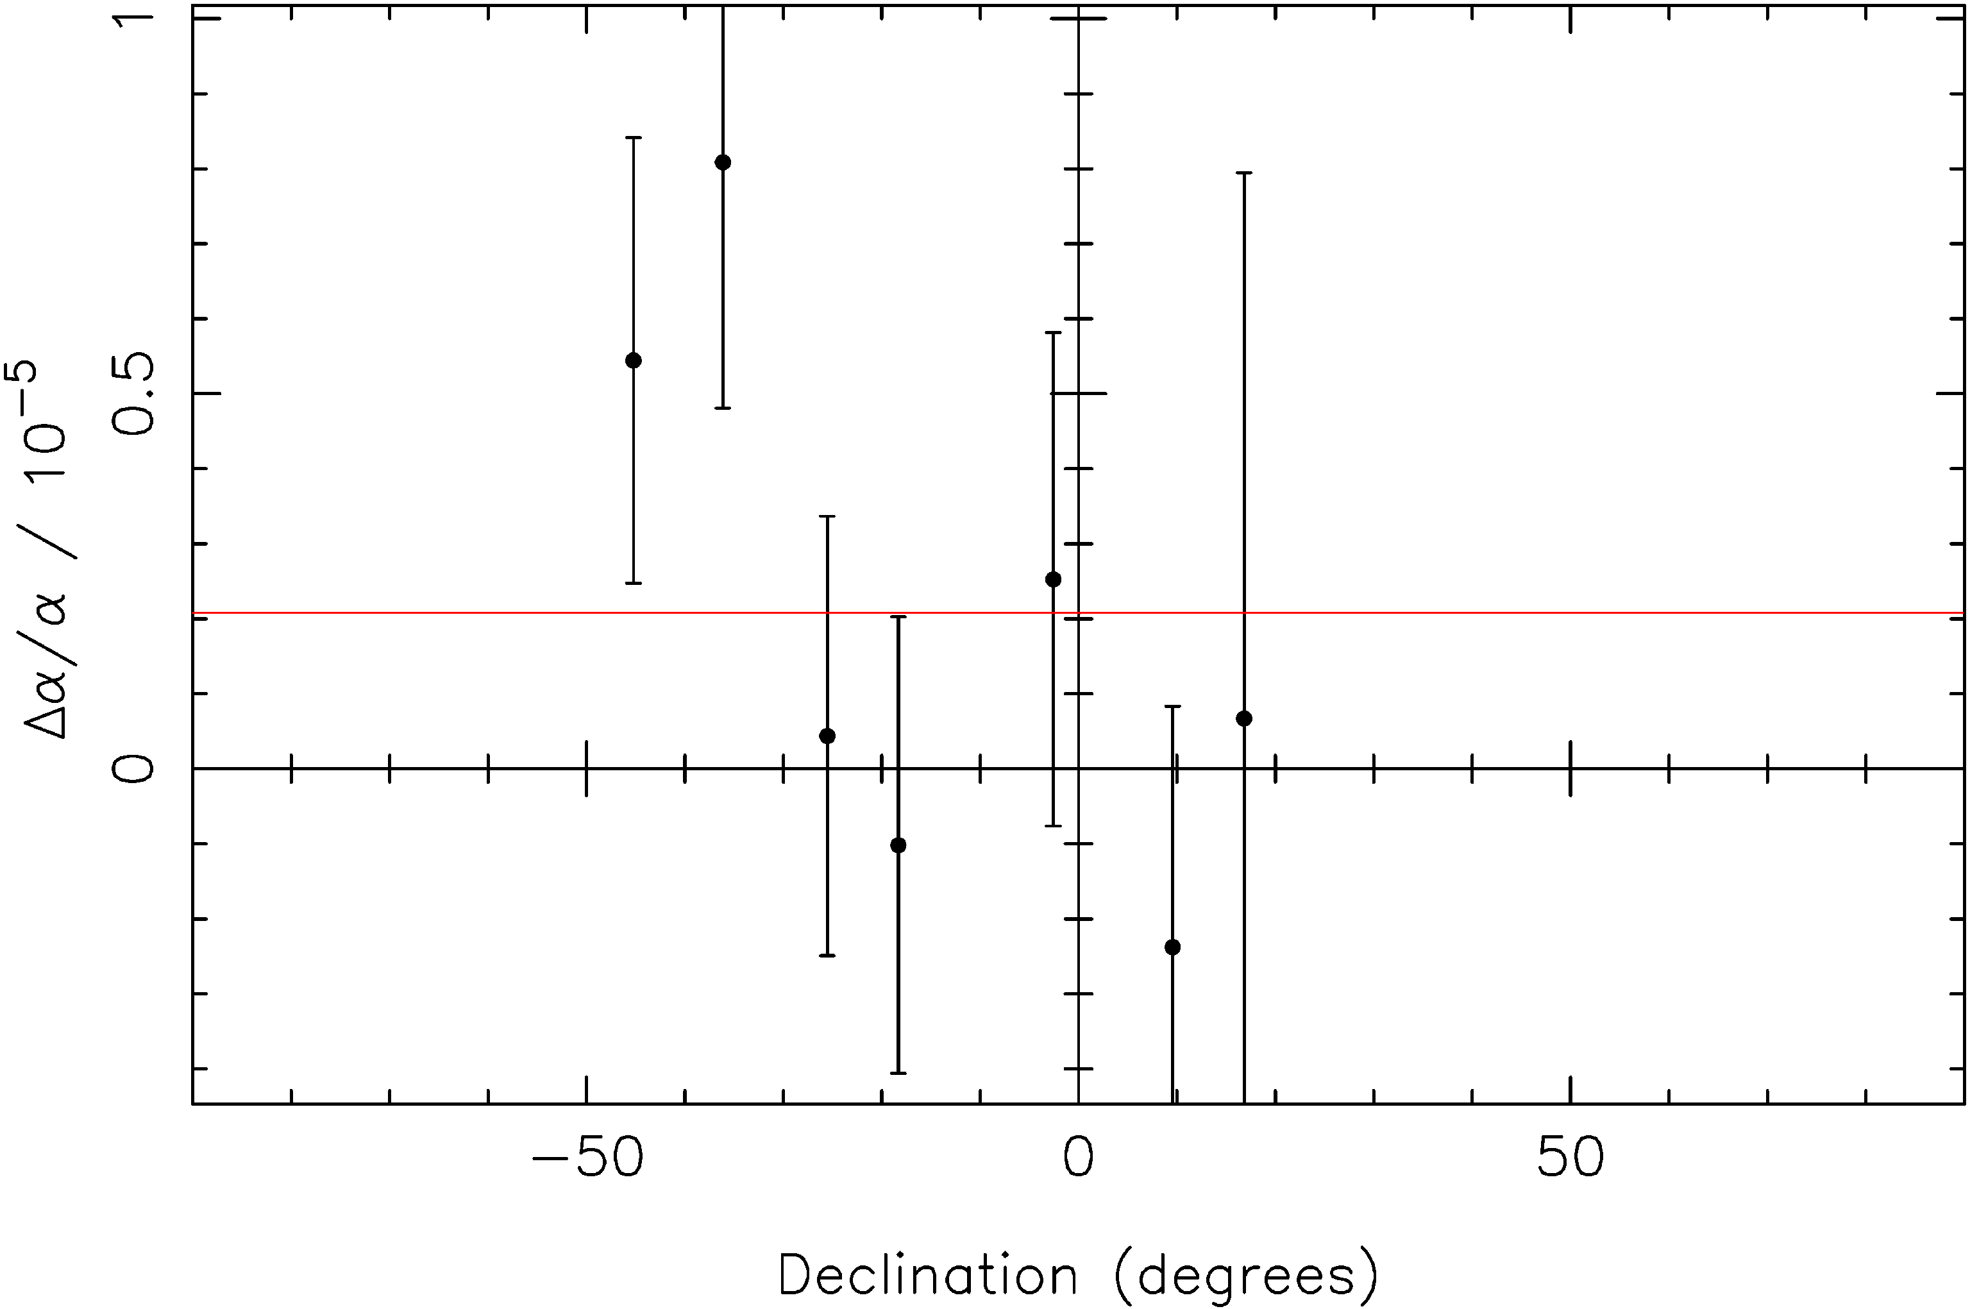
Correlation with declination?:
Declination = latitude on sky
Using VLT data only
2.1-σ anti-correlation

Slide 40
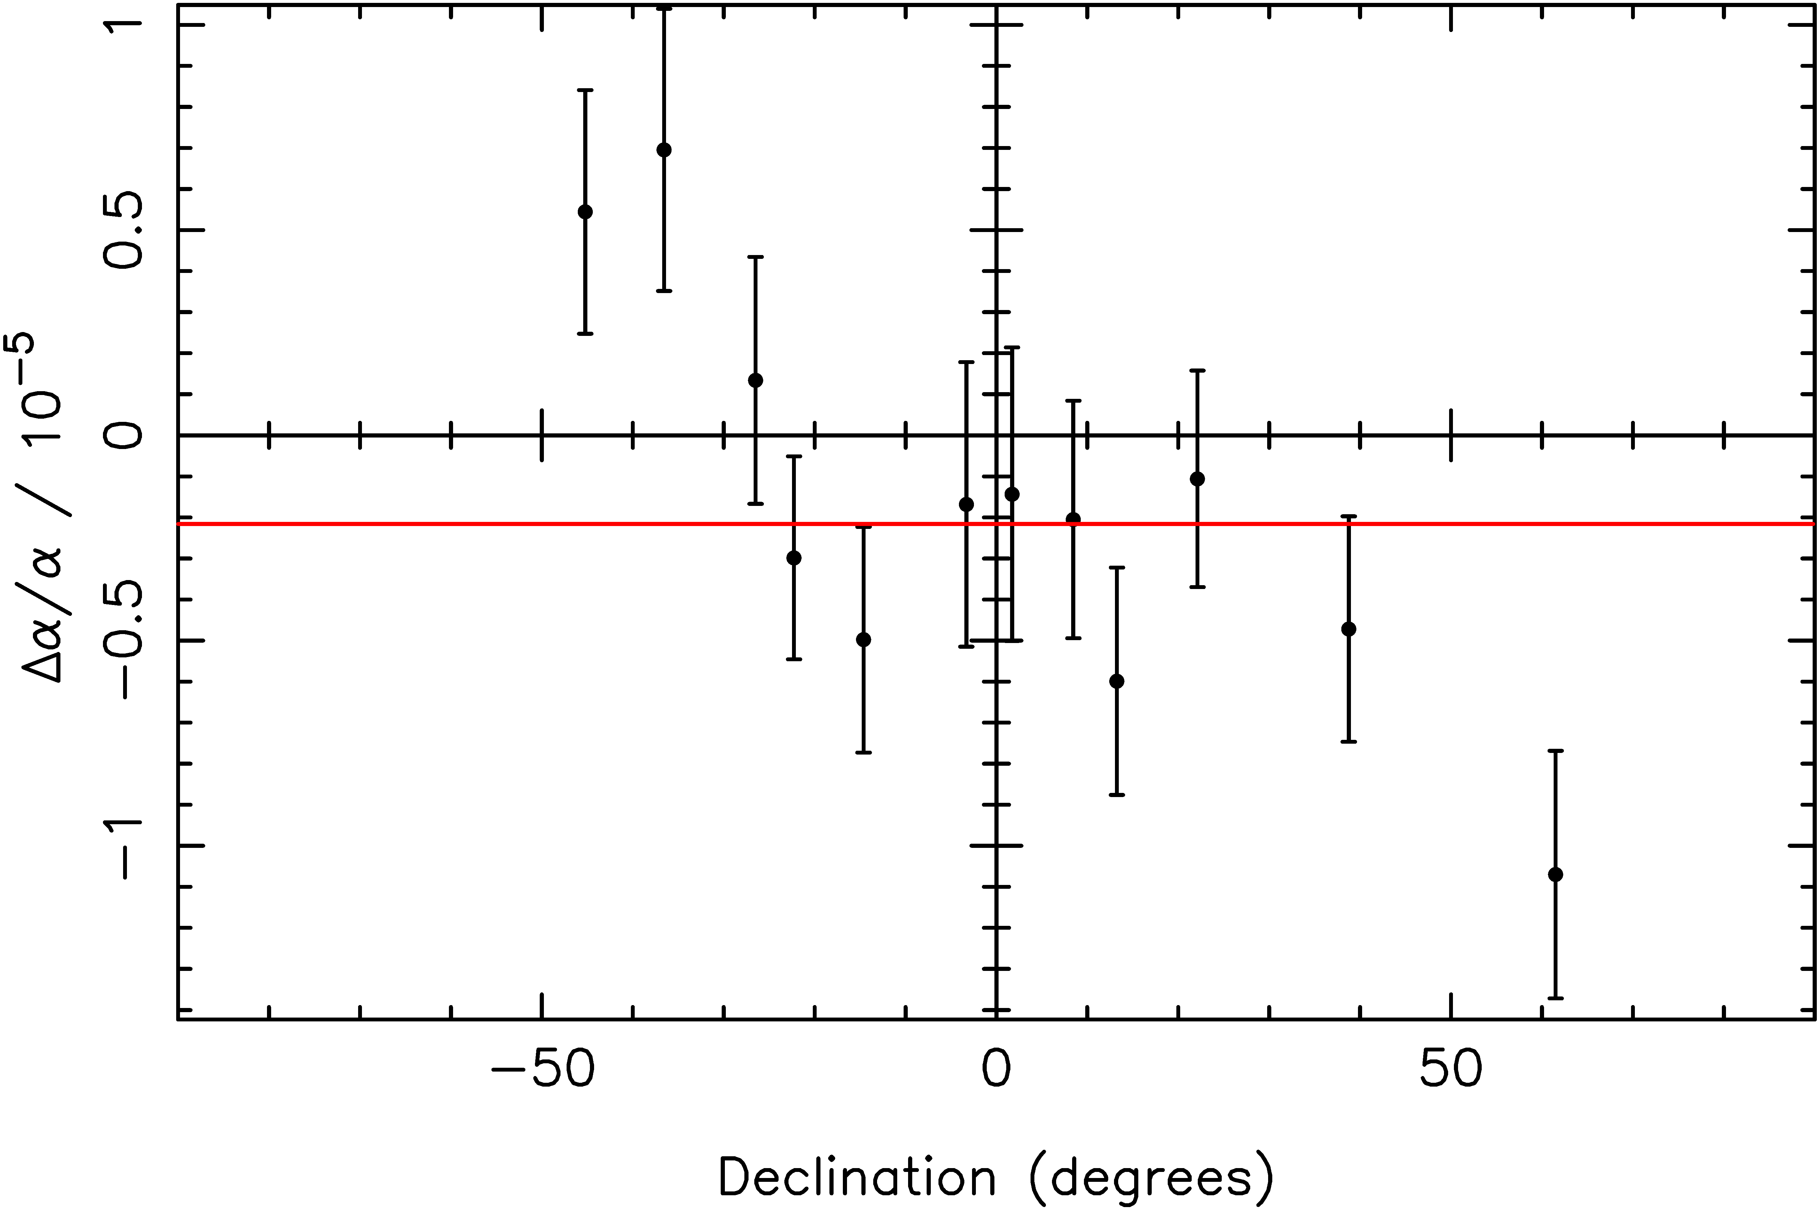
Correlation with declination?:
Declination = latitude on sky
Using VLT and Keck data

Slide 41
Correlation with declination?:
Declination = latitude on sky
Using VLT and Keck data
VLT
Keck

Slide 42
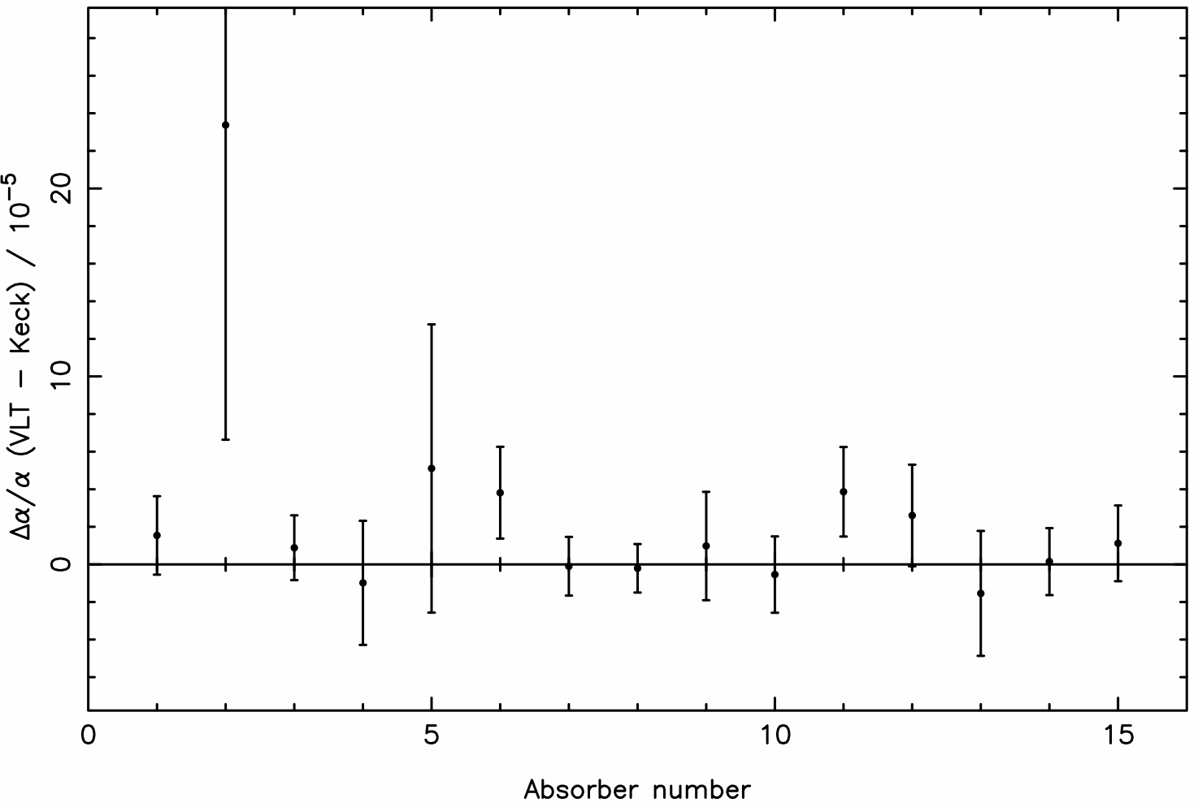
7 Keck/VLT pairs, 15 absorbers:

Slide 43
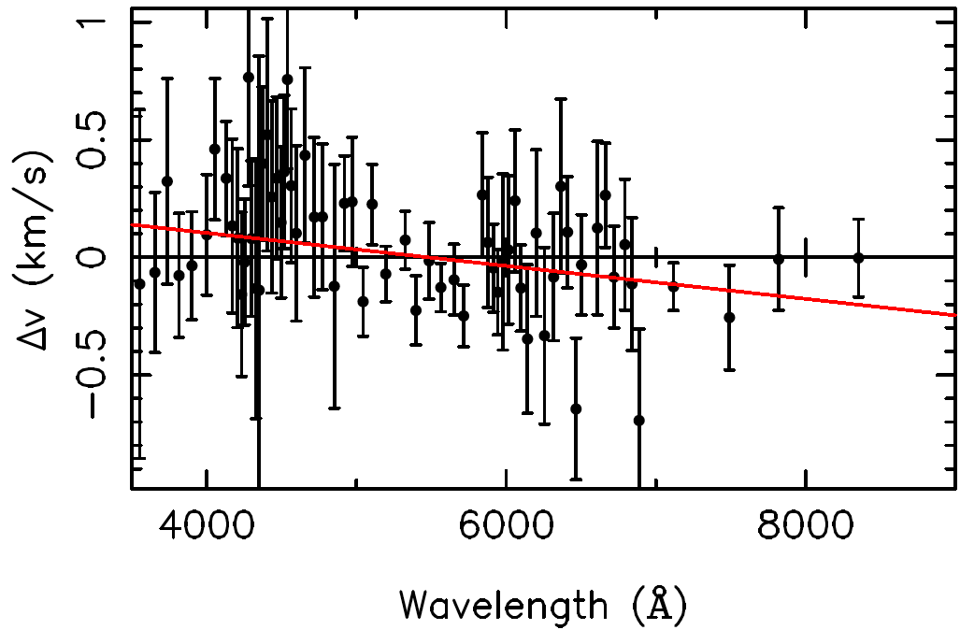
Direct Keck–VLT comparison:
Binned Δv values from ~800 lines in 6 paired spectra

