Slide 1
Two and Three Dimensional Self-gravitating System with Initial Singularity
Ludek Jirkovsky¹ and Luis Maria Bo-oT^{2,*}
¹Department of Informatics and Geo-informatics,
Fakulta Zivotnivo Prostedi,
Univ. of J.E. Purkyne, Kralova Vysina 7,
Usti n. L., 40096 Czech Republic
²Plasma Physics Lab, National institute of Physics,
Univ. of the Philippines, Diliman,
Quezon City, 1101 Philippines
* luis_bo_ot@yahoo.com

Slide 2
Abstract
Motivation & Objective
Coupled Vlasov-Poisson Equation
Results for Two and Three Dimension
Conclusion & Prospects
References & Acknowledgement

Slide 3
Abstract
It is shown that it is possible
to extend perturbation calculations used in solving
the coupled Vlasov-Poisson Equations
for a one-dimensional gravitational gas
to two and three dimensions. An example using AN
initial Dirac delta distribution and Maxwellian velocity distribution is given.
We reproduce main features of the
one-dimensional model such as formation of inhomogeneities and also OBTAIN quantitatively and qualitatively new results in the higher dimensions Demonstrating how galaxies could be formed
in the early universe.

Slide 4
Motivation/Objective
A suggestion (Mineau etal, 1990; Muriel etal, 1993) that limited results in the studies of the one-dimensional gravitational gas should be extended to two and three dimensions is the main motivation.
Studies for gravitational gas in higher dimensions are rare, and even until recently, most of them are numerical solutions (Bonvin etal, 1998; Miller etal, 2005) since analytic solutions are difficult.
Our purpose is to reproduce the results in one dimension, and obtain new and interesting results for the case of two and three dimensions.

Slide 5
Coupled Vlasov-Poisson Equation
The coupled Vlasov-Poisson equation
(1)
(2)
where is the particle density as an integral of the distribution function over velocity space and is the gravitational constant.

Slide 6
‘Linearizing’ (Landau, 1946), perturbing and transforming
Eqns. 1 & 2 to spherical coordinates we obtain
Expanding the distribution function and the field
in perturbation series, ie
then substituting to Eq. 1 after which we extract terms of appropriate orders of .
(3)
(4).

Slide 7
Zero-order Vlasov Equation: (5).
First-order Eqn.: (6).
Second-order Eqn.:
(7).
- - - - - - - - - - - - - -
Zero-order Solution: where is the number of particles, is chosen as a Maxwellian velocity distribution, and is an arbitrary function .

Slide 8
The i-th order Solution:
(8)
● time development of density not exceeding Jeans period
● true values for ; ;

Slide 9
Results
Zero-order -function in polar coordinates:
Initial Singularity with Maxwellian velocity distibution:
Zero-order distribution: satisfying Vlasov eqn.
Zero-order density:
Zero-order density from Poisson eqn:

Slide 10
…..the expressions for the first-order correction to the field and
the succeeding second-order corrections to the distribution function and density
are algebraically lengthy involving exponentials and erf functions….!!!
...even using Maple®!!

Slide 12
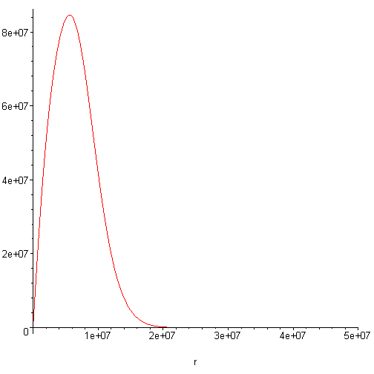
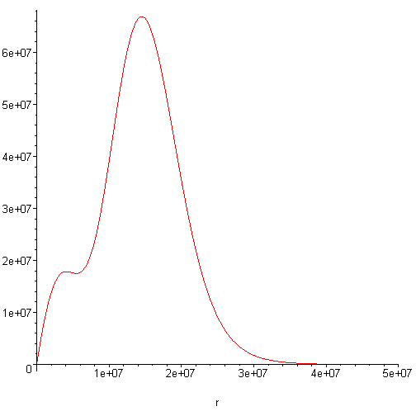
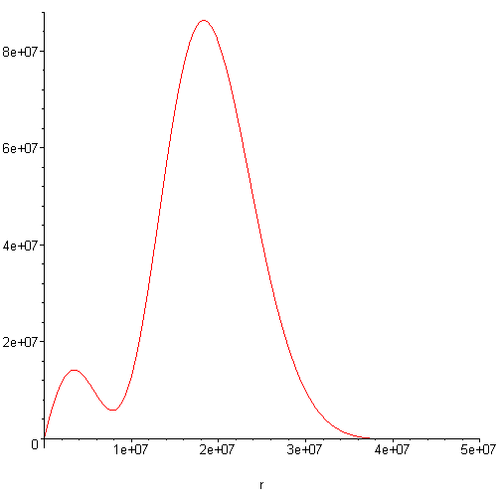
Fig. 1. For the two-dimensional system, time development of mass density vs. radial distance for t=4,6,8 (above, left to right).

Slide 13
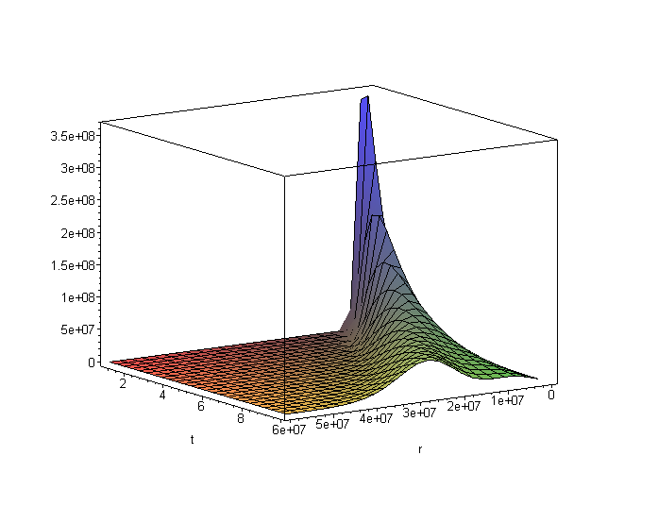
Fig. 2. For the three dimensional system, time development of mass density vs. radial distance for t =1-10.

Slide 14
Conclusions
Reproduced main feature of the one-dimensional gas model—formation of inhomogeneities hinting at substructures which are important to formation of galaxies.
There is some ‘angular motion’ as seen in the three-dimensional case.
However, in three-dimensions unlike in one-dimension, the inhomogeneities are positive.
Also, time evolution of the density also shows ‘splitting’.

Slide 15
Prospects
Term by term analysis of the more involved analytic expansions.
We note that only gravitational forces are used in this work, no electromagnetic forces so far.

Slide 16
References & Acknowledgment
References
Bonvin, J.C., Martin P.A., Piasecki J. and Zotos X.: 1998
J. Stat. Phys. 91, 177
Landau, L.D.: 1946, J. Phys. (USSR) 10, 25
Lecar, M. and Chen, L.: 1971, Astrophys. Space Sci. 13, 397
Miller, B., Yawn, K. and Maier, B.: 2005, Phys. Lett. A 346, 92
Mineau, P., Feix, M.R and Muriel, A.:1990, Astron. Astrophys. 233, 422
Muriel, A., Feix, M. and Jirkovsky, L.: 1993, Astron. Astrophys. 279, 341
This work acknowledges support from the Hitachi Scholarship Foundation.

