Slide 1
Dark energy from primordial inflationary quantum fluctuations.
ArXiv:1006.0368[astro-ph.CO]
PRL 105, 121301 (2010)
Christophe Ringeval (Louvain University)
Teruaki Suyama (Research Center for the Early Universe)
Tomo Takahashi (Saga University)
Masahide Yamaguchi (Tokyo Institute of Technology)
Shuichiro Yokoyama (Nagoya University)

Slide 2
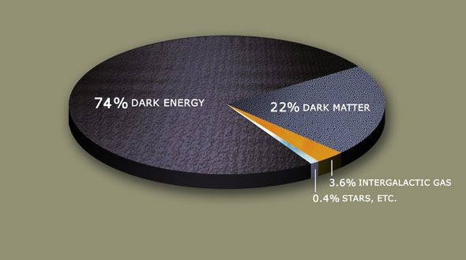
The expansion of the universe is accelerating.
From wikipedia
Cosmological constant
Quintessence (introduction of a scalar field)
Modification of gravity
….

Slide 3
Quintessence
Acceleration by the potential energy of the scalar field
Freezing type
Thawing type
w
w
w=-1
w=-1
t
t

Slide 4
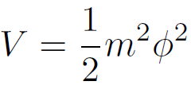
The scenario
: quintessence field
During primordial inflation, the coarse grained field undergoes random walk.
Quantum diffusion

Slide 5
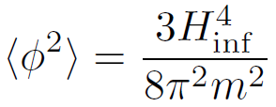
The scenario
: quintessence field
During primordial inflation, the coarse grained field undergoes random walk.
Gaussian distribution
The field takes this typical value in our observable universe.

Slide 6
The scenario
The potential energy
Only depends on
We require that this potential energy is responsible for the current accelerated expansion:
(1)
(2)
is completely fixed. (no free parameters)

Slide 7
The scenario
Energy scale of the primordial inflation
To summarize,
If there is a light scalar field such that , and if the primordial inflation has occurred at TeV scale, then the field drives the current accelerated expansion.

Slide 8
Some consequences
(1) Reheating temperature
(2) Tensor-to-scalar ratio
(3) Eternal inflation
The number of e-fold required to reach the Bunch-Davies distribution
This can be realized in the eternal inflation.

Slide 9
Observational constraints
Parameters that are varied.
Basic equations
Observations
Type Ia supernovae (R.Amanullah et al., ApJ. 716, 712 (2010))
Baryon acoustic oscillations (W.J.Percival et al., MNRAS, 401, 2148, (2010))
Acoustic peak of the CMB power spectrum (arXiv:1001.4538)

Slide 10
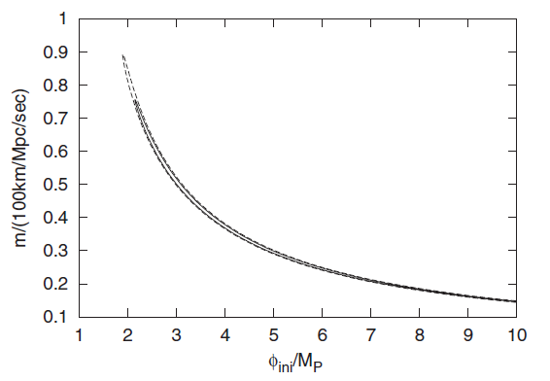
Observational constraints
well fits with

Slide 11
Energy scale of inflation

Slide 12
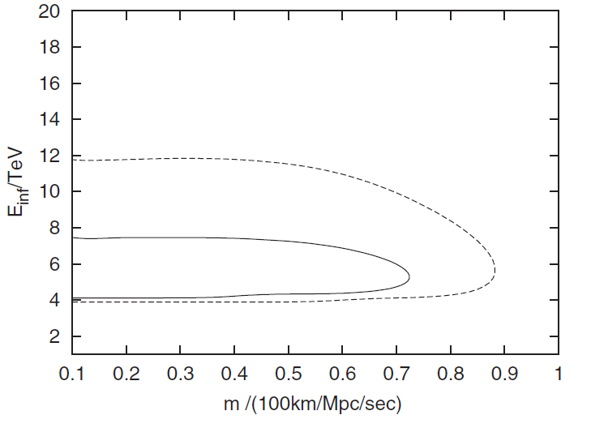
Energy scale of inflation

Slide 13
Summary
We proposed new dark energy scenario that has a link with the primordial inflation.
The current acceleration of the universe is due to the quantum fluctuation of the scalar field generated during the primordial inflation.
In this scenario, the energy scale of the primordial inflation is predicted to be around TeV scale.
Negligile tensor to scalar ratio.
Reheating temperature less than TeV.
Eternal inflation is one possible model.

