Slide 1
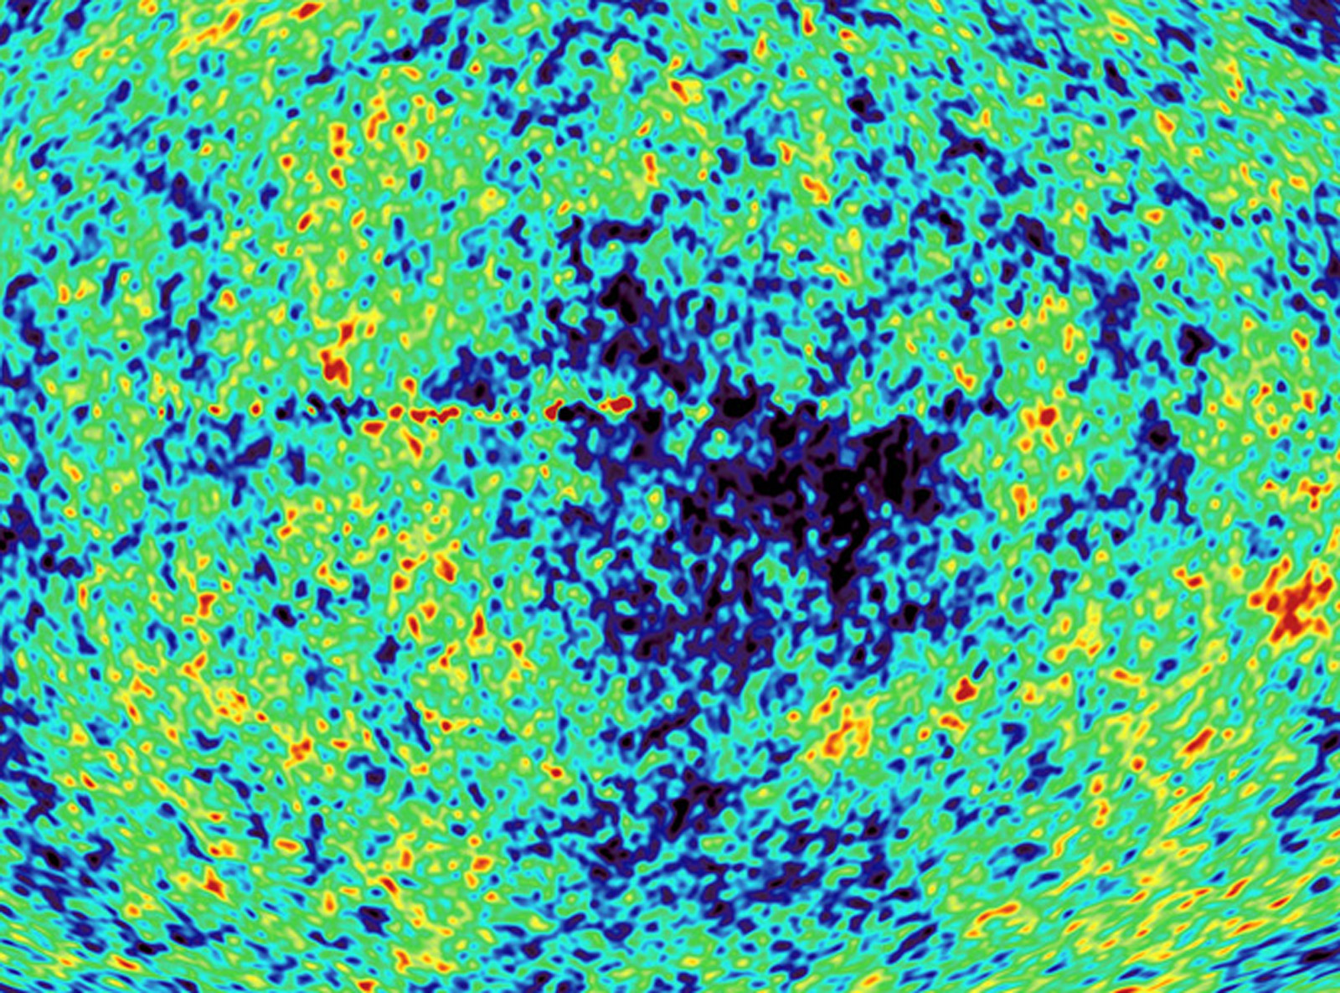
(some) Future CMB Constraints on fundamental physics
COSMO/CosPA2010, Tokyo University (Hongo) September 26th 2010
Alessandro Melchiorri
Universita’ di Roma, “La Sapienza”

Slide 2
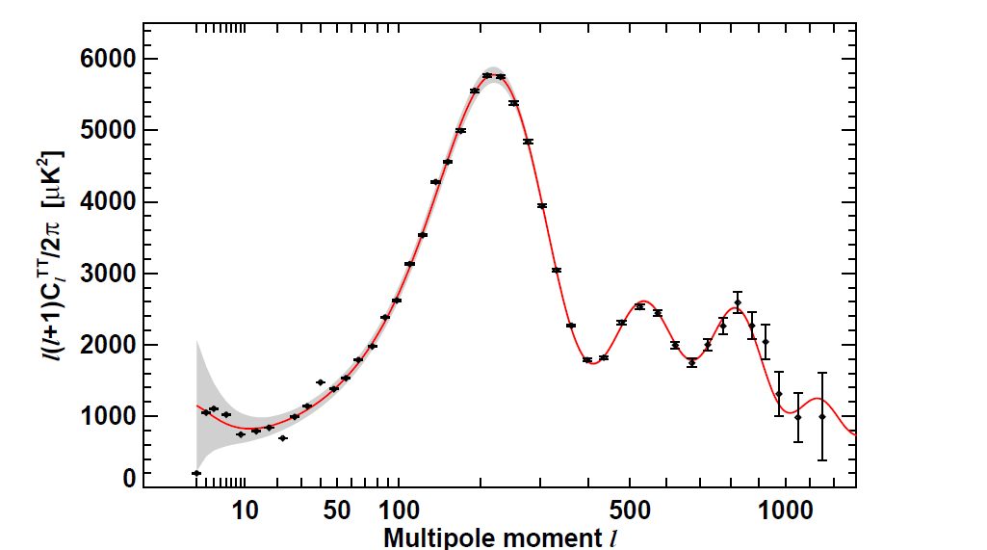
New WMAP results from 7 years of observations
Komatsu et al, 2010, 1001.4538

Slide 3
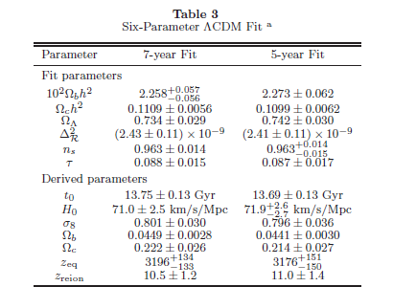

Slide 4
New Measurements, More Parameters !
Neutrino masses
Neutrino effective number
Primordial Helium

Slide 5
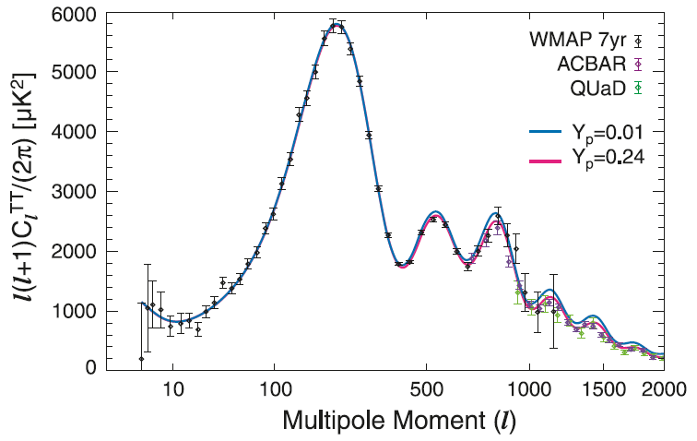
Small scale CMB can probe Helium abundance at recombination.
See e.g.,
K. Ichikawa et al., Phys.Rev.D78:043509,2008
R. Trotta, S. H. Hansen, Phys.Rev. D69 (2004) 023509

Slide 6
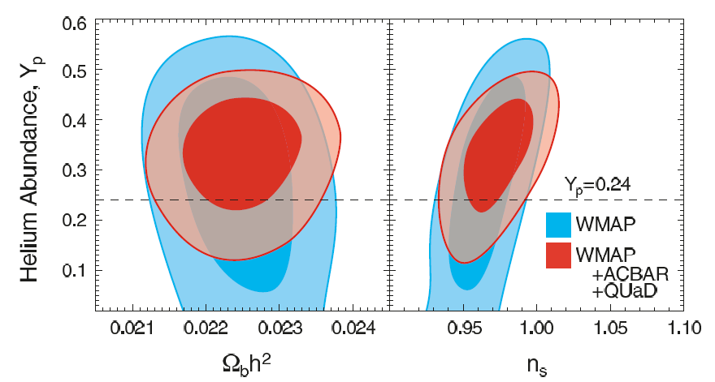

Komatsu et al, 2010, 1001.4538

Slide 7
Cosmological (Active) Neutrinos
Neutrinos are in equilibrium with the primeval plasma through weak
interaction reactions. They decouple from the plasma at a temperature
We then have today a Cosmological Neutrino Background at a temperature:
With a density of:
That, for a massive neutrino translates in:

Slide 8
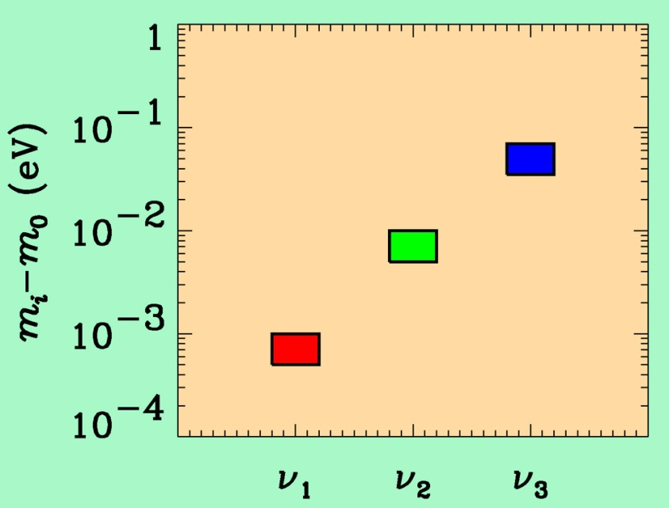
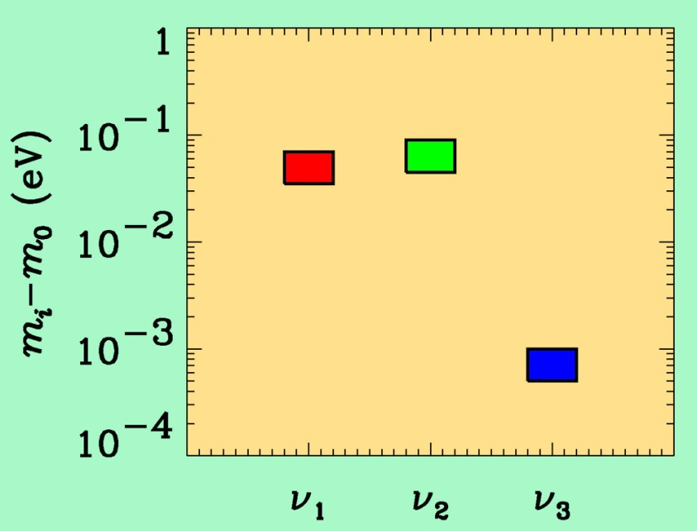
If neutrino masses are hierarchical then oscillation experiments
do not give information on the absolute value of neutrino masses
ATMO. ν
K2K
SOLAR ν
KAMLAND
Normal hierarchy
Inverted hierarchy
Moreover neutrino masses can also be degenerate

Slide 9
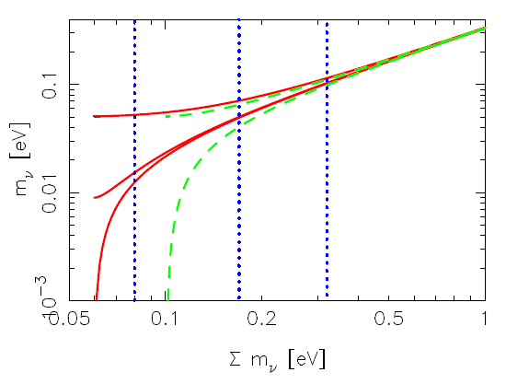
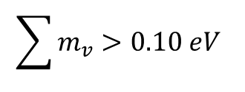

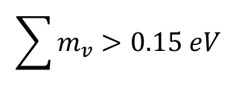
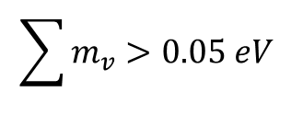
Testing the neutrino hierarchy
Degenerate Hierarchy predicts:
$$\sum{m_{v}}>0.15 eV$$
Inverted Hierarchy predicts:
$$\sum{m_{v}}>0.10 eV$$
Normal Hierarchy predicts:
$$\sum{m_{v}}>0.05 eV$$
$$m_{}^{2}=0.0025{eV}^{2}$$
we assume

Slide 10
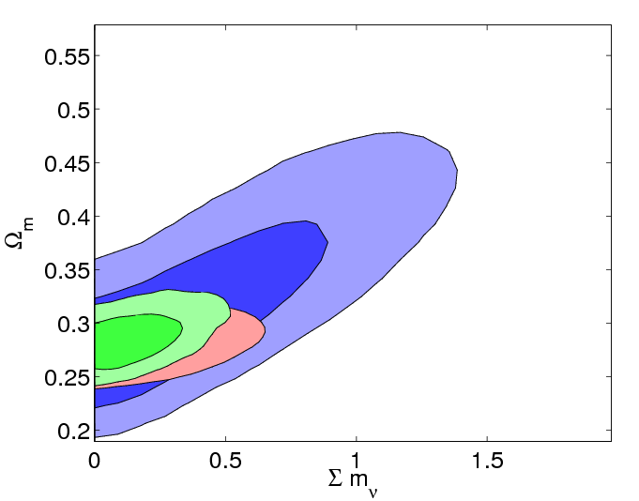
Current constraints on neutrino mass from Cosmology
(Fogli et al, 2010 in preparation).
Blue: WMAP-7
Red: w7+SN+Bao+H0
Green: w7+CMBsuborb+SN+LRG+H0
Current constraints (assuming ΛCDM):
Σmν<1.2 [eV] CMB
Σmν<0.7-0.5 [eV] CMB+other
Σmν<0.3 [eV] CMB+LSS (extreme)
[eV]
See also:
M. C. Gonzalez-Garcia, Michele Maltoni, Jordi Salvado, arXiv:1006.3795
Toyokazu Sekiguchi, Kazuhide Ichikawa, Tomo Takahashi, Lincoln Greenhill, arXiv:0911.0976
Extreme (sub 0.3 eV limits):
F. De Bernardis et al, Phys.Rev.D78:083535,2008, Thomas et al. Phys. Rev. Lett. 105, 031301 (2010)

Slide 11
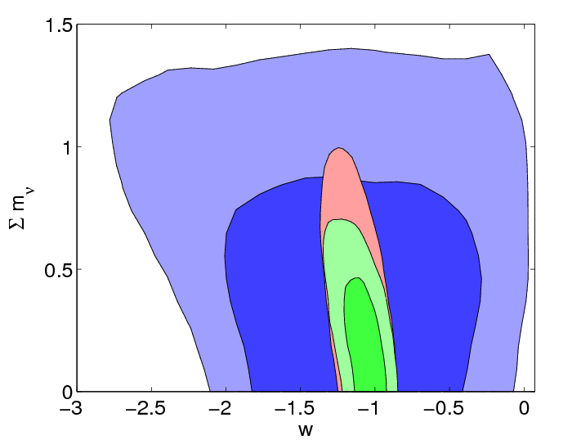
Current constraints on neutrino mass from Cosmology
(Fogli et al, 2010 in preparation).
Blue: WMAP-7
Red: w7+SN+Bao+H0
Green: w7+CMBsuborb+SN+LRG+H0
Constraints weaken by 30-50%
when «dark energy» is included.

Slide 12
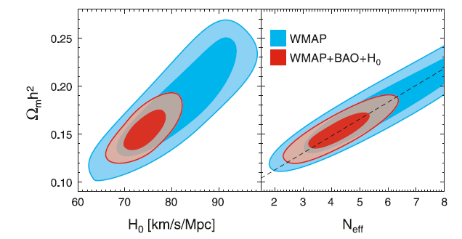
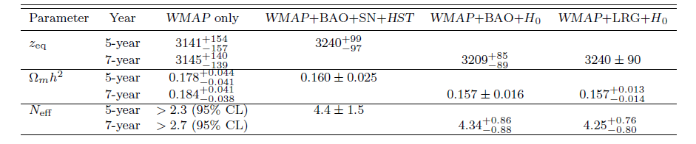
Komatsu et al, 2010, 1001.4538
Neutrino background.
Changes early ISW.
Hint for N>3 ?

Slide 13
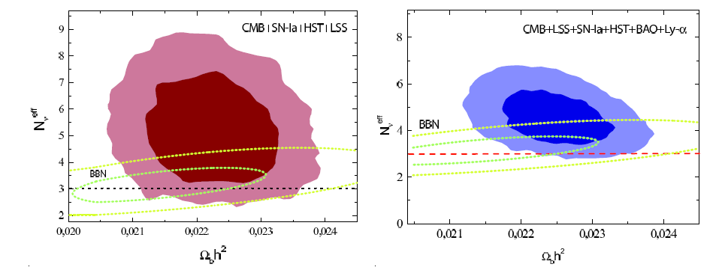
Gianpiero Mangano, Alessandro Melchiorri, Olga Mena, Gennaro Miele, Anze Slosar
Journal-ref: JCAP0703:006,2007

Slide 14
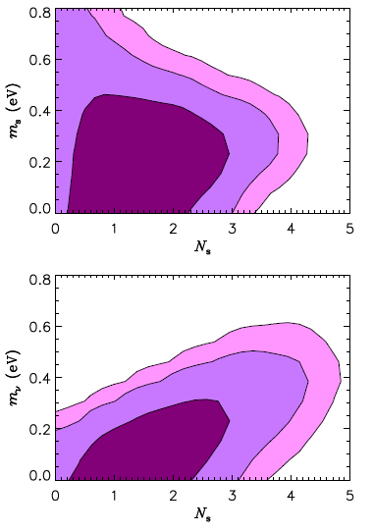
3 Active massless neutrinos+
Ns massive neutrinos
3 Active massive neutrinos +
Ns massless neutrinos
J. Hamann et al, arXiv:1006.5276

Slide 15
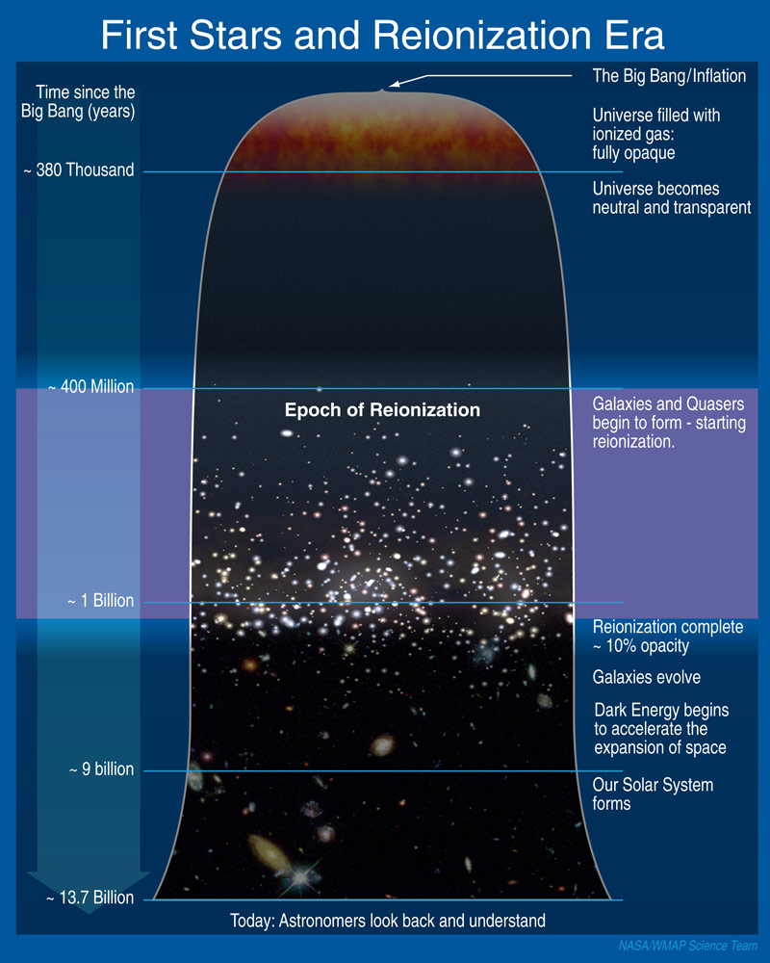

Slide 16
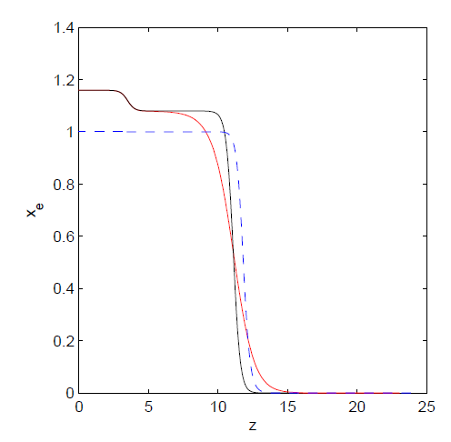
Sudden Reionization
CAMB Notes, Antony Lewis
As we don’t know precisely the details of the reionization history we should consider more general reionization scenarios
Notes:
Most of the current constraints on cosmological parameters from CMB anisotropy are obtained under the assumption of a specific phenomenological model for the ionization history.
The WMAP team assumes for reionization a model in which the reionization is an instantaneous or sudden process, rather than a more complicated and multi-phases one.
In this model the electron ionization fraction xe(z) is indeed parameterized with a single parameter z such that for z << z_reion xe(z) = 1 (xe(z) = 1.08 for z < 3 in order to take into account Helium recombination) and xe(z) = x2 e = 2 10^-4 for z > z_reion, i.e. joining the value after primordial recombination. The transition between these two values is smooth and given by a tanh function…. where y(zre) = (1 + zre)3/2 is where xe = f=2, i.e. z_re measures where the reionization fraction is half of its maximum.

Slide 17
MH’s Reionization
Following Mortonson & Hu we can parametrize the reionization history as a free function of the redshift by decomposing the free electron fraction as
The principal components Sμ (z) are the eigenfunctions of the Fisher matrix of an ideal, cosmic variance limited, experiment.
mμ are the amplitudes of the Sμ (z)
x^{fid} (z) is the WMAP fiducial model at which the FM is computed
M. J. Mortonson and W. Hu ApJ 686, L53 (2008)

Slide 18
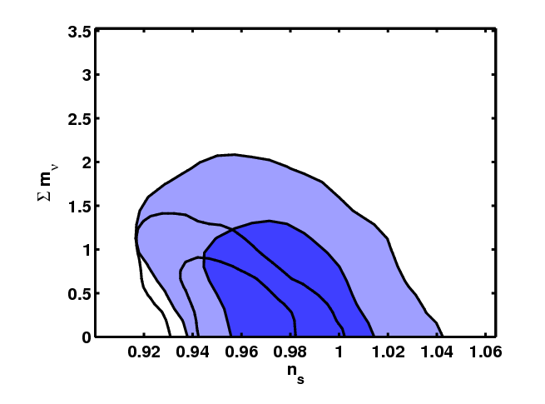
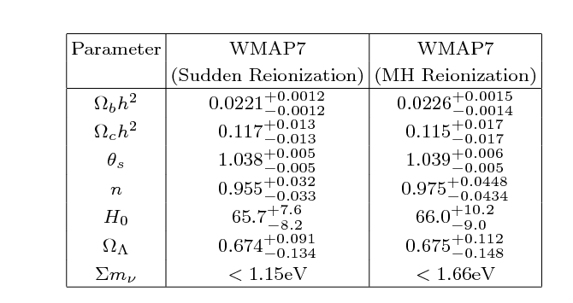
Impact of generalized reionization on CMB constraints on Neutrino Mass
Archidiacono, Cooray, Melchiorri, Pandolfi, 2010, PRD in press

Slide 19
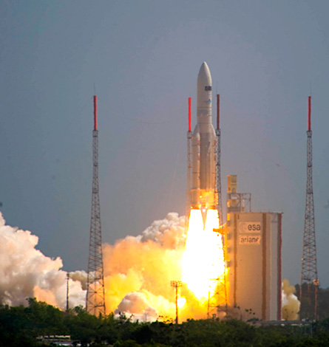
Planck
Satellite launch
14/5/2009

Slide 20
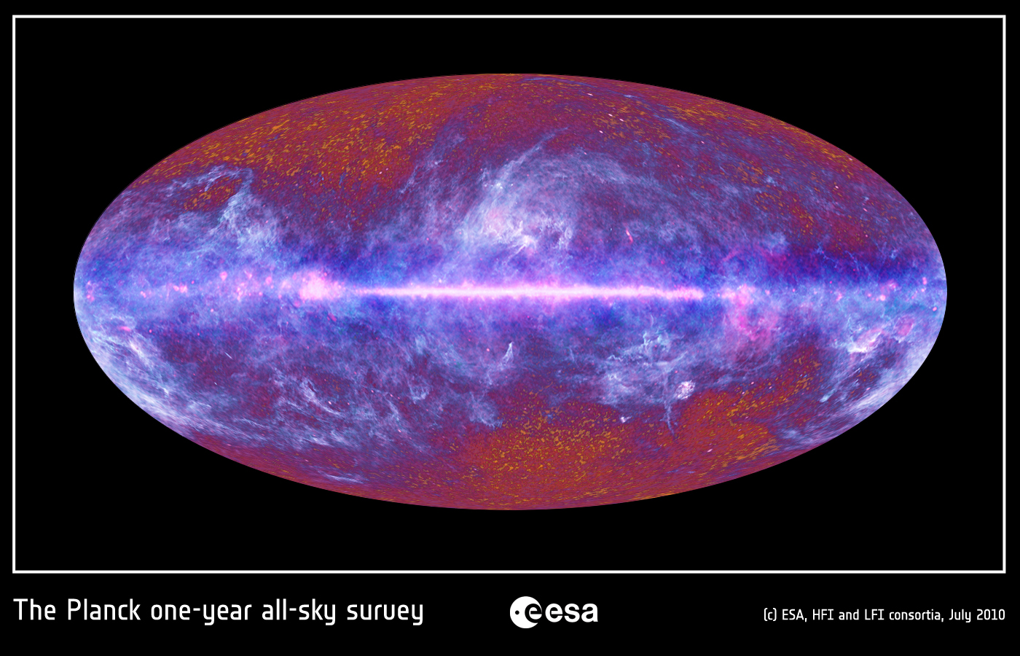

Slide 21
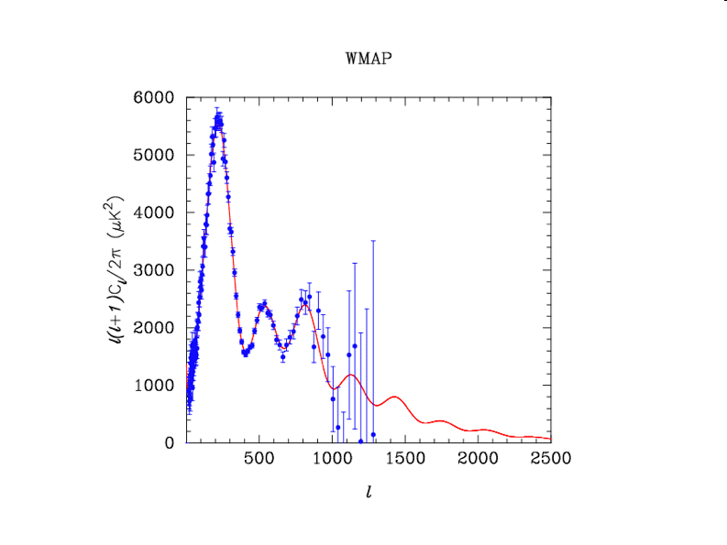
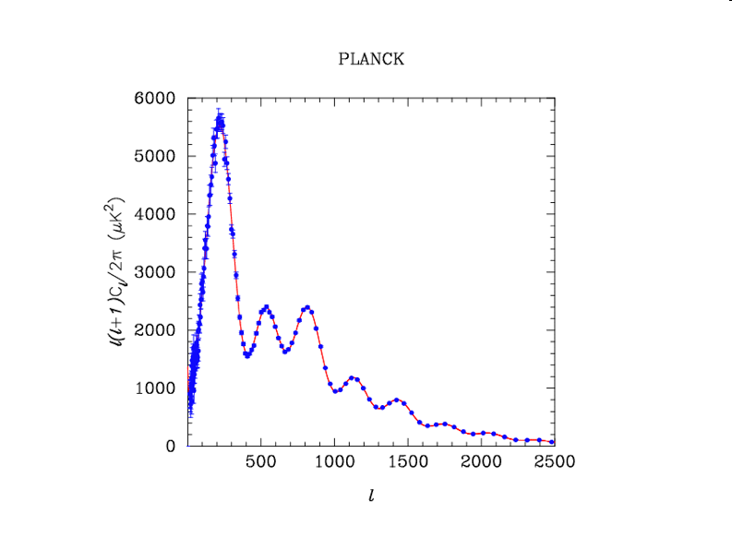

Slide 22
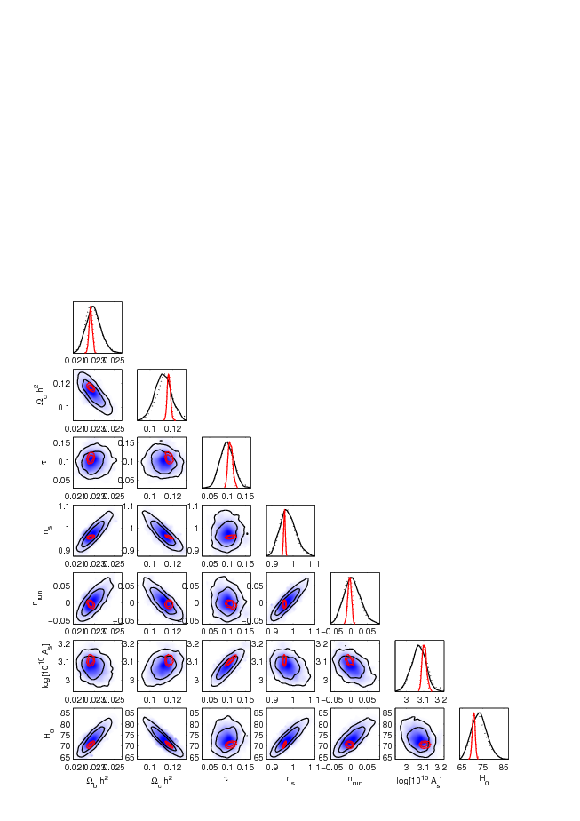
Blue: current data
Red: Planck

Slide 23
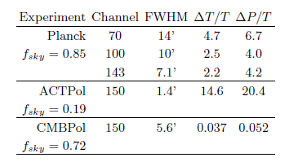
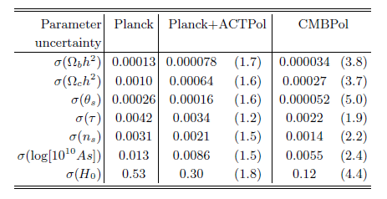
Let’s consider not only Planck but also
ACTpol (From Atacama Cosmology Telescope,
Ground based, results expected by 2013)
CMBpol (Next CMB satellite, 2020 ?)
Galli, Martinelli, Melchiorri, Pagano, Sherwin, Spergel, PRD submitted,
arXiv:1005.3808 2010

Slide 24
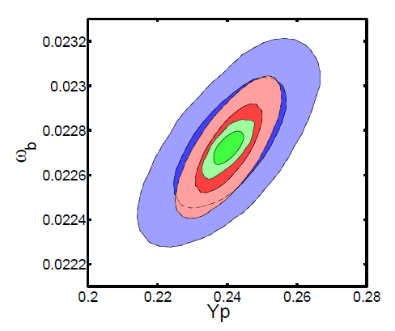
Constraints on Helium Abundance
Blue: Planck ΔYp=0.01
Red: Planck+ACTpol ΔYp=0.006
Green: CMBPol ΔYp=0.003
Galli, Martinelli, Melchiorri, Pagano, Sherwin, Spergel, PRD submitted,
arXiv:1005.3808 2010

Slide 25
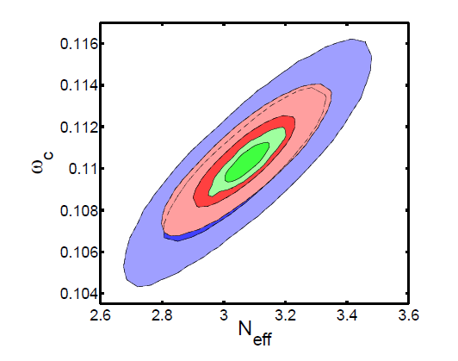
Constraints on Neutrino Number
Blue: Planck ΔNν=0.18
Red: Planck+ACTpol ΔNν=0.11
Green: CMBPol ΔNν=0.044
Galli, Martinelli, Melchiorri, Pagano, Sherwin, Spergel, PRD submitted,
arXiv:1005.3808 2010

Slide 26
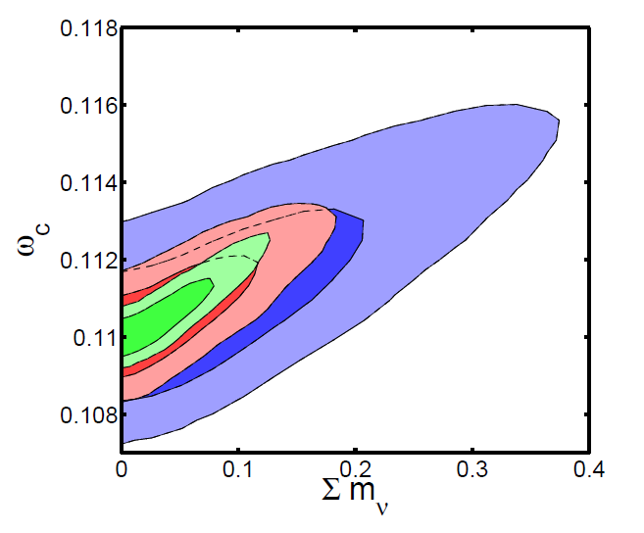
Constraints on Neutrino Mass
Blue: Planck ΔΣmν=0.16
Red: Planck+ACTpol ΔΣmν=0.08
Green: CMBPol ΔΣmν=0.05
Galli, Martinelli, Melchiorri, Pagano, Sherwin, Spergel, PRD submitted,
arXiv:1005.3808 2010

Slide 27
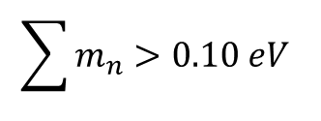
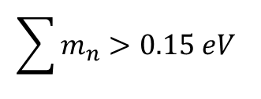
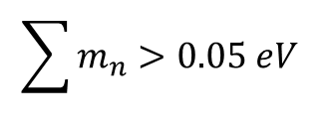
Testing the neutrino hierarchy
Degenerate Hierarchy predicts:
$$\sum{m_{n}}>0.15 eV$$
Inverted Hierarchy predicts:
$$\sum{m_{n}}>0.10 eV$$
Normal Hierarchy predicts:
$$\sum{m_{n}}>0.05 eV$$
$$m_{}^{2}=0.0025{eV}^{2}$$
we assume

Slide 28
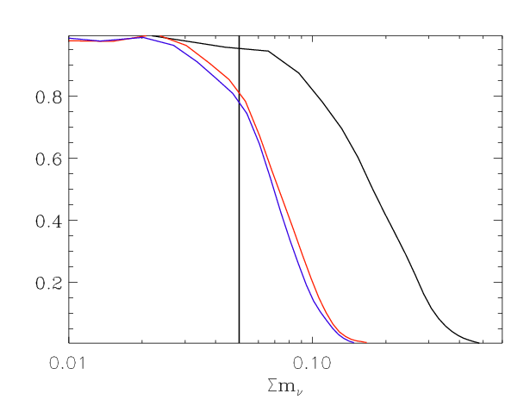
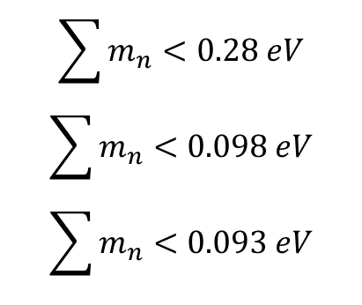
Constraints on Neutrino Masses from CMB
Limits at 95% c.l.:
$$\sum{m_{n}}<0.28 eV$$
$$\sum{m_{n}}<0.098 eV$$
$$\sum{m_{n}}<0.093 eV$$
Black: Planck
Red: Planck+
New exp. 1000 bol.
Blue: Planck+
New exp. 5000 bol.
[eV]
Combining a new CMB experiment to Planck coud improve the bounds on the neutrino
mass by a factor 3. This would:
Falsify Degenerate Hierarchy and Probe the Inverted Hierarchy

Slide 29
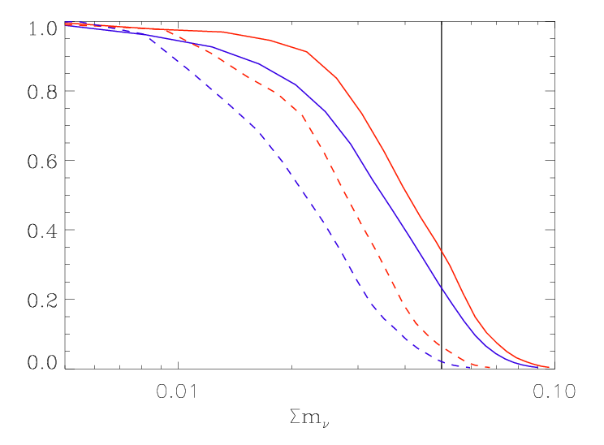
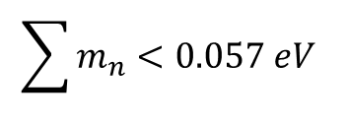
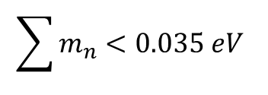
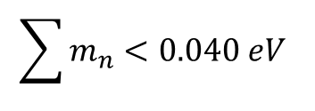
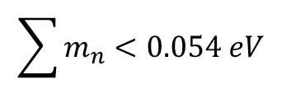
Constraints on Neutrino Masses from CMB+Priors
Limits at 95% c.l.:
Red: 1000 riv+
Prior 1% H0+
Priori 2% Ωm
Blue: 1000 riv+
Prior 1% H0+
Priori 2% Ωm
Red Dashed: 1000 riv+
Prior 0.5% H0+
Priori 1% Ωm
Blue Dashed: 1000 riv+
Prior 0.5% H0+
Priori 1% Ωm
$$\sum{m_{n}}<0.057 eV$$
$$\sum{m_{n}}<0.054 eV$$
$$\sum{m_{n}}<0.040 eV$$
With external priors on the Hubble parameter
And the matter density also the Normal
Hierarchy can be probed: safe detection of
a neutrino mass.
$$\sum{m_{n}}<0.035 eV$$

Slide 30

CONCLUSIONS
Recent CMB measurements fully confirm Λ-CDM. Improved constraints on inflation
With future measurements constraints on new parameters related to laboratory
Physics could be achieved.
In 2012 from Planck we will know:
If the total neutrino mass is less than 0.5eV.
If there is an extra background of relativistic particles.
Helium abundance with 0.01 accuracy.
Good Luck Planck !
Don’t miss the
talk by Jo Dunkley tomorrow:
Updates from ACT !
つづく

Slide 31


