Slide 1
Gravitational waves from collapsing domain walls
Ken’ichi Saikawa
ICRR, The University of Tokyo
Based on
[1] T. Hiramatsu, M. Kawasaki and KS, JCAP05(2010)032.
[2] M. Kawasaki and KS, in prep.

Slide 2




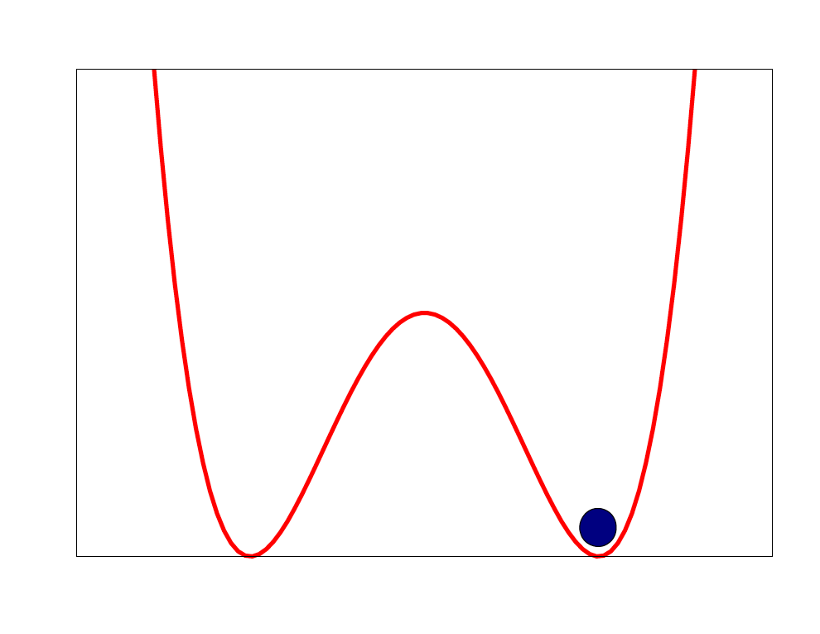


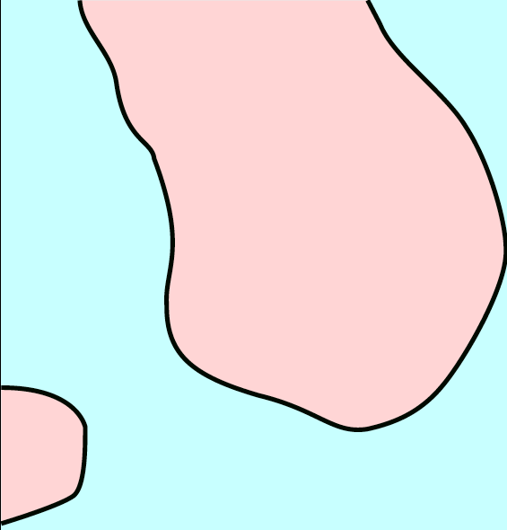


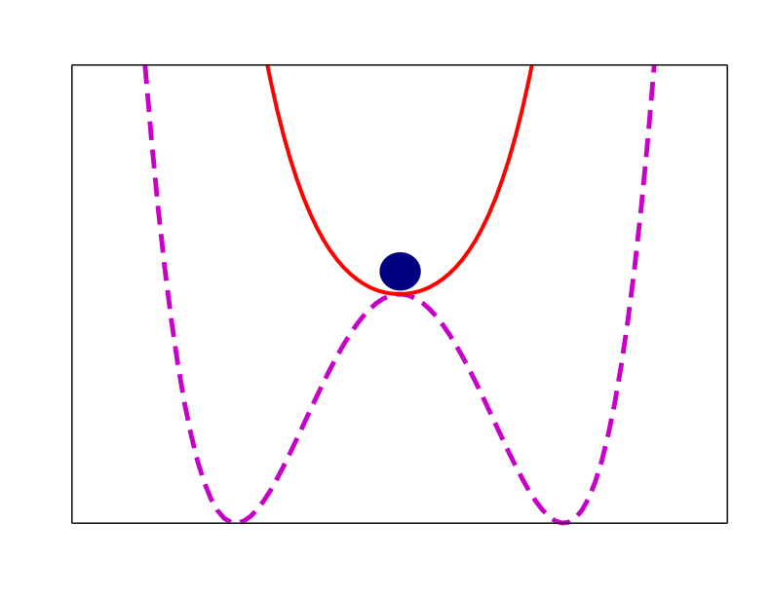
Domain wall
Example: SSB in the theory of the real scalar field
2-dimensional surface-like defects
produced when a discrete symmetry is
spontaneously broken

Slide 3



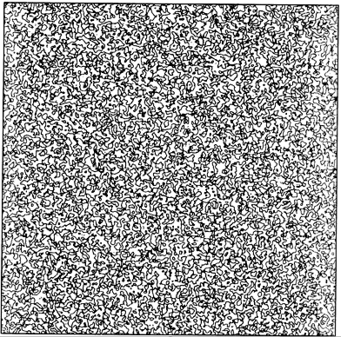
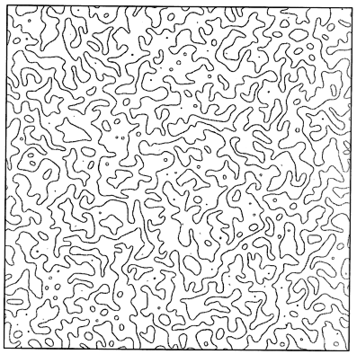
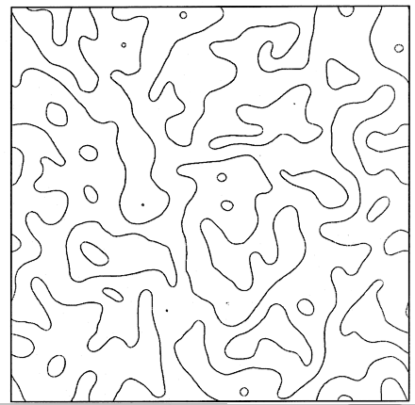
Scaling solutions Press, Ryden, and Spergel (1989)
One wall per one Hubble radius
  where is the distance of two neighboring walls and is the curvature radius
  Energy density
Surface mass density of the wall
Horizon radius/Box size
1/100
1/30
1/10
Notes:
一つの地平線あたりウォールが約一枚
というのがスケーリング解の定義.
それを数値シミュレーションによって確認した.

Slide 4


Domain wall problem
If stable domain wall exists…
  Distort CMB anisotropy
  Ruled out by observations
  Zel’dovich, Kobzarev, Okun (1975)
To avoid the domain wall problem
  Assume an inflationary era after the formation of walls, or …
  Consider unstable domain walls
    Allowed if they decay before BBN epoch
    Can be the source of the gravitational wave background

Slide 5
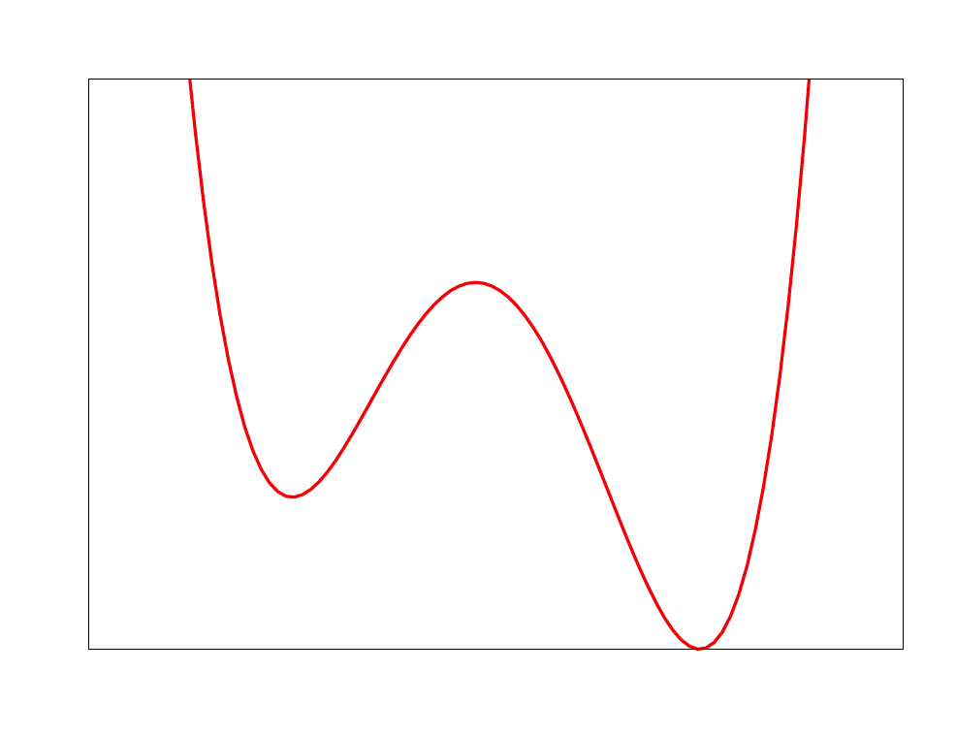


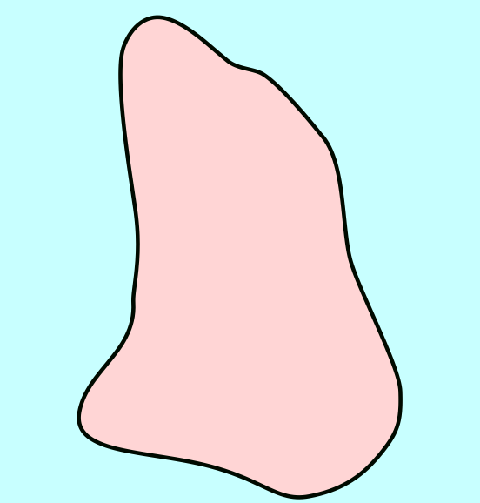
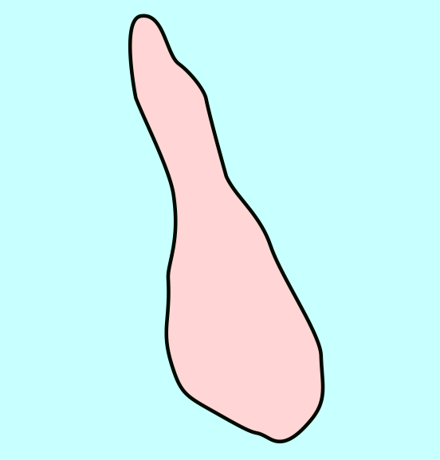
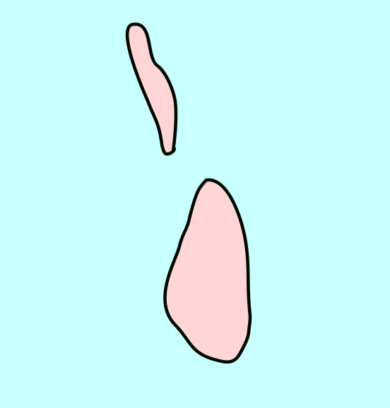
Collapse of domain walls
Approximate discrete symmetry (bias) Vilenkin (1981)
The energy difference between two vacua affects
as a pressure on the wall
Relic GW from domain walls
  Another source of stochastic gravitational wave background
  Probe for new physics
Notes:
エネルギーの差(bias)は実効的にウォールに働く圧力となる。
真の真空が偽の真空を押しつぶす。

Slide 6



The role of the bias
Two forces acting on domain walls
  Tension (straightens the wall)
  Pressure (collapses the wall)
Pressure dominates when
  Decay time of the wall

Slide 7
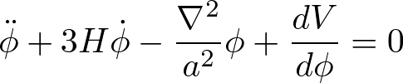
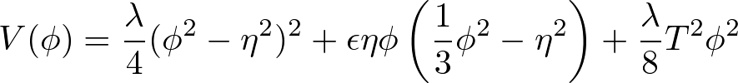


Numerical simulation
Solve the classical field equation on 3D lattice
Input parameters
Scheme | 4th Runge-Kutta
Number of grid | 256×256×256
Era | Radiation dominated
Initial time | such that
Final time | 151
Time resolution | 0.01
Box size | 25 or 50
 | 1.0
 | 10¹⁷ GeV
 | 0〜0.04
Numerical codes based on “aphrodite” developed by
T. Hiramatsu

Slide 8




Typical evolution of the (stable) DW

Slide 9
Typical evolution of the (unstable) DW

Slide 10
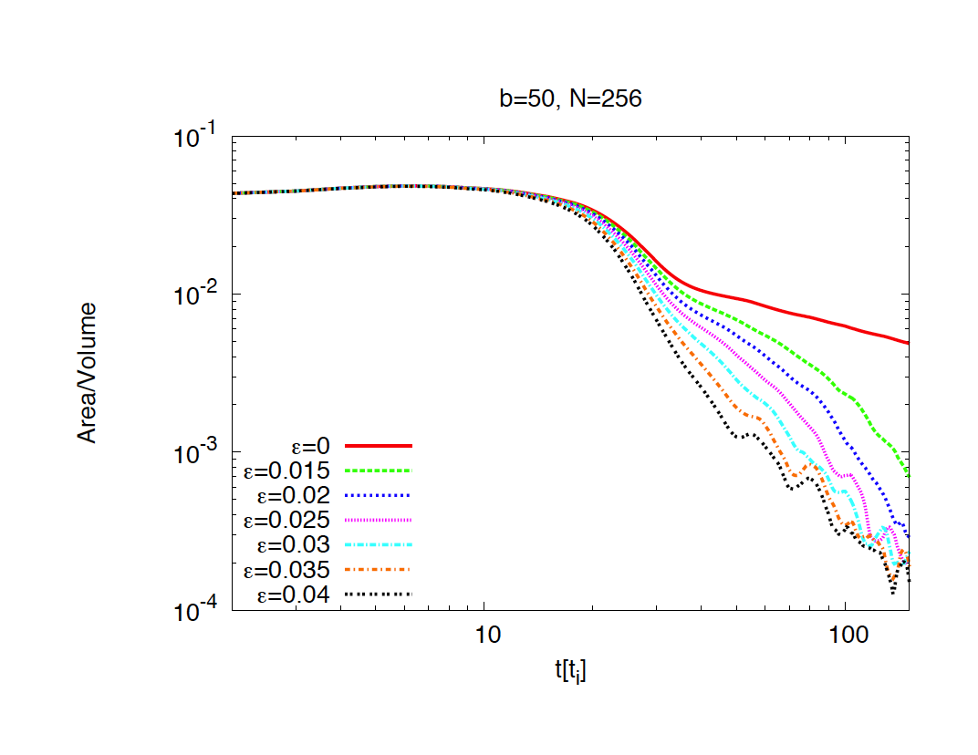


Scaling if the bias is 0
The decay time is well described by

Slide 11



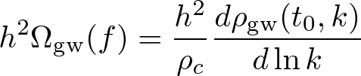

Gravitational Wave
Linearized theory
Energy density of GW
Observable

Slide 12
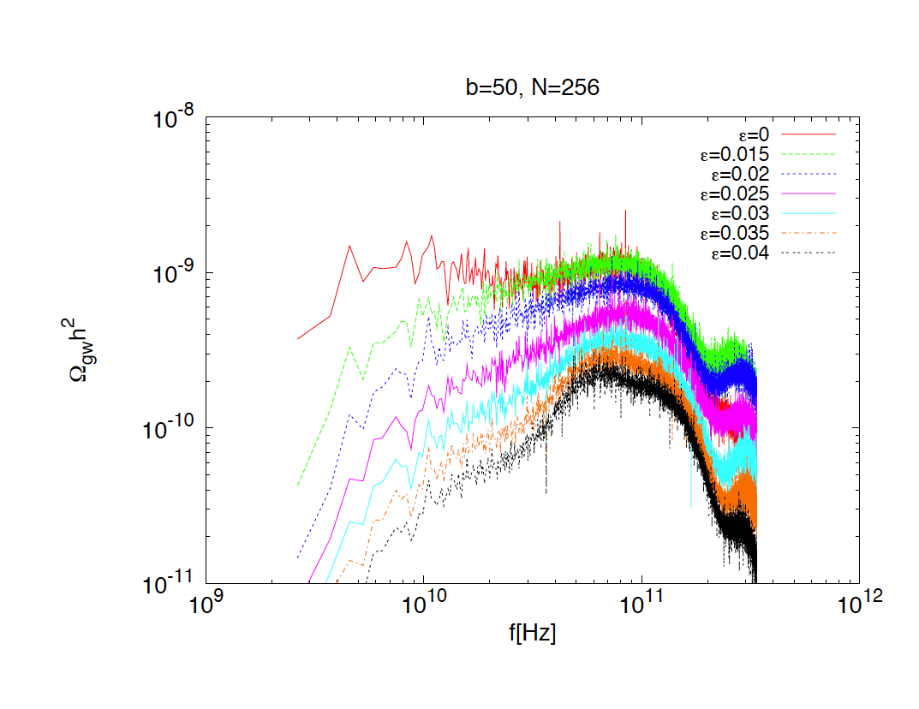
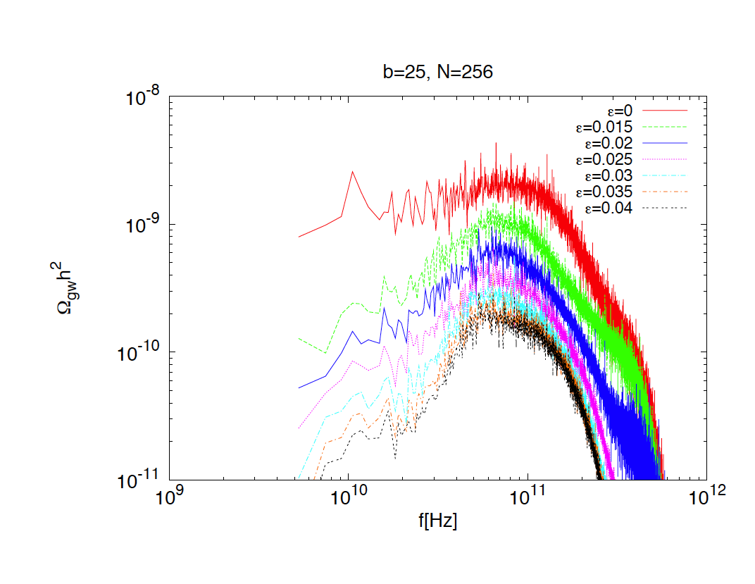



Spectrum of Gravitational Wave
Large box (low resolution)
Small box (high resolution)
Peak : width of the wall
Edge : Hubble expansion rate at decay time
Spectrum : nearly flat
Notes:
GW spectrum (b=50)
バイアスが大きいほど早く崩壊してamplitudeが小さくなる。
低周波数に立ち上がり、高周波数側にピーク
さらに高周波の端に立ち上がり（b=25で非物理的なピーク）
GW spectrum (b=25)
高周波数側が下がっている。b=50での立ち上がりは非物理的なものである。

Slide 13
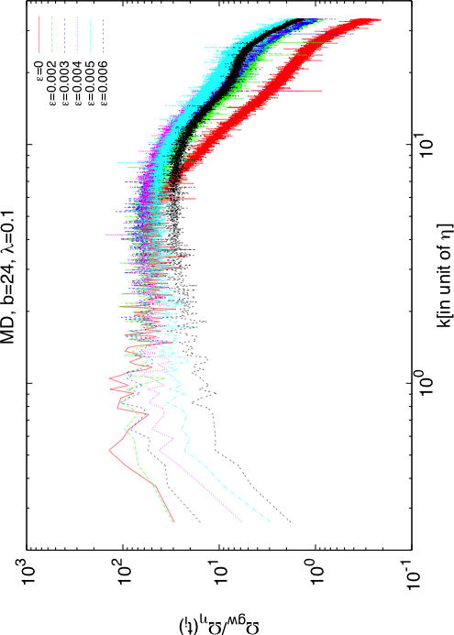
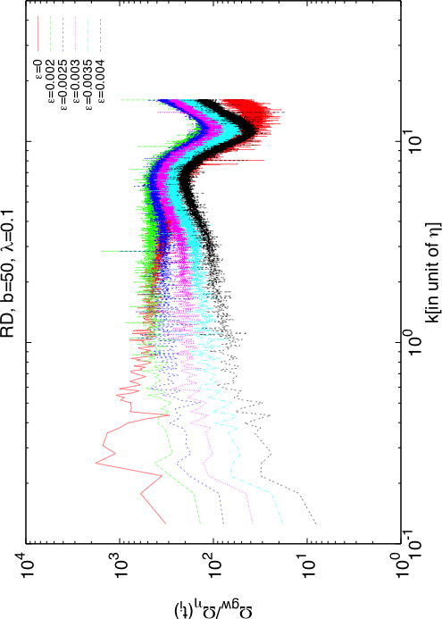
Dependence on the Background Evolution
Radiation dominated (RD) background
Matter dominated (MD) background
The spectrum in MD is indeed flat, similar to the result in RD.

Slide 14
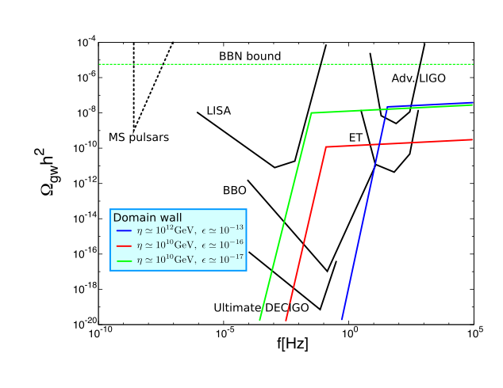
Extrapolation of the numerical results
Peak is too high to observe.
We can measure the parameters such as and from the frequency and intensity of the edge.

Slide 15
Summary
We calculated the gravitational wave spectrum by running 3 dim. lattice simulations of domain walls.
  The edge corresponds to the horizon scale when walls collapse
  The peak corresponds to the width of the wall
  Shape of the spectrum is almost flat
Extrapolation of the numerical results
  There is a parameter region in which the edge is observable in the future experiments.
Further numerical/analytic investigation is needed in order to give an accurate prediction for GW spectrum. (work in progress)
It can be a new observational window to probe particle physics models with (approximate) discrete symmetry.

Slide 16
Appendix

Slide 17
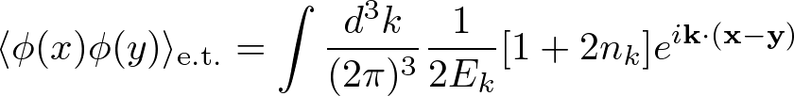

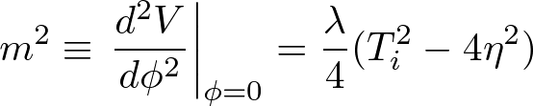


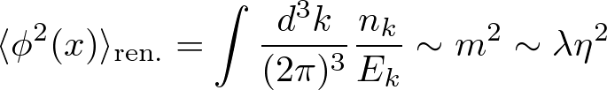
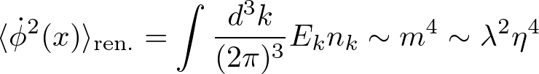
Initial condition (1)
Correlation function in the finite temperature
: Bose-Einstein statics
1 in is the vacuum fluctuation → subtract

Slide 18









Initial condition (2)
In the momentum space,
No correlation in the k space
→ Generate as Gaussian with
→ Fourier transform to obtain and
: volume of the simulation box

Slide 19





Condition for avoiding wall domination
Walls dominate the universe if
The time when walls dominate
Require that walls decay before they dominate the universe
:energy density of the universe
:energy density of the walls

Slide 20
Earlier studies
Numerical simulations
Press et al. (1989); Kawano (1990); Coulson et al. (1996);
Larsson et al. (1997); Garagounis and Hindmarsh (2003); Avelino et al. (2005) …
  In order to resolve two extremely different scales,
  put an unphysical assumption about the wall width (PRS algorithm).
Gravitational radiation from DW decay
Gleiser and Roberts (1998)
  Only semi-analytic estimations
  Shape of the spectrum of GWs has been unknown
Our goal:
To investigate the evolution of DW in more realistic situations and calculate the spectrum of GWs.

Slide 21


Comments on the Numerical Study
Nonlinear evolution equation
  Difficult to solve analytically
  Need for numelical simulation
Problem in numelical study
  One must consider two extremely different length scales.
    Width of the wall
    Hubble radius
  We can not simulate the physical evolution for a long time.

Slide 22


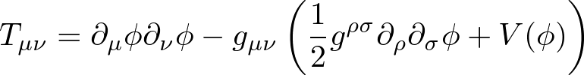




“Green’s function” method Dufaux et al. (2007)
Assume the source exists during
The time evolution of is obtained by the numerical simulation.
→ calculate
→ evaluate by performing the time integral

Slide 23

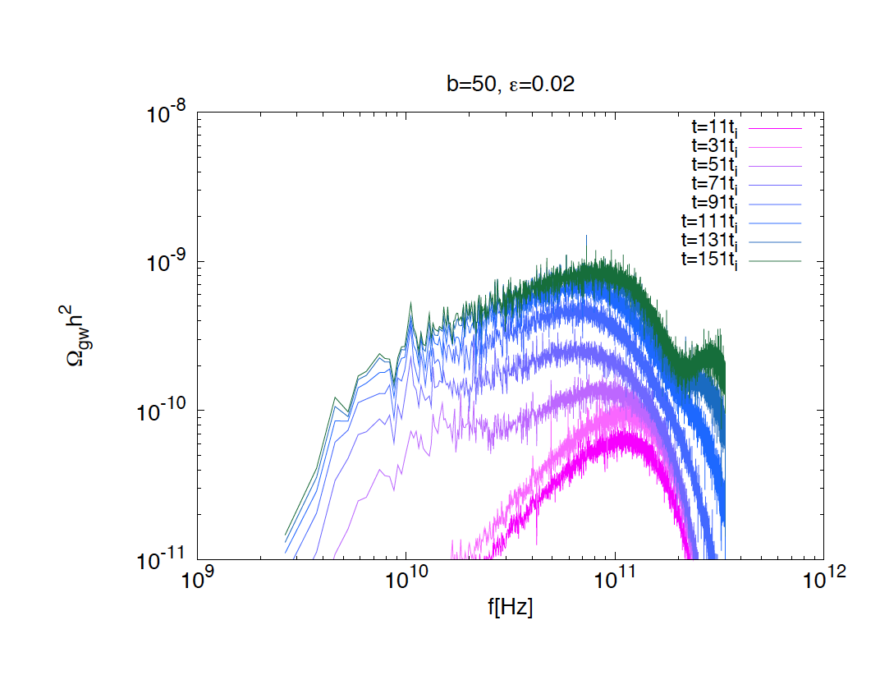

Physical interpretation of the spectrum
The physics relevant for the generation of gravitational waves
  Interaction of wall networks (collision, separation, reconnection, collapse …)
    Typical scale：width of the wall
  Relativistic motion of the wall
    Cease to generate after the decay of walls
    Typical scale：Hubble radius
Form of the spectrum
  Peak corresponds to the width of the wall
  Edge corresponds to the Horizon scale
The numerical values of the amplitude and frequency for peak and edge are consistent with simple dimensional analysis except a factor of O(1).

Slide 24
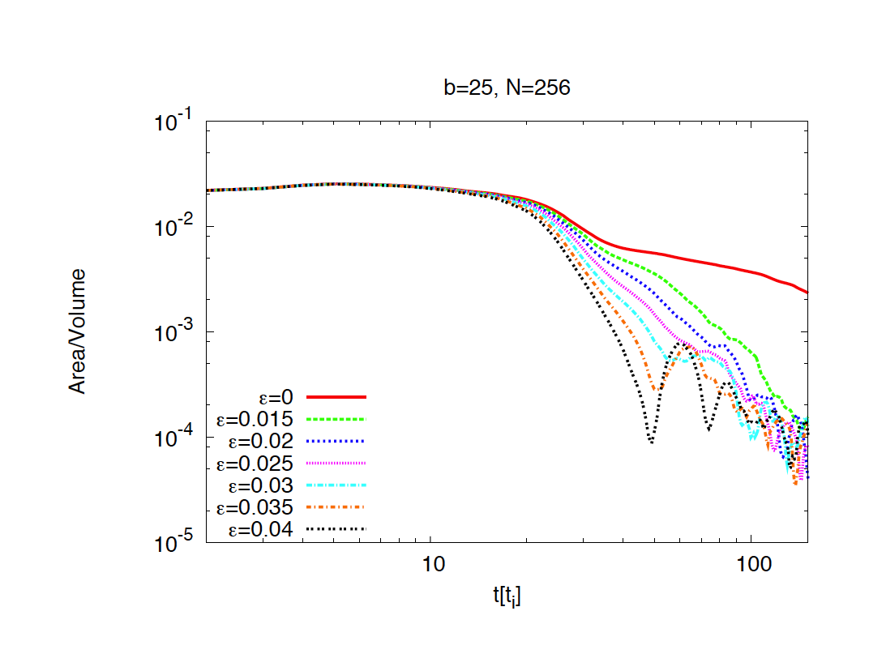
Notes:
b=25のAreaのプロット

Slide 25
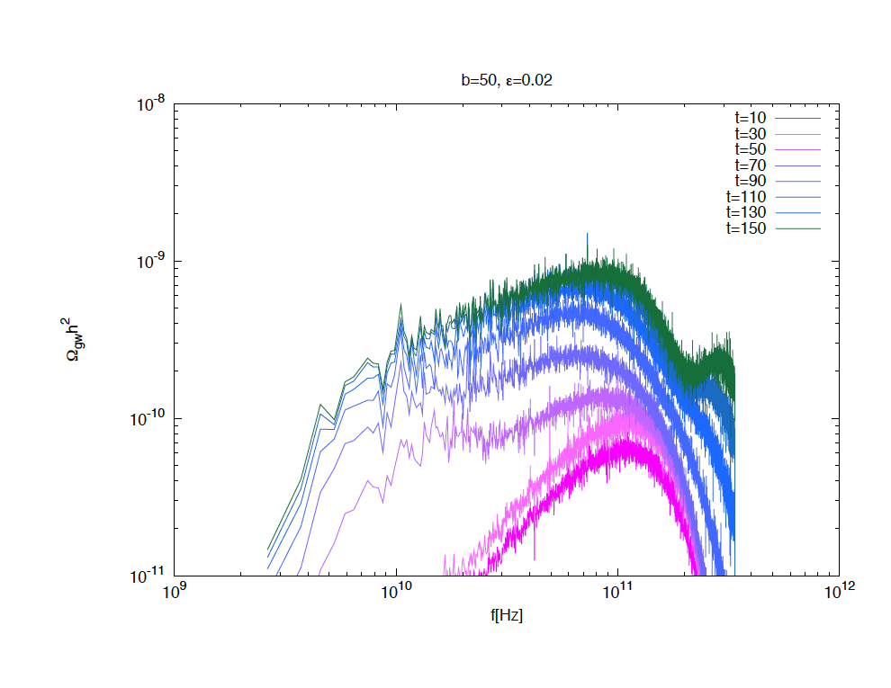
Notes:
スペクトルの時間変化
Wall形成後、horizonスケールにピーク
Wall崩壊によってピークがsmall scaleに移る

Slide 26


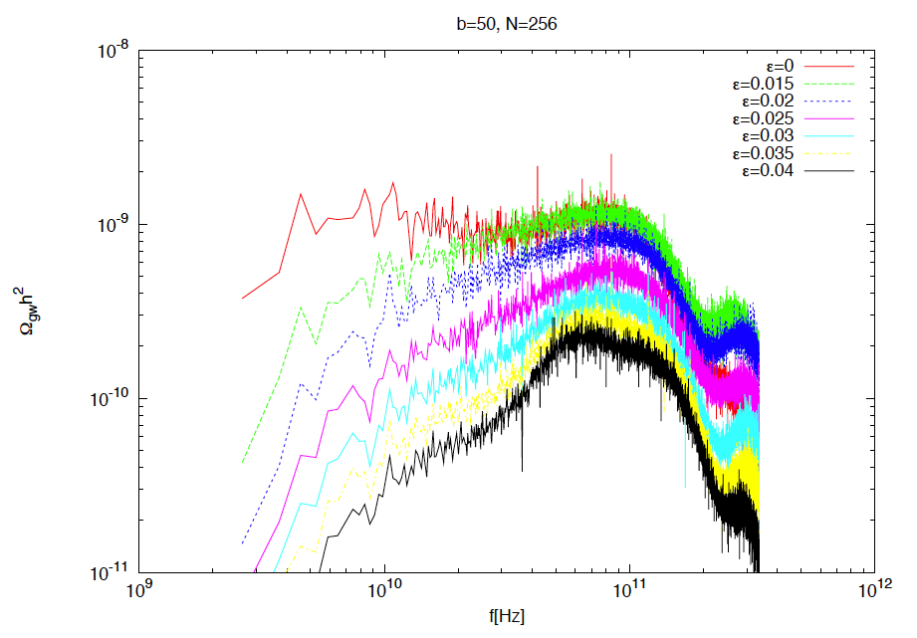

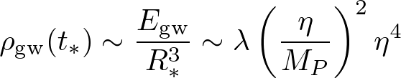
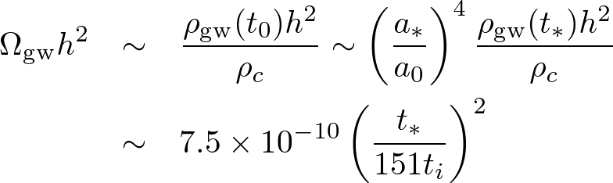


Estimation for peak amplitude
Energy of GW from DW decay
Energy density
for
Notes:
t*はGW放出時刻とする。
Redshift factorよりt*^2に比例→epsilon^-2に比例

Slide 27
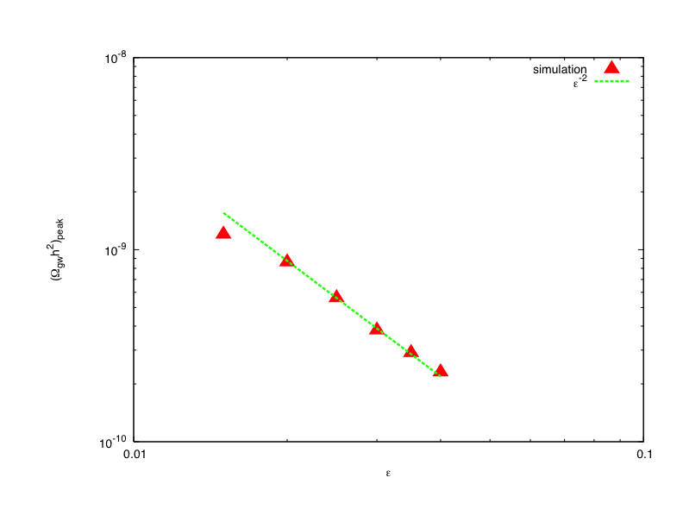
Peak amplitude （ε dependence）
Fit into

Slide 28
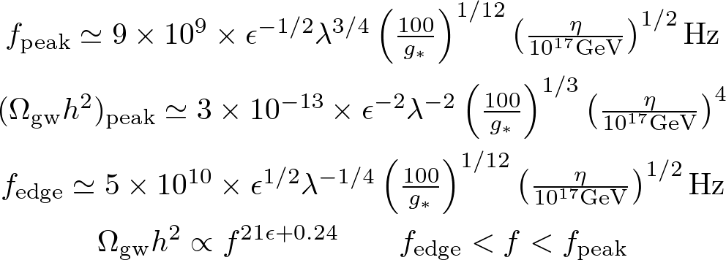
Fitting formulae
Parameter dependence obtained from the dimensional analysis and the numerical results
We can use them to predict the gravitational wave spectrum for generic values of parameters.

