Slide 1
Probing Extreme Universe through Ultra-High Energy Cosmic Ray
Yamamoto Tokonatsu
Konan University, Japan
Introduction
UHECR observation
Recent results from Auger observatory
Future and perspective

Slide 2
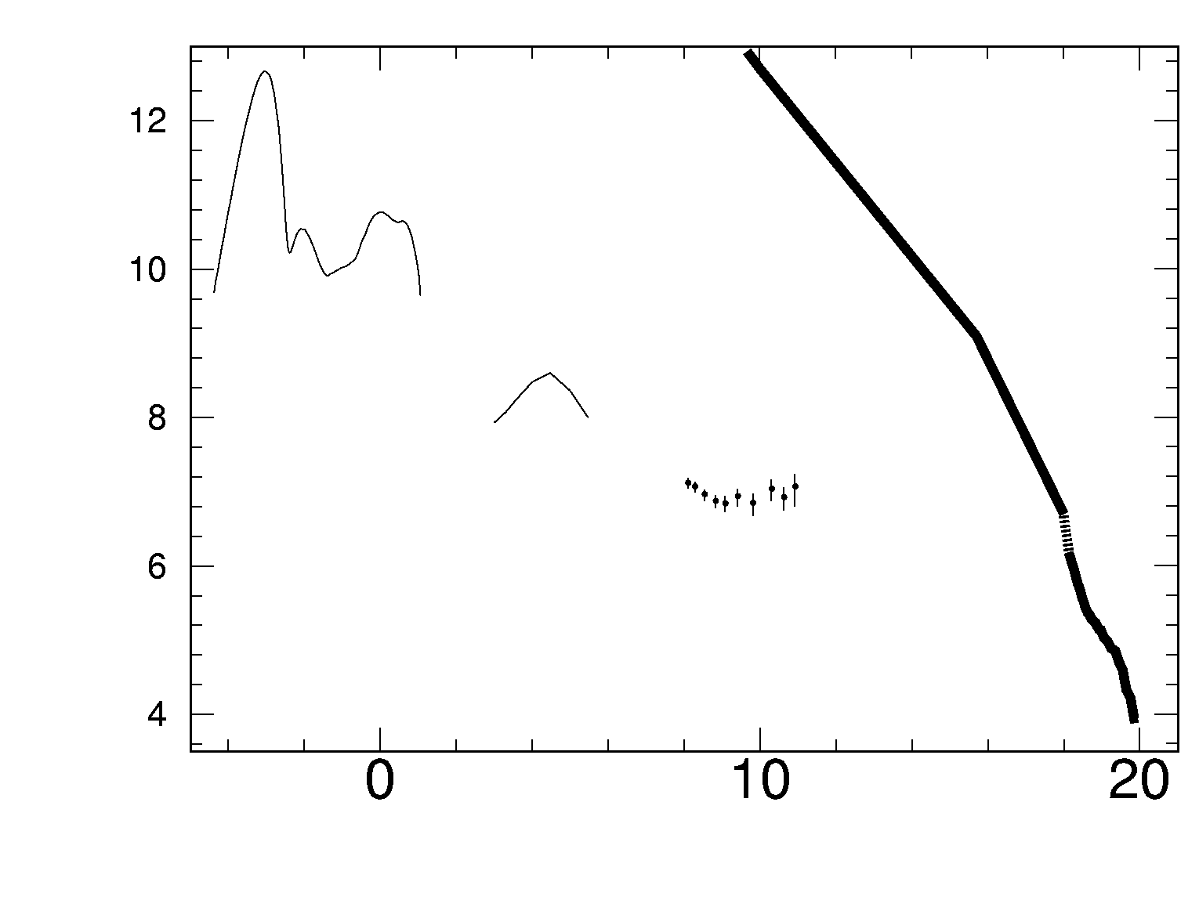
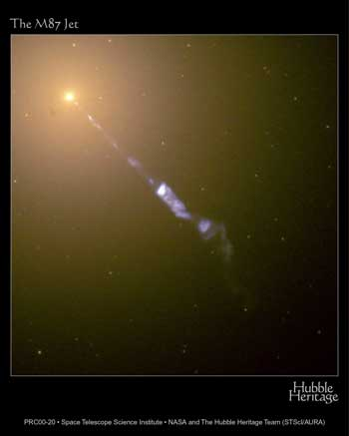
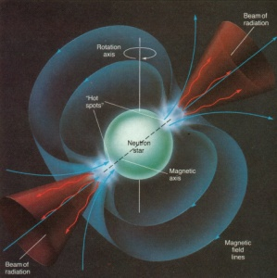
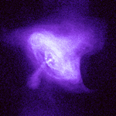
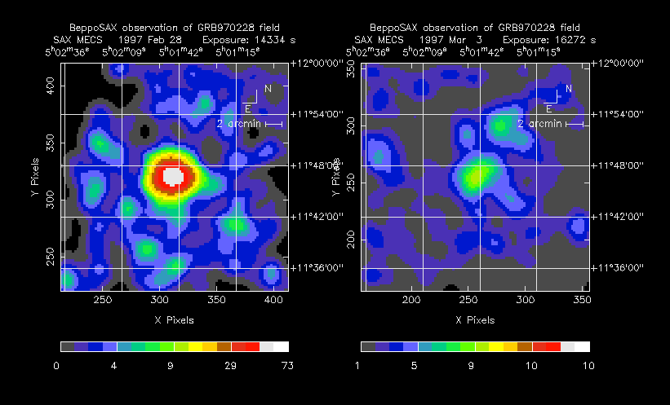
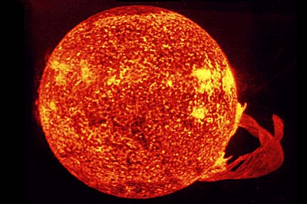
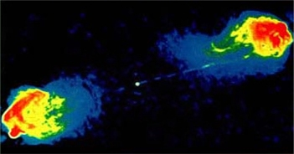
Boom in Energy Radiation on the Space
AGN
Pulsar
Cosmic Ray
X ray
CMB
log10(Energy Flux [ev/sr/s/m²])
gamma
Optical
SNR
Infrared
GRB
UHE Cosmic Ray
log10(Energy [eV])
Star
Currency in the inter-stellar space
CMB 0.25 eV/cm³
Cosmic ray ~ 1 eV/cm³
Galactic Magnetic Field ~0.25eV/cm³
Radio Lobes
Notes:
What is Cosmic Ray? CR is ..
Activity in the Universe is controlled through Gravity and radiate enormous energy. Space economy are still booming by such as Black hole and super-nova Energy circulates as money
Ruled by the Physics law

Slide 3
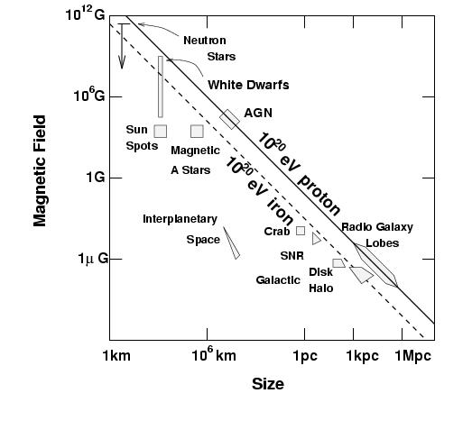
Life of UHE Cosmic Ray [1]
Source of the UHE Cosmic Ray
AGN
Pulsar
Hillas Diagram
GRB
SNR
Radio Lobes
Notes:
Non-acceleration scenarios

Slide 4
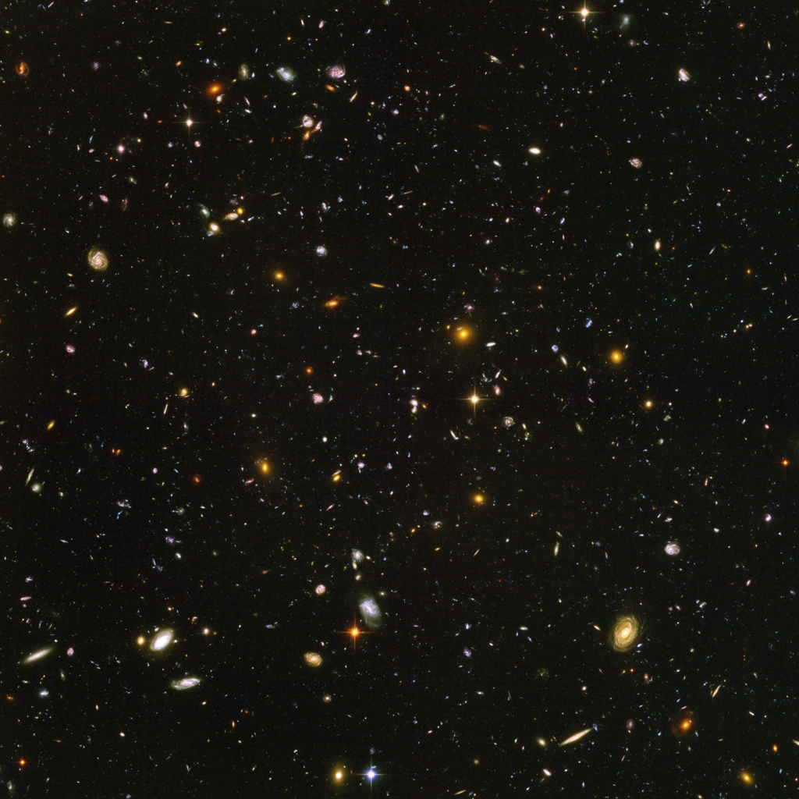

Life of UHE Cosmic Ray [2]
Propagation
Magnetic Field and Turbulent
CMB (~200MeV on the Rest System of UHECR)
Interaction with Photon Field, GZK
Interaction with Magnetic Field
Heating Inter-galactic gas
Ionization of the Interstellar medium
Building turbulent magnetic fields at various scales
Influence astro-chemical processes
Notes:
Berezinsky will describe this physics

Slide 5
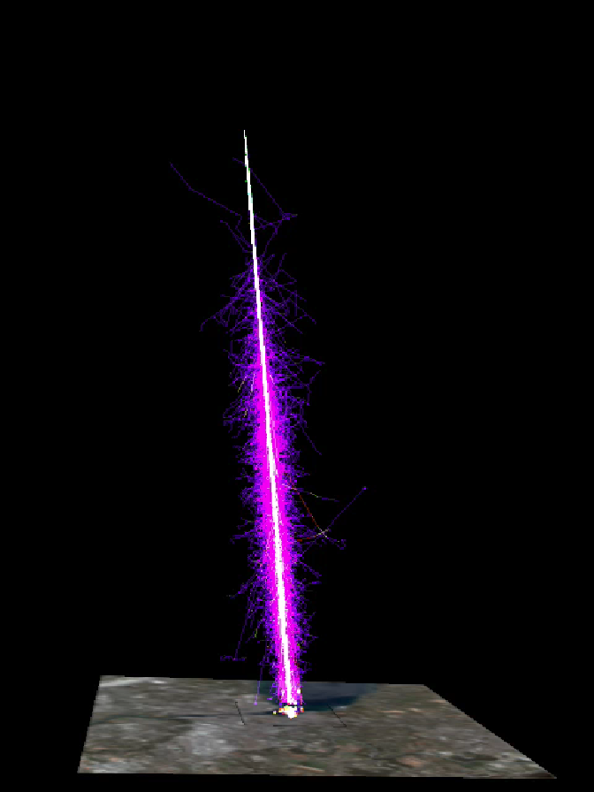
Extensive Air Shower
First interaction
start-up
Xmax
decay
Life of UHE Cosmic Ray [3]
End of the Cosmic Ray
σp-air ~ 250mb
λ ~ 80/g/cm2
π0 decays transfer EM shower
atm. depth > 12λ ~ 25 χ0
Moliere Radius = 77 m
π±decays produce hard muons
When Energy of e+e- < ~84 MeV, ionization loss dominates over radiative scattering.
Xmax
~200g/cm2
Particel spread ~few km.
γ:e+e-:μ=100:10:1
e+e- ~ 10 MeV, μ ~ 1 GeV
Notes:
pi 0 decays transfer energy into the EM shower.

Slide 6
Mysteries of the Cosmic Rays
Where are they from?
What are these particles?
Why their spectrum is so smooth?
How do they get to us?
How do they react in the atmosphere?
Are the known physics describing everything?
Notes:
only way to get extra-galactic matters.
all these basic questions are not answered yet.

Slide 7
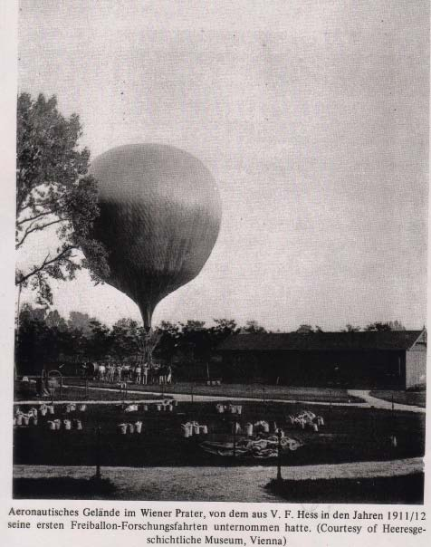
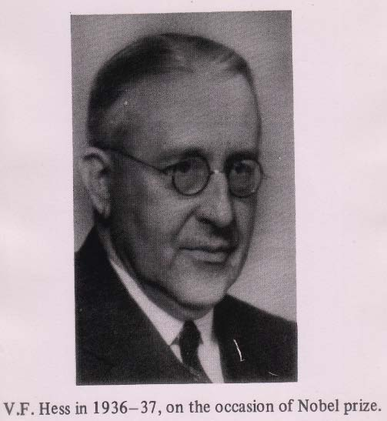
History of Cosmic Ray Observation [1]
First Space Observation using Flying object
discovered Cosmic Ray in 1912
Notes:
It has been almost 100 years after the CR discovered.

Slide 8
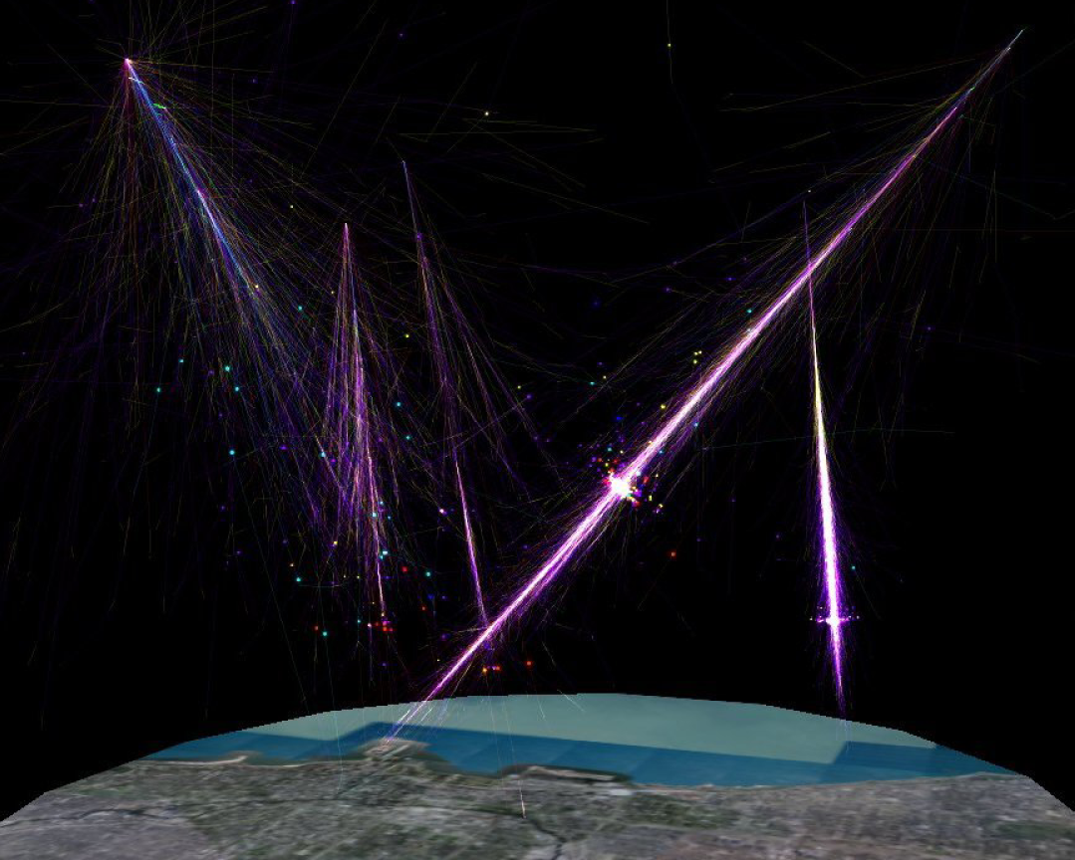
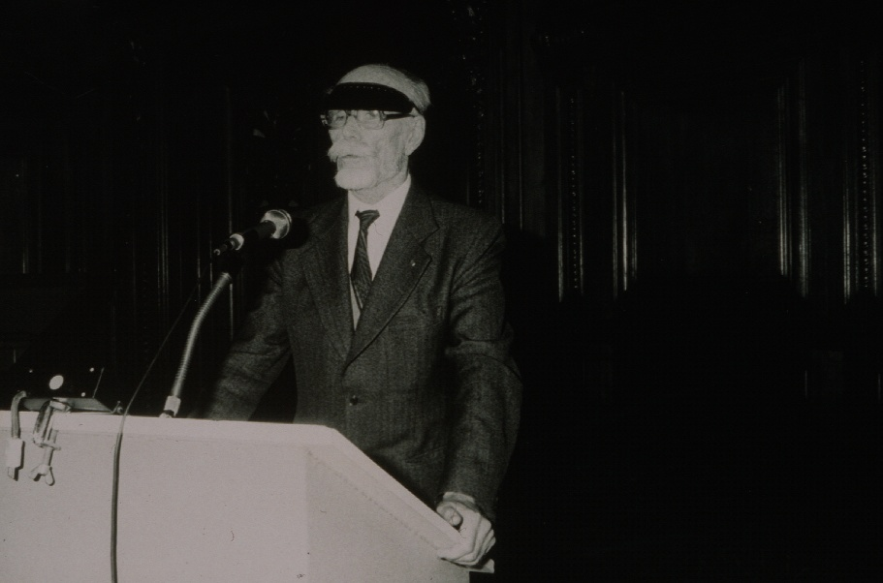
Extensive Air-Shower phenomenon was discovered by Pierre Auger in 1932

Slide 9
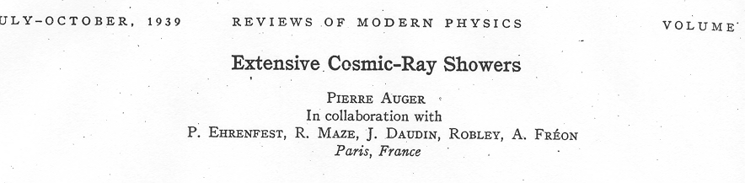
Claims for primary (photons) of 10¹⁵ eV
Factor of ~ 10⁶ above any known energy
High Energy Cosmic Ray observation initiated from this discovery at 1939.

Slide 10
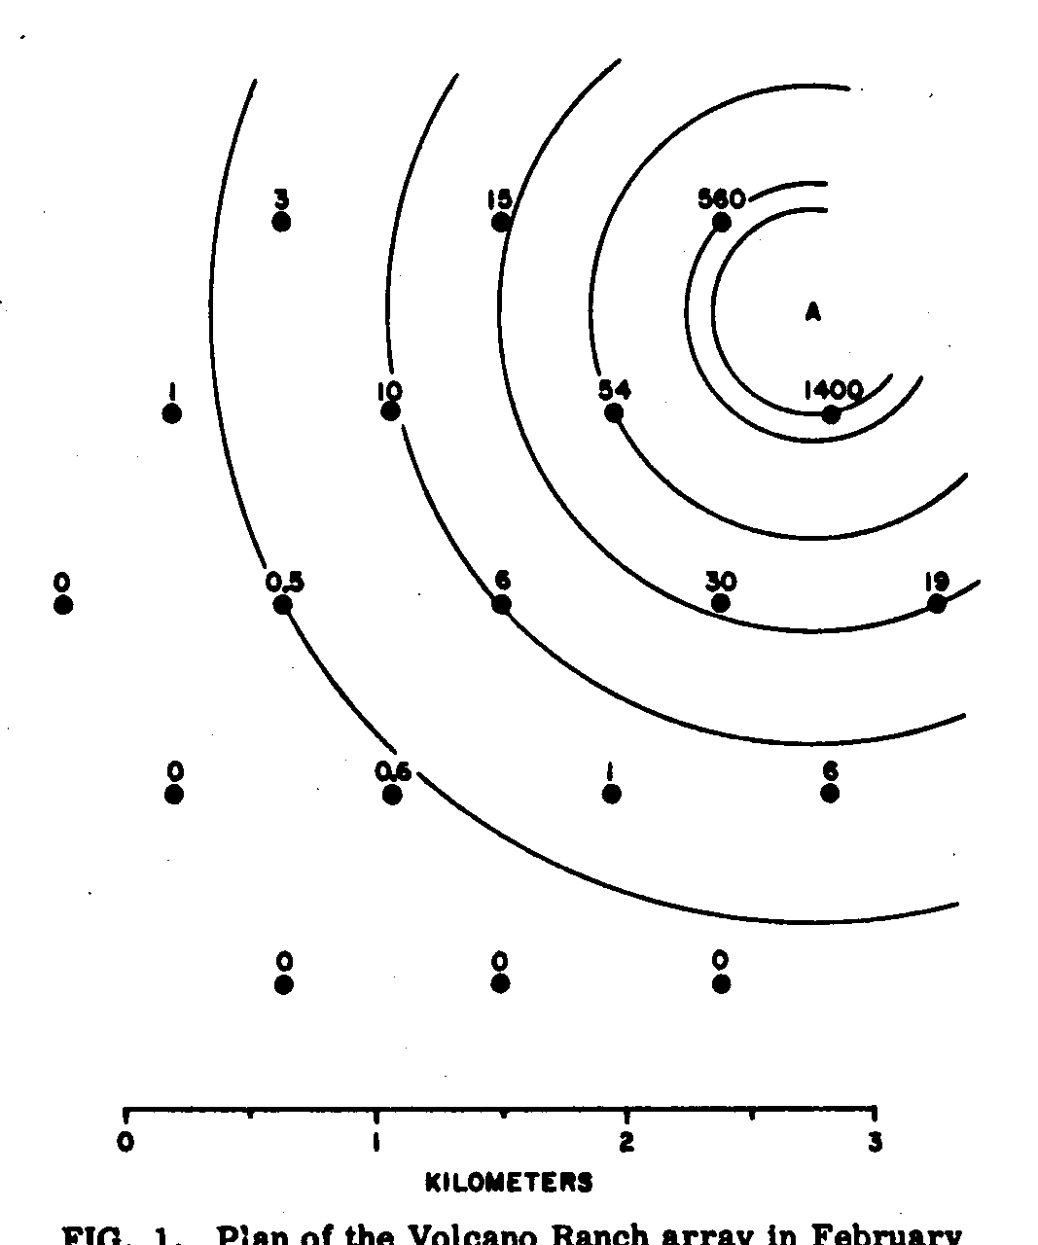
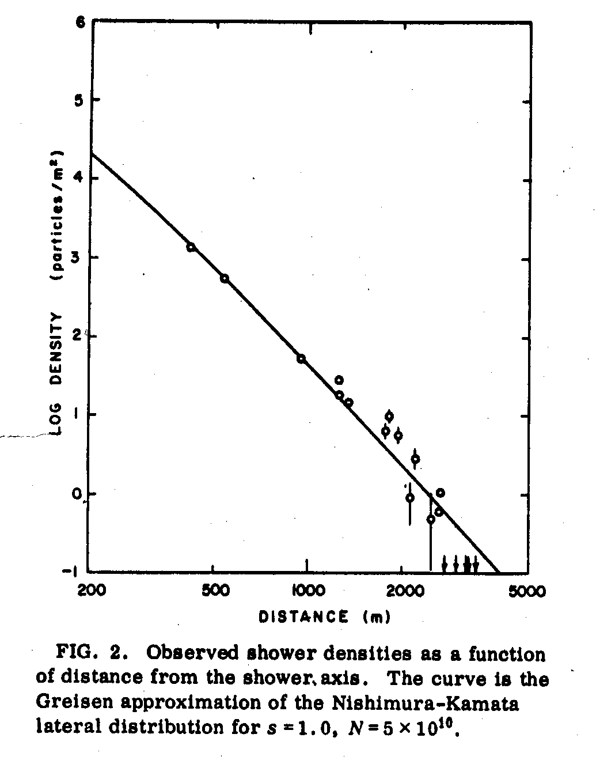
Volcano Ranch at New Mexico led by Linsley discovered the first UHE cosmic ray at 1962.
CMB was discovered two years after this discovery.
Notes:
I think this is most important discovery in the CR observation history.

Slide 11
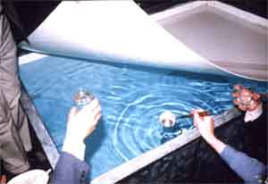
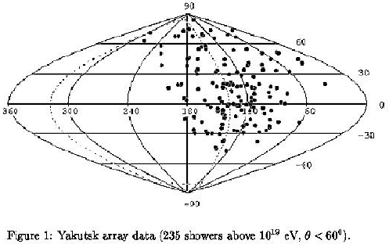
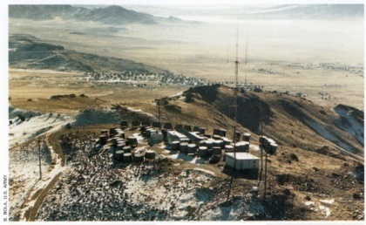
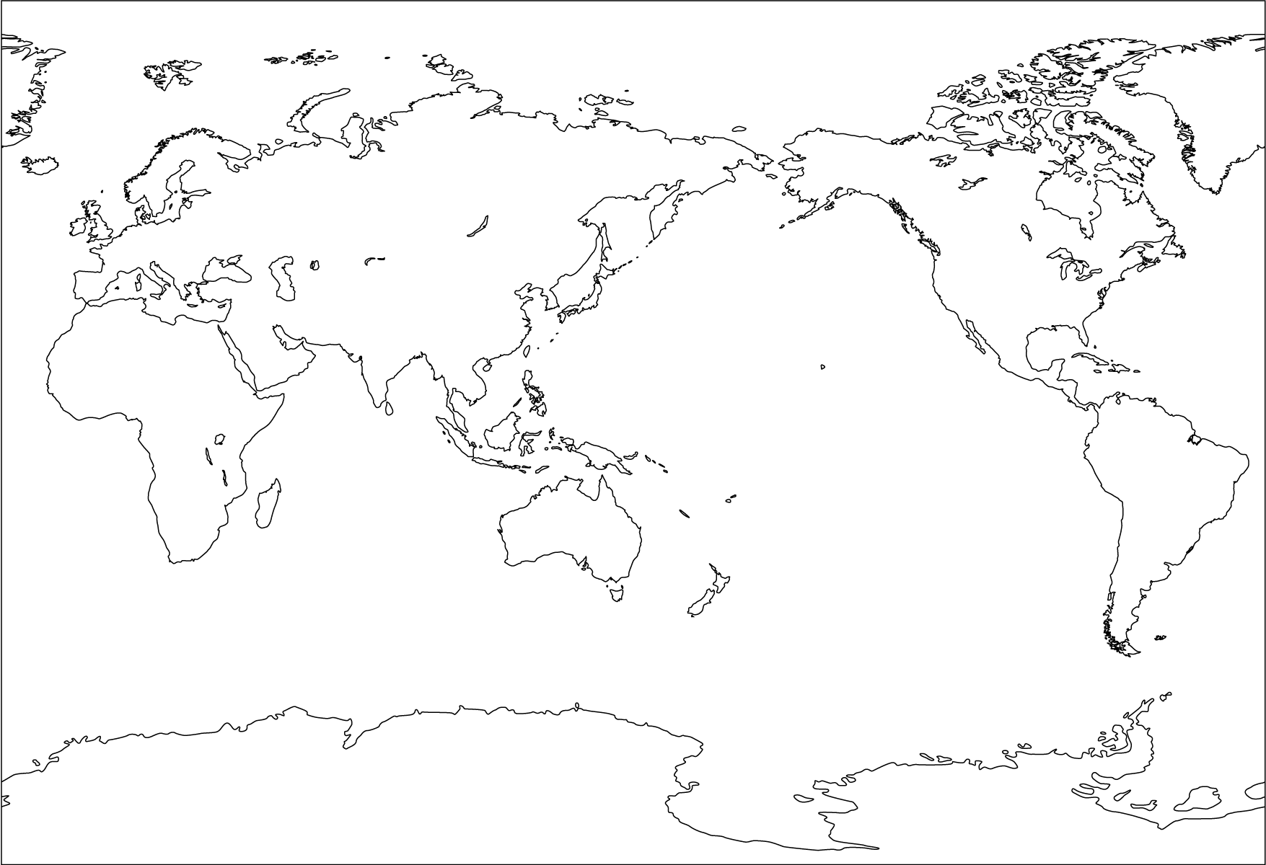
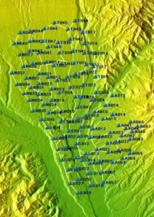
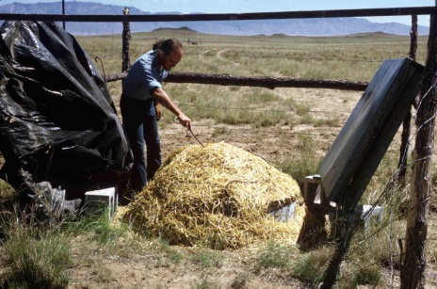
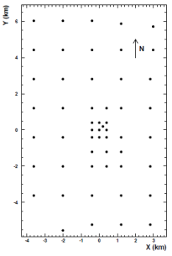
Pioneering Ground Arrays to Observer UHE Cosmic Rays
Yakutsk
(24km²)
Haverah Park (16km²)
Fly’s Eyes/HiRes
AGASA
(111km²)
SUGER
(80km²)
Volcano Ranch
(10km²)
Notes:
Volcano ranch @ MIT (Albuquerque, New Mexico)10km2 , SUGER operated from 1968 to 1979 near Sydney 7x12km2, Yakutsk 6x4km2
The most important discovery is the existence of UHECR. → GZK effect
Collecting extra-galactic matters
Order of a few cosmic-ray per century and per km2 over the whole sky

Slide 12
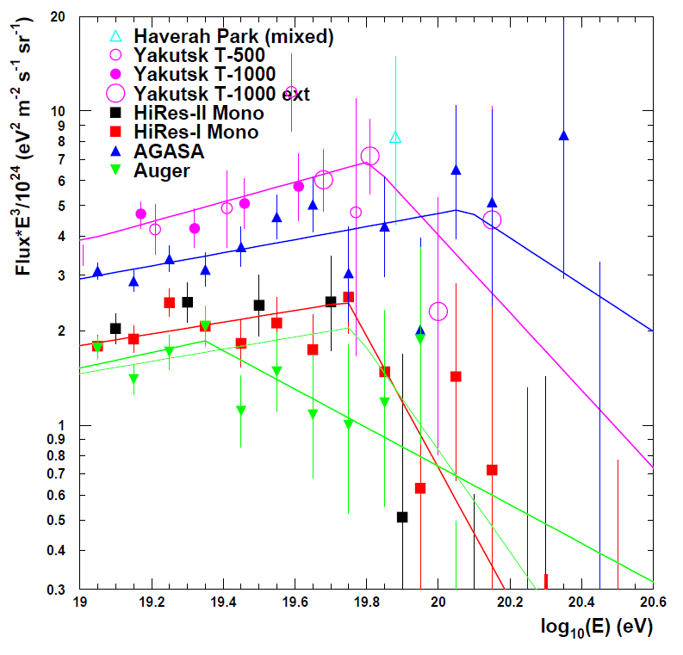
Measurement of the UHECR spectrum
Douglas R Bergman and John W Belz: arXiv:0704.3721v1
Notes:
What they found is observation of UHECR is not simple at all.

Slide 13
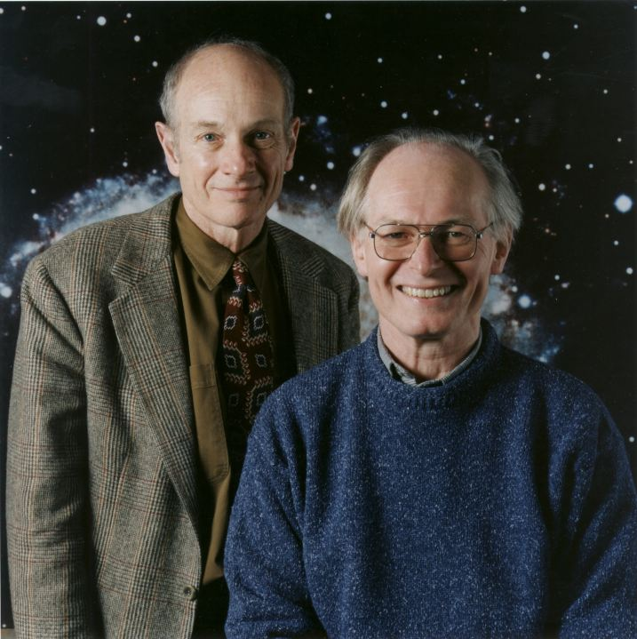
Jim Cronin: Dublin ICRC 1991
“You’re not nearly ambitious enough:
We should build 5000 km²”
European Cosmic Ray Symposium: Nottingham 1990
A A Watson: review talk
It is disappointing and salutary to realize that these conclusions are not essentially different from those which were reached ten years ago. It has been clear for that 1000km² of instrumental area is needed.
All that is needed is dedication, money and patience:

Slide 14
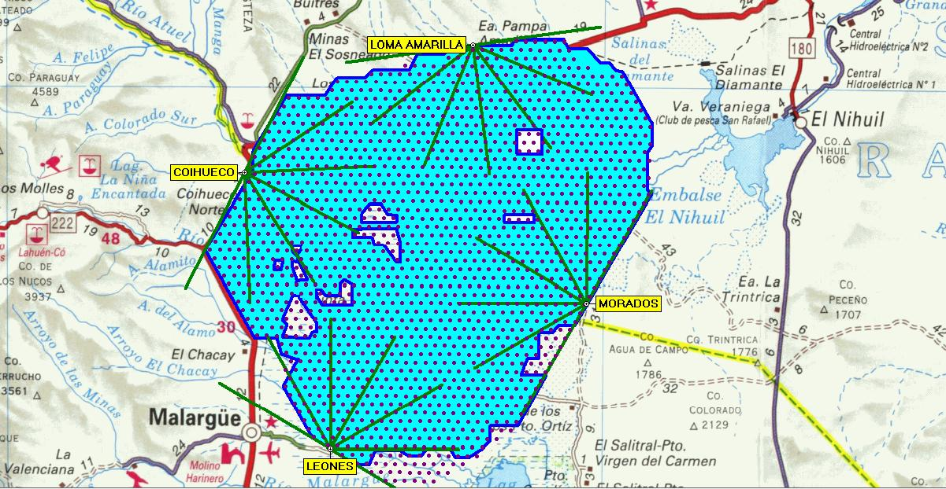
Southern-Auger Observatory
Completed at June this year
1603 detectors with 24 telescopes are in operation.
Notes:
Auger Google Map
Visible from Space
If distant SD hung-up..
AGASA Longitude(EW) -138.5 Latitude(NS) 35.78
Auger Longitude(EW) 69.4 Latitude(NS) -35.4

Slide 15
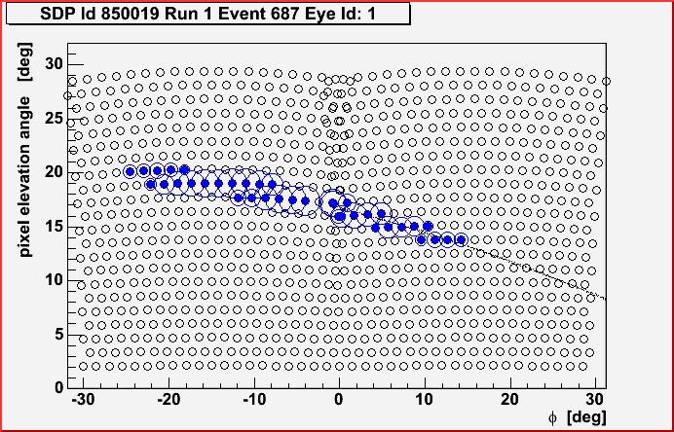
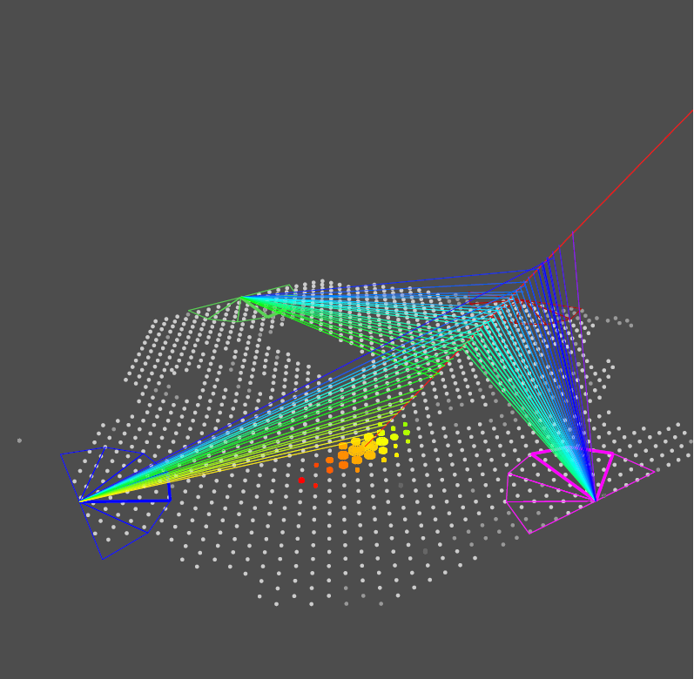
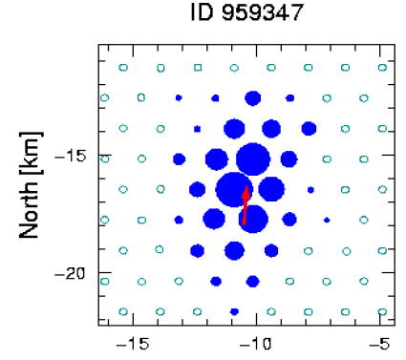
Longitudinal Profile
Hybrid Detection
Δθ=0.2 degree
Δθ=3-5 degrees
Lateral Distribution
Δθ=1-2 degrees
Notes:
Hybrid detector design , energy determination is about 10-20%, Hybrid is more than SD+FD

Slide 16
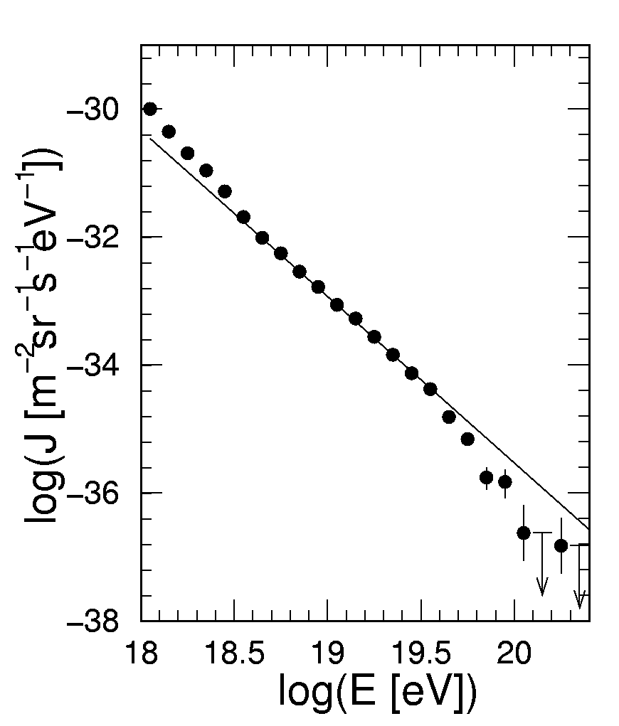
Auger Spectrum 2007
Spectrum measured by Auger shows a significant suppression of the spectrum at the highest energy.
Energy scale still have 24% of systematic uncertainty.
ANKLE
GZK effect?
J_{S}
E^{-2.6}

Slide 17
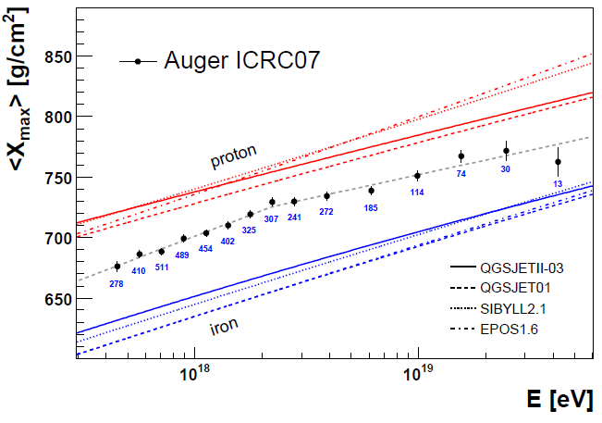
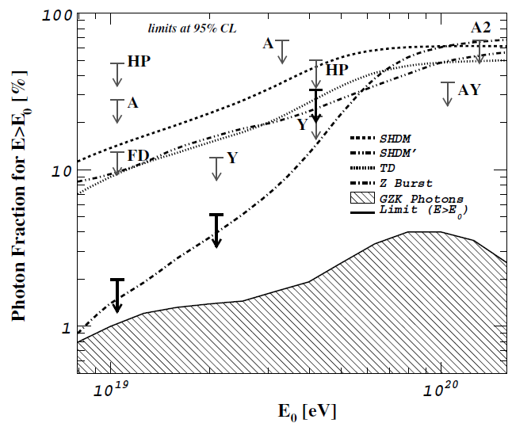
Composition of the UHECR
Evolution of average <Xmax>
Fraction of UHE photon
indicating some breaks around ankle and at Highest energy. Firm conclusion would require larger statistics which will be accessible to Auger.
disfavor the Non-acceleration models of UHECR.

Slide 18
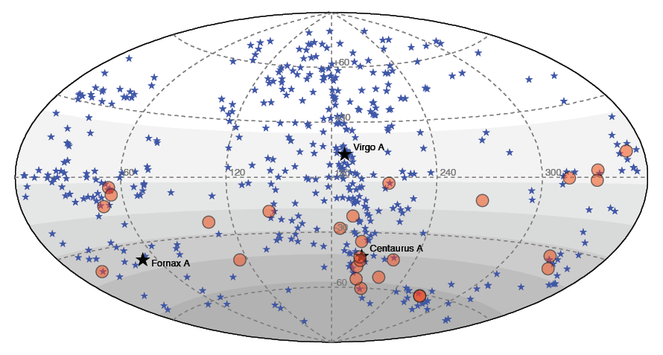
Arrival Direction
AGN ( z< 0.018 ~75Mpc)
27 Highest Energy CRs (>5.7×10¹⁹eV)
No anisotropy has been detected in lower energy.
Notes:
The First experimental evidence of their anisotropic distribution of CR
Suggesting extra-galactic and bottom-up origin
Larger statistics is needed to discover the individual souses

Slide 19
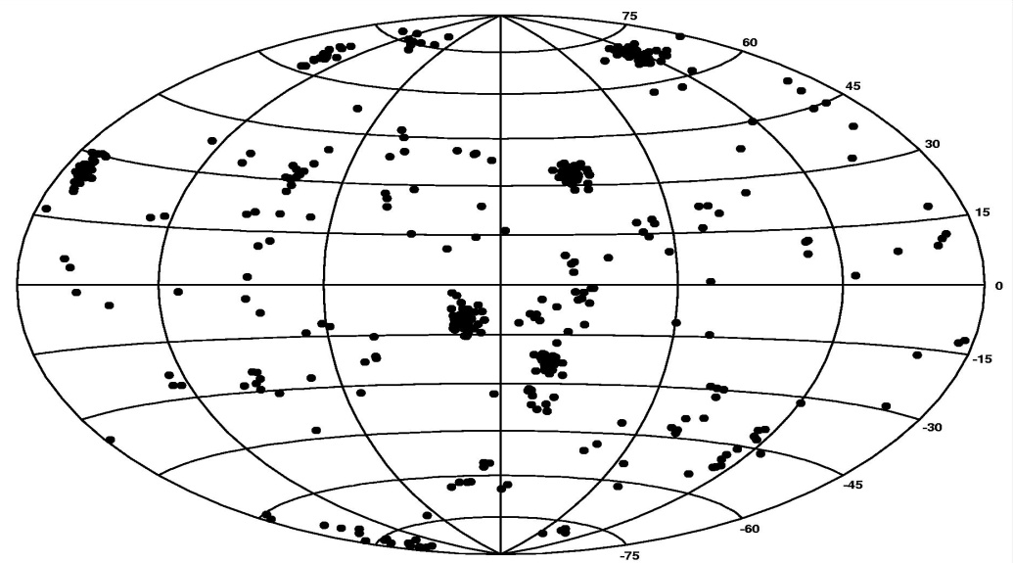
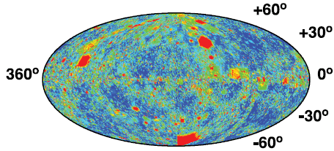
Detail simulations suggest 1000 UHECRs are enough to find individual sources!!
IRAS galaxies
This number will be accessible to Auger.
Ide (2001),
Yoshiguchi, Nagatak & Sato (2003)
Takami, Yoshiguchi & Sato (2006),
Takami & Sato (2007, 2008)
Simulation of the UHECR propagation
1,000 events : E>7x10¹⁹eV

Slide 20
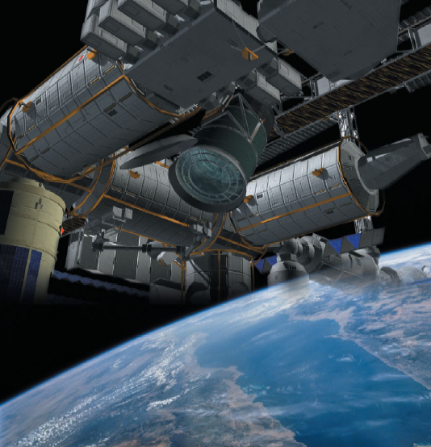


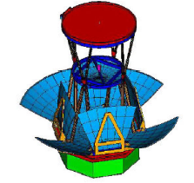

Near Future of Cosmic Ray Observation
Towered Particle Astronomy
TA (700km²)
North-Auger
(20,000km²)
JEM-EUSO
Southern-Auger
(3,000km²)
Super-EUSO
Notes:
What ever the situation (of the economy in our planet), we have to find the questions of CR.
And we are ready for that. We already have technology we need. Theoretians are waiting the data.

Slide 21
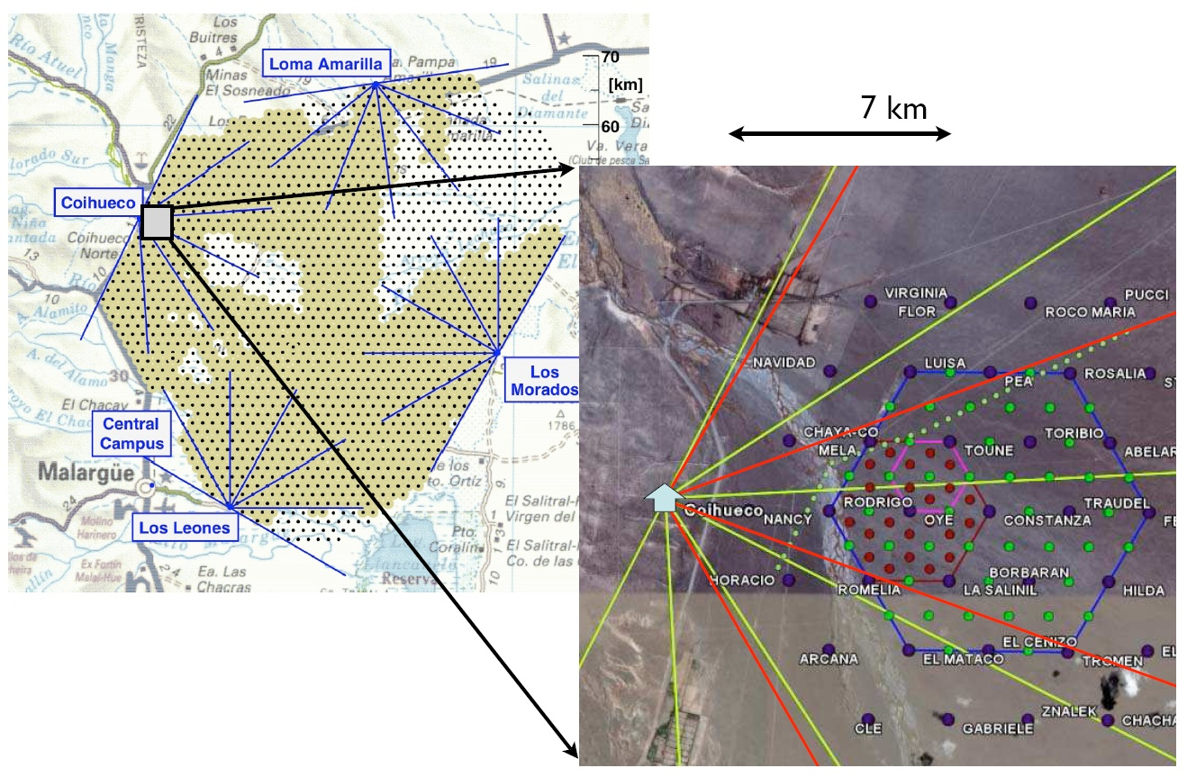
Low-Energy Enhancement In S-Auger

Slide 22
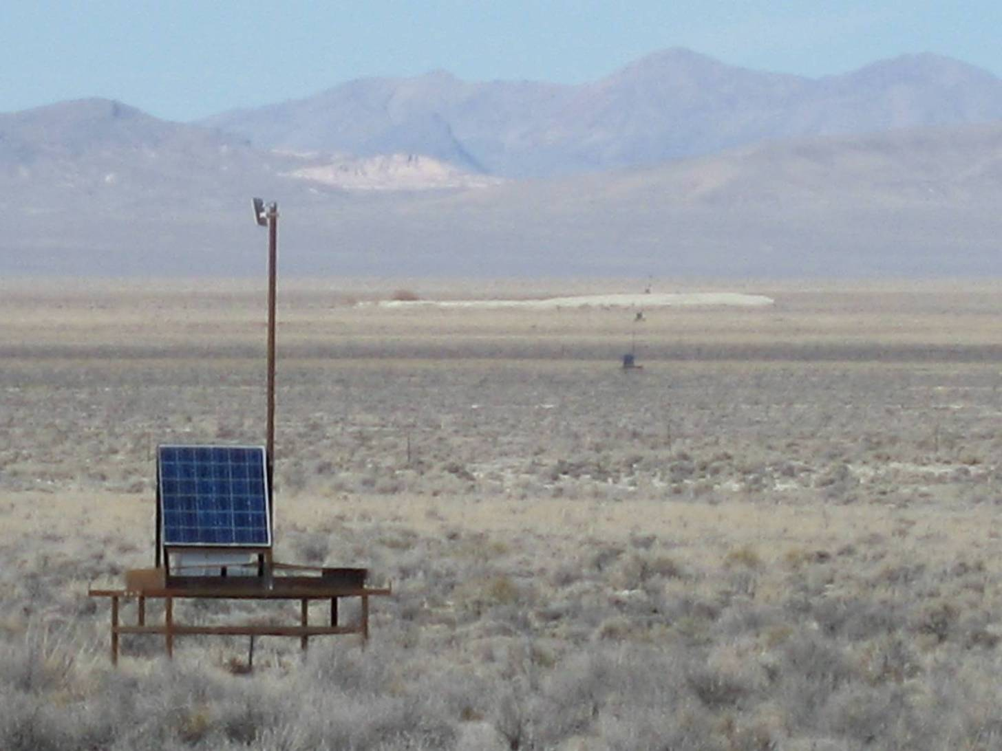
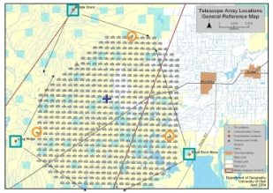
First Results from the Telescope Array in Northern-Hemisphere will come next year!!

Slide 23
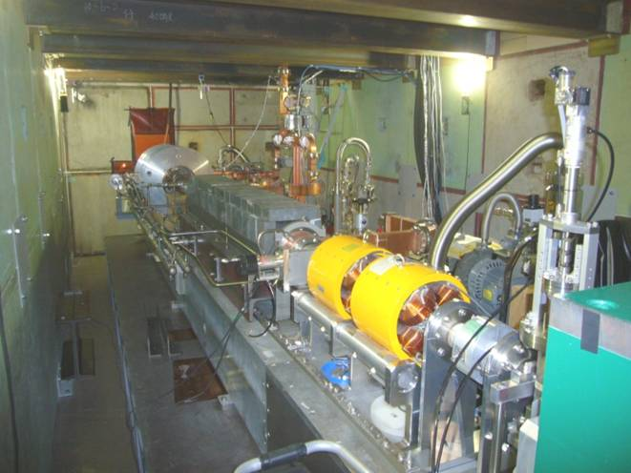
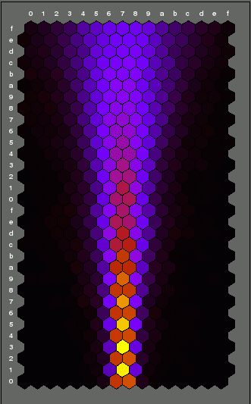
TA LINAC Calibration
Shoot 4x10¹⁶eV electrons in total energy in the Air
Simulation

Slide 24
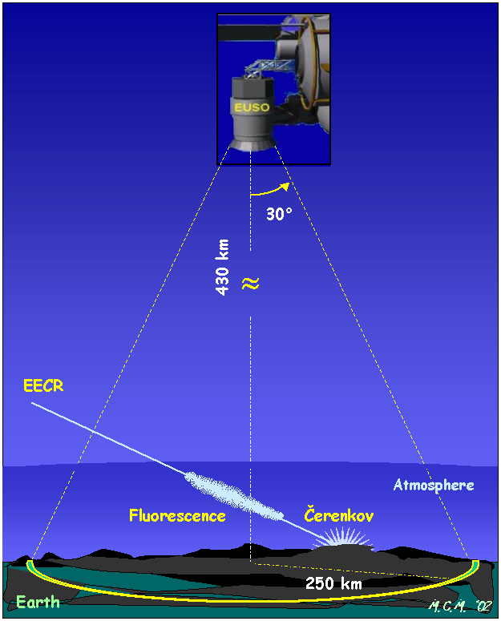
BACK TO THE SPACE!!!
Observation on the ground is facing its limitation. We got to go to the SPACE !!
JEM-EUSO
Notes:
Observation on the ground is

Slide 25
SUMMARY
Data set corresponding to one year of full scale S-Auger has revealed
A significant suppression of the spectrum at the highest energy.
A composition that apparently getting heavier at high energy
A constraining upper limit on the UHE photon flux disfavoring top-down models
Stringent upper limit on the background neutrino flux at 10^18 eV
The First evidence of the underlying anisotropic distribution of UHECRs
All that is needed is dedication, money and patience.

