Slide 1
Large Primordial Non-Gaussianity from early Universe
Kazuya Koyama
University of Portsmouth

Slide 2
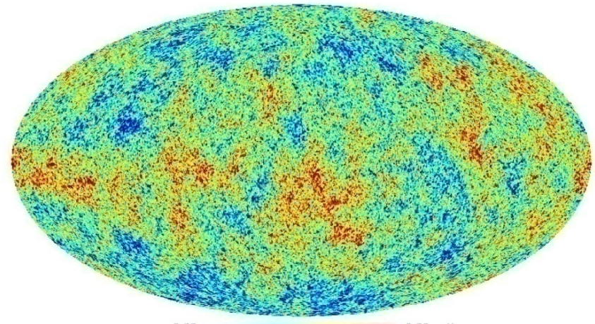
Primordial curvature perturbations
Komatsu et.al. 2008
Proved by CMB anisotropies
nearly scale invariant
nearly adiabatic
nearly Gaussian
Generation mechanisms
inflation
curvaton
collapsing universe (Ekpyrotic, cyclic)

Slide 3
Generation of curvature perturbations
Delta N formalism
curvature perturbations on superhorizon scales
= fluctuations in local e-folding number
Starobinsky ;85, Stewart&Sasaki ‘95

Slide 4
How to generate delta N
entropy
perturbations
Sasaki. 2008
adiabatic
perturbations
curvaton,
modulated reheating,
multibrid inflation
single field inflation
multi-field inflation, new Ekpyrotic
isocurvature

Slide 5
Suppose delta N is caused by some field fluctuations at horizon crossing
Bispectrum
Lyth&Rodriguez ‘05
Local type (‘classical’)
(local in real space
=non-local in k-space)
Equilateral type (‘quantum’)
(local in k-space)

Slide 6
Observational constraints
local type
maximum signal for
WMAP5
Equilateral type
maximum signal for
WMAP5

Slide 7
Theoretical predictions
 | Standard inflation | Non-standard scenario
Single field |  | K-inflation, DBI inflation Features in potential Ghost inflation
Multi field | depending on the trajectory | DBI inflation curvaton new Ekpyrotic (simplest model) isocurvature perturbations (axion CDM)
Rigopoulos, Shellard, van Tent ’06
Wands and Vernizzi ’06
Yokoyama, Suyama and Tanaka ‘07

Slide 8
Three examples for non-standard scenarios
(multi-field) K-inflation, DBI inflation
(simplest) new ekpyrotic model
(axion) CDM isocurvature model
Arroja, Mizuno, Koyama 0806.0619 JCAP
Koyama, Mizuno, Vernizzi, Wands 0708.4321 JCAP
Hikage, Koyama, Matsubara, Takahashi, Yamaguchi
(hopefully) to appear soon

Slide 9
K-inflation
Non-canonical kinetic term
Field perturbations (leading order in slow-roll)
Amendariz-Picon et.al ‘99
sound speed
Garriga&Mukhanov ‘99

Slide 10
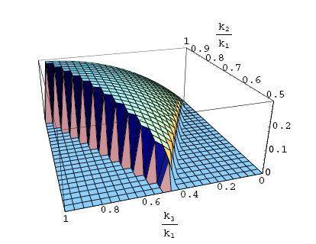
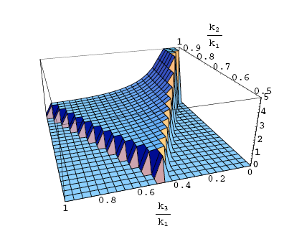
Bispectrum
LoVerde et.al. ‘07
DBI inflation
cf local-type
Aishahiha et.al. ‘04

Slide 11
Observational constraints
(too) large non-Gaussianity
Lyth bound
for equilateral configurations
D3
inflaton
anti-D3
Huston et.al ’07, Kobayashi et.al ‘08

Slide 12
Multi-field model
Arroja, Mizuno, Koyama ’08
Renaux-Petel, Steer, Langlois Tanaka‘08
Adiabatic and entropy decomposition
adiabatic sound speed
entropy sound speed
entropy
adiabatic

Slide 13
Multi-field k-inflation
Multi-field DBI inflation
Final curvature perturbation
Langlois&Renaux-Petel’08
Renaux-Petel, Steer, Langlois Tanaka‘08

Slide 14
Transfer from entropy mode
Tensor to scalar ratio
Bispectrum
k-dependence is the same as single field case!
large transfer from entropy mode eases constraints
Trispectrum
different k-dependence from single field case?
Renaux-Petel, Steer, Langlois Tanaka‘08
Mizuno, Koyama, Arroja ’09

Slide 15
New ekpyrotic models
Collapsing universe
Ekpyrotic collapse
bounce
Khoury et.al. ‘01

Slide 16
Old ekpyrotic model
spectrum index for is
the bounce may be able to creat a scale invariant spectrum but it depends on physics at singularity
New ekpyrotic model
Khoury et.al. ‘01
Lyth ‘03
B2
B
Lehners et.al , Buchbinder et.al. ‘07

Slide 17
Multi-field scaling solution is unstable
entropy perturbation which has a scale invariant spectrum
is converted to adiabatic perturbations
Koyama, Mizuno & Wands’ 07
B2
B
B
B2
B:
B2:

Slide 18
Delta-N formalism
B
B2
B2
B

Slide 19
Predictions
Generalizations
changing potentials
conversion to adiabatic perturbations in kinetic domination
Koyama, Mizuno, Vernizzi & Wands’ 07
Buchbinder et.al 07
Lehners &Steinhardt ‘08

Slide 20
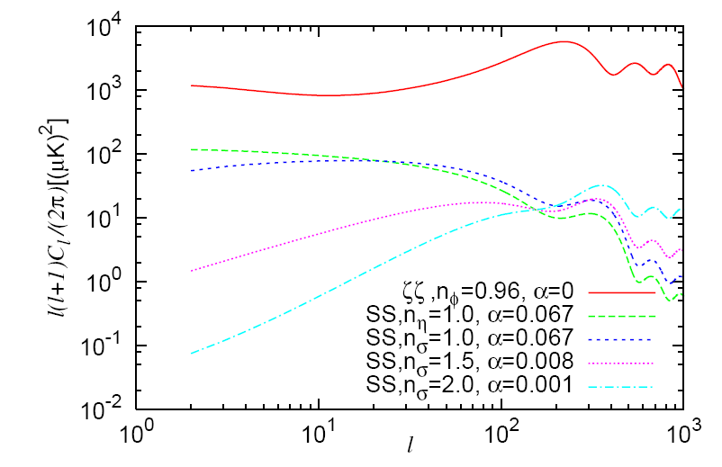
Non-Gaussianity from isocurvature perturbations
(CDM) Isocurvature perturbations are subdominant
Non-Gaussianity
can be large
Boubekeur& Lyth ‘06, Kawasaki et.al ’08,
Langlois et.al ‘08

Slide 21
Axion CDM
Massive scalar fields without mean
Entropy perturbations
Dominant nG may come from isocurvature perturbations
Linde&Mukhanov ‘97, Peebles ’98, Kawasaki et.al‘08

Slide 22
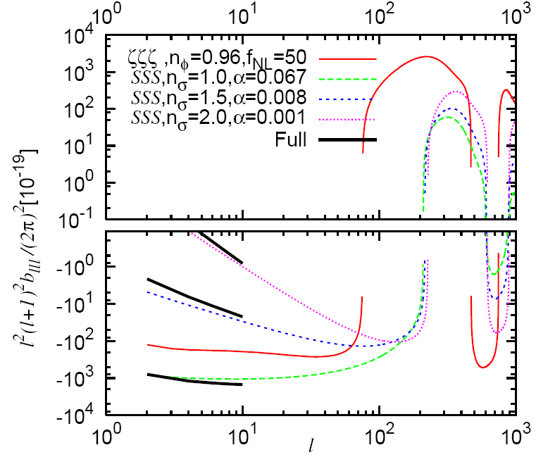
Bispectrum of CMB from the isocurvature perturbation
Noise: WMAP 5-year
Equilateral triangle
Adiabatic (f_{NL}=10)
The isocurvature perturbations can generate large non-Gaussianity (f_{NL}~40)

Slide 23
WMAP5 constraints -Minkowski functional
Hikage, Koyama, Matsubara, Takahashi, Yamaguchi ‘08
Minkowski functional measures the topology of CMB map (=weighted some of bispectrum)
no detection of non-G from isocurvature perturbations and get constraints
comparable to constraints from power spectrum

Slide 24
Theoretical predictions
 | Standard inflation | Non-standard scenario
Single field |  | K-inflation, DBI inflation Features in potential Ghost inflation
Multi field | depending on the trajectory | DBI inflation curvaton new Ekpyrotic (simplest model) isocurvature perturbations (axion CDM)

Slide 25
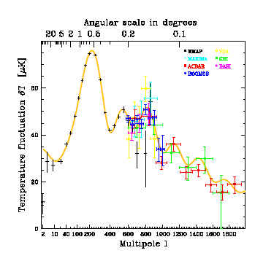
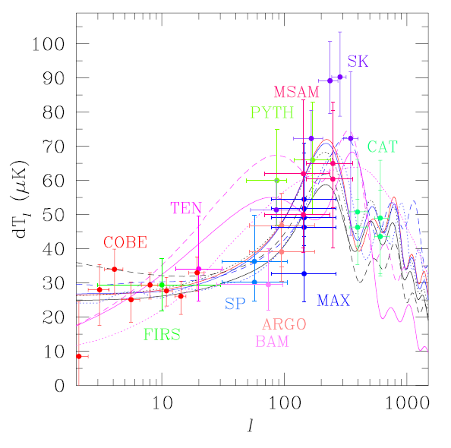
Conclusions
Power spectrum
from pre-WMAP
to post-WMAP
bispectrum
WMAP 8year
Planck
Do everything you can now!

Slide 26
Axion CDM
Classical mean of axion
quantum fluctuations
if

