Slide 1
On the Acceleration of Our Universe and the Effects of Inhomogeneities
Akihiro Ishibashi
Cosmophysics IPNS KEK
RESCEU Symposium Nov 14th 2008

Slide 2
Introduction
Distant SNe-Ia (at z ～ 0.5) appear to be fainter than expected in Einstein-de Sitter model

Slide 3
The concordance model
Geometry: FLRW Symmetry = Isotropic & Homogeneous
Main constituents: Dark Matter and Dark Energy
Still does NOT have any basis in fundamental physics
Ｔｈｅ ｉｓｓｕｅｓ ｏｆ ｗｈｙ ｓｏ ｓｍａｌｌ ａｎｄ ｗｈｙ ｎｏｗ
We might be misinterpreting the cosmological data
Alternative model?
Geometry: In-homogeneous
Main constituents: Dark Matter (No Dark Energy)

Slide 4
“ Which is more absurd,
Dark Energy or Inhomogeneous models? ”
Iguchi – Nakamura - Nakao 2002

Slide 5
Purpose of this talk:
Introduce recent attempts to account for acceleration of the universe by the effects of inhomogeneities
Point out some serious flaws in these attempts from theoretical -- relativisitc -- viewpoints

Slide 6
Outline
Newtonianly perturbed FLRW universe
VS
Super-horizon scale perturbations
Sub-horizon perturbations & averaging
Anti-Copernican inhomogeneous universe

Slide 7
Newtonianly perturbed FLRW universe

Slide 8


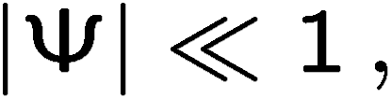

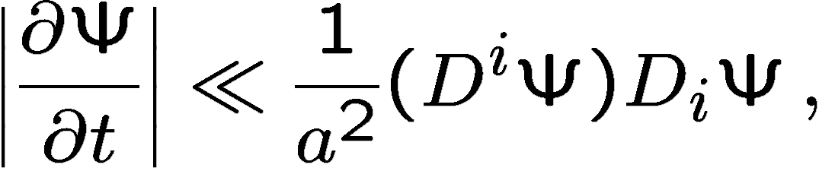
FLRW metric + scalar perturbations
homogeneous-isotropic 3-space
Newtonian perturbation

Slide 9
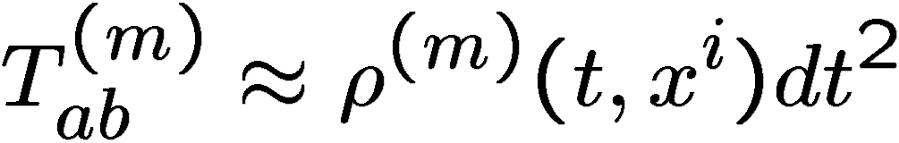
Stress-tensor
Smoothly distributed component
e.g., Dark Energy component
Inhomogeneously distributed component

Slide 10
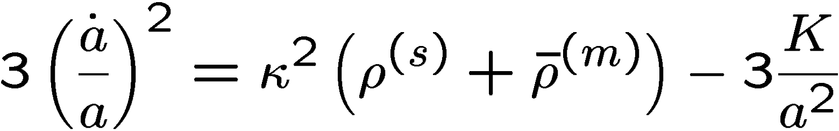
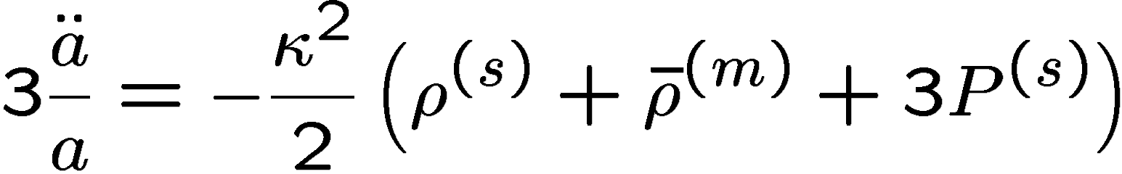
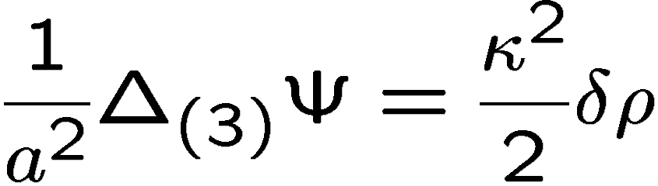
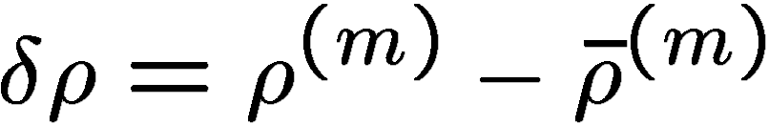
Einstein equations
( )
Large - scale
FLRW dynamics
Small - scale
Newtonian gravity

Slide 11
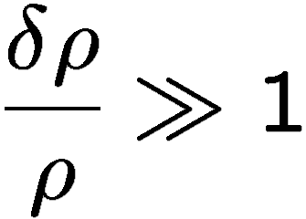
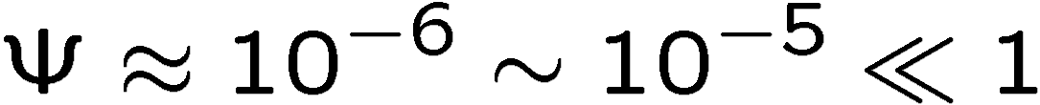
This is not the case
It is commonly stated that when
we enter a non-linear regime
Solar system, Galaxies, Clusters of Galaxies

Slide 12
Newtonianly perturbed FLRW metric appears to very accurately describe our universe on all scales
(except immediate vicinity of BHs and NSs)
If this assertion is correct
higher order corrections to this metric
from inhomogeneities would be negligible

Slide 13
… but we cannot preclude the possibility that other models could also fit all observations

Slide 14
Our points
If one wishes to propose an alternative model
then it is necessary to show that all of the predictions of the proposed model are compatible with observations.
It does not suffice to show that some quantity
(type of scale factor) behaves in a desired way

Slide 15
Super-horizon perturbations
Backreaction from

Slide 16
Long-wave perturbations
Another FLRW universe
A horizon scale patch
FLRW universe

Slide 17
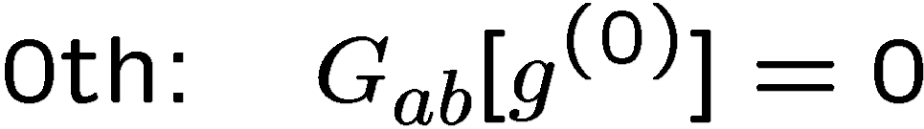
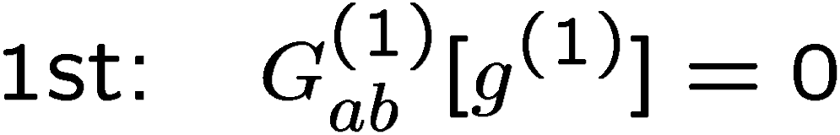
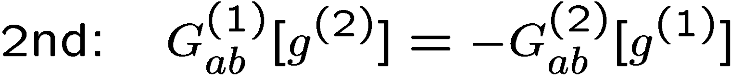
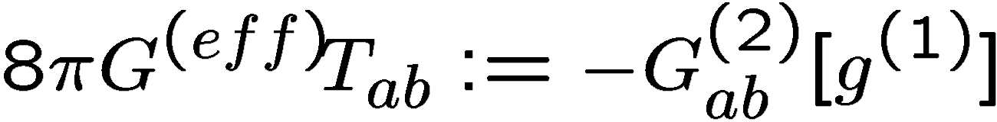
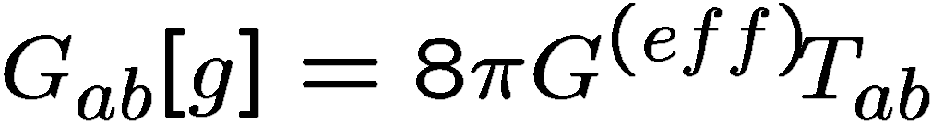

2nd-order effective stress-tensor approach
For vacuum case
View
and equate as
: backreacted metric
Brandenberger et al 1997 - 2005

Slide 18
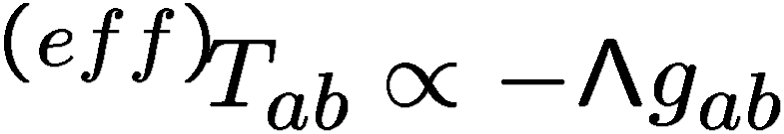
If the effective stress-tensor takes the form and has the appropriate magnitude
we are done … !?
Martineau – Brandenberger 2005

Slide 19
Some flaws in this approach
AI & Wald 2006
“Backreaction equation” is NOT consistently constructed from “perturbation theory”
2nd-order effective stress-tensor is gauge-dependent
If 2nd-order stress tensor has large effects, one can NOT reliably compute backreaction in 2nd-order theory
Long-wavelength limit corresponds to “other FLRW universe” (e.g., with different initial data)

Slide 20
Long-wave perturbations
Another FLRW universe
A horizon scale patch
FLRW universe

Slide 21
Sub-horizon perturbations
& spatial averaging
Backreaction from

Slide 22

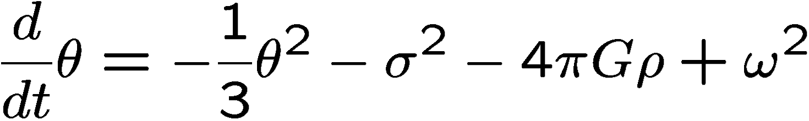
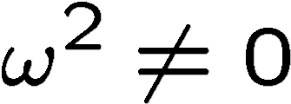
Inhomogeneous metric
Raychaudhuri equation:
: expansion
Deceleration unless one has large “vorticity”
“Accelerated” expansion
need some new mechanism

Slide 23
For simplicity and definiteness we hereafter focus on an inhomogeneous universe with irrotational dust.
Then in the comoving synchronous gauge

Slide 24
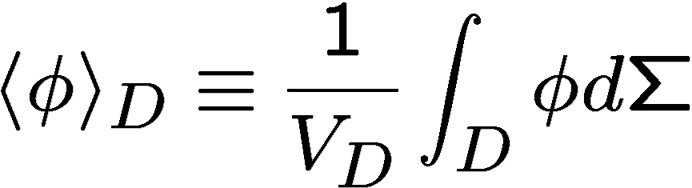
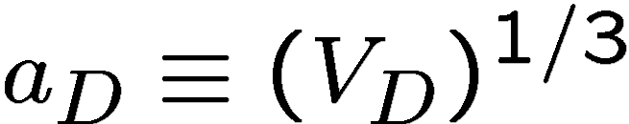
Spatial-Averaging
Buchert et al
Definition over Domain :
Depend on the choice of domain
Averaged scale factor:
Smoothing out inhomogeneities
Effective FLRW universe

Slide 25
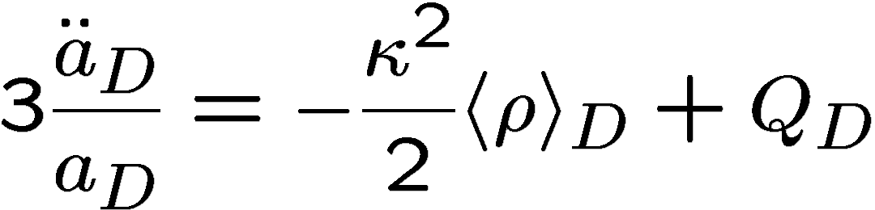
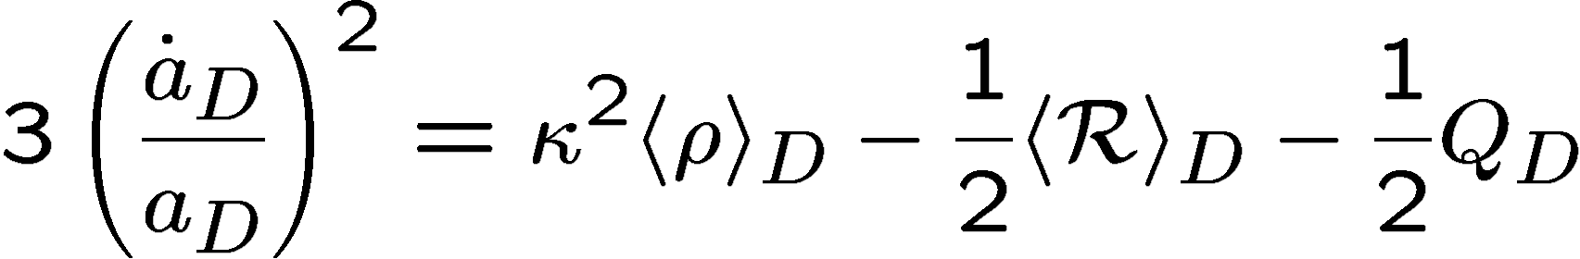
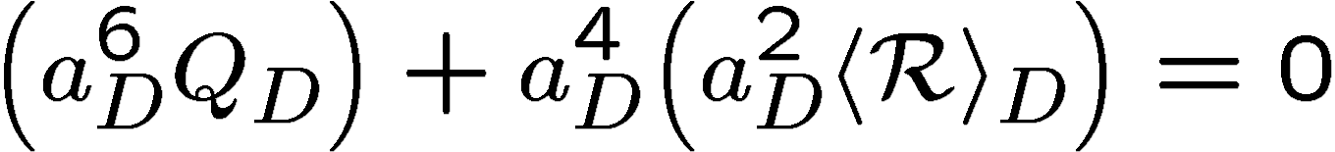
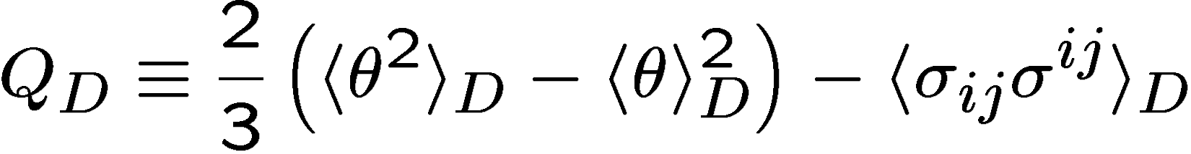
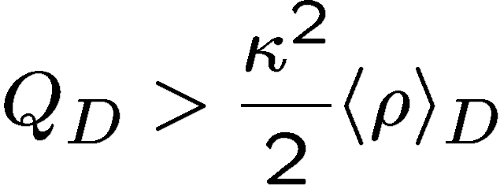

Equations for “averaged quantities”
Buchert 2000
.
.
Integrability condition:
Kinematical backreaction:
If
Acceleration

Slide 26
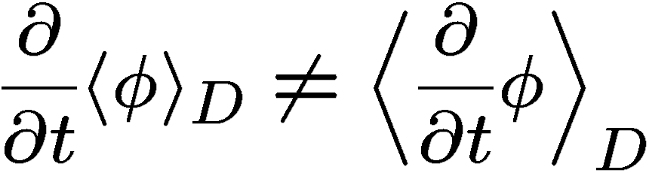
Spatial averaging and time evolution
do NOT commute
Ｔｈｅ ｓａｍｅ ｉｎｉｔｉａｌ ｄａｔａ

Slide 27

Contributions from non-linear sub-horizon perturbations to and the apparent acceleration of the volume-averaged scale factor have been studied by using gradient expansion method
Perturbation series appear to diverge
Kolb – Matarrese-Riotto 2005
-- The results seem to depend on the definition
(e.g. choice of the domain) of the spatial averaging
-- unclear the relations btwn averaged quantities and physical observables
-- seemingly they have used the perturbation method
beyond its regime of validity

Slide 28

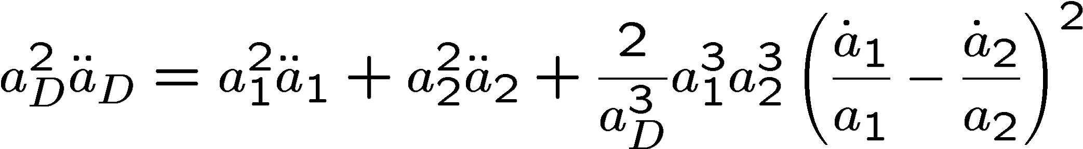
An example of averaged acceleration
Averaging a portion of expanding open FLRW universe
and a portion of collapsing closed FLRW universe exhibits “acceleration” in the averaged scale factor
Nambu & Tanimoto 2005
Even if
can be positive
This does NOT mean that we can obtain physically
observable acceleration by spatial averaging
-- rather implies “spurious acceleration”
AI & Wald 2006

Slide 29
in Minkowski spacetime
An example of spurious Acceleration

Slide 30
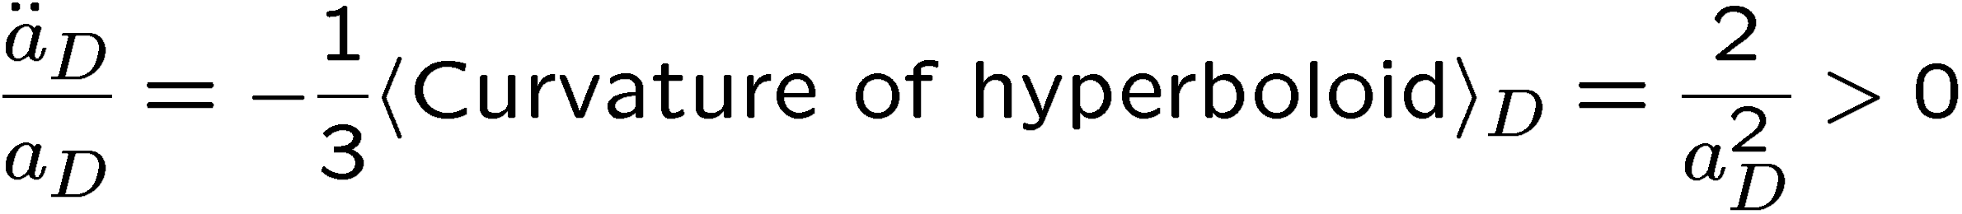
Expanding Hyperboloid
Contracting Hyperboloid
Always possible to take two (portions of) hyperboloids so that

Slide 31
Lessons
Gauge artifacts: The averaged scale factor displays “acceleration”
without there being any physically observable consequence
No reason to believe that the averaged quantities correspond to any physical effects
Small inhomogeneities generate negligible effects
2nd-order analysis Kasai– Asada – Futamase 2006
Vanderveld et al 2007
Behrend et al 2008
Need large inhomogeneities to get large backreaction
But then averaging procedure has large ambiguities in the choice of Time-slice and Domain

Slide 32
Anti – Copernican universe

Slide 33
Inhomogeneous (non-perturvative) models
Geometry: Spherically Symmetric
Main constituents: Dark Matter
We are living in the center of the world
e.g.
Local void of a few hundred Mpc:
Tomita 2000
Local void of a few Gpc :
Garcia-Bellido & Haugboelle 2008

Slide 34
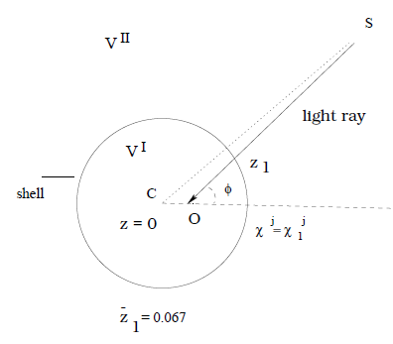
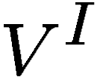
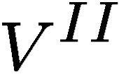
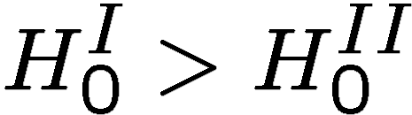
A local void model
Tomita 2000
: low-dense region
: high-dense outer
-- can be positioned 50Mpc
away from the center
The mismatch between the local and global expansion can explain the observed dimming of SN-Ia luminosity

Slide 35
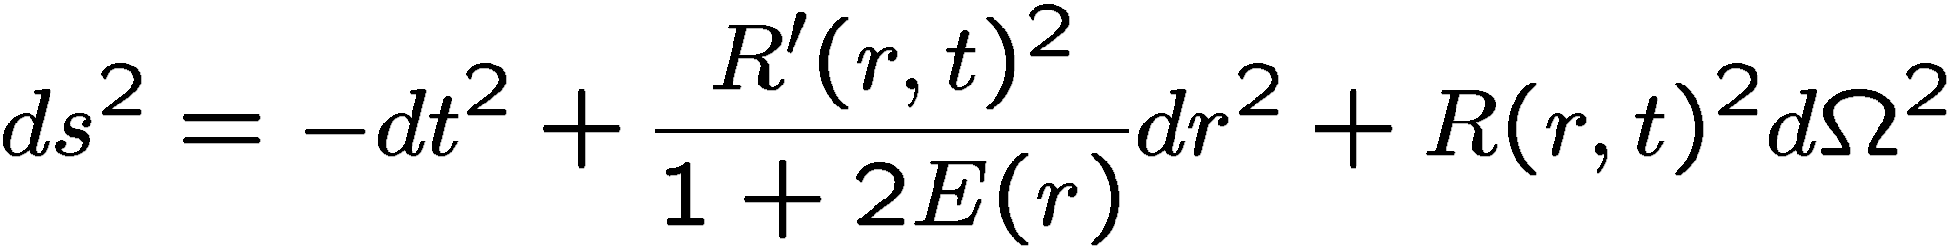
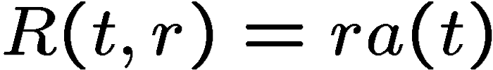
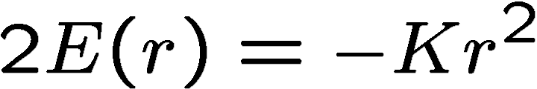
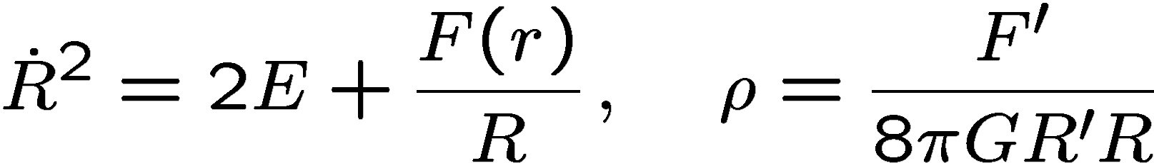
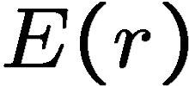
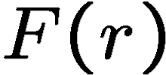
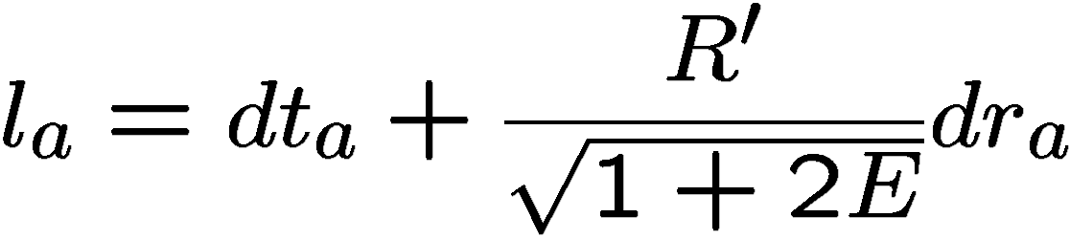
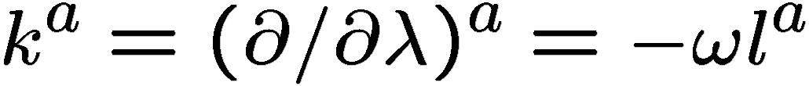

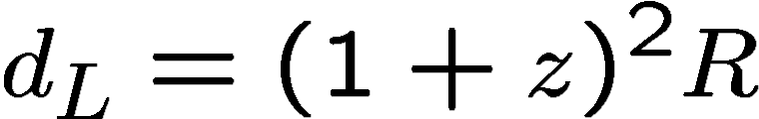
Lemaitre-Tolman-Bondi (LTB) metric
Simplest model:
FLRW metric
Two arbitrary functions
Null vector
Luminosity-distance:

Slide 36
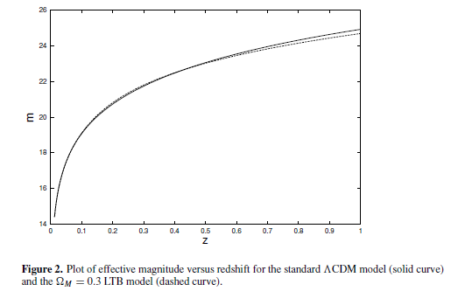
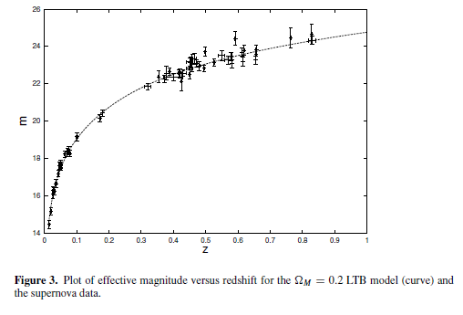
The LTB model can fit well the redshift-luminosity relation
Iguchi – Nakamura – Nakao 2002
Garfinkle 2006

Slide 37
However …
Many LTB models contain a weak singularity at the center
Vanderveld-Flanagan-Wesserman 2006
We have more cosmological data than SN-Ia
How to reconcile large scale structure formation
without Dark Energy?
How to confront with CMB spectrum?
1st-peak of CMB power spectrum can be made to match WMAP observations
e.g. Alnes-Amarzguioui-Groen 2006
Garcia-Bellido – Haugboelle 2008
If no Dark Energy, density perturbations would have grown too much

Slide 38
Conclusion
Inhomogeneous models can mimic an “accelerated expansion” without Dark Energy
Backreaction scenarios from perturbations and/or
spatial averaging suffer from serious gauge ambiguities
Anti-copernican models have attracted more attention
Seems unlikely that all cosmological data can be explained by inhomogeneous models
But the issue has not yet been settled
… noy yet definitively ruled out

