Slide 1
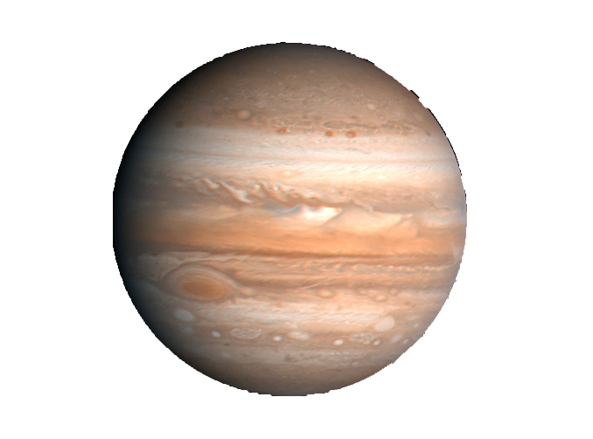
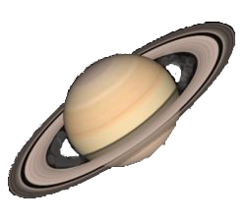
Capture of Solids in the Late Stage of Gas Giant Formation
The Effect of Multiplicity and Migration of Gas Giants
Sho Shibata, Yuhiko Aoyama, Masahiro Ikoma
The University of Tokyo
Notes:
My name is Sho Shibata.
Today, let me talk about my recent study.
The title is capture of solids in the late stage of gas giant formation, the effect of multiplicity and migration of gas giants.
This research is a collaboration with Aoyama-san and Ikoma-san.

Slide 2
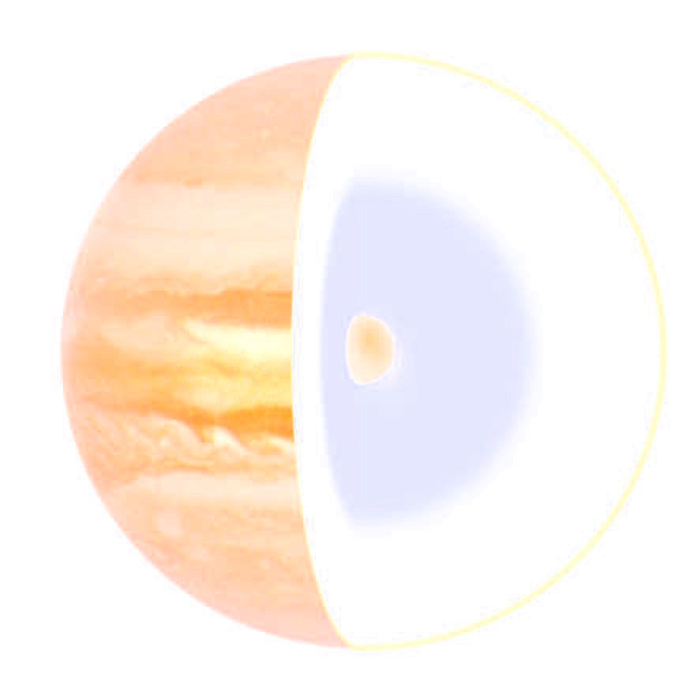
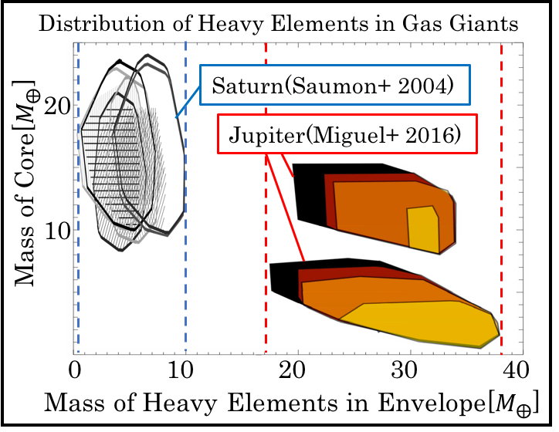
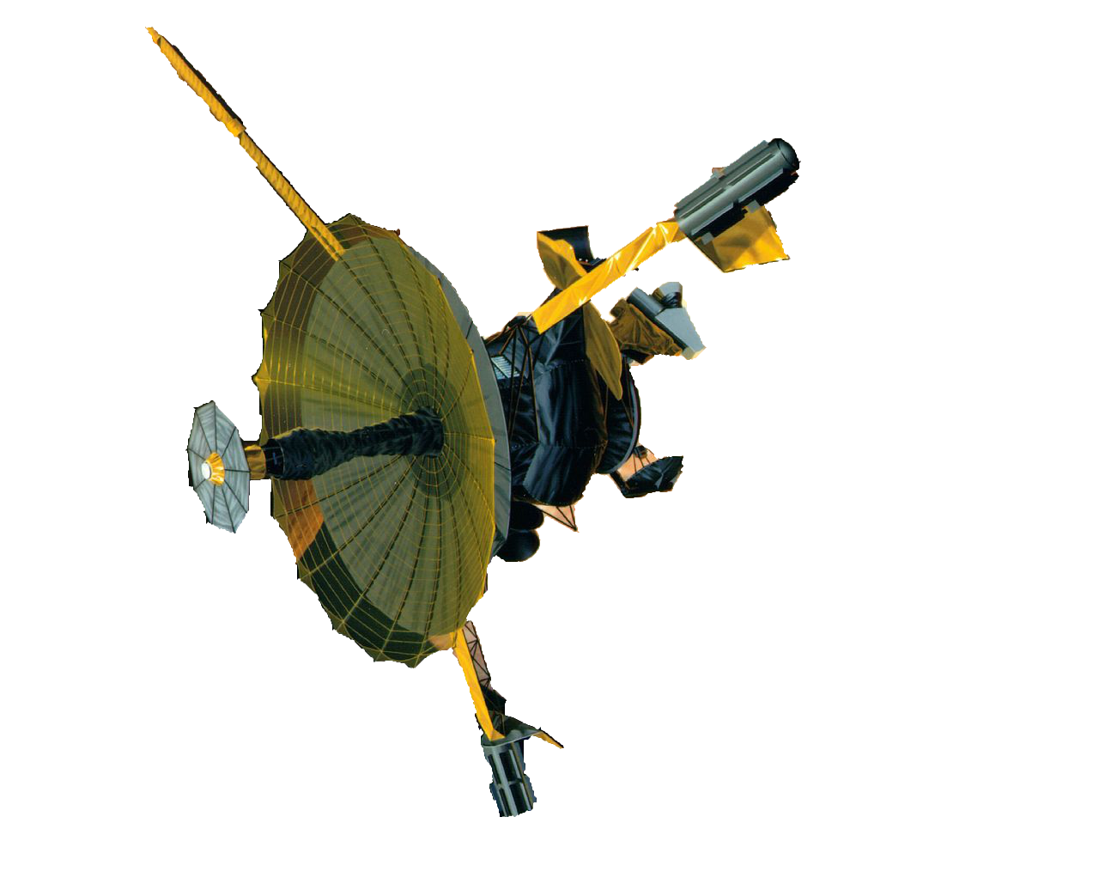
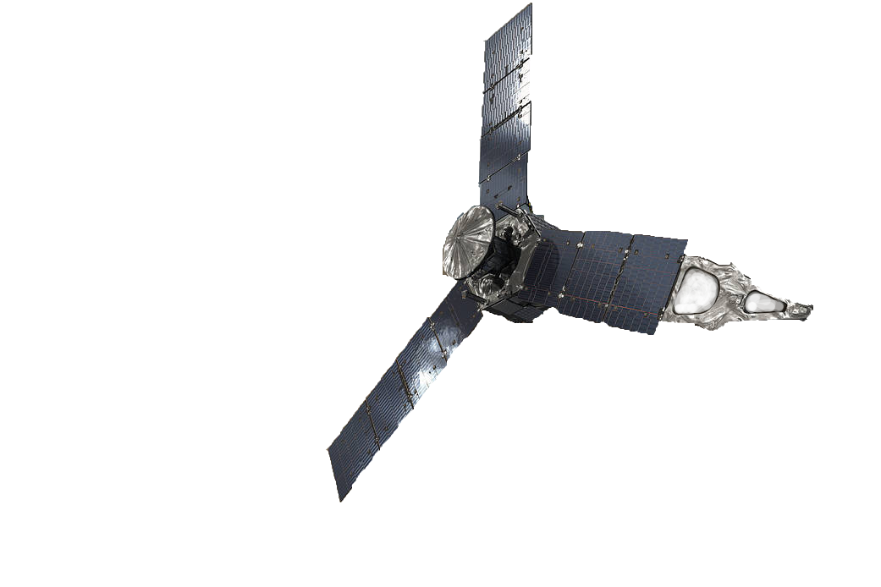
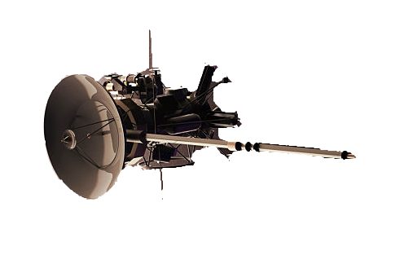
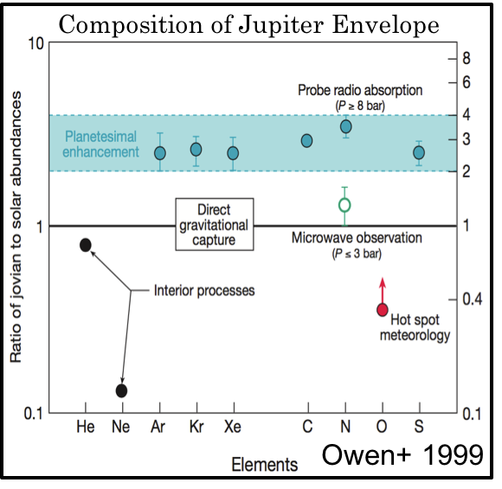



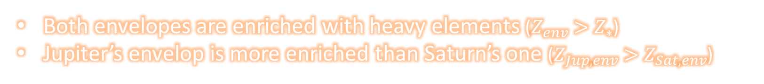
Introduction：Observation of Gas Giant
Gas giants are planets that are composed of
  Rocky Core
  Massive Envelop
Observations of exploration satellites revealed some features about the gas giants’ envelopes
    Galileo 1989-2003
    Cassini 1997-2017
    Juno 2011-
Direct Observation
The Amount of Heavy Elements in Gas Giants’ Envelopes
Jupiter
$$17\sim 38M_{⊕}$$
0
10
20
30
40
$$M_{⊕}$$
Saturn
$$0\sim 10M_{⊕}$$
Both envelopes are enriched with heavy elements ($Z_{env}>Z_{∗}$)
Jupiter’s envelop is more enriched than Saturn’s one ($Z_{Jup,env}>Z_{Sat,env}$)
Notes:
Gas giants are planets that have rocky core and massive envelop.
In recent years, some exploration satellites have observed solar system gas giants, namely Jupiter and Saturn.
They revealed some important features about their envelopes.
This diagram shows the amount of heavy elements in their envelopes.
As you can see, Jupiter and Saturn have much heavy elements in their envelopes.
In addition, Jupiter has much more heavy elements than Saturn.
These features are very important because simple core accretion model cannot explain that the fraction of heavy elements in gas giant's envelop is higher than the solar abundance.
So, the final goal of our study is to explain the origin of heavy elements theoretically.

Slide 3
Introduction：Hypothesis and Mechanism
  Proposed Hypothesis：
  Late Stage Capture of Solids by Accreting Proto-Gas-Giant Planets
    Late Stage = Gas giant has a massive envelope
    Captured planetesimals would evaporate in the envelope
    Heavy elements in planetesimals would be distributed to the envelope
Evaporation of Solids in Gas Giant’s Envelope
But capture of planetesimals is not so easy
Envelope
Planetesimal
Core
Notes:
A hypothesis was already proposed to explain the observations, which is "late stage capture of solids by accreting proto-gas-giant planets".
In the late stage of gas giants' formation, they have massive envelopes.
If planetesimals enter the envelope, they would experience strong gas drag and evaporate in the envelope, and never reach the core.
So the capture of planetesimals in this stage would increase the amount of heavy elements in the gas giants' envelopes.
But the capture of planetesimals is not so easy.

Slide 4
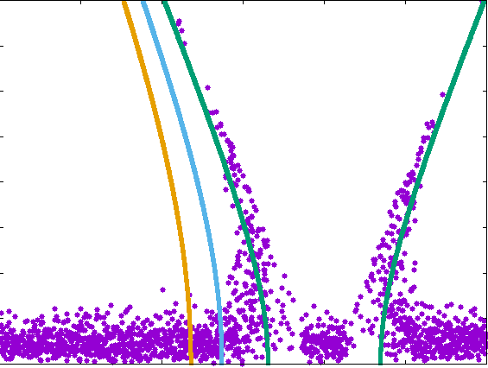



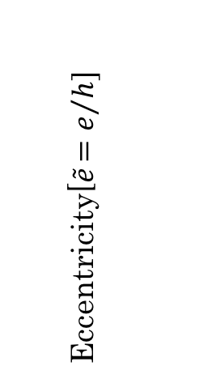



Introduction：Hypothesis and Mechanism
  Proposed Hypothesis：
  Late Stage Capture of Solids by Accreting Proto-Gas-Giant Planets
Distribution of Planetesimals in $\tilde{a}−\tilde{e}$ Plane
    Jacobi Energy：
    $$E_{J}=\frac{1}{2}\left({\tilde{e}}^{2}+i^{2}\right)−\frac{3}{8}{\tilde{b}}^{2}+\frac{9}{2}+O\left(h\right)$$
    Feeding Zone(FZ)：
    $$E_{J}>0$$
8
$$E_{J}=−0.10$$
$$E_{J}=0$$
6
Feeding Zone
$$E_{J}>0$$
External Force
$$E_{J}=−0.05$$
Eccentricity[$\tilde{e}{=e}/h]$
4
    Processes occurring around protoplanet
    Gravitational scattering by protoplanet
    Gas damping of eccentricity
    ➞ A kind of potential barrier
2
Stirring from
Proto-Planet
0
-15
-10
-5
0
5
10
Semi-Major Axis[$\tilde{b}\text{=}{\left(a−a_{p}\right)}/{ha_{p}}$]
Planetesimals have to enter the FZ of the protoplanet to be captured
External force is necessary for Planetesimals to enter the FZ
Notes:
This diagram shows the distribution of planetesimals around protoplanet in the plane of semi-major axis and eccentricity.
In this plane, we can draw the feeding zone of the protoplanet as a green area.
These lines show the constant Jacobi Energy.
Since mass of the planetesimals is negligibly small relative to the protoplanet, the dynamics of the planetesimals can be treated as a restricted three body problem.
Therefore, you cannot change the Jacobi energy of planetesimals only by gravitational force of protoplanet.
So, in order to push the planetesimals to the feeding zone, you need external forces.

Slide 5
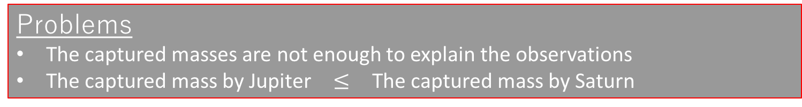
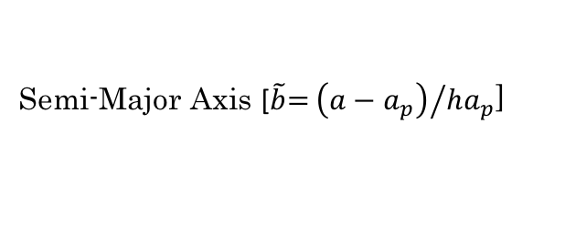





Introduction：Previous Study
  Zhou&Lin 2007, Shiraishi&Ida 2008 ➞ In situ capture in gas accretion phase
They study the capture of planetesimals by protoplanet in gas accretion phase.
Planetesimals can enter the FZ in this phase, because Hill radius is expanding.
Inflow
VS
Outflow
8
Growth Timescale
$$τ_{Grow}$$
Damping Timescale
$$τ_{Damp}$$
Eccentricity [$\tilde{e}{=e}/h$]
6
Feeding Zone
$$E_{J}>0$$
Increase in Mass
Increase in Eccentricity by
Gravitational Scattering
4
Expansion of Hill Radius
2
Expansion of FZ
Effective Gas Damping
Results
The captured masses are
  Jupiter：$\sim 8M_{⨁}$
  Saturn：$\sim 11M_{⨁}$
0
-10
-5
0
5
10
Semi-Major Axis [$\tilde{b}\text{=}{\left(a−a_{p}\right)}/{ha_{p}}$]
Problems
The captured masses are not enough to explain the observations
The captured mass by Jupiter $≤$ The captured mass by Saturn
Notes:
Next, I will summarize the previous studies briefly.
They consider the in situ capture of planetesimals in gas accretion phase.
In this phase planetesimals can enter the Feeding Zone because the Feeding Zone is expanding.
They found that the captured mass is determined by the competitions of the two timescales.
The one is growth timescale of protoplanet, this effect can be drawn as a green arrow in this diagram.
It pushes planetesimals into the Feeding Zone.
The other one is damping timescale of disk gas , this effect can be drawn as a purple arrow.
It eliminates planetesimals from Feeding Zone.
So, if the protoplanet grows faster, you can capture more planetesimals.
They calculated the amount of captured mass.
They found the captured mass for Jupiter is about 8 Earth masses, and that for Saturn is about 11 Earth masses.
But these results are not consistent with the observations in two points, the captured masses are not enough and Saturn captured more planetesimals than Jupiter.
So we have to consider additional effect.

Slide 6
Introduction：Summary
Observations of solar system gas giants revealed some important features for their envelopes
  Envelopes of Jupiter and Saturn are enriched with heavy elements
  Jupiter’s envelop is more enriched than Saturn’s one
Late stage capture of solids by a growing protoplanet is proposed as a hypothesis to explain these observations
However, the captured heavy elements through in situ planet formation are not sufficient to explain the observations
  The captured mass is smaller than the mass inferred from observations
  Saturn captures more planetesimals than Jupiter
In this study, we consider the effect of
  planet migration
  supply by another migrating protoplanet
Notes:
Let me summarize our introduction

Slide 7




Our Study：Effect of Planet Migration
We consider the orbital evolution phase of proto planet
Gas giant interacts with gas disk and moves toward the central star
Migrating planet encounters a great number of planetesimals
Distribution of planetesimals
8
Inflow
VS
Outflow
Feeding Zone
$$E_{J}>0$$
Eccentricity [$\tilde{e}{=e}/h$]
6
Migration Timescale
$$τ_{Grow}$$
Damping Timescale
$$τ_{Damp}$$
4
2
0
-10
-5
0
5
10
Semi-Major Axis [$\tilde{b}\text{=}{\left(a−a_{p}\right)}/{ha_{p}}$]
Notes:
First, we consider the effect of planet migration.
Relatively massive protoplanet interacts with gas disk and moves in the radial direction in a protoplanetary disk.
If a gas giant moves toward the central star, it encounters a great number of planetesimals.
So planet migration have a possibility to increase the captured mass.
In this process, the effect that pushes the planetesimals to the feeding zone is the planet migration, so the captured mass would be determined by the competitions of the two timescales, migration timescale and damping timescale.

Slide 8
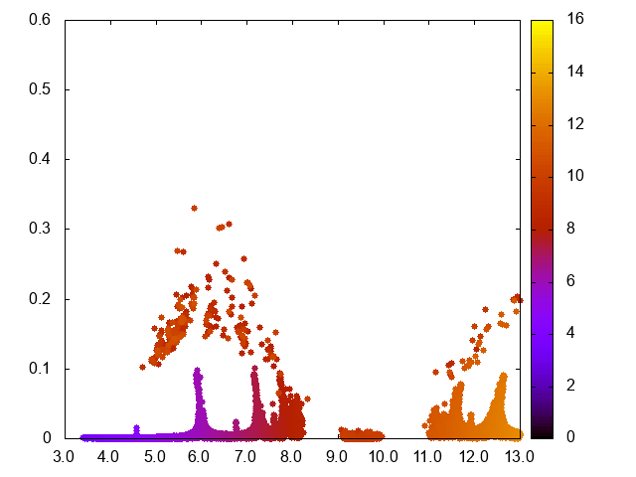
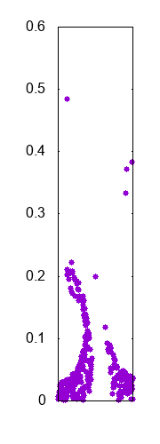

Our Study：Effect of Planet Migration
Setting
Number of Planet：1
Mass of Planet：$M_{p}=M_{Jup}$
Migration Timescale $t_{Mig}$ ：parameter
Migration Range：9.2AU ⇨ 5.2AU
Distribution of Planetesimals in Planet Migration
Expansion of 1:2 MMR
1:2 MMR
Eccentricity
Initial Semi-Major Axis
Eccentricity
Semi-Major Axis
Semi-Major Axis
Many planetesimals are trapped in mean motion resonances (MMRs).
Notes:
This is the result of the calculation, where we have assumed the protoplanet is located initially at 9.5 AU and then migrates inward to 5.2 AU in hundred thousand years.
The initial distribution of planetesimals is the same as that of MMSN.
As you can see, the protoplanet is migrating toward the central star.
The planetesimals near the protoplanet are captured by it, on the other hand many of the planetesimals relatively far from the protoplanet cannot be captured.
This is because they are trapped in mean motion resonances of Jupiter.
MMRs of massive planet like Jupiter and Saturn are so strong that the resonance trap is effective.

Slide 9
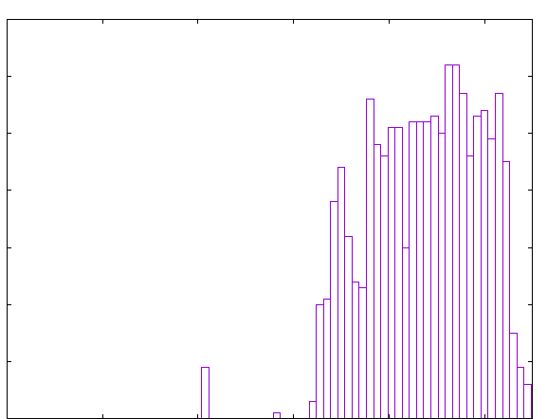
Our Study：Effect of Planet Migration
Number of captured planetesimals vs. Initial semi-major axes
1:2
2:3
3:4
60
Number
40
Under the effect of Resonance Trap
20
0
5
6
7
8
9
Initial Semi-Major Axis [AU]
Planetesimals beyond the strong mean motion resonances are never captured, because of resonance trapping.
Planet migration is ineffective in increasing the captured mass.
Notes:
This figure shows the histogram of captured planetesimals.
The horizontal axis shows the initial semi-major axes of captured planetesimals.
As you can see, planetesimals beyond the strong mean motion resonances, such as 1 to 2, 2 to 3, are never captured.
So planet migration is not effective in increasing the captured mass.
Namely we cannot explain the observations by this effect only.

Slide 10
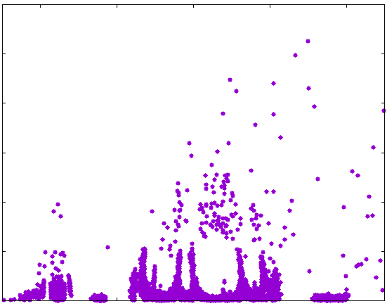
Our Study：Effect of Multiplicity
We consider another protoplanet that is migrating toward the proto-Jupiter.
In this situation, planetesimals can enter the FZ ,because of the gravitational scattering by the other protoplanet.
… similar situation to the Grand-Tack model
Distribution of planetesimals
0.6
Feeding Zone of Inner Planet
Feeding Zone of Outer Planet
0.4
Eccentricity
0.2
0
2
4
6
8
10
Semi-Major Axis
Notes:
Then, we consider another protoplanet that is migrating toward the inner protoplanet.
We call these protoplanet proto-Jupiter and proto-Saturn in this model.
This model is similar situation to the Grand -Tack model.
In this situation, planetesimals can enter the feeding zone because of the gravitational scattering by the other protoplanet.

Slide 11
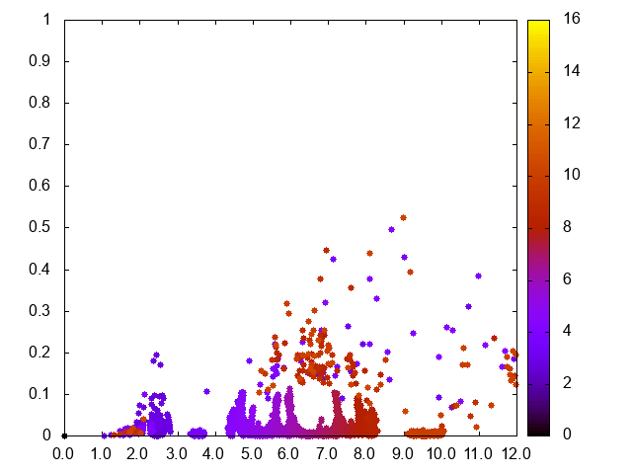
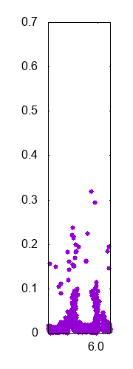

Our Study：Effect of Multiplicity
Setting
Number of Planet：2
Mass of Planet：$M_{p}=M_{Jup}$, $M_{Sat}$
Migration Timescale $t_{Mig}$ ：${10}^{5}$ year
Migration Range：9.2AU ⇨ 5.2AU
Distribution of Planetesimals in Multiple System
Expansion of inner planet 2:1 MMR
Initial Semi-Major Axis[AU]
Eccentricity
1:2 MMR of Inner Planet
Eccentricity
Semi-Major Axis
Semi-Major Axis [AU]
When the MMRs of the inner and outer planets overlap each other, the eccentricity of planetesimals at the MMRs becomes higher
Notes:
This is the result of the calculation, where we have assumed the proto-Jupiter is located at 3.5 AU and the proto-Saturn is located at 9.5 AU initially, and then the proto-Saturn migrates inward to 5.5 AU.
Migration timescale is hundred thousand years.
As you can see,
when the proto-Saturn migrates inward, MMRs of the proto-Saturn also move inward.
So MMRs of the proto-Jupiter and the proto-Saturn overlap many times, and sometimes then eccentricity of planetesimals at MMRs are increased extremely.

Slide 12


Our Study：Effect of Multiplicity
Change in Captured Mass in Multiple Planetary System
Captured Mass of Planetesimals[$M_{⨁}$]
3
Proto-Jupiter
2
1
Proto-Saturn
0
1
2
3
4
5
Time[$×{10}^{5}$year]
Proto-Saturn captures planetesimals continuously.
In contrast Proto-Jupiter captures stepwisely, because of the MMRs overlap.
In this process, proto-Jupiter captures more planetesimals than proto-Saturn.
Notes:
This diagram shows the change in the captured mass by the proto-Jupiter and the proto-Saturn.
Green line shows the proto-Saturn, purple line shows the proto-Jupiter.
The proto-Saturn captures planetesimals continuously.
In contrast, the proto-Jupiter captures planetesimals stepwisely.
This difference comes from the overlapping of MMRs.
Interestingly, the overlapping of MMRs increases the captured mass of the proto-Jupiter selectively.

Slide 13
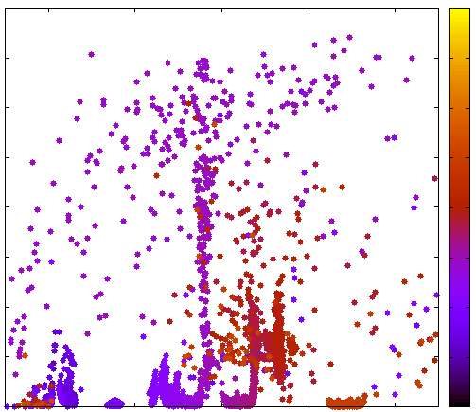
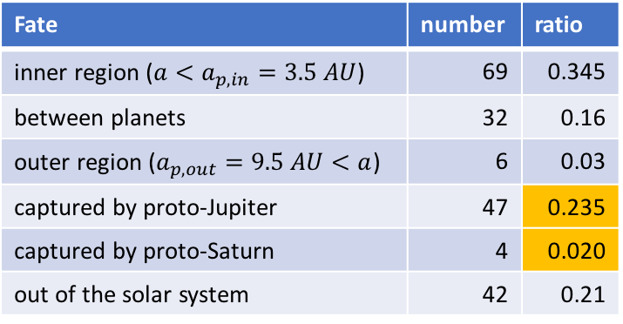
Our Study：Effect of Multiplicity
Analysis of MMR-Overlap
Fate of planetesimals trapped in 1:2 MMR of the proto-Saturn
Distribution of planetesimals
16
The shape of F.Z. is asymmetry
Fate | number | ratio
inner region ($a<a_{p,in}=3.5 AU$) | 69 | 0.345
between planets | 32 | 0.16
outer region ($a_{p,out}=9.5 AU<a$) | 6 | 0.03
captured by proto-Jupiter | 47 | 0.235
captured by proto-Saturn | 4 | 0.020
out of the solar system | 42 | 0.21
Initial Semi-Major Axis
0.6
12
Eccentricity
0.4
8
0.2
4
Calculated 200 planetesimals
0
0
2
4
6
8
10
Semi-Major Axis[AU]
    This model have a possibility to explain the observations
Notes:
This table shows the fate of planetesimals trapped in 1 to 2 MMRs of the proto-Saturn.
The ratio of captured planetesimals by the proto-Jupiter and the proto-Saturn is about 10.
This result may be related to the shape of the feeding zone.
The shape of the feeding zone is asymmetry, and this asymmetry makes the difference of the captured mass between the proto-Jupiter and the proto-Saturn.
This model, considering the another migrating protoplanet, has the possibility to explain the observations because of the overlapping of MMRs.

Slide 14
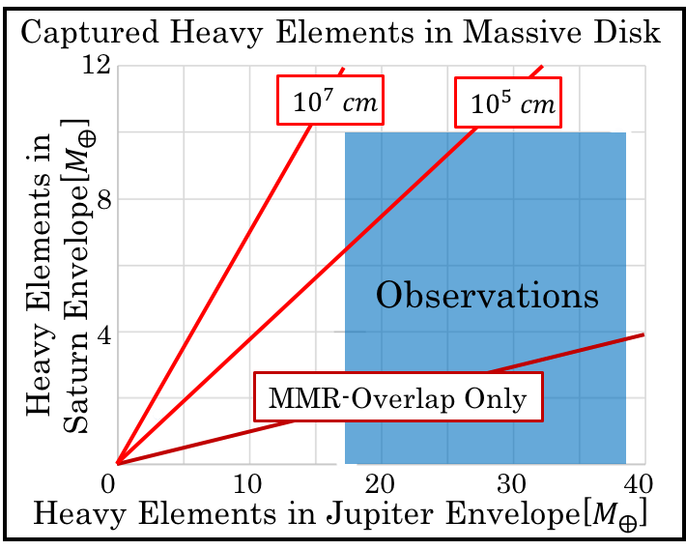
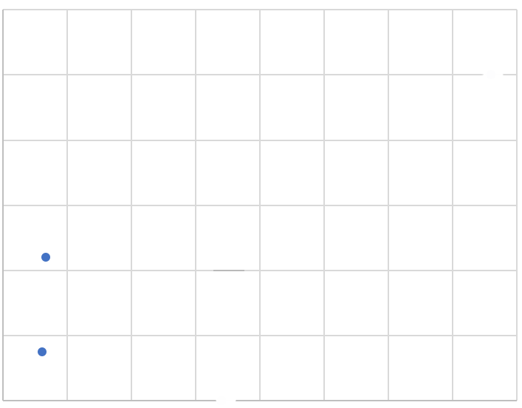
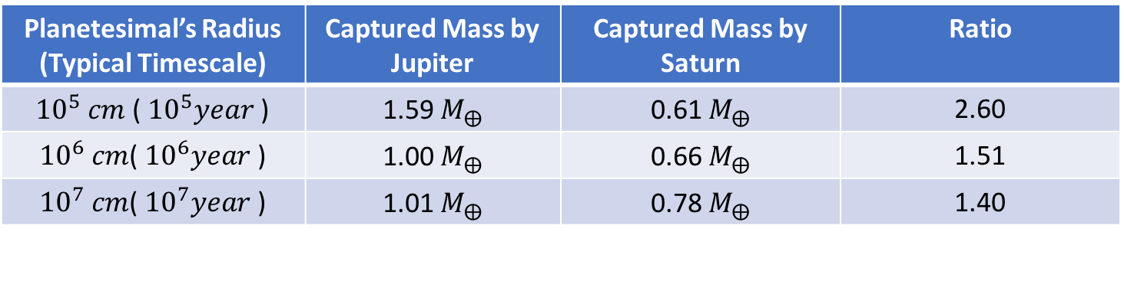

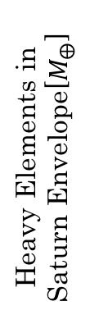
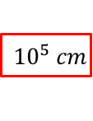
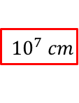
Our Study : comparison with observations
Captured mass in MMSN
Planetesimal’s Radius (Typical Timescale) | Captured Mass by Jupiter | Captured Mass by Saturn | Ratio
${10}^{5} cm$ ( ${10}^{5}year$ ) | 1.59 $M_{⨁}$ | 0.61 $M_{⨁}$ | 2.60
${10}^{6} cm$( ${10}^{6}year$ ) | 1.00 $M_{⨁}$ | 0.66 $M_{⨁}$ | 1.51
${10}^{7} cm$( ${10}^{7}year$ ) | 1.01 $M_{⨁}$ | 0.78 $M_{⨁}$ | 1.40
Captured Heavy Elements in Massive Disk
12
$${10}^{7} cm$$
$${10}^{5} cm$$
8
10MMSN
Heavy Elements in Saturn Envelope[$M_{⨁}$]
15MMSN
Observations
4
MMR-Overlap Only
0
10
20
30
40
Heavy Elements in Jupiter Envelope[$M_{⨁}$]
Notes:
Let me compare our results with the observations.
We performed parameter study in damping timescales.
This table shows the results.
As you can see, the ratio of captured planetesimals between proto-Jupiter and proto-Saturn is increasing with drag strength.
This is because gas drag moves planetesimals inward, which would increase the captured mass by inner protoplanet.
And this diagram shows comparison of our results with observations.
Horizontal axis is the amount of heavy elements in Jupiter envelope, and vertical axis is Saturn.
If we consider the massive disk and strong gas drag, our model consists with observations.

Slide 15
Summary
Observations of solar system Gas Giants revealed some important features for their envelopes
  Gas Giant’s envelope is enriched with heavy elements
  Jupiter’s envelop is more enriched than Saturn’s one
Late stage capture of solids by a Proto-Gas-Giant is proposed as a hypothesis to explain these observations
However, the captured heavy elements through in situ planet formation are not sufficient to explain the observations
  Lack in captured mass
  Saturn captures more planetesimals than Jupiter
In this study, we have investigated the effects of planet migration and supply by another migrating protoplanet and then demonstrated:
  Planet migration is inefficient in collecting many planetesimals, because of resonance trapping.
  Another migrating protoplanet (proto-Saturn) supplies planetesimals at MMRs to the inner protoplanet (proto-Jupiter), each time Saturn’s MMRs reach and overlap with Jupiter’s ones.
Notes:
OK, let me summarize this talk.
So our model, considering migrating outer planet, may be able to explain the observations.

Slide 16
Appendix

Slide 17
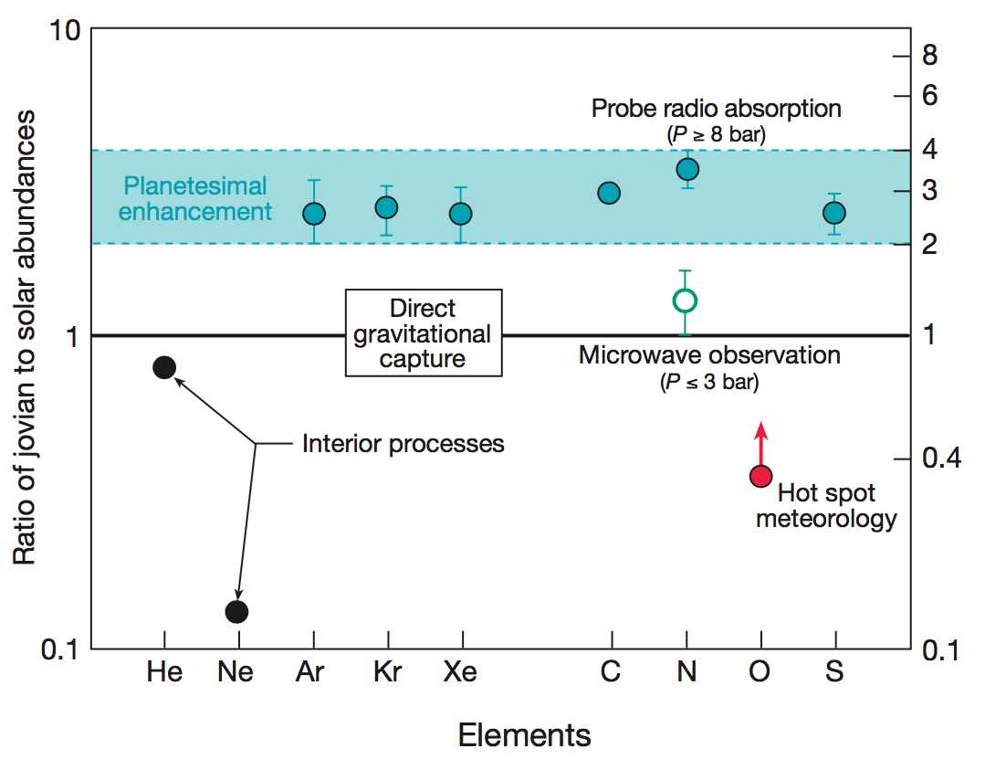
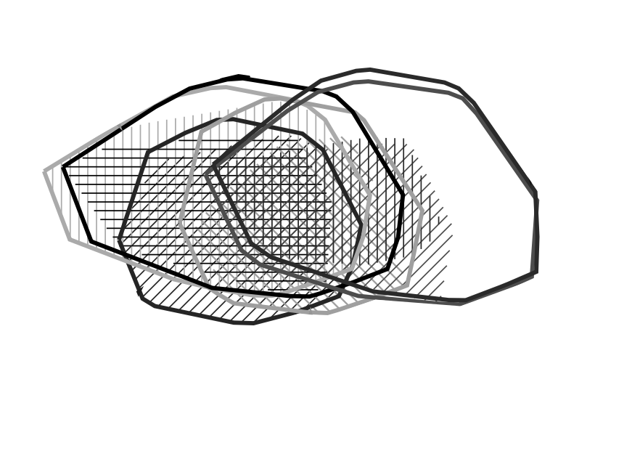
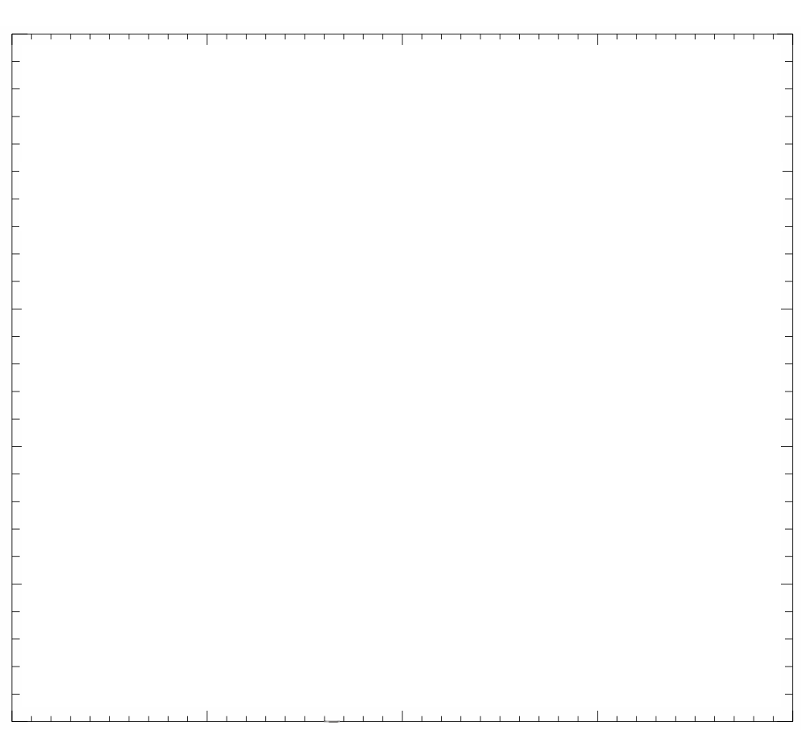
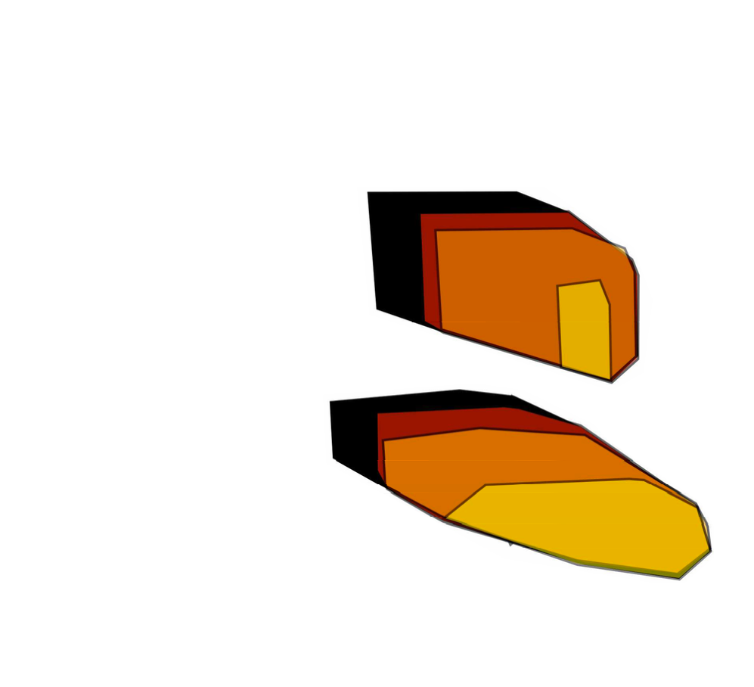






Introduction：Observation
Composition of Jupiter’s envelope
Direct observation of Galileo Satellite
Distribution of Heavy Elements in Gas Giants
Using a observational value of gravitational moment $J_{0},J_{2},J_{4}$, distribution of heavy elements is expected
Owen+ 1999
Composition of Jupiter Envelope
Distribution of Heavy Elements in Gas Giants
Saturn(Saumon+ 2004)
20
Jupiter(Miguel+ 2016)
Mass of Core[$M_{⨁}$]
10
(Owen+ 1999)
$$Z_{env}<Z_{∗}$$
0
10
20
30
40
Mass of Heavy Elements in Envelope[$M_{⨁}$]
$Z_{env} \sim 2−4 Z_{∗}$
$Z_{Jup,env} \sim 20−40M_{⨁}$
$Z_{Sat,env} \sim 0−10M_{⨁}$
Notes:
近年太陽系内のガス惑星に関して様々な観測が行われており、エンベロープの組成に関していくつかの特徴が明らかになっています。
左の図は探査機ガリレオのプローブが直接木星大気を観測して得られたデータです。
これによると重元素は太陽組成の2-4倍ほど含まれていることがわかります。
また、内部構造モデルを用いて重力モーメントの観測値を再現する重元素の分布をプロットすると、右の図のようになります。
これによると木星のエンベロープには土星のエンベロープよりも多くの重元素が含まれていることがわかります。
気象学的効果：雨・雲形成、物質の融点の違いによる選択的な枯渇。H2SとNH3はより上層で枯渇。
Miguel：色の違い＝使う(J2,J4)データの違い
mass spectorometer

Slide 18

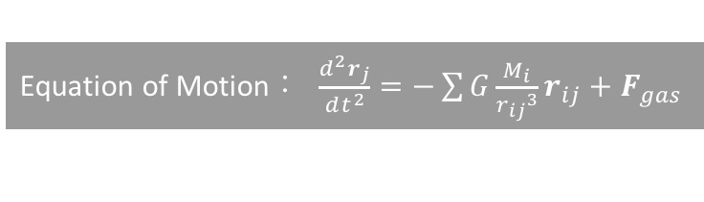
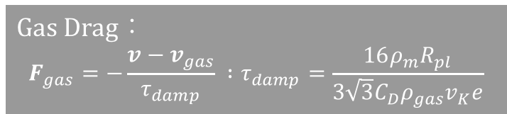
Study：Model and Setting
Method
  Execute the orbital integral using forth-order-Hermite Scheme(Makino & Aarseth 1992)
  Planetesimals will be captured if they collide the planet or loss the escape energy
  We treat the Planetesimals as test particle
Model
Equation of Motion： $\frac{d^{2}r_{j}}{dt^{2}}=−\sum{G\frac{M_{i}}{{r_{ij}}^{3}}r_{ij}+F_{gas}}$
Gas Drag：
$$F_{gas}=−\frac{v−v_{gas}}{τ_{damp}} :τ_{damp}=\frac{16ρ_{m}R_{pl}}{3\sqrt{3}C_{D}ρ_{gas}v_{K}e}$$
Central Star
Planetesimal
Gas Giant
  Hayashi Disk：$\left\{\begin{aligned}Gas\left\{\begin{aligned}Σ_{g}=1.7×{10}^{3}{\left(\frac{a}{1AU}\right)}^{{−3}/2} [g/{{cm}^{2}]} \\ T=280{\left(\frac{a}{1AU}\right)}^{{−1}/2} [K] \\ ρ_{gas,disk}=1.4×{10}^{−9}{\left(\frac{a}{1AU}\right)}^{−{11}/4} [g/{{cm}^{3}]}\end{aligned}\right. \\ Dust \left\{\begin{aligned}Σ_{d}=30{\left(\frac{a}{1AU}\right)}^{{−3}/2} [g/{{cm}^{2}]} \\ R_{pl} :{10}^{6} [cm] \\ N_{pl}=10,000\end{aligned}\right. \end{aligned}\right.$
Protoplanetary Disk
Notes:
計算のモデルです。
微惑星獲得量を算出するために、太陽、惑星、微惑星からなる系の軌道計算を行います。微惑星が惑星に衝突するか、脱出エネルギーを失うかしたら惑星に獲得されたと判断し、計算時間内にどれだけの微惑星を獲得できるか計算します。
計算は単純で運動方程式を解きます。
式には太陽と惑星の重力、円盤からのガス抵抗が含まれ、惑星の場合は後述する円盤からの重力の効果も含めます。
円盤モデルは林円盤を仮定しています。

Slide 19

Our Study：Effect of Planet Migration
Similar point as Tanaka & Ida 1999
  The amount of captured planetesimals is determined as a result of the competitions of migration timescale and damping timescale
Inflow
VS
Outflow
Migration Timescale
$$τ_{Grow}$$
Damping Timescale
$$τ_{Damp}$$
Difference from Tanaka & Ida 1999
Planetesimals in the farther area than the point of the strong MMR cannot be captured
The amount of captured planetesimals are reduced by Resonance Trap
Histgram of Captured Planetesimals
Number of Captured Planetesimals
60
1:2
2:3
3:4
40
Under the effect of Resonance Trap
20
0
5
6
7
8
9
Initial Semi-Major Axis [AU]
We cannot increase the amount of captured planetesimals enough by planet migration effect only
Notes:
この図は横軸がMigration Timescale 、縦軸が獲得した微惑星の割合を示しています。
赤い領域と黄色の領域でShepherd とPredatorの領域が切り替わっており、微惑星獲得量のMigration Timescale依存性は先行研究と同じになっています。
しかしながら、獲得した微惑星が最初どこに分布していたのか見てみると、先行研究とは異なる結果が得られています。
強いMMRよりも遠くに分布していた微惑星は、Resonance Trapの影響を受け獲得できないという結果になりました。
したがって Planet Migration の効果だけでは、微惑星獲得量を十分に増やすことは難しいことが示唆されました。

Slide 20
Study：Mean Motion Resonance と Resonance Trap
Difference between lite Planet and heavy Planet
  ＝ the strength of Mean Motion Resonance
Mean Motion Resonance(MMR)
When the periods of two objects are in simple ratio(p:q), the effect of gravity will be amplified
Eccentricity of planetesimals which experience the MMR become higher
Strength of MMR depends on the planet mass and order of resonance(p:q)
  ⇨ Resonance of Gas Giant is strong
Resonance Trap
Planetesimals which is in MMR will be more trapped in MMR
Ex：1:2 MMR
Meeting point would not change
Notes:
結果に入る前に、月〜地球サイズの軽い惑星と木星サイズの重い惑星で異なる点について触れておきます。
重い惑星の周りではMean Motion Resonance の効果が強くなります。
Mean Motion Resonanceは、二つの天体の公転周期が簡単な整数比になる時、会合点が揃うことで摂動が増幅されるという現象です。
MMRに嵌った微惑星は、重力の摂動の増幅によって離心率が高くなります。
また、MMRに嵌った微惑星にはよりMMRに嵌ろうとする力が働き、MMRに嵌ったまま抜けられなくなります。
これをResonance Trap と言います。
この効果に注意して結果を見ますと、

Slide 21
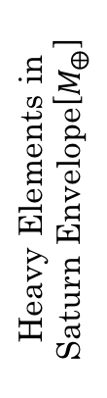
Result：Comparison the result with observation
Comparison with observation
Consider the massive disk, we can draw a linear line
Ratio of Jupiter and Saturn
  The result of Study 2 can consist with observation
  Total of Growing Process and Study 2 cannot consist with observation
Future Work
  Focus on the MMR-Overlap
  Parameter study in Planet Mass and Migration Timescale
  Looking for the parameter set that can explain the observation, and calculate the Possibility
Distribution of Heavy Elements
12
Growing Process Only
Total
8
Heavy Elements in Saturn Envelope[$M_{⨁}$]
Study 2
Observations
4
MMR-Overlap Only
0
10
20
30
40
Heavy Elements in Jupiter Envelope[$M_{⨁}$]
Notes:
最後に今回得られた結果を観測と比較します。
この点がMMSNを仮定した時の計算結果で、黄色が惑星成長のプロセス、赤が惑星移動のプロセス、紫がそれらの和になります。円盤質量を変えるとこのライン上に解が分布することになります。
これによれば、Migration Processのみを考えれば観測値と一致しますが、合計では観測を説明することができていません。
そこで今後の予定です。
Parameter Studyを行なって、今回の結果がどう変わるかを調べます。
何らかの形でMMR-Overlapの効果を強くできれば、観測を説明できる可能性があります。
また、モデルの改良を行うことで、ガス集積期の微惑星獲得量を減らすことができる可能性があります。これもトータルとしては観測を説明するのに有利に働く効果として期待されます。
これらの研究を進めれば、観測を説明できるかもしれません。

Slide 22
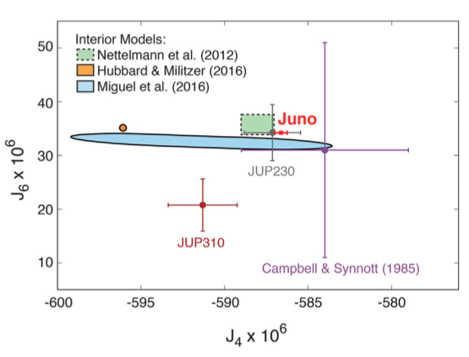
Introduction：巨大ガス惑星の観測
Junoのデータと重元素量

Slide 23
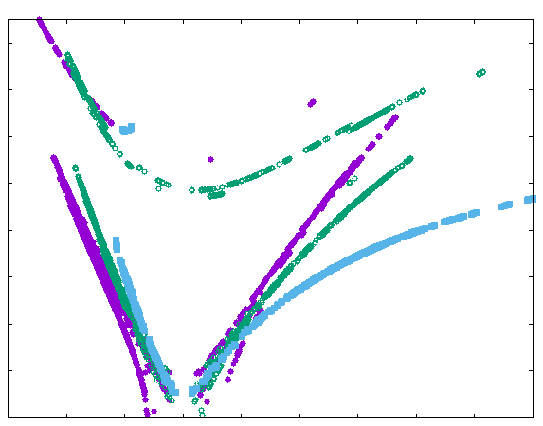

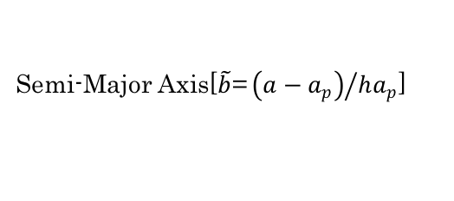
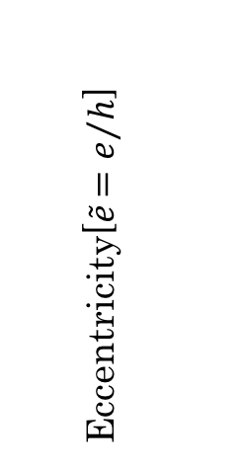
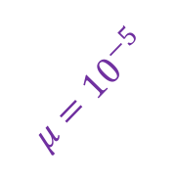
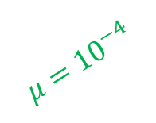
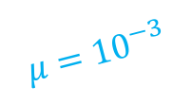
本研究：観測との比較と今後の予定
Distribution of Heavy Elements
観測との比較
獲得絶対量
  土星はMMSNで観測と一致
  木星はMMSNではガス集積期、軌道進化、それらの合計ともに獲得量が不足
木星と土星の比率
  軌道進化のみならば観測と一致
  ガス集積期との合計では一致しない
Feeding Zone の形と惑星質量
  Feeding Zone の形は惑星質量によって変化する。MMR-Overlapでの獲得量はF.Z.の形に依存することが予想される。
今後の予定
  MMR-Overlapは重元素の${木星}/{土星}$比を上げることができる唯一のチャンネル
  惑星質量、Migration Timescale のParameter Study を行い、観測を説明できる解の存在と、その実現確率を求める。
12
Growing Process Only
Total
8
Heavy Elements in Saturn Envelope[$M_{⨁}$]
Study 2
Observations
4
MMR-Overlap Only
0
10
20
30
40
Heavy Elements in Jupiter Envelope[$M_{⨁}$]
Orbital Evolution of Planetesimal with $E_{J}=0$
16
12
Eccentricity[$\tilde{e}{=e}/h$]
$$μ={10}^{−4}$$
8
$$μ={10}^{−5}$$
$$μ={10}^{−3}$$
4
0
-10
0
10
20
30
Semi-Major Axis[$\tilde{b}\text{=}{\left(a−a_{p}\right)}/{ha_{p}}$]
Notes:
最後に今回得られた結果を観測と比較します。
この点がMMSNを仮定した時の計算結果で、黄色が惑星成長のプロセス、赤が惑星移動のプロセス、紫がそれらの和になります。円盤質量を変えるとこのライン上に解が分布することになります。
これによれば、Migration Processのみを考えれば観測値と一致しますが、合計では観測を説明することができていません。
したがって、何らかの形でMMR-Overlapの効果を強くできれば、観測を説明できる可能性があります。

